Slide 1


Our economy
Through the eyes of the Monetary Policy Committee
Insurance Institute of Leicester – 26 Feb 2020
Rosie Smith, Agent, East Midlands Agency

Slide 2

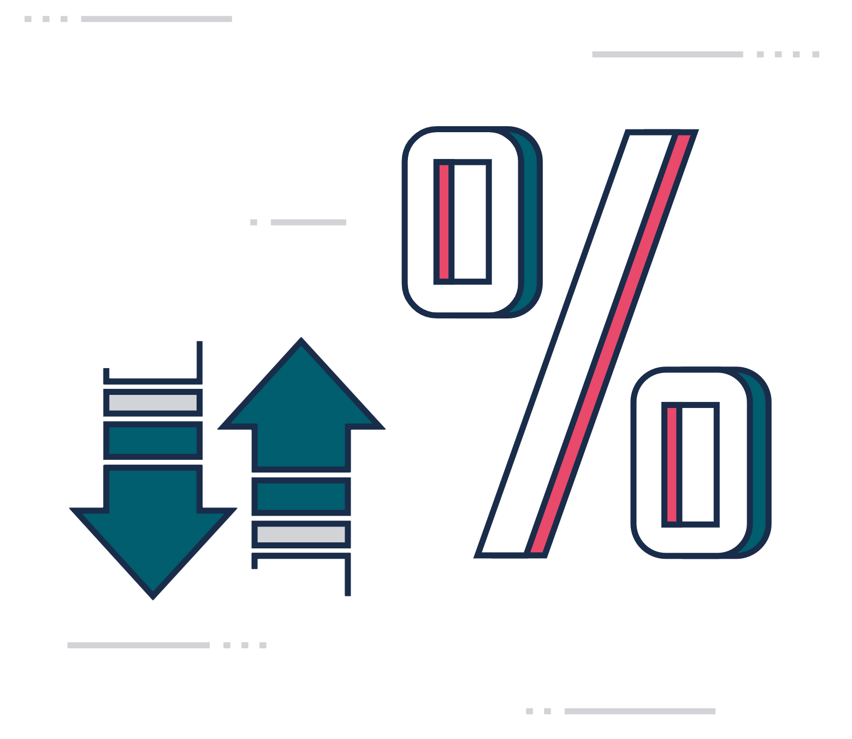
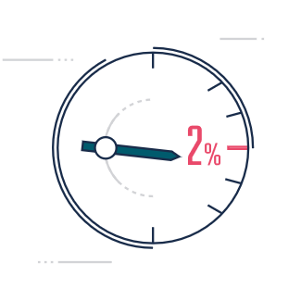
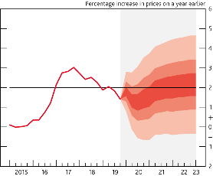
The world economy
Demand
Supply
Prices
Our projections for the next 2-3 years
?
The big questions for the MPC today
  Your thoughts, feedback and questions

Slide 3
The world economy

Slide 4
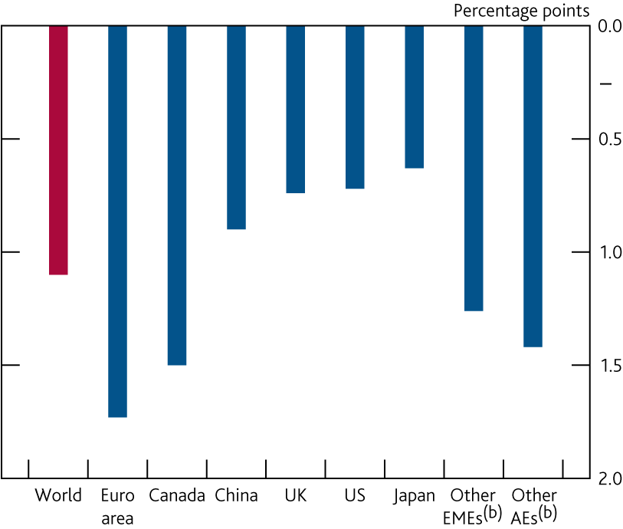
Global growth has slowed across the world
Change in four‑quarter GDP growth rates between 2017 Q4 and 2019 Q3^{(a)}
Sources: Eikon from Refinitiv, Eurostat, IMF World Economic Outlook (WEO), Japanese Cabinet Office, National Bureau of Statistics of China, ONS, Statistics Canada, US Bureau of Economic Analysis and Bank calculations.
Notes:
(a) Chained‑volume measures.
(b) Other EMEs and other advanced economies (AEs) include data for 154 and 11
countries, respectively, as defined by the IMF WEO. Both measures are
weighted according to their shares in world GDP, using the IMF’s purchasing
power parity (PPP) weights.

Slide 5
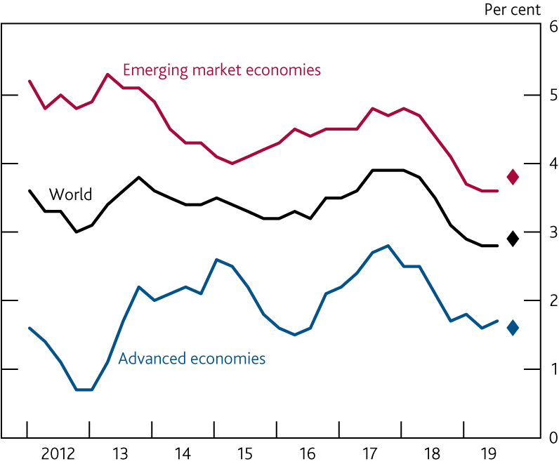
Global growth is expected to pick up slightly in 2019 Q4
    Four-quarter PPP-weighted GDP growth^{(a)}
Sources: Eikon from Refinitiv, IMF WEO and Bank calculations.
Notes:
Constructed using real GDP growth rates of 189 countries according to their
shares in world GDP using the IMF’s PPP weights. Diamonds show Bank
staff’s projections for growth in 2019 Q4.

Slide 6
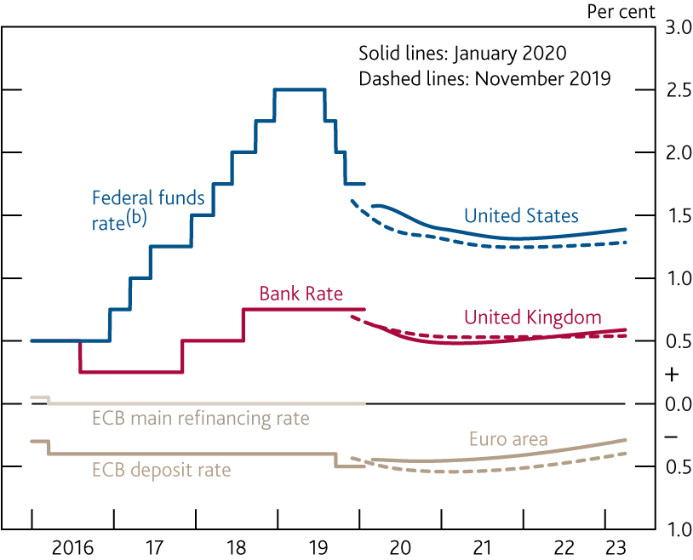
Monetary policy is expected to remain accommodative
    International forward interest rates^{(a)}
Sources: Bloomberg Finance L.P. and Bank calculations.
Notes:
All data as of 22 January 2020. The January 2020 and November 2019 curves
are estimated using instantaneous forward overnight index swap rates in the
15 working days to 22 January 2020 and 30 October 2019 respectively.
(b) Upper bound of the target range.

Slide 7
Demand

Slide 8
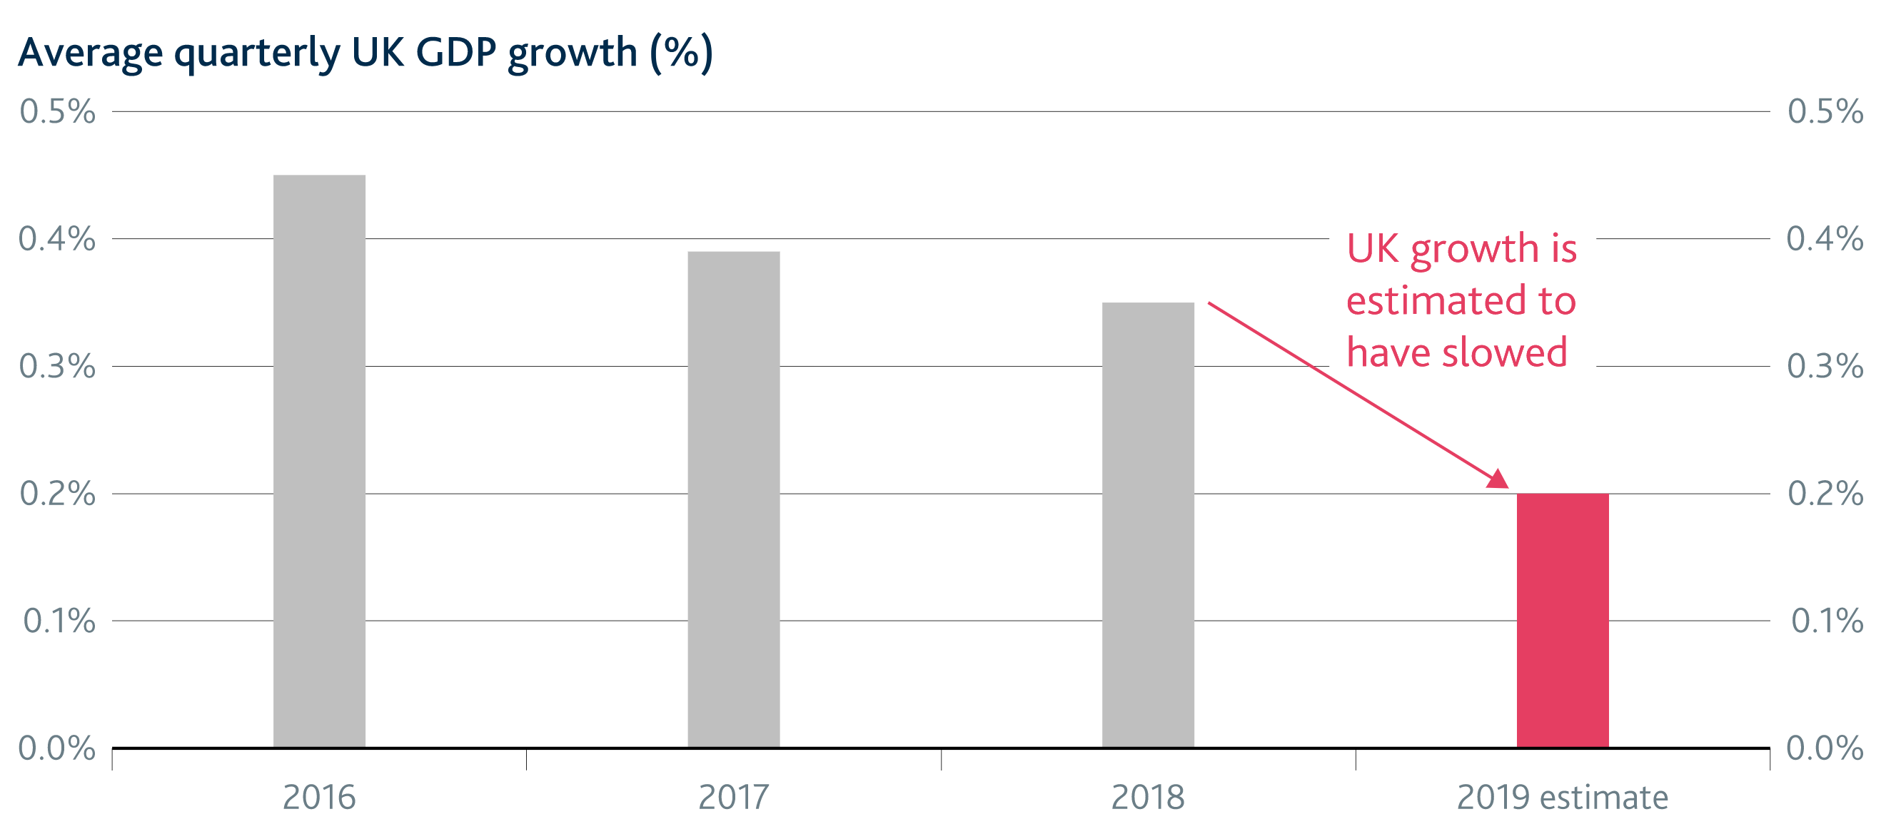
The UK economy slowed in 2019

Slide 9
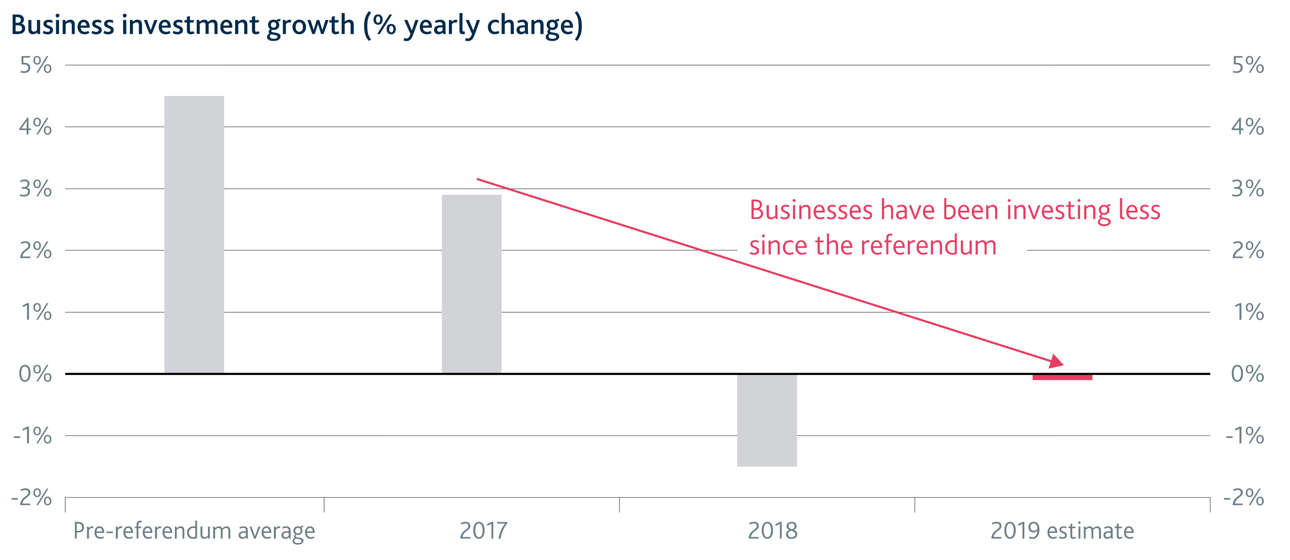
Investment growth was particularly weak

Slide 10
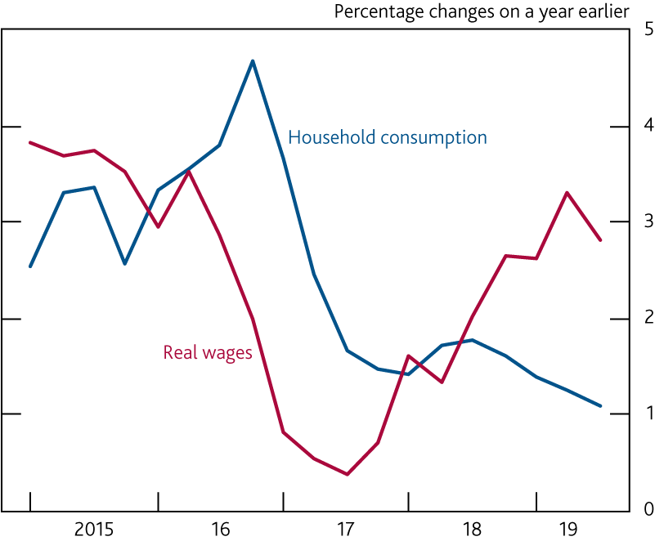
Consumption growth has been weaker than real wage growth
Household consumption and real wages^{(a)}
Sources: ONS and Bank calculations.
Notes:
Real wages are whole‑economy real average weekly earnings (excluding bonuses) multiplied by whole‑economy employment.

Slide 11
Supply

Slide 12
The labour market has tightened between 2013 and 2019
Sources: Bank of England, ONS and Bank calculations.
Notes:
(a) See Chart 3.2 for more on employment intentions, Chart 3.4 for more on vacancies, Chart 3.7 for more on job-to-job flows and Chart 3.10 for more on youth unemployment.

Slide 13
The flows between labour market states offer an alternative perspective
Sources: Labour Force Survey and Bank calculations.
Notes:
a) Bank staff estimates using the Labour Force Survey. Stocks and flows are expressed as proportions of the 16–69 year old population. All figures are seasonally adjusted by Bank staff.

Slide 14
Productivity growth is weak
Sources: ONS and Bank calculations.
Notes:
(a) Output is based on the backcast for the final estimate of GDP. Diamonds show Bank staff’s projections for 2019 Q4, based on data to November.

Slide 15
Productivity growth is particularly weak in finance & manufacturing
Sources: ONS and Bank calculations.
Notes:
(a) Sectoral output per hour is calculated as gross value added (GVA) divided by hours worked. Figures in parentheses are weights in GVA. Other is calculated as a residual and includes other sectors and allocation effects.

Slide 16
Potential supply growth has slowed and is expected to remain subdued
Sources: ONS and Bank calculations.
Notes:
(a) Average percentage point contributions to annual growth unless otherwise specified. Contributions may not sum to the total due to rounding.
(b) Positive numbers indicate that a fall in the equilibrium unemployment rate has increased potential labour supply.
(c) Based on a growth-accounting framework using a constant returns to scale Cobb-Douglas production function, with total output to capital elasticity of ⅓.
(d) Capital deepening refers to growth in capital services per person-hour.
(e) Total factor productivity growth refers to improvements in the efficiency with which both capital and labour are used to produce output. Calculated as a residual.

Slide 17
Prices

Slide 18
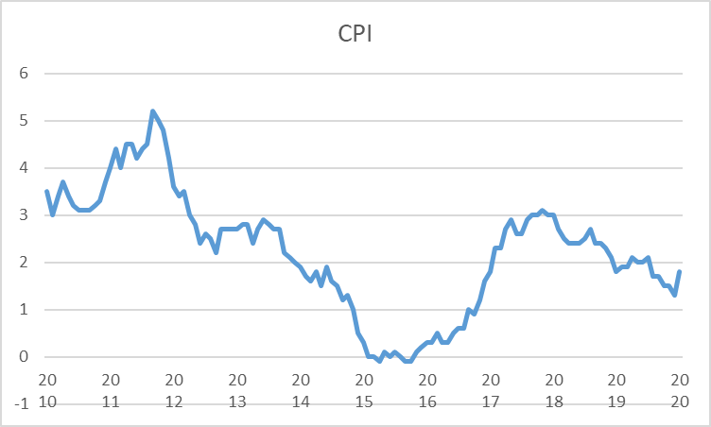


Inflation is below target

Slide 19
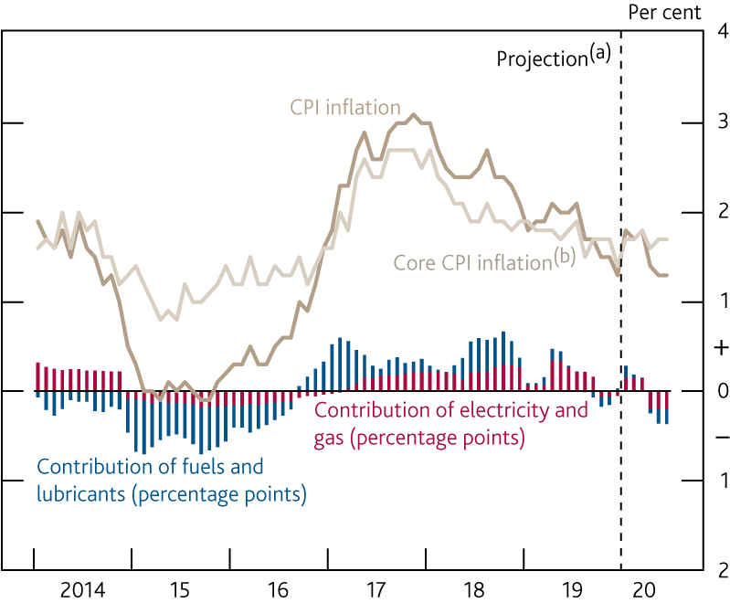
The fall in inflation recently has been driven by energy prices
CPI inflation, core CPI inflation and the contribution of energy
Sources: Bloomberg Finance L.P., Department for Business, Energy and Industrial Strategy, ONS and Bank calculations.
Notes:
Bank staff’s projection. Fuels and lubricants estimates use Department for
Business, Energy and Industrial Strategy petrol price data for January 2020
and are then based on the sterling oil futures curve.
(b) CPI inflation excluding food, energy, alcohol, tobacco and non‑alcoholic
beverages.

Slide 20
Pay growth has slowed, but is still higher than recent years
Notes:
(a) Three-month average growth on the same period a year earlier.

Slide 21
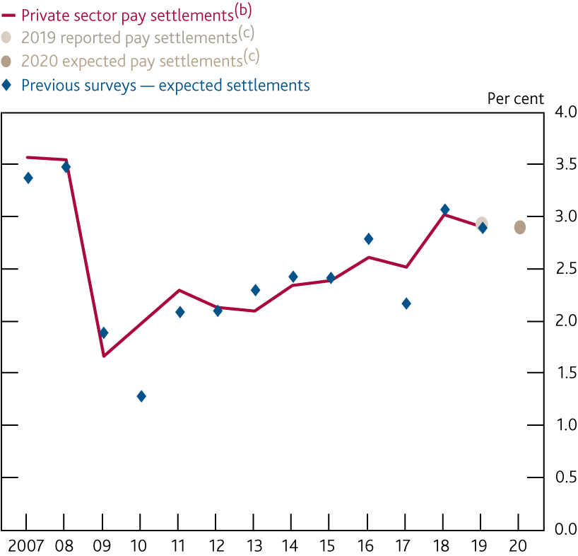
Pay settlements are expected to be the same in 2020 as in 2019
Pay settlements^{(a)}
Sources: Bank of England, including the wage settlements database (which draws on information from the Bank’s Agents, Incomes Data Research, Incomes Data Services, Industrial Relations Services and the Labour Research Department) and Bank calculations.
Notes:
Companies were asked to state their average UK pay settlement for 2019 and
their expected average UK pay settlement for 2020.
(b) Average over the past 12 months, based on monthly data.
(c) Data gathered from the 2020 Agents’ Pay Survey.

Slide 22
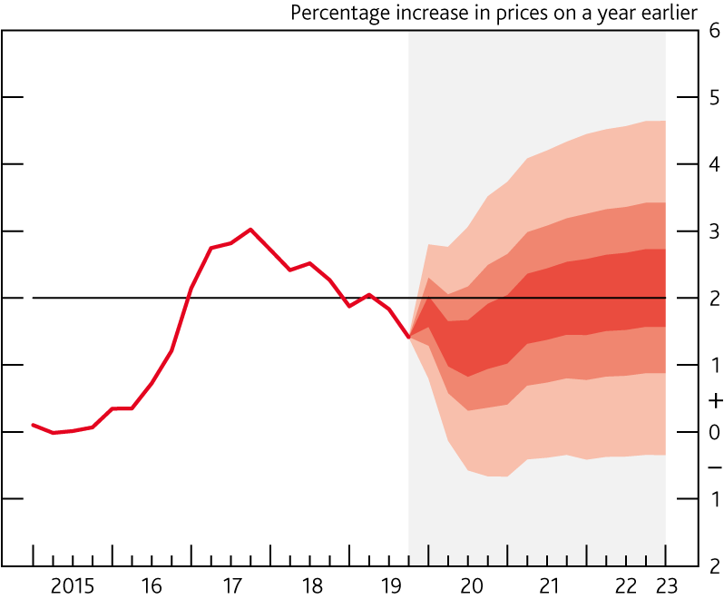
Our projections for the next 2-3 years

Slide 23
Our assumptions
An immediate but orderly move, at the beginning of 2021, to a deep free trade agreement between the UK and the EU.
Uncertainty fades gradually as details about trading relationship emerge.
Government spending & taxation is as announced in the Spending round 2019 (i.e. increased spending which was expected to raise GDP by around 0.4%)
Note
Market expectations for Bank Rate are used in our calculations (Bank Rate falling slightly over the forecast period)

Slide 24
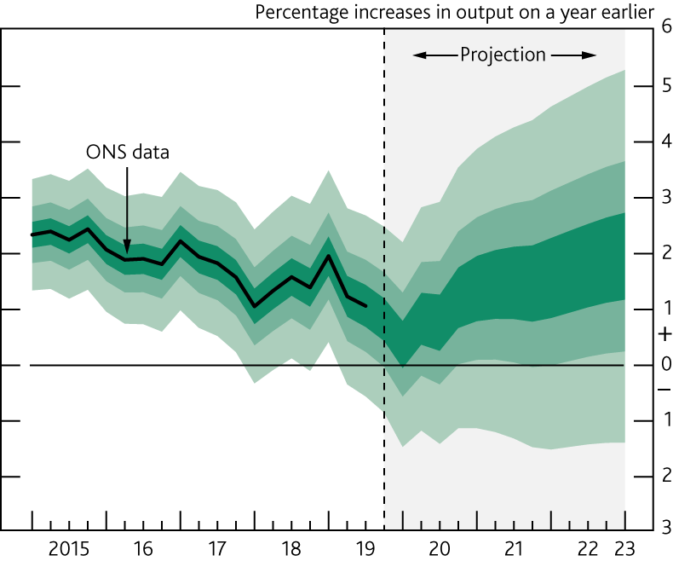
GDP projection based on market interest rate expectations
Notes:
The fan chart depicts the probability of various outcomes for GDP growth. It has been conditioned on the assumptions in Table 1.A footnote (b). To the left of the vertical dashed line, the distribution reflects uncertainty around revisions to the data over the past. To aid comparability with the official data, it does not include the backcast for expected revisions, which is available from the ‘Download the chart slides and data’ link at ww.bankofengland.co.uk/monetary-policyreport/2020/january-2020. To the right of the vertical line, the distribution reflects uncertainty over the evolution of GDP growth in the future. If economic circumstances identical to today’s were to prevail on 100 occasions, the MPC’s best collective judgement is that the mature estimate of GDP growth would lie within the darkest central band on only 30 of those occasions. The fan chart is constructed so that outturns are also expected to lie within each pair of the lighter green areas on 30 occasions. In any particular quarter of the forecast period, GDP growth is therefore expected to lie somewhere within the fan on 90 out of 100 occasions. And on the remaining 10 out of 100 occasions GDP growth can fall anywhere outside the green area of the fan chart. Over the forecast period, this has been depicted by the light grey background. See the box on page 39 of the November 2007 Inflation Report for a fuller description of the fan chart and what it represents.

Slide 25
CPI inflation projection based on market interest rate expectations
Notes:
Chart 1.5 depicts the probability of various outcomes for CPI inflation in the future. It has been conditioned on the assumptions in Table 1.A footnote (b). If economic circumstances identical to today’s were to prevail on 100 occasions, the MPC’s best collective judgement is that inflation in any particular quarter would lie within the darkest central band on only 30 of those occasions. The fan chart is constructed so that outturns of inflation are also expected to lie within each pair of the lighter red areas on 30 occasions. In any particular quarter of the forecast period, inflation is therefore expected to lie somewhere within the fans on 90 out of 100 occasions. And on the remaining 10 out of 100 occasions inflation can fall anywhere outside the red area of the fan chart. Over the forecast period, this has been depicted by the light grey background. See the box on pages 48–49 of the May 2002 Inflation Report for a fuller description of the fan chart and what it
represents.

Slide 26
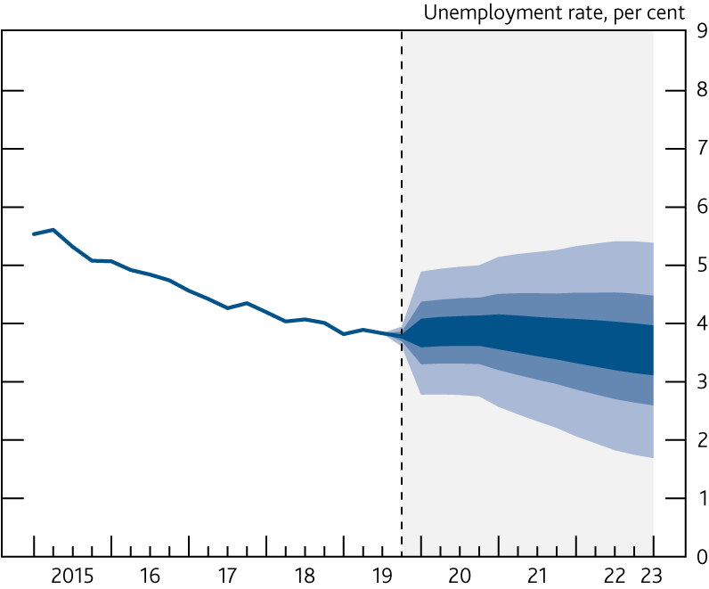
Unemployment projection based on market interest rate expectations
Notes:
The fan chart depicts the probability of various outcomes for LFS unemployment. It has been conditioned on the assumptions in Table 1.A footnote (b). The coloured bands have the same interpretation as in Chart 1.3, and portray 90% of the probability distribution. The calibration of this fan chart takes account of the likely path dependency of the economy, where, for example, it is judged that shocks to unemployment in one quarter will continue to have some effect on unemployment in successive quarters. The fan begins in 2019 Q4, a quarter earlier than the fan for CPI inflation. That is because Q4 is a staff projection for the unemployment rate, based in part on data for October and November. The unemployment rate was 3.8% in the three months to
November, and is projected to be 3.8% in Q4 as a whole. A significant proportion of this distribution lies below Bank staff’s current estimate of the long-term equilibrium unemployment rate. There is therefore uncertainty about the precise calibration of this fan chart.

Slide 27
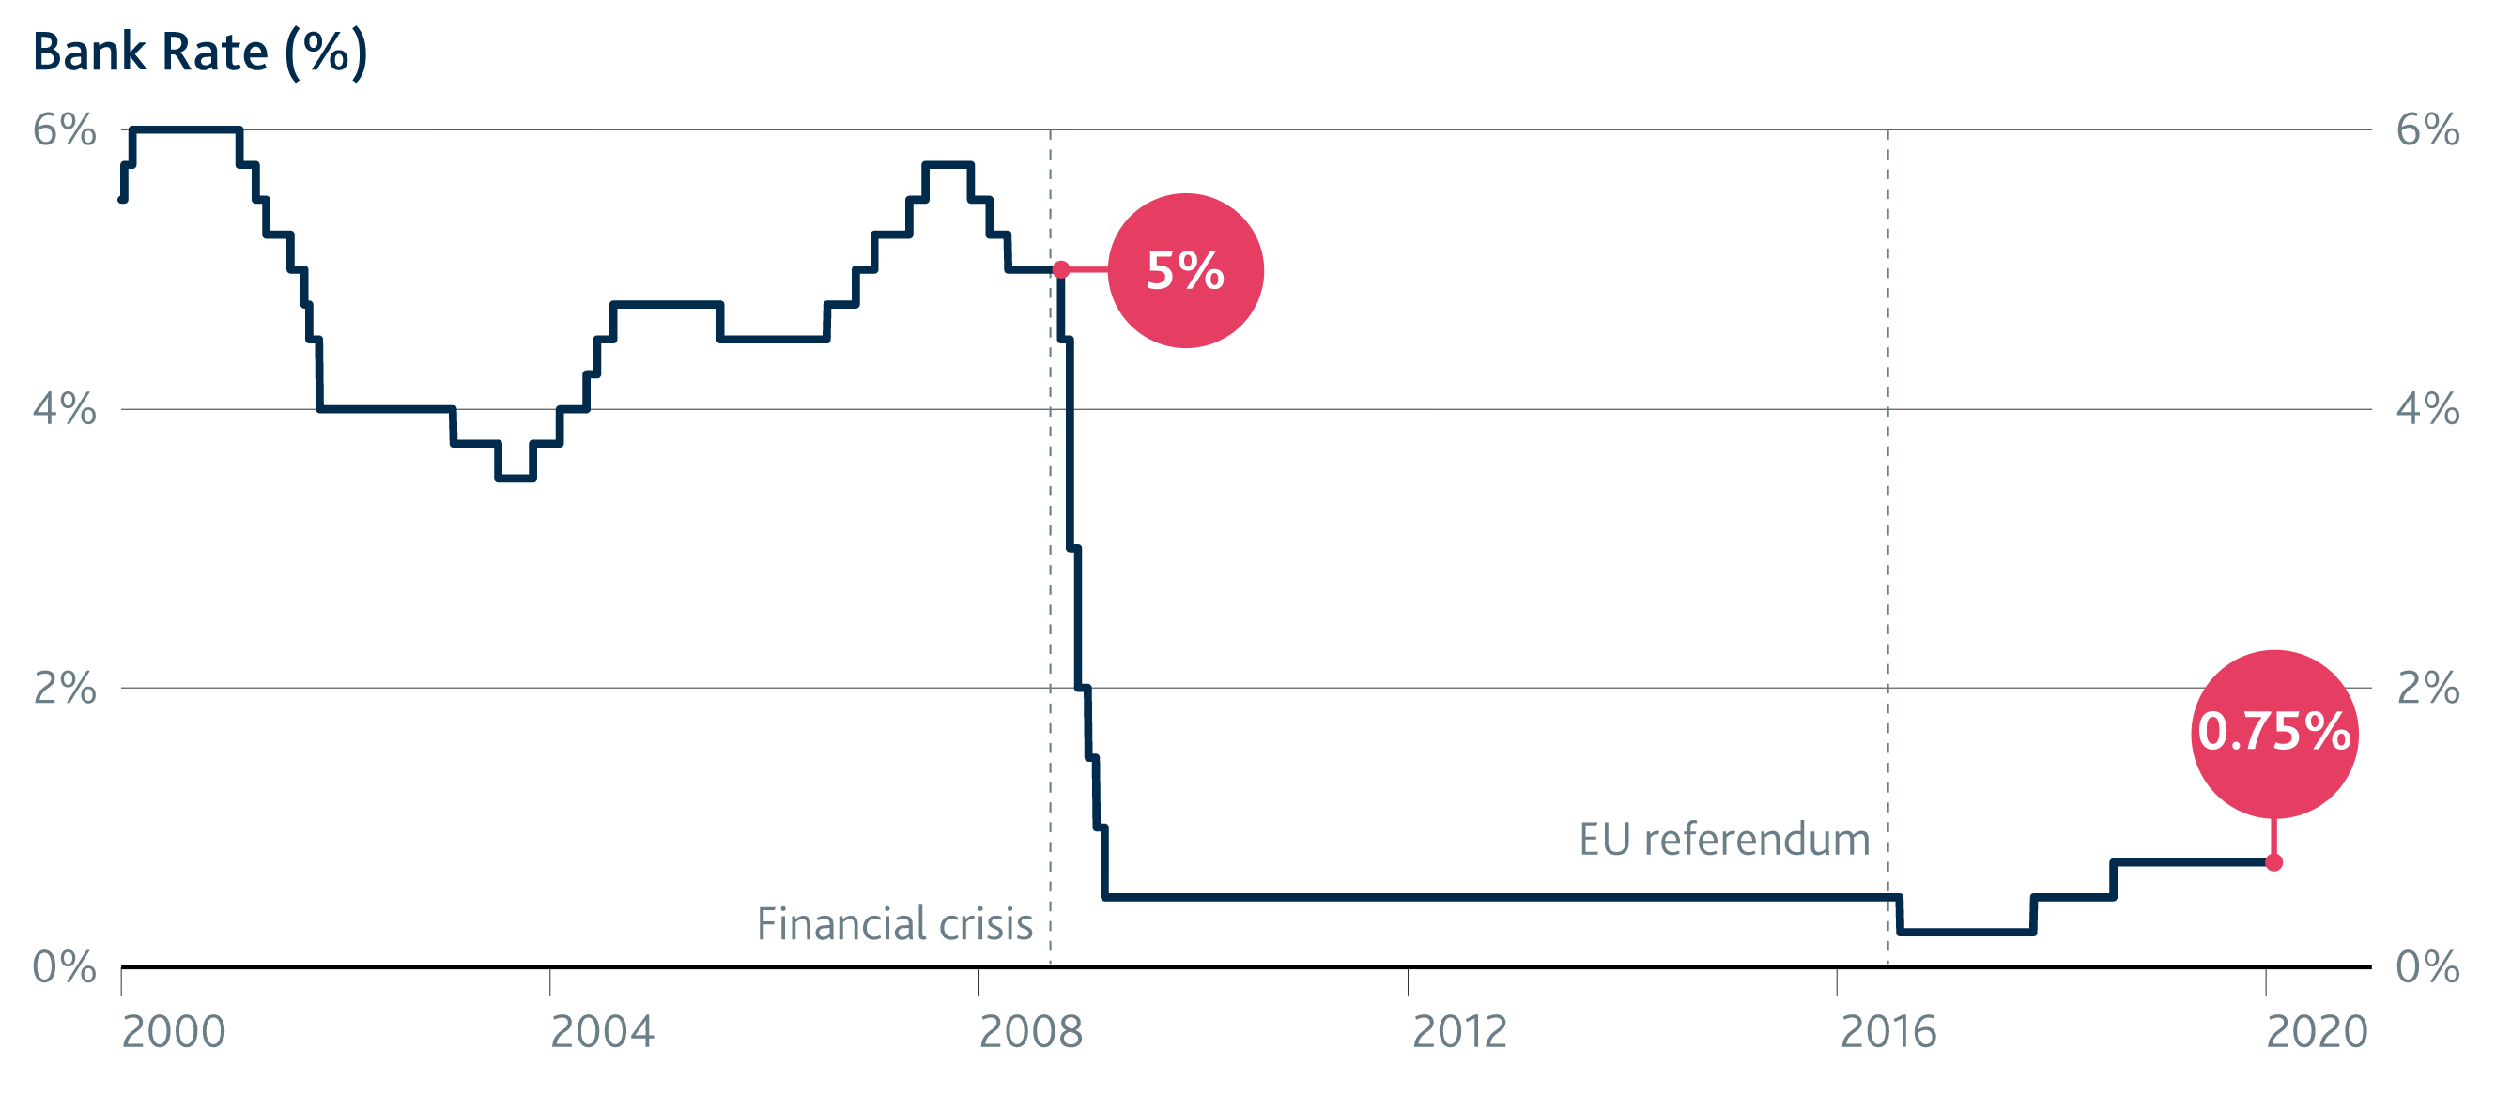
The MPC voted 7-2 in late January to keep Bank Rate at 0.75%

Slide 28
What will be the impact of Coronavirus on the economy?
Confidence
Trade
Travel
Etc?

Slide 29
Questions & Comments welcome
Rosie Smith, Agent
East Midlands Agency

