Slide 1
Terrorism: a Dynamic Risk
Warren Haydock
CLAIMS MANAGER

Slide 2
Pool Re in Numbers
£2,200,000,000,000
£2.2tn of liabilities insured by Pool Re.
£6,600,000,000
£6.3bn fund has been built up by Pool Re to meet potential claims.
£635,000,000
£635m has been paid out in claims equivalent to £1.25bn adjusted for inflation.
£990,000,000
£990m of premiums has been paid to HMT Treasury, though Pool Re can draw on this amount should government funds be required.
15%
It is estimated that less than 15% of SMEs have terrorism insurance.
90%
Pool Re are estimated to reinsure 90% of the terrorism insurance market, the rest is kept in the private sector.
£2,300,000,000
£2.3bn of reinsurance is purchased by Pool Re from private sector reinsurers.
£75,000,000
£75m raised from external investors through the placement of an insurance linked security bond.

Slide 3
Agenda
Terrorism: A Dynamic Risk: a brief background of the Pool Re Scheme, reinsurance coverage, and how the threat of terrorism has and continues to change, recent terrorism events across Great Britain, the emerging claims issues
The Pool Re Scheme, Terrorism Reinsurance and Pooling-Mechanisms
The Terrorism Threat, and the Changing Face of Terrorism
Recent Terrorism Events, the Emerging Claims Issues
Questions

Slide 4
The Pool Re Scheme

Slide 5
The Pool Re Scheme
Mutual Reinsurer, owned by Members, supported by Government
Market failure to provide terrorism reinsurance following 1993 Baltic Exchange bomb
Provides reinsurance cover for commercial property and BI in Great Britain
260 Member companies insuring GB businesses

Slide 6
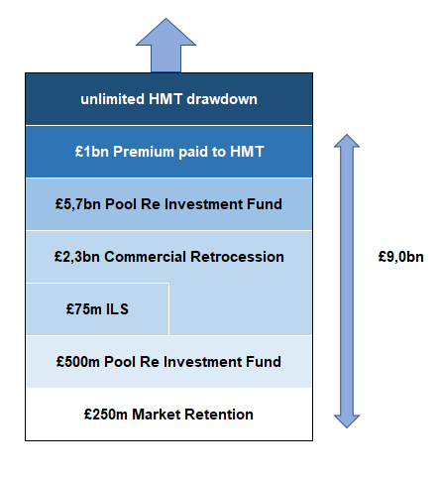
The Pool Re Scheme
Effective 2019
Excluding additional circa £2bn of new premium inflows likely between event happening and exhaustion of the investment fund

Slide 7
The Pool Re Scheme
An Act of Terrorism: acts of persons acting on behalf of or in connection with any organisation which carries out activities directed towards the overthrowing or influencing, by force or violence, of Her Majesty’s government in the UK or any other government de jure or de facto Reinsurance (Acts of Terrorism) Act 1993
Certification: allows Pool Re Member companies to claim against their Reinsurance Agreement
Members notify Pool Re as soon as they become aware of any claims relating to an event which may constitute an Act of Terrorism
Pool Re request Certification of the event from Her Majesty’s Treasury (HMT)
HMT have 10 working days to Certify
Failure to Certify leads to independent Tribunal process, commenced within 21 days, 3 arbitrators, binding decision
Protocols govern the tribunal process
Final decision independent of government

Slide 8
The Pool Re Scheme
Reinsurance coverage features
All Risks coverage
Territorial limits GB (excl Northern Ireland)
Commercial policies only
Automatic cession, we accept all risks, no value or accumulation issues
Maximum 12 months cover
Marine, aviation, motor, transit, bankers blanket bonds, contingency excluded
Chemical, Biological, Radiation and Nuclear (CBRN) cover is included

Slide 9
The Pool Re Scheme
Cyber
Proximate cause must be a certified Act of Terrorism
No additional premium
Must be damage to tangible property at Insured’s premises
Specified Events basis
Excludes Money and Data

Slide 10
The Pool Re Scheme
Non-Damage Business Interruption Class B
Potential insurance coverage gaps: recent attacks have caused BI that did not result from damage (the Terrorism Gap)
The property market generally covers NDBI (unless Terrorism)
Act of Parliament amended on 12 Feb 2019 allowing NDBI Terrorism cover to be provided without damage arising
Cover for Loss of Attraction and Denial of Access
1 Mile territorial restriction, 90 day limit

Slide 11
Terrorism Reinsurance and Pooling-Mechanisms
Constrained capital due to terrorism attacks across Europe, as well as merger activity and Lloyd’s profit review
Unpredictability of terrorism and difficulty of frequency and severity modelling
Insufficient capital for a large-scale London event, let alone CBRN context of 10’s of billlions
Significant increase on property values in major cities, most notably London
Willis Re 2018 Risk Insurance Report suggests alternative capital up, whilst traditional reinsurance capital 10% down
Recent reinsurance losses exacerbated by non-core perils (hail, wildfire)
Market capacity will return over time, but unlikely to be sufficient to completely fulfil demand
Pool Re adopting modern modelling and actuarial techniques to reflect reasonable premium rating
Pool Re considering exploring coverage gaps to reflect coverage and market relevance

Slide 12
The Terrorism Threat

Slide 13
The Terrorism Threat: The Landscape in Great Britain
Actors
Islamist
Extreme Right Wing
Dissident Republicans
Other forms of extremism
Methodology
Bladed and Vehicle
Homemade IEDs
Firearms
Targets
Crowded Places
Critical National Infrastructure
Police, military and government
Symbolic
Property
Attacks & Plots
11 attacks since 2017
8 Islamism, 3 right wing
24 plots since 2017
16 Islamism, 8 right wing
266 persons in custody
78% Islamist, 15% right wing, 6% other

Slide 14
The Changing Face of Terrorism
2015
France Paris: shooting, Charlie Hebdo and Hypercacher market, 20 deaths, 22 injured
France Paris: Stade de France stadium and Bataclan: bomb and shooting, 137 deaths, 368 injured
2016
Belgium Brussels: bomb, 25 deaths, 340 injured
France Nice: vehicle, 87 deaths, 434 injured
Germany Berlin Christmas market: vehicle, 12 deaths, 56 injured
2017
Spain Barcelona: vehicle, 24 killed, 152 injured
UK London and Manchester: vehicle, bomb, bladed, 35 deaths, 198 injured
2019 and 2020
UK London: bladed, 2 deaths, 7 injured

Slide 15
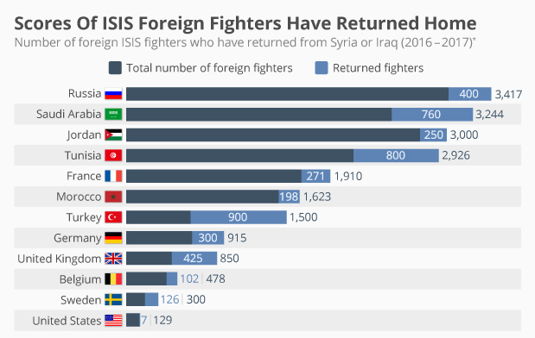
The Changing Face of Terrorism: Returning Fighters
Estimated 30,000 fighters joined ISIL
Estimated 10,000 fighters still at large
Hundreds of fighters in Syrian camps
Expulsion of prisoners from Turkey

Slide 16
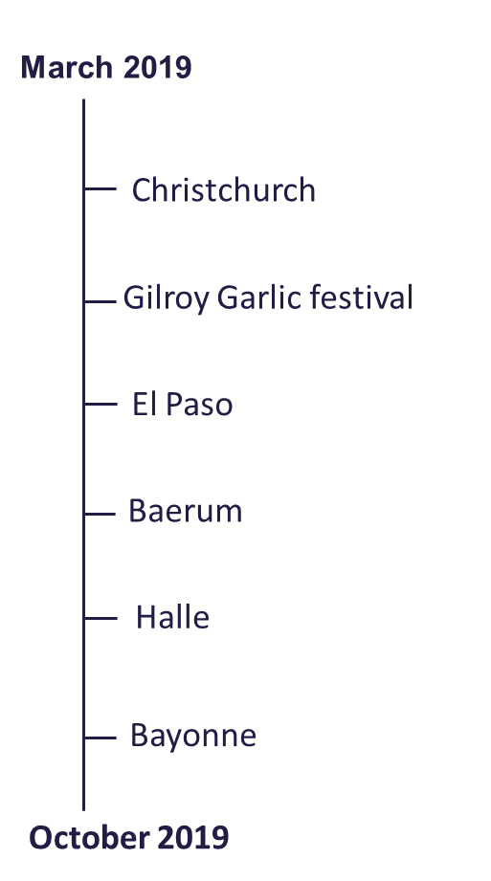
The Changing Face of Terrorism: Extreme Right Wing
While Islamist extremism remains primary terror threat
Threat from extreme right-wing (XRW) terrorism has evolved and increased in recent years
XRW terrorists responsible for around a quarter of disrupted plots since 2017

Slide 17
The Changing Face of Terrorism: Cyber
US-Israeli Stuxnet attack on Iran enrichment facility heralded age of physically destructive cyber attacks
Subsequent malware on Saudi Aramco and other Gulf producers
Ukrainian electricity grid
USA Democratic National Committee hacks manipulating politics
Recent WannaCry and Not Petya ransomwares
2009 - Stuxnet, Natanz Enrichment Plant
2014 blast furnace override, German steel mill
2012 - Shamoon, Saudi Aramco
2016, Bangladesh Bank heist
2017, Triton, Saudi Aramco
2015, TV5 Monde
hack
2017, WannaCry locker
2015, BlackEnergy, Ukrainian power outage
2016 Industreyor Ukrainian power outage
2019 Eurovision
hack
2016, DNC email leak
2017, NotPetya locker
2014 Sony Pictures hack

Slide 18
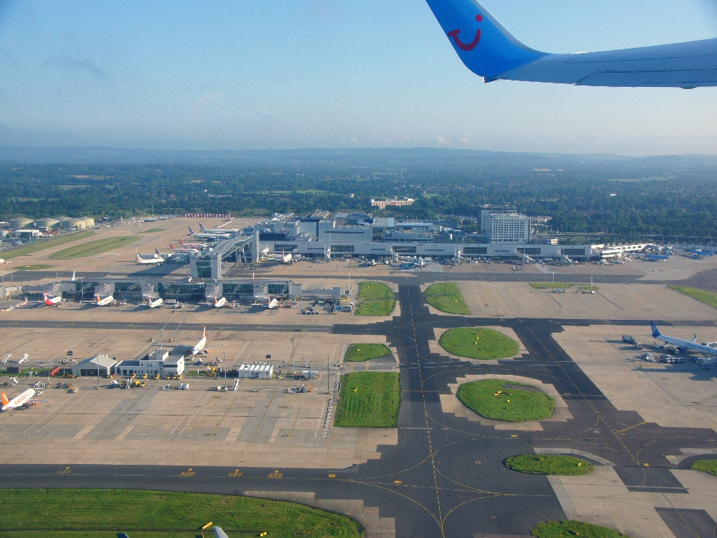
The Changing Face of Terrorism: Drones
Gatwick Airport Drones
2018
3 Days interruption of over 1,000 flights
140,000 Passengers affected
£5m spent on military anti-drone system
Over £20m cost to authorities
ISIS 2018/19 drone strikes
Caracas 2018 attempted assassination

Slide 19
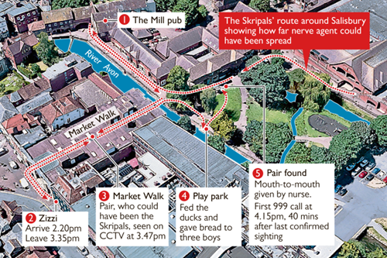
The Changing Face of Terrorism: CBRN
Salisbury
2018
Graduated response, various parties involved
Identification of toxin, decontamination, how clean is clean
Cautious approach by authorities with extended period of interruption
Contingent losses, denial of access, loss of attraction
Cover must recognise the dynamic nature of terrorism, extended interruption periods
2001/02 USA Ricin plots
2018 Three European Ricin plots
2017 Australian hydrogen sulphide

Slide 20
Terrorism Claims in Great Britain

Slide 21
Certified Terrorism Incidents in Great Britain
date | policyholder | members | pool re | total | description
Apr-93 |  | £33,039,581 | £261,661,320 | £294,700,901 | Bishopsgate: bomb
Aug-93 | £545,333,381 | £303,050 | £398,482 | £546,034,913 | Bournemouth: bomb
Jan-94 | £701,532 | £270,000 | £30,451 | £1,001,983 | West End Incendiaries: bomb
Feb-94 | £298,740 | £591,822 | £162,280 | £1,052,842 | Marble Arch: bomb
Jul-94 | £1,060,546 | £502,450 | £1,310,130 | £2,873,126 | Israel Embassy: bomb
Jul-94 | £3,462,580 | £478,558 | £252,791 | £4,193,929 | Israeli (Finchley) : bomb
Aug-94 | £737,042 | £47,200 |  | £784,242 | Bognor Regis: bomb
Feb-96 | £47,200 | £9,713,584 | £108,482,607 | £118,243,391 | South Quay: bomb
Jun-96 | £118,610,245 | £19,523,778 | £233,658,714 | £371,792,737 | Manchester: bomb
Mar-01 | £255,346,410 | £126,516 | £285,257 | £255,758,183 | Wood Lane: bomb
Aug-01 | £911,772 | £729,681 | £5,392,867 | £7,034,320 | Ealing Broadway: bomb
Jul-05 | £6,150,197 | £4,640,000 | £8,761,000 | £19,551,197 | London Underground: bomb
Aug-13 |  | £3,000,000 | £13,613,000 | £16,613,000 | Portishead: anarchist arson
Mar-17 |  | £4,000 |  | £4,000 | London Westminster: vehicle, bladed
May-17 |  | £3,900,000 | £787,000 | £4,687,000 | Manchester Arena: bomb
Jun-17 |  | £840,000 |  | £840,000 | London Borough Market: vehicle, bladed
Nov-19 |  | £100,000 |  | £100,000 | London Bridge: bladed
 | £932,659,645 | £77,710,220 | £634,795,899 | £1,645,165,764

Slide 22
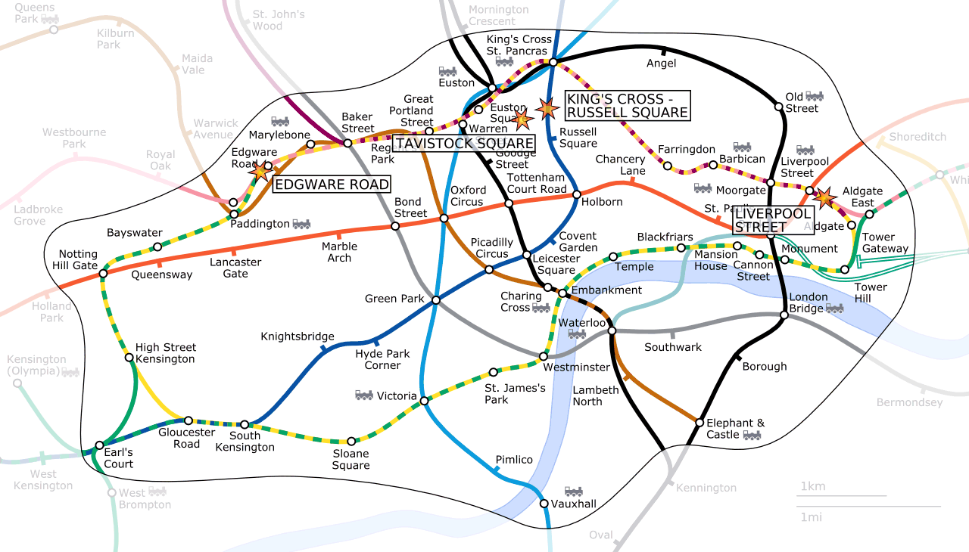
Recent GB Terrorism Incidents
London Underground
July 2005
Multiple bomb attacks throughout London
52 Deaths, 700 injuries
Further subsequent attempts in London West End
Member claims (42) settled at £15m

Slide 23
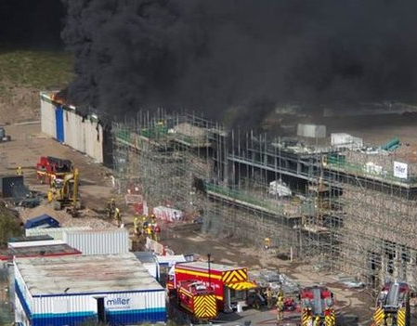
Recent GB Terrorism Incidents
Bristol Portishead
August 2013
Arson by anti-government anarchists
Destruction of Police firing range under construction
Member claims (4) settled at £15m

Slide 24
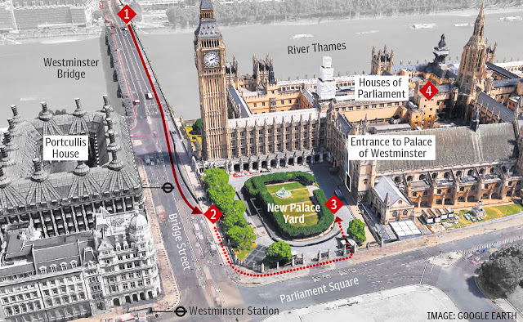
Recent GB Terrorism Incidents
London Westminster
March 2017
Vehicle and bladed attack by lone actor
6 Deaths, over 50 injuries
Closure of area and businesses
Member claims (5) within retention

Slide 25
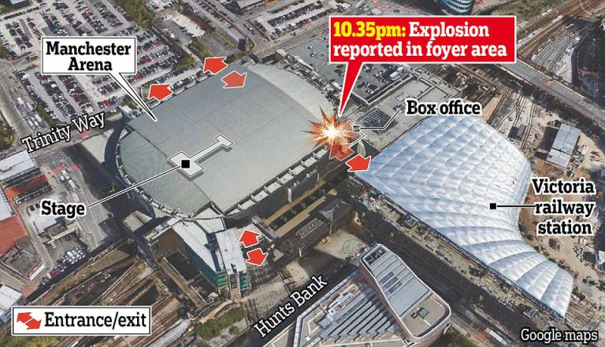
Recent GB Terrorism Incidents
Manchester Arena
May 2017
Suicide bomb at music concert stadium by lone actor
22 Deaths, over 100 injuries
Closure of area and businesses
Cancellation of events
Member claims (11) £4,7m
Pool Re paid £800,000

Slide 26
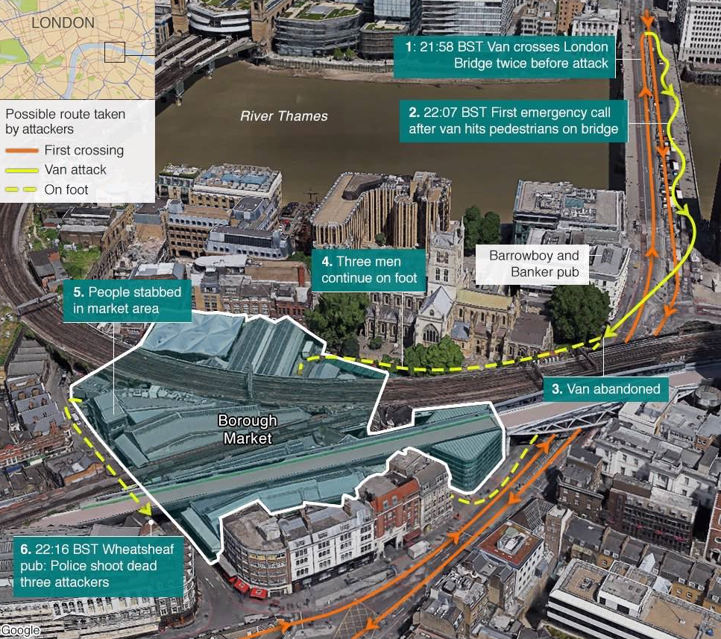
Recent GB Terrorism Incidents
London Borough Market
June 2017
Vehicle and bladed attack by 3 men
7 Deaths, over 48 injuries
Closure of area and businesses
Member claims (9) £800,000

Slide 27
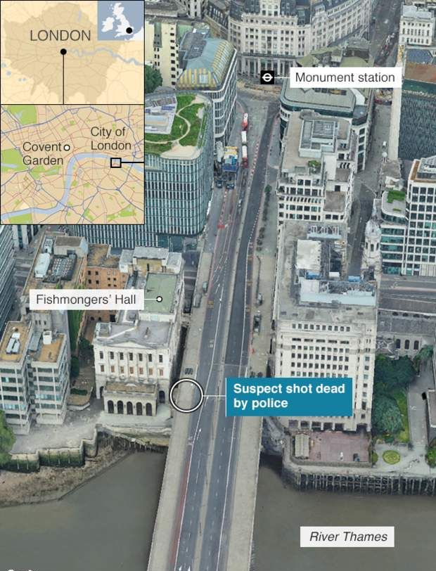
Recent GB Terrorism Incidents
London Bridge
November 2019
Bladed attack by individual
2 Deaths, 5 injuries
Closure of area and businesses
Member reinsurance claims (3) £100,000
Claims within retentions

Slide 28
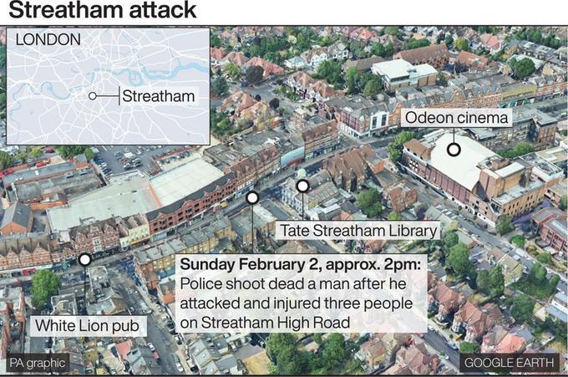
Recent GB Terrorism Incidents
Streatham London
February 2020
Bladed attack by individual
2 injuries
Closure of area and businesses
Recent release from jail for terror offences
Under active counter-terrorism surveillance
Member reinsurance claims unknown

Slide 29
The Emerging Claims Issues
Claim Issues
Multiple events
Longevity of claims
Injury and the loss of life, exhumation
Volume and technical complexity of large losses
Complexities of co-insurance and layered insurance programs
Potential legal issues and litigation form coverage, suitability of contracts
Logistical difficulty of demolition and re-construction in city centres, site access
Unknown government response, planning and regulatory changes, erection of memorial sites
Claim inflation from delays in validation, reconstruction, reserving inadequacy
Post Loss Amplification due to failure of infrastructure, transportation, availability of and increased costs of materials and equipment

Slide 30
Questions
This document has been prepared by Pool Reinsurance Company Limited (Pool Re). While this information has been prepared in good faith, no representation or warranty, express or implied, is or will be made and no responsibility or liability is or will be accepted by Pool Re, or by any of its respective directors, officers, employees or agents in relation to the accuracy or completeness of this document and any such liability is expressly disclaimed.
In particular, but without limitation, no representation or warranty is given as to the reasonableness of future suggestions contained in this document.
Pool Re is a company limited by guarantee and registered in England and Wales under company no. 02798901 having its registered office at 7 Savoy Court, London WC2R 0EX.
© Pool Reinsurance Company Limited 2019

Slide 31
Pool Re in numbers
2,200,000,000,000
£2.2tn of liabilities insured by Pool Re.
6,600,000,000
£6.3bn fund has been built up by Pool Re to meet potential claims.
635,000,000
£635m has been paid out in claims equivalent to £1.25bn adjusted for inflation.
990,000,000
£990m of premiums has been paid to HMT Treasury, though Pool Re can draw on this amount should government funds be required.
15%
Less than 15% of SMEs are estimated to have terrorism insurance.
90%
90% of the terrorism insurance market is estimated to be reinsured by Pool Re, the rest is kept in the private sector.
2,300,000,000
£2.3bn of reinsurance is purchased by Pool Re from private sector reinsurers.
75,000,000
£75m raised from external investors through the placement of an insurance linked security bond.

