Slide 1
The Modern
Built Environment
CII Leicester November 2019
Rob Dakin Head of Business Resilience
Notes:
Introduce yourself and explain role including

Slide 2
Purpose
  The built environment continues to change and adapt. Pressures around climate change and sustainability are influencing new build more than every before
  There are major housing shortages in the UK so how do you build quickly and efficiently without compromising on protecting the building and occupants?
  This session will explore the methods of building but also the challenges they face around repairability for traditional insurance perils such as fire, escape of water and flood and the building lifecycle
Notes:
Explain that there are formal definitions of “Modern Methods of Construction” which focus solely on MMC involving off site manufacturing techniques but today we are user wider definition to include a wide range of modern construction techniques. However, time is limited, so we will focus on most common types.
Ask the audience if they have sat through presentations before on MMC? Explain this is not about bashing all of the new technologies with little advantage to insurers!

Slide 3
Learning objectives
Understand some of the most common modern methods
of construction
Understand the issues attached to non fire events such as escape of water, flood and impact
The risks they face during construction phase and as-built
Be aware of the combustibility of materials and how they are protected
The Modern Built Environment
2
The Modern Built Environment
3

Slide 4


Housing shortage
England needs to build four million new homes to deal with an escalating crisis, according to research, prompting calls for the government to dramatically increase funding and set more ambitious targets.
Groundbreaking research be Heriot-Watt University says England has a backlog of 3.91 million homes, meaning 340,000 new homes need to be built each year until 2031.
This figure is significantly higher than the government’s current target of 300,000 homes annually.
The Modern Built Environment
3
The Modern Built Environment
4

Slide 5
Drivers for new methods
How long does it take to build a traditional house?
On average – 32 weeks
How long to build a modular house?
36 hours on average for the actual installation (excludes groundworks)
Not impacted by weather halting production – most of
the work is in a factory environment
Quality Control – Factory environment for pods/modules with
strict tolerances
How often do you hear of poor build standards in
new houses?
Lower cost for the property often considerably so
The Modern Built Environment
6

Slide 6

Commercial business interruption
Commercial Business Interruption
Imagine a fire that destroys a large part of the premises
How long to reinstate?
Weeks, months, years?
Alternatives are available, which shows
how quickly rebuild could happen:
The Modern Built Environment
7

Slide 7
Health & Safety
The construction sector is one of the highest risk for major injury:
New methods
of construction can
positively impact on these figures
“
According to recent research by the Health and Safety Executive, although the construction industry only accounts for 5% of the UK's workforce, figures show that 22% of fatal injuries and 10% of reported major injuries are occurring within
this sector.
  Quicker build
  = Less time on site
”
  More off site
  factory construction
  Less
  dust and noise
The Modern Built Environment
8

Slide 8
Where can new build
differ to our risk
expectations of buildings?

Slide 9
Standard construction
A typical commercial policy definition…
“Brick stone or concrete built and roofed with slates tiles metal concrete or sheets or slabs composed entirely of incombustible mineral ingredients and plastic roof lights”
Insurers for obvious reasons prefer non combustible or fire resistant buildings. This will gain best price/terms
Main issue is the contribution of fire within the structure,
not just the materials within. Insurers want a building
repair, not a replacement
Repair also far less disruption to the occupant/tenant/business
New buildings may be more likely to involve
full replacement
The Modern Built Environment
10

Slide 10
The Green Agenda
Wider consideration of ‘thermal elements’
(walls, roofs and floors) to limit heat gains and losses
UK government targets for all new housing to
be "zero carbon"
Results in greater use of
  Renewable resources such as timber
  Materials with high thermal insulation
  values such as expanded polystyrene
  & polyurethane
The Modern Built Environment
11

Slide 11
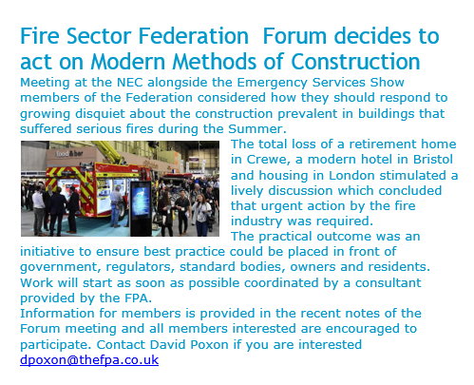
Industry disquiet

Slide 12
Recent loss history
In April 2018 at the Persimmon Homes Greenacres development in Exeter, a fire started by a cigarette dropped at ground level spread up to the roof of a house, and then to the neighbouring properties.
An internal investigation found that 37 per cent of the homes on the estate had no fire barriers, and 650 homes across the UK were then found with missing or incorrectly installed fire barriers, according to the series.
www.timberframefires.co.uk
  Worcester Park Fire
  St James residents
The Modern Built Environment
8

Slide 13

Modern methods of construction
Cladding Systems
Modular & Pods
Composite Panels
Brick Slips
SIPS Panels
CLT
Modern Timber Framed Techniques
Insulated Formwork
Insulated Render Systems
The Modern Built Environment
12
The Modern Built Environment
Notes:
Go through slide content. Explain that some of these other techniques (that we won’t have time to cover today) but shows the wide options of construction now in the residential section, but also hospitals, hotels, offices, retail and industrial

Slide 14
Modular/Volumetric buildings and pods

Slide 15
What are modular buildings?
Overview
Factory produced units with integral support structure
Delivered to site and bolted together
Frames vary – steel, timber, concrete
Finish varies – base structure for finishing on site up to all
internal / external surfaces and utility services pre-installed
Watch
The Modern Built Environment
14

Slide 16
Modular buildings?
Overview
Some materials being used will not perform well in a fire situation – possible resulting in rapid fire development and spread
Un-protected voids and shafts may allow fires to track through the building (such fires are difficult to detect and fight)
Durability – Will these buildings stand up to the day-to-day use and weather?
Repairs and replacement of modules may present a challenge
However, less material delivery to site, reducing on
fire/arson risk from combustible goods
The Modern Built Environment
15

Slide 17

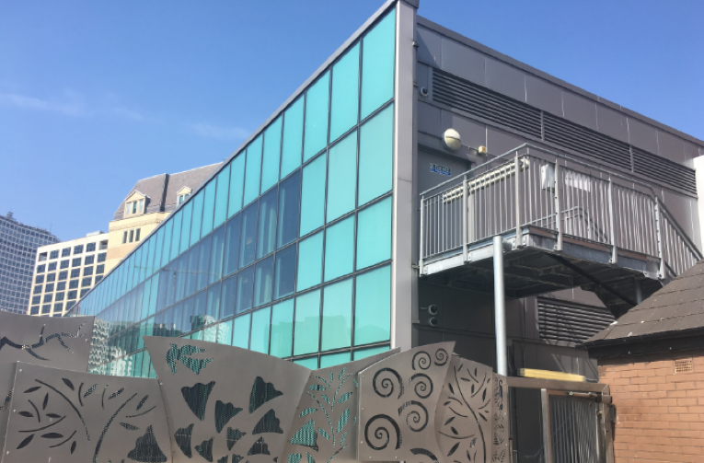
Pod
Overview
Factory produced units
Delivered to site and added to a superstructure
(i.e. steel frame)
Typical ready made pods incorporating utility services
and fittings pre-installed are bathrooms and kitchens
Usual risk assessment considerations apply regarding
materials used including and insulation plus how
easy it is to replace or repair a damaged
‘Pod’ following a partial loss.
The Modern Built Environment
16

Slide 18
Brick Slips

Slide 19
Cladding – Brick Slips
Overview
Externally applied brick ‘slices’ to the substrate of a vertical elevation using adhesive
Applied in panels in various sizes or individually
Typically applied to an insulation material – such as polyurethane or polystyrene
Visually challenging to identify easily. Can be more uniform than traditional brock construction and any insulation material will not be known unless a specification obtained
Whilst the brick slips themselves are non-combustible, full specification
details of the construction should be obtained as the insulation and/or
substrate may be combustible.
The Modern Built Environment
18

Slide 20
S.I.P.S

Slide 21
What are S.I.P.S panels?
Overview
Factory produced panels
Delivered to site for fast assembly
Insulating core between 2 structural timber facing boards – typically Orientated
Strand Board (OSB)
Used in residential and light commercial property
Strong and good insulating properties
Hybrid construction (semi-volumetric is a combination of volumetric and
panelised in the same structure
Usual risk assessment considerations apply as timber and also
need details of the insulating material used which can be foam or
at worst Polystyrene.
The Modern Built Environment
20

Slide 22
Commercial use of S.I.P.S
The Modern Built Environment
21

Slide 23
Timber frame
buildings

Slide 24
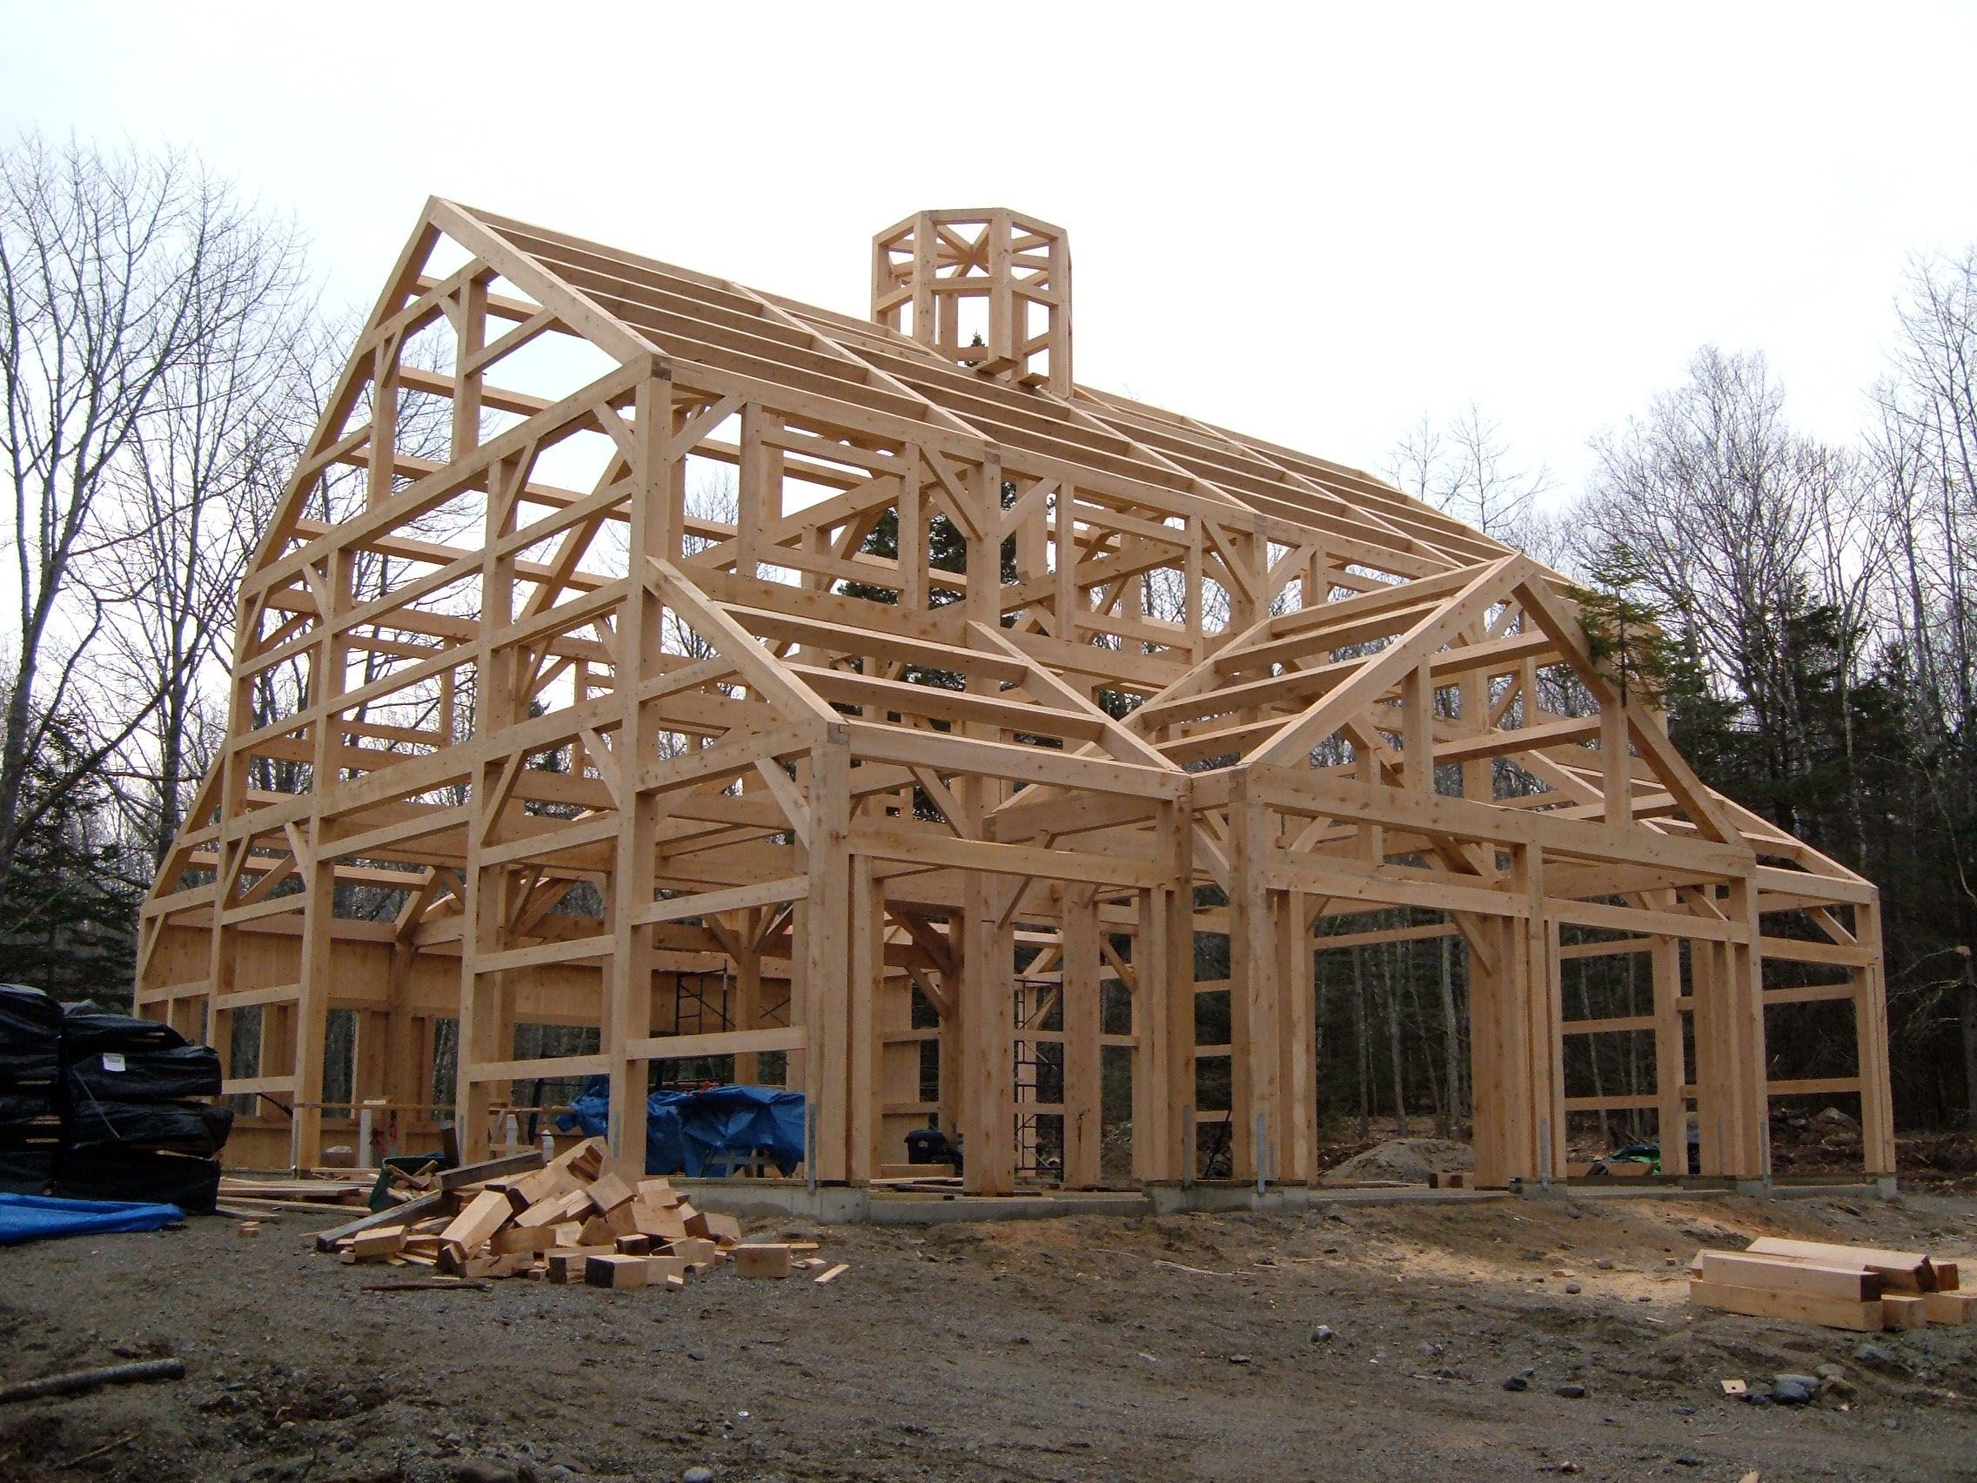

High risk during construction phase
Many standards have been introduced
to reduce the rise in construction
site fires on construction sites
The Modern Built Environment
23

Slide 25
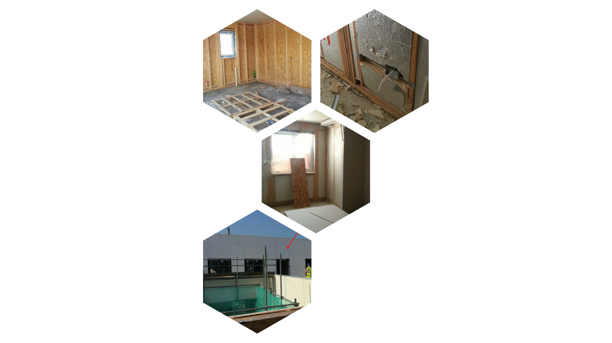
Panellised buildings
Timber framed block of flats under
construction – shows OSB
(Oriented Strand Board)
and frame internally
Timber framed block of flats under construction
– shows foam insulation being fitted
Utilises a lightweight timber frame
Strengthened using board material
Often feature cavities and voids
(which may assist fire spread)
Timber framed block of flats under
construction – shows interior, insulation
and frame now covered with plasterboard
Timber framed block of flats under
construction – cement board
cladding will be rendered
The Modern Built Environment
24
Notes:
Important to understand exactly what materials used in the construction. Fire spread via cavities and unprotected shafts likely to be an issue even if materials are acceptable.

Slide 26
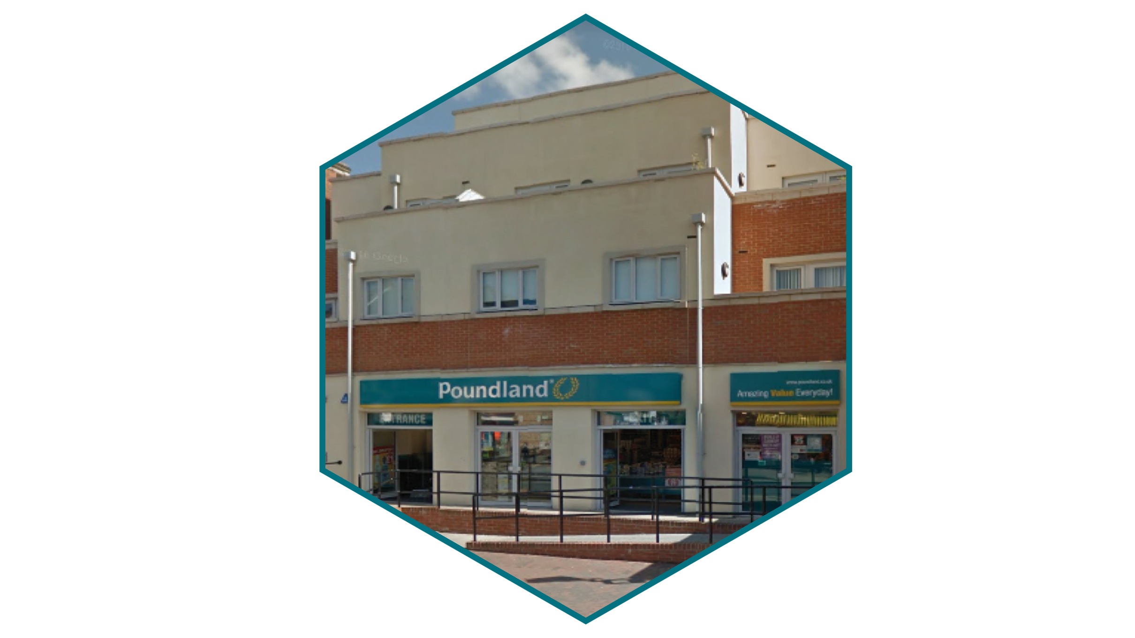
Panellised buildings
The finished building
The Modern Built Environment
25

Slide 27
Considerations for insurance cover
Buildings are lightweight in relation to other buildings
  Fire impact therefore could be worse and potential collapse in whole or part
Framework may be vulnerable to fire and flood damage
  Particularly for lightweight timber frame and heavy insulated structures
Construction phase may result in significantly increased risk until structure is closed in
  This applies particularly for lightweight timber frame
Insulation materials and framework can be combustible being reliant on perfect sealing from external and internal face/linings
  Consider changes made by tenants within the building
Lifespan is severely limited in comparison to traditional buildings
  Unlikely you will see these buildings survive beyond 50 years
Increased escape of water loss potential
  Higher use of push fit connections but also all pipework will be sealed behind panels, pods and modules with access problems
The Modern Built Environment
26

Slide 28
Modern methods of construction
Cladding Systems
Modular & Pods
Composite Panels
Brick Slips
SIPS Panels
CLT
Modern Timber Framed Techniques
Insulated Formwork
Insulated Render Systems
The Modern Built Environment
27

Slide 29
Learning objectives
Understand some of the most common modern methods
of construction
Understand the issues attached to non fire events such as escape of water, flood and impact
The risks they face during construction phase and as-built
Be aware of the combustibility of materials and how they are protected
The Modern Built Environment
28

Slide 30
Thank You

