Slide 1
Insurance Law Update
16 October 2019
James Harvey
Partner, and Head of the Birmingham office james.harvey@blmlaw.com

Slide 2
Outline of today’s talk
Recent policy changes and reforms
Gig Economy
Vicarious Liability Update

Slide 3
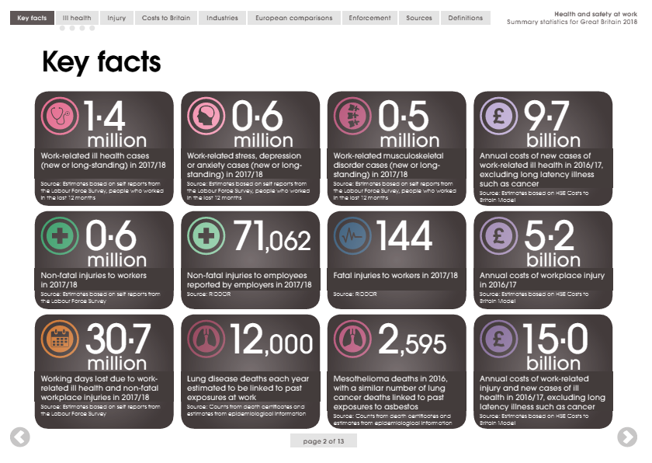
Source: HSE

Slide 4
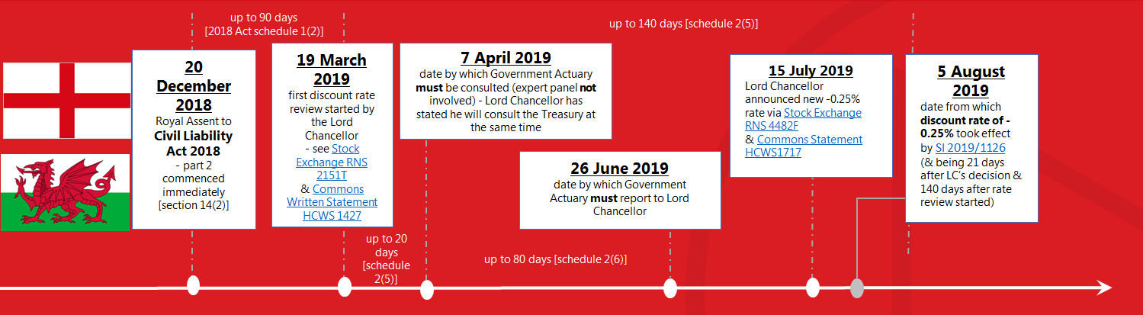
Civil Liability Act 2018 - part 2 governs the discount rate in England & Wales

Slide 5
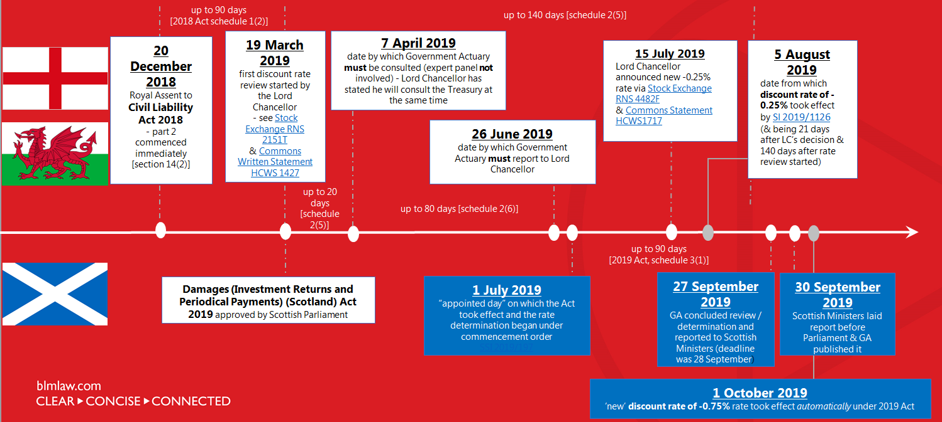
Civil Liability Act 2018 - part 2 -England & Wales
Damages (IR & PP)(Scotland) Act 2019 - makes different provision in Scotland

Slide 6
Civil Liability Act 2018 - part 2 governs the discount rate in England & Wales
Damages (IR & PP)(Scotland) Act 2019 – makes different provision in Scotland
a. there will be 5 year cycles of reviews in both jurisdictions
Eng & Wales: “Each subsequent review of the rate of return must be started within the 5 year period following the last review”
  ie: 5 August 2019 + 5 years + 230 days for rate-setting = 1 February 2025
Scotland: “A review … must be started … on the day after the last day of the 5 year period …”
1 October 2019(?) +5 years + 90 days for rate-setting = 30 December 2024
b. insurers must provide data to the regulator (England & Wales only)
section 11 CLA 2018 requires detailed & audited reports from insurers to the regulator by 1 November 2023
“The Act therefore imposes a new statutory requirement on insurers to provide information to the Financial Conduct Authority (FCA) about claims costs and premium prices, as well as what they might have expected these figures to be, had the act not been passed. This will enable the Treasury, with the help of the FCA, to fulfil obligations placed on it by the act to lay a report before Parliament which assesses whether policy holders have benefited from any savings made by insurers as a result of the reforms of the act.”
c. possibility of consultation on dual discount rates during the 5 year cycle
Both Acts allow for dual rates and the Government Actuary has already carried out initial analysis, described by the Lord Chancellor (E&W) as “interesting … with some promising indications, particularly in relation to addressing the position of short term claimants”. Currently there is not enough evidence of the effects of dual rates, meaning further consultation during the 5 year review period is likely.

Slide 7
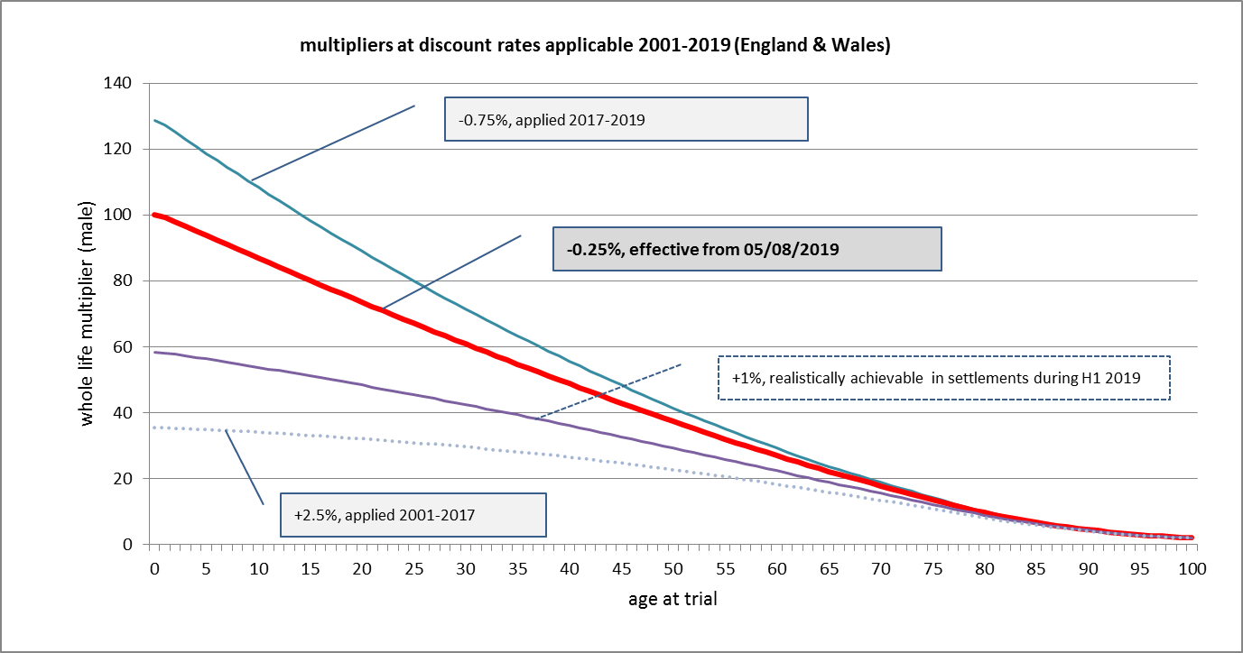

Slide 8
Whole life multipliers at current PIDRs - illustrative only & based on 7th edition Ogden tables
claimant’s / pursuer’s age (m) statutory discount rate | 17 | 37 | 57
-0.25% England & Wales - from 05/08/2019 | 77.48 | 52.34 | 29.95
-0.75% Scotland - numercial rate unchanged, but on different legal basis before & after 01/10/19 | 94.55 | 60.25 | 32.69
increase on E&W multiplier | +18.1% | +13.1% | +8.4%
+2.5% England & Wales before 20/03/2017 | 32.73 | 27.53 | 19.68

Slide 9

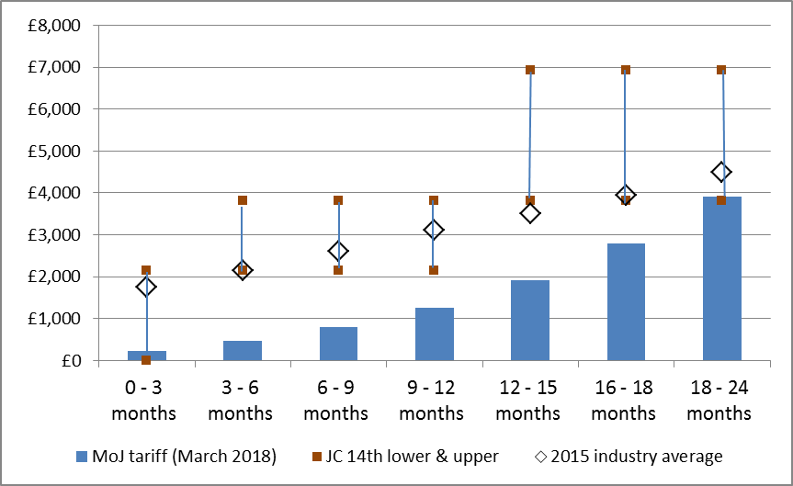
Whiplash Reforms
Source: Ministry of Justice

Slide 10
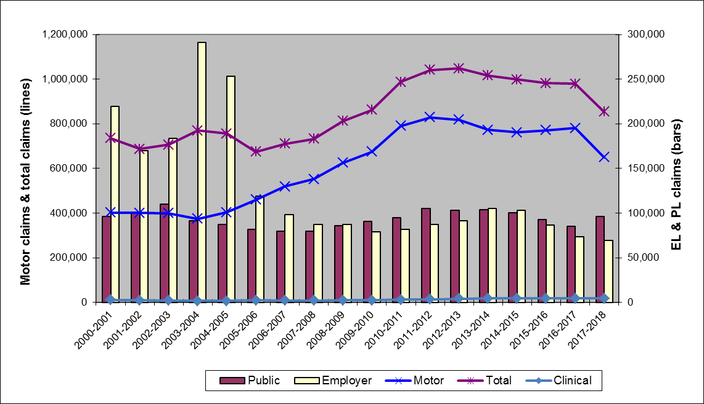
Notified Claims (CRU data)

Slide 11
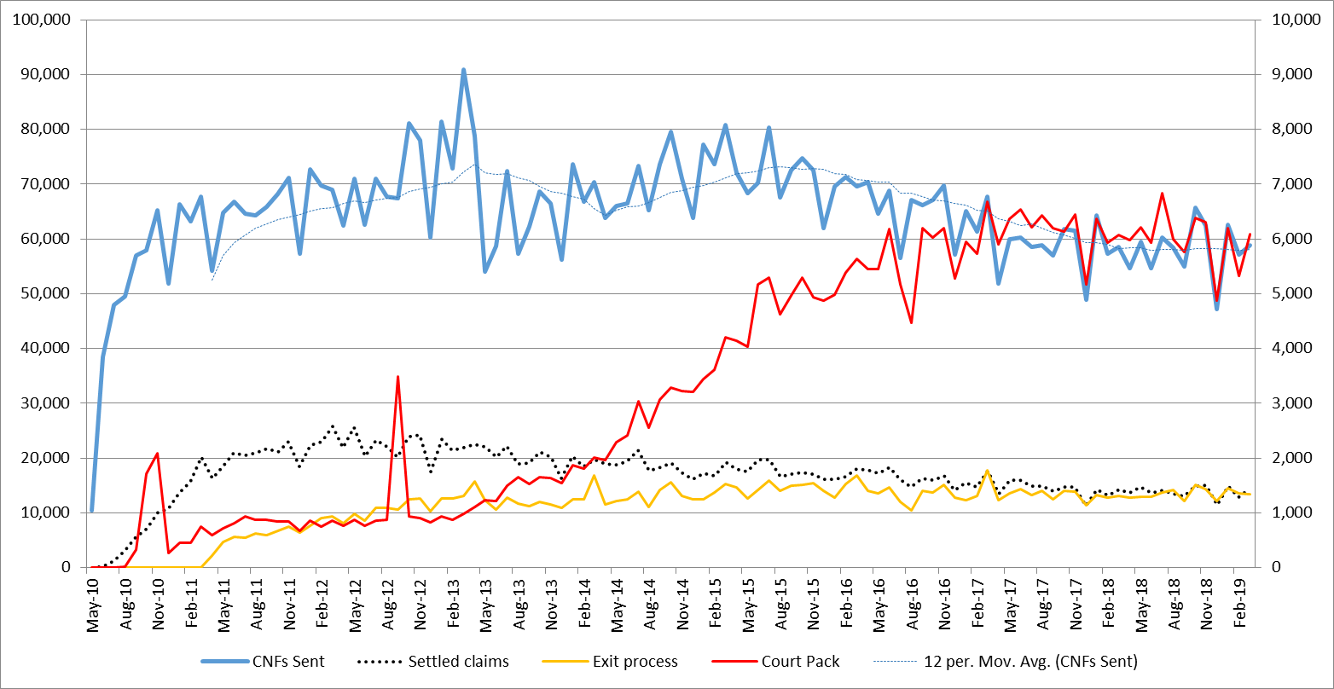
Motor claims trends (portal co data)

Slide 12
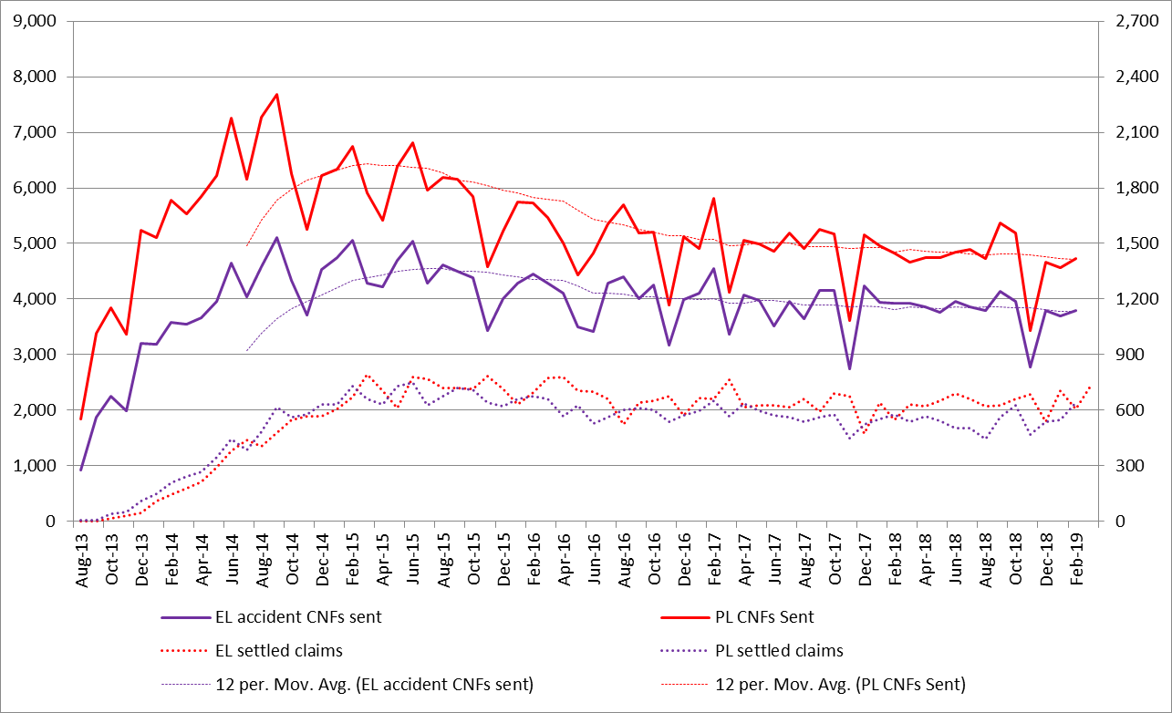
EL & PL claims trends (portal co data)

Slide 13





Slide 14
worker, employee or contractor?
Employment lawyers recognise three broad categories of individuals who supply their labour:
For the purpose of this talk, employees and workers will be treated the same for the purpose of civil claims as employers owe the same liabilities to employees and workers irrespective of their legal definition. It is only in employment claims where the employee/ worker distinction becomes relevant.
Companies do not however owe the same civil liabilities to those who are self-employed/ contractors.
Employees | An individual who has entered into or works under a contract of employment. This is the simplest relationship and the contract does not have to be in writing (section 230, Employment Right Act 1996).
Workers | An individual who has entered into or works under a contract of employment which defines the individual as a worker or any other contract where the individual undertake to do or perform any work or service… (section 230, Employment Rights Act 1996).
Self-employed/ contractors | The legal status of such self-employed/ contractors depends upon the application of various criteria. The courts have shown a willingness to overlook the fact that the worker is described as "self-employed“ or a “contractor” if the other factual circumstances actually point towards employment. Note that they are not employees; treated different for tax and NIC; their engagement can be terminated in accordance with the contract and they do not have any employment rights.

Slide 15
DELIVEROO
Independent Workers' Union of Great Britain (IWGB) v RooFoods Ltd (t/a Deliveroo), [2017] 11 WLUK 313, 14 November 2017
Facts:
Deliveroo engaged people to deliver takeaway food. Riders sign up to the app, sign a contract, and were given training.
Riders can choose whether to accept or decline delivery jobs.
Contract provided that riders can engage a substitute to provide services, although the rider was responsible for ensuring any substitutes had the requisite skills and training.
Union asked the Central Arbitration Committee to accept an application to be recognised for collective bargaining by Deliveroo.
Issue was whether the riders were ‘workers ‘ within the statutory definition of the Employment Rights Act 1996 s.230(3)(b).
Held:
A right of substitution both before and after riders have accepted a job was genuine, so the riders did not undertake to personally work or provide services for someone which defeated the claim that the riders were ‘workers’.
The Union’s claim to collective bargaining was therefore rejected and the riders were therefore self-employed.
It is absolutely key to find the true agreement by examining all relevant evidence including the contract, read in context to determine whether a right is genuine or otherwise.
It is fundamental to a claim of worker status that a person is personally providing services.

Slide 16
pimlico plumbers
Pimlico Plumbers Ltd & Anor v Smith [2018] UKSC 29, 13 June 2018
Mr Smith carried out plumbing work for Pimlico Plumbers between 2005 and 2011.
Mr Smith claimed that he was an employee of Pimlico Plumbers and that following a heart attack in 2011 he was unfairly or wrongfully dismissed and discriminated against on the grounds of his disability. Pimlico Plumbers’ position was that he was self-employed.
Employer/Worker | Self-employed/Contractor
Pimlico uniform, branded van, and ID card Use of a company mobile phone. Worked exclusively for Pimlico. Limited right of substitution with another Pimlico Plumber e.g. illness Income referred to as wages. | Could choose to reject work. Decided his own working hours. No obligation to provide him with work. He believed he was a subcontractor.

Slide 17
The pimlico decision
The Appeal Tribunal found that whilst Mr Smith was not an employee, but a worker.
It was clear that the claimant was not a self-employed contractor, by looking at the true construction of the contract.
The limitation of the facility to appoint a substitute in practice was significant . Mr Smith had no express right of substitution in his contract. There was no unfettered right to substitute at will - contrast with Deliveroo.
Pimlico Plumbers appealed to the Supreme Court maintaining that Mr Smith was self-employed.
The Supreme Court held that Pimlico had tight control over Mr Smith, which was shown by the fact that:
He had to wear a branded uniform;
He had to drive a branded van;
He had to carry an ID card with him; and
He had to follow the administrative instructions given by the control room.
It was noted that there was strict terms in respect of when and how much Pimlico would be obliged to pay Mr Smith and there was also a suite of covenants which restricted his activities following termination of the agreement. The Supreme Court therefore found Mr Smith to be a worker and agreed with the Appeal Tribunals.

Slide 18
ADDISON LEE
Addison Lee Ltd v Lange [2018] 11 WLUK 193, 14 November 2018 (Appeal to Court of Appeal outstanding)
A professional private hire taxi firm appealed to the Employment Appeal Tribunal against a decision that the drivers were workers within the Working Time Regulations 1998 and the National Minimum Wage Act 1998 to claim holiday pay.
Drivers signed a contract stating that they were an independent contractor. Drivers had to pay a vehicle fee for vehicles which were emblazoned with Addison Lee branding.
Driver can choose whether to accept or decline delivery jobs. There was no obligation on a driver to work for any specific number of hours, and the company was not obliged to provide work.
When a driver was allocated a job, the company expected the driver to accept it, or to provide an acceptable reason for refusing, or they risked being sanctioned.
The dispute focused on the definition of ‘worker’ which was functionally similar to the Employment Rights Act 1996, definition as in the Deliveroo case.
Held:
The court upheld that the finding that they were limb (b) workers when they logged on because they were then personally undertaking to do work or perform services. This was because that a driver had to accept a job allocated in the absence of an acceptable reason; and that if a driver did not do so a sanction could be imposed, notwithstanding the contract drivers signed that stating they were independent workers.

Slide 19
Uber – the LATEST IN judicial recognition of worker status in the gig economy
Uber BV v Aslam [2018] EWCA Civ 2748, 19 December 2018
Uber has been granted permission to appeal to the Supreme Court, should it wish to do so.
Uber is a technology platform facilitating the provision of taxi services; it does not provide those services itself.
The taxi services are provided by the drivers. A contract is concluded between driver and passenger for each ride. Uber argued that the app acted purely as an intermediary providing booking and payment services.
The drivers are all self-employed.
Drivers supply their own vehicles. Driver remain liable for all running costs, including the costs of private hire licences.
Drivers are not required to make any commitment to work.
At the end of a trip, Uber’s servers calculate a recommended fare based on GPS data from the driver’s phone. The driver cannot agree a higher fare. The passenger pays the fare direct to UBV, via the app. Uber pays drivers weekly in respect of the fares they have earned, minus a ‘service fee’ of 20-25% for the use of the app.
Uber takes the risk in some matters including, for example, some instances of fraud by passengers.
Drivers are not required to wear any uniform.

Slide 20
The uber appeal
  Uber appealed an Employment Tribunal decision to the Employment Appeals Tribunal (“EAT”). In November 2017, the EAT dismissed the appeal and asked itself the question: “when the drivers are working, who are they working for?”
  The EAT considered whether that was the reality of the relationship between Uber and the drivers and had been entitled, on the facts, to answer in the negative. It found that the drivers were integrated into Uber's business and operated under Uber's control. These included, by way of example:
The scale of Uber's operation (not a determinative factor, but a relevant one nonetheless and goes back to public policy consideration);
Drivers could not grow their businesses and could not establish business relationships with passengers (drivers were not provided with passenger details);
Drivers had no ability to negotiate terms with passengers (beyond being able to agree a lower fare with the passenger, but still faced Uber taking its percentage based on the fare it had set); and
Drivers had to accept Uber's terms.
The Court of Appeal dismissed Uber’s appeal by a majority and confirmed that:
Uber ran a transportation business to which drivers were providing services; the contractual documents did not reflect the reality of the situation and confirmed that the drivers were working for Uber London within the meaning of s230 of the ERA 1996.
What does this series of judicial decisions recognising ‘worker’ status within the confines of contractual interpretation and judicial activism leave the future of the gig economy?

Slide 21
TAYLOR REVIEW – THE FUTURE OF THE GIG ECONOMY
  The Taylor review published in July 2017 was wide-ranging and more than 50 recommendations that the government could choose to act on.
  A key recommendation was to clearly define ‘worker’ status in primary legislation, with secondary legislation providing more detail.
  Another recommendation was to change the test for ‘worker’ status by placing more emphasis on control, and less emphasis on the requirement to perform work personally i.e. a worker can send a substitute.
  The government published their ‘Good Work Plan’ in December 2018 where they will consider these recommendations, and has commissioned research into those with uncertain employment status which will help inform detailed policy proposals.
  It also suggests that if an individual brings an employment tribunal claim, alleging that they are a worker or employee, the burden of proving that they are not should rest with the employer, subject to safeguards. The government stated that they would return to this recommendation when decisions have been reached on the way forward regarding employment legislation, and when an online tool has been developed to reach an initial determination of status.
  All this discussion surrounding worker status ties in with the issue of vicarious liability which we shall turn to now.

Slide 22
MOHAMUD V MORRISONs [2016] – EMPLOYEE
There is a two stage test for determining whether or not vicarious liability exists:
1) Is the relationship one of employment or akin to employment?
2) If so, was the tort sufficiently closely connected with that employment or quasi employment?
This case concerns an employer’s vicarious liability in tort for an assault carried out by an employee of the defendant and expanded on the application of the second stage of the test.
The claimant was of Somali origin. He went to a petrol station which was owned by the defendant. The claimant went to the kiosk at the petrol station and asked whether they could print documents from a USB. An altercation shortly after ensued between the claimant and the defendant’s employee.
The defendant’s employee used racist and threatening language and ordered the claimant to leave the kiosk. He then followed the claimant to his car, where a further altercation ensued, including the employee physically assaulting the claimant.
Held: it was the employee’s job to respond to customer enquiries and his conduct in answering the claimant’s request was inexcusable, but within the “field of activities” assigned to him as the employee told the claimant to never come back to the petrol station which led to a chain of unbroken events.

Slide 23
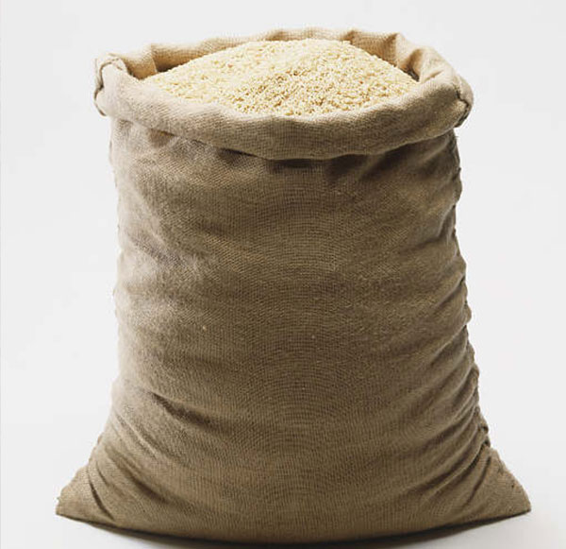
Cox v ministry of justice [2016]
The claimant was a prisoner who worked as a catering manager. Prisons were required by statute to ensure that prisoners did useful work. The prisoner responsible for the injury had earned a nominal wage. Kitchen supplies were delivered. A sack of rice was dropped by a prisoner. The claimant bent down to prop up the broken sack. Whilst she was bent over, another prisoner lost his balance and dropped a sack on the claimant’s back causing her injury.
Held: the Prison Service was liable applying the Christian Brothers criteria. This case expanded on the application of the first stage of the test. It was sufficient that there was a defendant carrying on activities in furtherance of its own interests even though there was no commercial motivation. The prisoners were integrated into the prison’s operation. The prisoners were placed in a position where there was a risk that they could commit a variety of negligent acts within the field of activities assigned to them. Defendants could not avoid liability by technical arguments about the employment status of the tortfeasor.
Ultimately, it was a case where it was fair that vicarious liability should be imposed on the Prison Service.

Slide 24
IMPACT OF MOHAMUD and cox
Mohamud expanded the scope of vicarious liability because the defendant employer did not condone the actions of the employee and arguably no amount of training or risk assessments would have prevented the incident from occurring. The case is highly fact specific, as the case may have been decided for the defendant if the employee was acting on a whim by not purporting to act in the defendant’s interests. It was key that the employee was purporting to act on behalf of the defendant’s business, and the fact that there was a seamless chain of events.
Cox essentially confirmed that a strict employment relationship is not required to impose vicarious liability
Employers should actively take steps to mitigate the risk of violence in the workplace by reviewing their policies; ensuring that these policies are brought to the attention of all staff and, where violence has occurred, disciplinary action should be considered.

Slide 25
Various claimants v barclays bank [2018] – independent contractorS
126 claims were made against the defendant in respect of alleged sexual assaults perpetrated by a male doctor, who carried out medical assessments on prospective employees between 1968 and 1984. The majority of the claimants were young women who were required to attend these medical assessments as part of the defendant’s application process.
Confirmed that the two stage test in determining vicarious liability for employees, equally applies to independent contractors
Rejected a bright line test of no vicarious liability for independent contractors
The issue of control exercised by the defendant over the doctor was of critical importance. The defendant had directed the doctor in respect of the questions to be asked; the manner in which the physical examinations to be carried out and the proforma document that the doctor had to fill out.
Permission to appeal to the Supreme Court has been granted, and the hearing will take place on 28 November 2019

Slide 26

What about the upcoming Christmas party season?

Slide 27
Bellman v Northampton Recruitment Ltd [2018]
The claimant had attended a works Christmas party, and after headed to a Hilton hotel for some impromptu drinks. The MD and the claimant was involved in a heated exchange in respect of the deployment of an employee. The Managing Director of the defendant company assaulted the claimant who suffered brain damage.
Applying the two-stage test, it was held that the Director was the directing mind of the defendant, and therefore has a wide remit and working hours. The first stage was met.
In respect of the second stage, it was held that the Director wore his ‘director’s hat’ and used his position to drive home his authority with the use of blows. It was considered from an objective point of view that the attack had arisen out of the misuse of the Director’s position.
It was held that there was sufficient connection between the Director’s field of activities and the assault to render it just for the defendant to be found vicariously liable for his actions.

Slide 28
IMPACT OF BELLMAN
It should be noted that vicarious liability will not “…merely arise because there is an argument about work matters between colleagues, which leads to an assault, even when one colleague is markedly more senior than the other.” The floodgates have not opened.
Highly fact specific as the Court took into account the principles of social justice as the defendant had the means to meet the claim and the claimant was seriously injured through no fault of his own.
Comparisons can be drawn with Mohamud in the sense that the ‘sufficient connection’ is a relatively low threshold to meet i.e. the employee was purporting to act on behalf of his employer and had metaphorically not taken off his ‘work uniform’ at the time of the assault.

Slide 29
SHELBOURNE v CANCER RESEARCH [2019]
A Christmas party was held at the Cambridge Research Institute of Cancer Research UK (CRUK). The claimant was physically lifted up by a visiting scientist and fell and thus sustained a serious back injury. The scientist was not employed by the defendant.
Whilst the scientist was a sufficiently integral part of the CRUK business to render CRUK potentially vicariously liable for his acts, there was insufficient connection between his activities at the party and his role as a scientist working in laboratories to render them vicariously liable for his actions in picking up the claimant.
In particular, the scientist did not compulsorily attend the party which was organised by volunteers – not CRUK - that his attendance at the party was not connected with work he undertook and that the act of lifting the claimant had no connection with his research work led to a conclusion that it was not closely connected to his employment.
Liability is not imposed merely because a Christmas party is held, but rather due to the connection between the tortious acts and the tortfeasors field of activities. Social justice did not demand that vicarious liability attach to CRUK.

Slide 30

Brayshaw v Partners of Apsley Surgery [2018]
The claimant had mental health problems who contacted a surgery and asked to speak to a doctor. She spoke to a locum GP who recruited her into their faith. The claimant suffered an adverse psychological reaction including upsetting dreams, memories, and recurrence of her depression following a meeting which involved a telling of a story where a witch doctor had told him that he had to burn an owl near a human corpse.
The claimant brought claims in tort against the locum GP and a claim of vicarious liability against the surgery.
The court concluded that whilst the locum GP was held to be negligent in exposing her to faith and practices which caused a foreseeable deterioration in the claimant’s mental health; the surgery was not.
The locum’s activity was no part of the business activity of the surgery: the surgery was in the business of providing medical assistance, whereas the activities of the GP were religious. The religious activity was held off-site.
The fact that Mrs Brayshaw had met him through his work for the surgery was insufficient to establish liability.

Slide 31
Impact of Brayshaw
It is the first case involving a GP practice and a locum doctor engaged to look after the patients of that practice which further tested the boundaries of the imposition of vicarious liability
The court is always considering whether it is fair, just and reasonable to impose vicarious liability.
The court found that religious recruitment cannot be fairly be regarded as a reasonably incidental risk to the business of carrying on a doctors' surgery.
It could be said that this case is confined to its specific facts, as the claimant engaged with the defendant as a friend rather than as a patient.

Slide 32

MORRISONS v Various Claimants – DPA breach
Permission to appeal to the Supreme Court has been granted, and a hearing will take place on 6-7 November 2019.
The issue was whether Morrisons was liable in damages to those of its current or former employees whose personal and confidential information has been misused by being disclosed on the web by the criminal act of another employee, who had a grudge against the employer, in breach of the Data Protection Act 1998 ("the DPA") and in breach of that employee's obligation of confidence.
The tortious act which caused the harm was done by the employee at his home, using his own computer, on a Sunday, several weeks after he had downloaded the data at work onto his personal USB stick. Nevertheless, the court found that the tortious acts of the employee in sending the claimants' data to third parties was within the field of activities assigned to him by Morrisons as he was a data auditor.
There was a seamless sequence of events as he purchased a phone to make the disclosures; brought in his own USB stick to copy the information; and used another colleague’s name and date of birth to upload the information online.
Impact: whilst there might be an influx of claims against a company for potentially ruinous amounts, the solution is to for employers to insure against losses caused by dishonest or malicious employees.
VICARIOUS LIABILITY?

Slide 33
SUMMARY OF THE LAW AS OF 2019
relationship between principal defendant and person causing harm wrongful act was … | employment | “akin to employment” | neither employment nor “akin to employment” (which includes independent contractors)
“in the ordinary course of employment” (or the qualifying relationship) | YES classic formulation of and limitation of vicarious liability | YES JGE v Portsmouth [2012] SC (priest) | NO policy reasons for imposing vicarious liability no longer hold, essentially the control test cannot be satisfied Yates v National Trust [2014] QB
“so closely connected” to the employment (or the qualifying relationship) | YES Lister v Hesley Hall [2001] HL | YES Various Claimants v Catholic Child Welfare [2012] SC - weakened the test to “strong connection” expressly affirmed in Cox v MoJ and Mohamud v Morrisons [2016] SC
such that the employment (or the qualifying relationship) merely provided the opportunity for harm | NO policy reasons for imposing vicarious liability no longer hold; not fair and just / not foreseeable Lister v Hesley Hall (2001) HL |  | NO both the relationship and the act are simply too remote from the principal defendant BUT the courts will look beyond labels such as ‘independent contractor‘ - Various v Barclays Bank [2018] CA

Slide 34

French business trip – EXPANDING VICARIOUS LIABILITY - a cautionary tale from the other side of the channel

Slide 35
French BUSINESS TRIP – EXPANDING VICARIOUS LIABILITY
A Parisian court ruled that a man who worked for a railway construction company and died from a heart attack after having sex during a business trip had suffered a work-related accident. His employer was liable for extra pension contributions payable to a partner, funeral costs and a one-off payment.
It was said that the heart attack was linked to the casual encounter given that having sex was part of everyday life like having a shower or a meal and that the employee was therefore protected.
French law considers any accident that happens on a business trip whilst engaging in everyday day activities to be work-related, despite an apparent lack of connection between the accident and the work.

Slide 36
Questions?

