Slide 1
Leicester CII – 4 September 2019
The Salisbury Novichok Poisoning
Damian Glynn - Director, Head of Financial Lines

Slide 2


Agenda/Learning points
Overview of the circumstances
Identify practical challenges and responses
Highlight issues arising with regards policy wordings

Slide 3
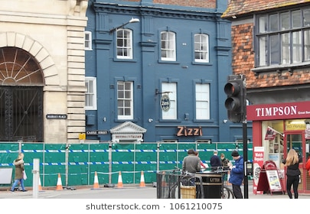
Submitted as (Non Damage) denial of access
action (in or outside UK)
Designed to influence Government or public
Re a political/ religious/racial/ ideological cause

Slide 4
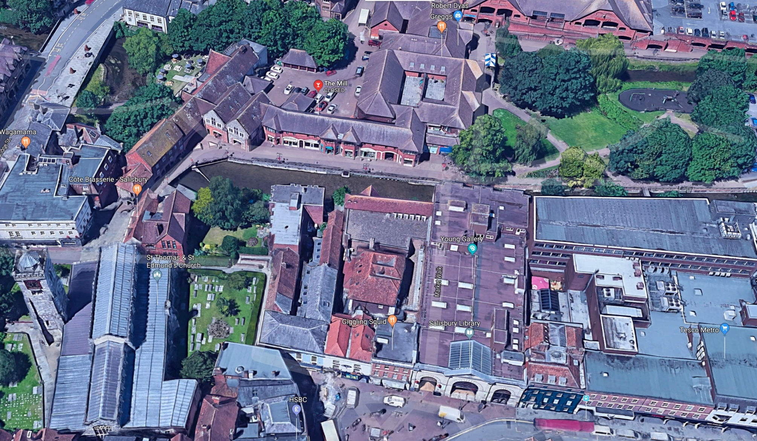
Movements of Sergei and Yulia Skripal : Cause?
2. The Mill Pub
1. Sainsbury’s car park
5. Skripls found
on bench
4. Market Walk
3. Zizzi

Slide 5
Timetable: March 2018
4th March 2018 | Initial uncertainty re cause/location
6th March 2018 | Counter – terrorism officers take over from Wiltshire police investigation
12th March 2018 | Presence of Novichok identified
14th March 2018 | Investigation focusing on Skripal’s home.
28th March 2018 | Conclusion that Skripal’s front door handle has been initially contaminated

Slide 6
Timetable: Overview 2018/2019
March 2018 | Poisoning: Salisbury economy down 50%
April/May 2018 | Skripals released from hospital
June 2018 | Prince Charles visit to Salisbury to show support. Normality returning - economy at 75%
July 2018 | Dawn Sturgess dies (‘perfume bottle’)
September 2018 | DEFRA hand back the restaurant. ‘Novichokol brothers’ in the press
November 2018 | Zizzi reopens
March 2019 | Salisbury declared decontaminated

Slide 7
Scope of investigation
2,500 pedestrians searched
900 witness statements
14,000 vehicles checked
2,300 exhibits recovered
4,000 hours of CCTV footage reviewed

Slide 8
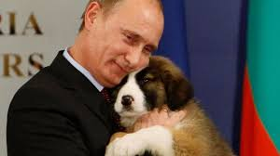
Terrorism?
Designed to influence Government or public
Re a political/ religious/racial/ ideological cause

Slide 9
Terrorism
Threat of action (inside or outside UK)
Designed to influence Government or public
Political/religious/racial/ideological cause
Pool Re claims process
Not certified as terrorism by the government
Threat of action (in or outs

Slide 10
Non damage denial of access?
action (in or outside UK)
Designed to influence Government or public
Re a political/ religious/racial/ ideological cause

Slide 11
Non Damage Denial of Access - textbooks
Riley: loss resulting from access being prevented/hindered due to property
  Occupied by terrorists/unlawfully by TP
  Closed down/sealed off by police, statutory authority
  Hoax bomb

Slide 12
Non Damage Denial of Access: actual policy wordings
Police/statutory restriction of access due to
      Incident in the vicinity
      Disturbance/commotion in the vicinity
Vicinity
Causation

Slide 13
Premises directly affected – damage?
Damage
        State of property has changed
        Subsequent repair/remediation
9 sites: Novichok contamination

Slide 14

Damage: policy considerations
Chemical exclusion (CBRN)?
Pollution/contamination exclusion
Exception to the exclusion: defined perils
Malicious persons: ejusdem generis, and relevance of location

Slide 15

Damage denial of access
Due to damage in the vicinity
Physical restriction (but wordings not always explicit)
Disinclination to travel is not a restriction

Slide 16
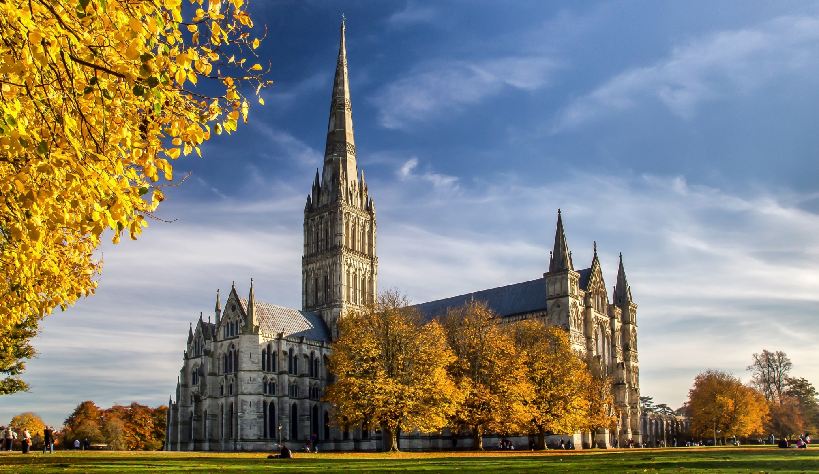
Loss of attraction?
Damage to property in the vicinity causing a fall in the number of customers to the insured premises
‘Salisbury’ is not an attraction: need specific property damage

Slide 17
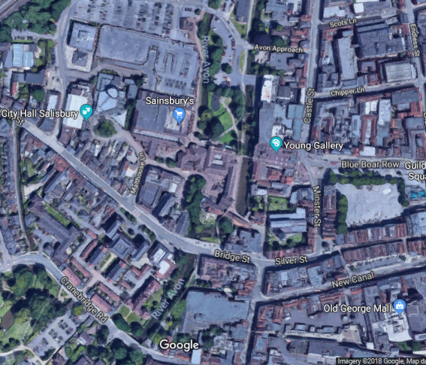
Subsequent developments (June/July): D Sturgess/C Rowley
Skripals found
on bench
Skiprals found
on bench
Queen Elizabeth Gardens
Queen Elizabeth Gardens

Slide 18
Policy Wordings – the lessons learned from claims

Slide 19
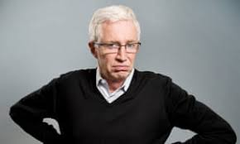
Policy Wordings – the lessons learned from claims

Slide 20
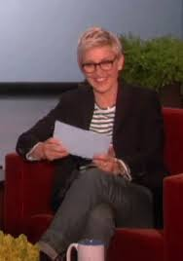
Policy Wordings – the lessons learned from claims

Slide 21
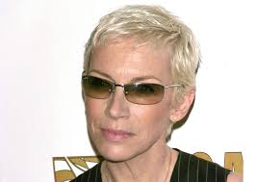
Policy Wordings – the lessons learned from claims)

Slide 22
Policy Wordings – the lessons learned from claims)
Damage – needs a better definition? Expert presumption?
Wide area damage

Slide 23
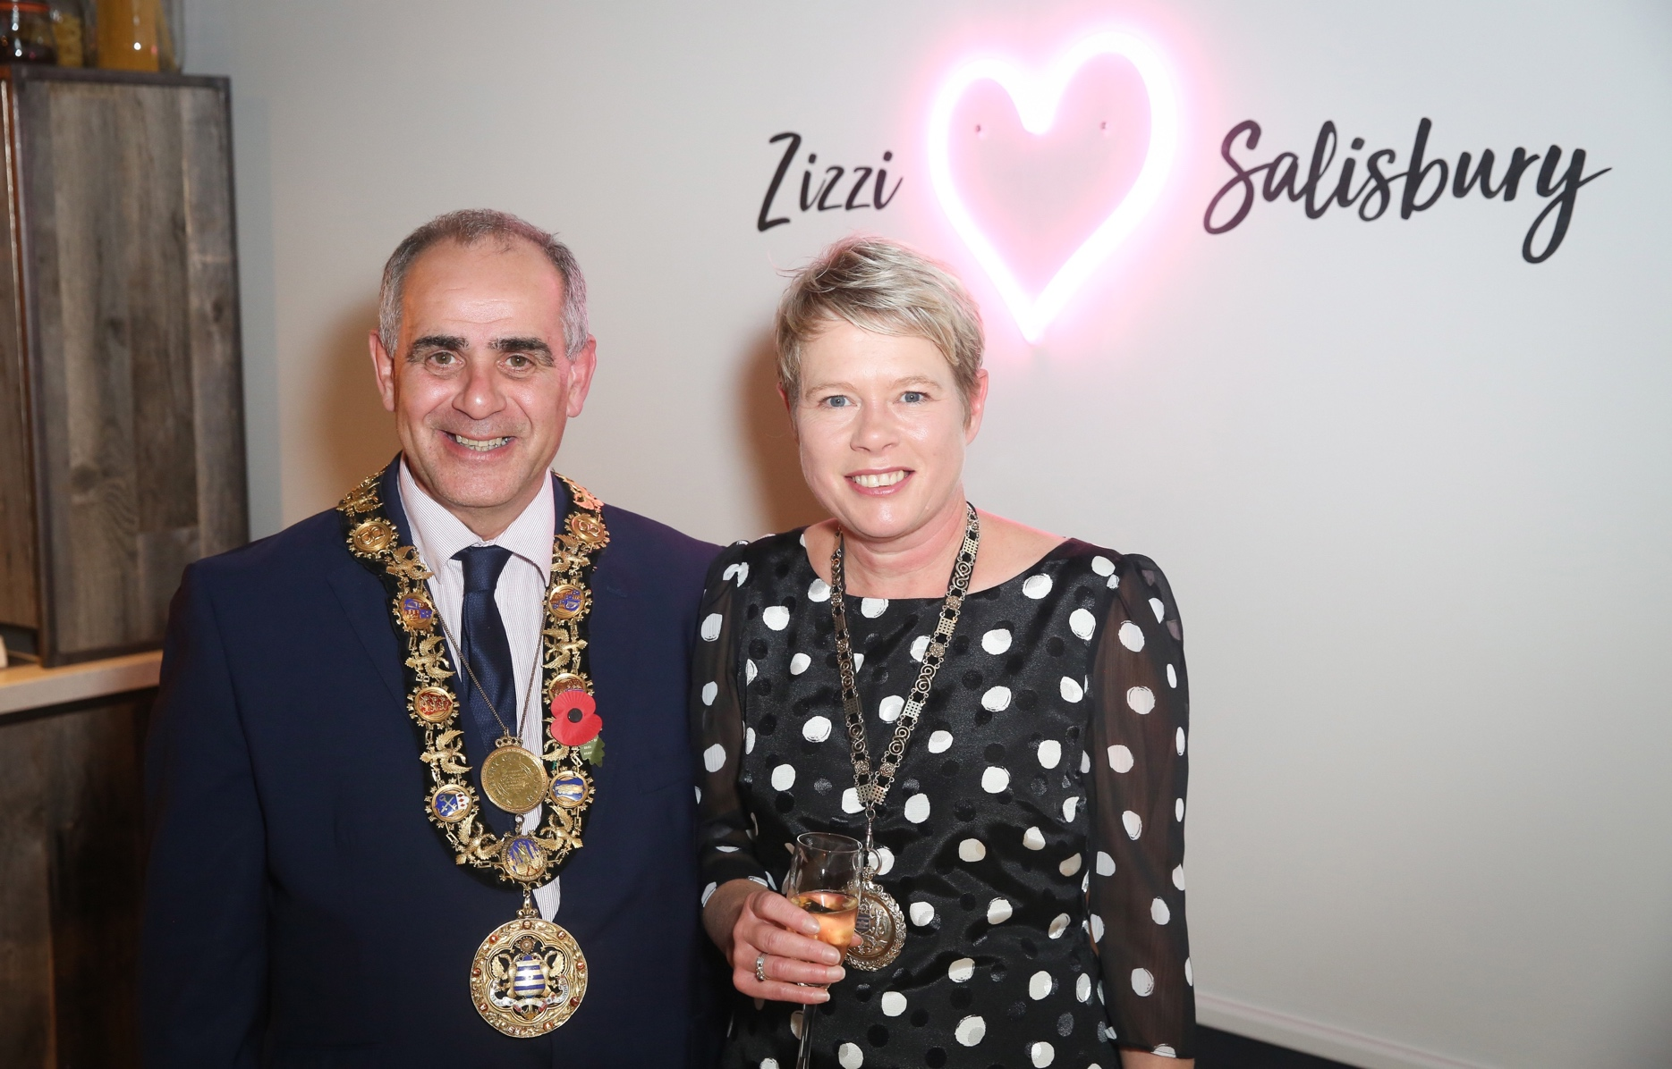
Zizzi postscript: re-opening – 6 November 2018
6 week refit turnaround
‘Pay what you think it is worth’
Outcome – no longer impacted by Novichok

Slide 24



Any questions?
Any Questions ?

