Slide 1
Solvency II and Ogden the Perfect Storm
Presentation by Alan Chandler, Chartered Insurer

Slide 2
Alan Chandler, Chartered Insurer
I have trained more than 1,000 individuals to become ACII qualified
I have trained over 50% of the individuals in the last 8 years that have gone onto achieve the highest ACII pass in the whole of the UK.
I train to a pass rate of more than 96% in all CII qualification levels. Certificate , Diploma and Advanced Diploma.
I deliver the Allianz scholarship and academy programmes in both the UK and Ireland and I have been a Cii examiner.
I have trained students who have won national prizes in almost all ACII subjects including Insurance Law (MO5), Liability (M96), Commercial Property and BI (M93), Personal Lines Insurance (P86), Business and Finance (M92), Underwriting Practice (M80), Advanced Underwriting (960), Claims Practice (M85), Advanced Claims (820), Marketing (945), Advanced Broking (930) and Advanced Risk Management (992).

Slide 3
Learning Objectives
Understand Insurers Solvency margins
Obtain an overview of Solvency II
Understand the current position of the Ogden table changes
Understand and be able to explain to your clients how Solvency II and Ogden is affecting the cover and premium being offered by the market.

Slide 4
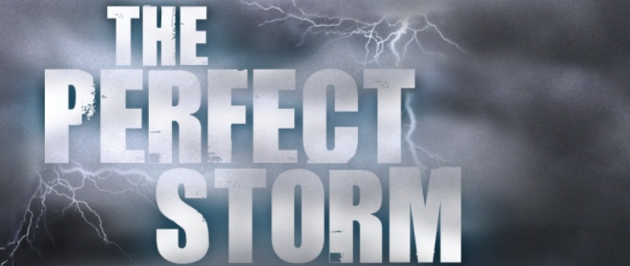
Solvency II and Ogden

Slide 5
What are Solvency Margins
In The UK and indeed right across Europe there has been a history of Insurance companies going bankrupt during the years.
One of the main reasons for this is the business model and accounting of insurance companies.
Most businesses cite their greatest challenge as cash flow not so insurance companies.

Slide 6


Having lots of upfront cash can mean big dividends are often paid

Slide 7
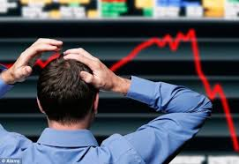
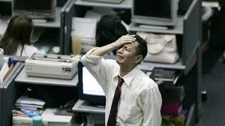
Then reality catches up! Lack of claims reserves, lack of unearned premium, lack of IBNR, lack of IBNER and lack of unearned risk provision – insurance accounting is complicated!

Slide 8
List of recent bankrupt insurance companies
Company | Date
AA Mutual International Insurance Services Ltd | 01/05/2007
Andrew Weir Insurance Company Ltd | 12/11/1992
Anglo American Insurance Company Ltd | 10/03/1997
BAI Ltd (Builders Accident) | 30/07/1998
Balva AAS Insurance | 04/07/2014
Bermuda Fire and Marine Insurance Company Ltd | 16/12/1994
Black Sea and Baltic General Insurance Company Ltd | 24/08/1998
Bryanston Insurance Company Ltd | 23/03/1992
Chester Street Insurance Holdings Ltd | 09/01/2001
Continental Assurance Company of London plc | 27/03/1992

Slide 9
And here is some more
Drake Insurance plc | 11/05/2000
English and American Insurance Company Ltd | 19/03/1993
Eurolife Assurance (International)Ltd | 24/04/2009
European Risk Insurance Company hf. | 28/04/2014
Highlands Insurance Company (UK) Ltd | 01/11/2007
HIH Casualty and General Insurance Company Ltd | 16/03/2001
Independent Insurance Company Ltd | 18/06/2001
KWELM Group of Companies | 17/11/1993
Lemma Europe Insurance Company Limited | 05/10/2012
Marina Mutual Insurance Association Ltd | 14/11/1997

Slide 10
And some more!
Millburn Insurance Company Ltd | 11/12/2013
Municipal General Insurance Ltd | 09/03/1994
North Atlantic Insurance Company Ltd | 06/03/1997
OIC Run Off Ltd / London and Overseas | 21/10/1994
Pacific and General Insurance Company Ltd | 15/11/1985
Paramount Insurance Company Ltd | 24/06/1996
Scan Re Insurance Company Ltd | 10/03/1994

Slide 11
And some more again! Remember this list does not include many foreign insurers who pass ported in like Quinn and this was why Solvency II was introduced
Sovereign Marine and General Insurance Company Ltd | 11/07/1997
The Aldgate Insurance Company Ltd | 12/11/2009
The Exchange Insurance Company Ltd | 06/10/2010
Trinity Insurance Company Ltd | 23/03/1992
UIC Insurance Company Ltd | 12/08/1996

Slide 12
What are solvency margins
A solvency margin is the amount of surplus assets insurance companies have to hold over and above their liabilities.
Solvency margins are set by regulators and stipulate the minimum surplus assets the insurer has to hold over and above their liabilities.
Example if an Insurer has to hold a solvency margin of at least £500M and their liabilities are £400m, they will need to make sure they hold assets of at least £900m

Slide 13
Solvency I
The EU have stipulated some form of solvency requirements since 1973 and the principles of Solvency I still remain today.
The Minimum Capital Requirement (MCR) known as solvency one has been with us for some time
This has both a premium and claims calculation and the insurer takes the highest of the two.
The MCR has been calculated at a 85% confidence level
Broadly speaking the MCR comes to around 20 to 25% of annual GWP

Slide 14
Solvency I
The FSA as was never felt Solvency I was enough and the previous list of bust insurance companies certainly testified this fact, so they introduced their own solvency requirements.
They introduced their own requirements of Enhanced Capital Requirement and Individual Capital Assessment but these only applied to the UK - hence many insurers who were struggling for capital headed for the offshore havens

Slide 15
Solvency II
The EU had originally planned to roll out new solvency requirements in 2005 but due to a combination of politics and the financial crash Solvency II never saw the light of day until the beginning of 2016.
From January 2016 Solvency II applies to all EU insurers and there is no longer hiding places in the EU to obtain soft touches
It is estimated that it cost the UK insurance industry £3 Billion to implement !

Slide 16
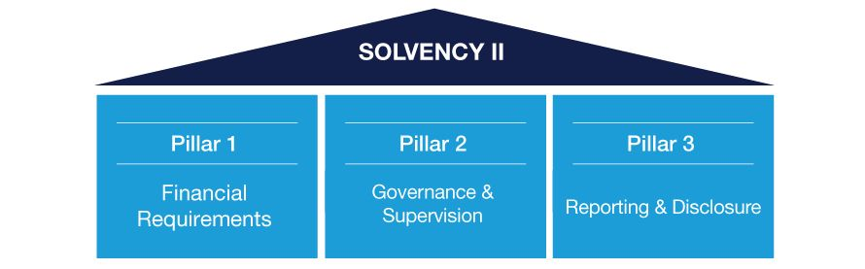
The Three Pillars of Solvency II

Slide 17
Solvency II
The new capital requirement under Solvency II is known as the Solvency Capital Requirement (SCR)
This has to be at a confidence level of at least 99.5%
Insurers can use the EU generic formula or use their own formula which has to be signed off by the PRA
It is also compulsory that insurers have an actuarial function, believe it or not certain EU insurers existed without one until Solvency II.

Slide 18
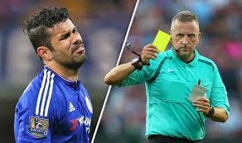
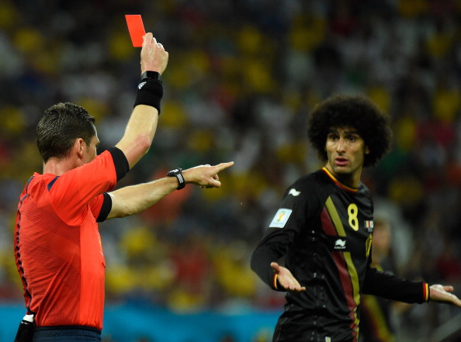
Solvency I (Red card) and Solvency II (Yellow card)

Slide 19
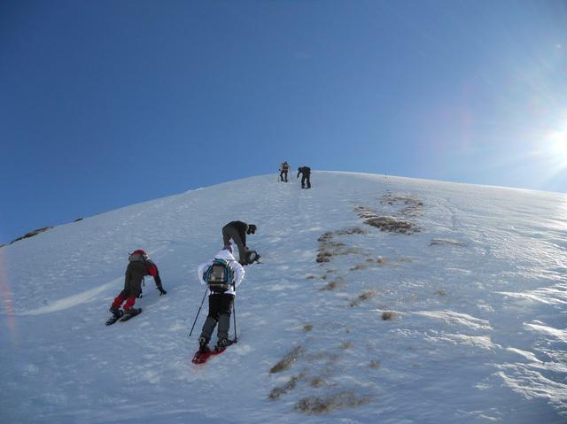
Solvency II was a massive challenge for almost everyone – some have got to the top of the solvency mountain ,some are working with their regulator and some have given up!

Slide 20
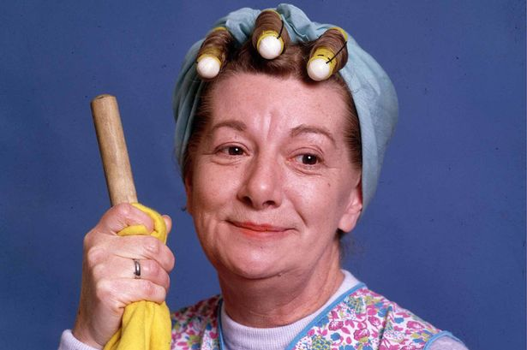
So having used up most of their spare capital to become compliant the last thing the insurance industry needed was a large claim hike!

Slide 21
Ogden Table change
In 2017 Liz Truss made a decision to move the Ogden table rate from 2.5% to -0.75%
This meant most motor and EL books had to be increased by a rate increase of between 9 and 15%
When premiums go up so does an insurers capital requirement - fine if you had spare capital not if you used it all up being compliant with Solvency II

Slide 22
Example of an Ogden settlement
Serious Brain injury to a person of 21 years of age at date of settlement.
At 2.5% rate
Claim would settle at £9,072,028 with a future loss element of £8,242,086.
At – 0.75% rate
Claim would settle at £20,020,103 with a future loss element of £19,193,161
This is an increase of 121%
Think about policy limits – EL, PL, Products are probably now all too low!

Slide 23
What’s next for Ogden
David Gauke was made the new Lord Chancellor on 8/1/18 - he does have a law degree unlike his last two predecessors!!!
MOJ proposed on 7/9/17 that new rate will be between 0 to 1% and a three year review date set by an independent committee.
This will have to go through parliament will take many months and around 12 stages including votes so the future is by no means certain.
It looked like parliament would push through a change to the Ogden rate urgently but since September 2017 it has moved at the speed of a tortoise.

Slide 24
The Perfect Storm
So with the combination of Solvency II and Ogden we have the perfect storm
Those with large spare capital will be king.
We now have a significant barrier to entry and MGA’s may well become more popular than setting up a new insurer.
Lets have a look at some of the effects of the perfect storm

Slide 25
The Perfect Storm
LV seek out Allianz’s massive cash pile despite its operation running well
Marker study are turning to the vast wealth of Qatar Re to keep them going
ERS pull of haulage fleet despite 12 months ago being one of the ‘go to’ markets
Gable insurance disappear completely
Enterprise insurance go bankrupt
CBL insurance go bankrupt

Slide 26
The Perfect Storm
There is a rush to the exit door for motor trade and construction business for many insurers and minimum premiums are increasing massively.
Many insurers will want to write more of the ‘new covers’ like Cyber and D&O – these covers are very capital hungry, so to capitalise these new covers insurers will have to start writing less of the traditional covers.
If you have to reduce your writing of traditional covers what will you write less of - particularly as Ogden will probably not change in 2018

Slide 27

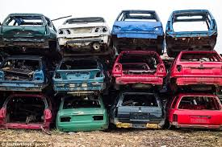
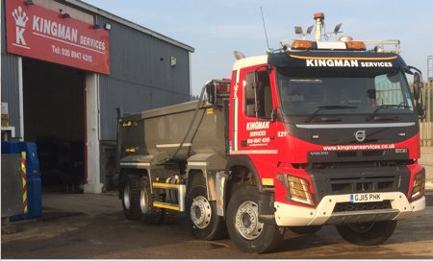

Covers under threat

Slide 28
How can brokers deal with the perfect storm
Educate clients about the affect of Solvency II and Ogden
Get clients to invest in risk management – if insurers are going to write high risk business they are going to be more far more ‘picky’ going forward. Give underwriters a reason to quote on your clients business.
Be aware of using offshore solutions – they never had ECR/ICA requirements so the gap they have to get to solvency II has been far greater than UK FCA/PRA regulated insurers and they are far more vulnerable to the perfect storm.
Look to proactively work with insurers who are in a great capital position – they are in a strong place and will get more and more of market share

Slide 29
Learning Objectives
Understand Insurers Solvency margins
Obtain an overview of Solvency II
Understand the current position of the Ogden table changes
Understand and be able to explain to your clients how Solvency II and Ogden is affecting the cover and premium being offered by the market.

