Slide 1
Alan Chandler, Chartered Insurer e mail alnchandler@uwclub.net website www.alanchandler.co.uk
Also on linked in Alan Chandler Ceo Alan ChandlerTraining
I have trained more than 2,000 individuals to become ACII qualified
I have trained over 50% of the individuals in the last 8 years that have gone onto achieve the highest ACII pass in the whole of the UK.
I train to a pass rate of more than 96% in all CII qualification levels. Certificate , Diploma and Advanced Diploma.
I deliver the Allianz and many other scholarship and academy programmes in both the UK and Ireland and I have been a Cii examiner.
I have trained students who have won national prizes in almost all ACII subjects including Insurance Law (MO5), Liability (M96), Commercial Property and BI (M93), Personal Lines Insurance (P86), Business and Finance (M92), Underwriting Practice (M80), Advanced Underwriting (960), Claims Practice (M85), Advanced Claims (820), Marketing (945), Advanced Broking (930) and Advanced Risk Management (992).

Slide 2
Employment trends the background
Lets start by looking at the recent trends of the economy
Lets think how employment practices have changed since the 1960’s

Slide 3
UK employment trends the background
There were 32.34 million people in work, 197,000 more than for October to December 2017 and 396,000 more than for a year earlier
The unemployment rate was 4.2%, down from 4.6% for a year earlier and the joint lowest since 1975
There were 1.42 million unemployed people (people not in work but seeking and available to work), 46,000 fewer than for October to December 2017 and 116,000 fewer than for a year earlier

Slide 4
Major Employment trend one – Many more small businesses starting up
Three main reasons
Some want to be their own boss
Some want the perceived tax advantages
The main driver is in fact ‘they have no choice’ – because to secure the work they want they are told to become ‘freelance’

Slide 5
Trend one
Many more small businesses starting up
There were a record 5.7 million private sector businesses at the start of 2017. Of these 1.8m are actively trading limited companies, 3.3m are sole traders and 0.6 m are partnerships.
This is an increase of 197,000 businesses since 2016, and 2.2 million more than in 2000.
The number of employing businesses increased by 41,000 (+3%) since 2016, and the number of non-employing businesses by 155,000 (+4%)

Slide 6
Trend one
Many more small businesses starting up
In 2017 there were 1.3 million employing businesses and 4.3 million non-employing businesses. Therefore, 76% of businesses did not employ anyone aside from the owner(s)
Of the 5.7 million businesses, 45% (2.6 million) were registered for VAT or PAYE (or both) – meaning 55% (3.1 million) were very small both earning less than £85,000 in most cases (some trades are Vat exempt) and employing no one other than the owner – are the insurance needs of these very small businesses being met?

Slide 7
Trend one
Many more small businesses starting up
SMEs account for at least 99.5% of the businesses in every main industry sector.
Nearly a fifth of all SMEs operate in Construction, compared with less than 1% in the Mining, Quarrying and Utilities sector

Slide 8
Trend one
Many more small businesses starting up
There are 1m businesses in London, and 900,000 in the South East – together accounting for 1/3 of all UK businesses.
London has seen a 41% increase in total business numbers since 2010, compared to a mere 16% rise in the West Midlands.

Slide 9
Employment trend one
Small businesses – insurance needs
Often work from home – is the insurance sector good enough here is there an opportunity
Do they need advice ?
The FCA have estimated that 40% of SME’s are under insured many Insurers surveys have put figures well above this 40%
What does a typical package offer
Can the package offering get better
Should a package include cyber and D&O as standard? – at the end of 2016 86.3% of SME’s did not have any cyber cover
Is the cover for personal effects good enough – think motor traders

Slide 10
Major employment trend two
Increasing service sector
We are increasingly becoming a service sector economy
80% of jobs are now in the service sector compared to around 50% in the 1960’s
This means in many cases advice giving which means increased demand for Pi (but remember service sector does include many non pi risks also)

Slide 11
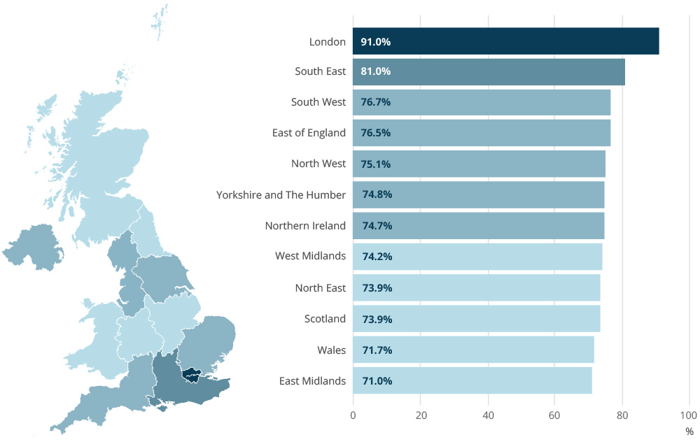
Geographical spread
Percentage of jobs in the service sector by region

Slide 12
Employment trend two
How good is the Pi market in catering for the needs of the new advice givers in the service sector
Do they need advice or should pi be purchased on line on a non advised basis making them the insurance experts!

Slide 13
Employment trend three – much more working for home
This is occurring in the self employed and employed sectors
IT is driving this trend which will increase considerably over the next few decades

Slide 14
Employment trend three – much more working for home
A recent Gallup study showing that employees who work from home three to four days a week are far more likely (41 percent versus 30 percent) to "feel engaged"
Data from the ONS shows that 4.2 million people regularly worked from home
The TUC found that the amount of people remote working has increased by nearly quarter of a million (241,000) over a decade

Slide 15
Advantages of remote working
Increased productivity – working remotely increases productivity by 16 per cent
Higher morale – a study showed that those who work from home love their job more than those who work in an office· Higher employee retention
Less stress – one in five employees say that juggling their work and personal lives is the main cause of stress
Reducing sick days and absenteeism (less people coming into work with contagious colds and flu and if you feel unwell you may still attempt some work)
Source smallbusiness.co.uk

Slide 16
Advantages of remote working
Get it right and there is major advantages for the employer who saves cost on office space and will get more hours from employees
Major advantages for employees are no commute so no wasted time, more flexibility to help with care responsibilities (or just enjoy life)
Better for the environment also

Slide 17
Disadvantages of remote working
Lack of control
Employers trust could be abused
Employees may start feeling isolated
Hot desking in the office (needed to cater for more homeworking) is seen as negative by employees who like their own personal area at work

Slide 18
How to make home working work
To make home work effectively, we encourage our staff to over-communicate on their home working days days – everyone talks electronically much more and many also fill out exactly what they’re doing on their Gmail calendars so that it’s completely clear as to what everyone is working on and how long it has taken them.’
Mathijs Eefting, CEO and co-founder of Moteefe (IT company who help create brands )

Slide 19
Employment trend three – much more working for home
Have wordings kept up with this ?
What is the position of losses at employees homes are these losses covered, how clear is the wording.
What about the self employed who work from home do current household policies cater properly for these individuals can they be improved?
Could an element of cyber be added to home workers policies?

Slide 20
Trend three continued
More people working from home
Should Insurers/brokers be making more use of this option from an employee perspective, will it help to retain the experienced staff by giving them the flexibility to work and balance their child care responsibilities
Remember child care is only one aspect – the ageing population means there will increasingly be many more elderly relatives to look after, so the challenge will be greater going forward.

Slide 21
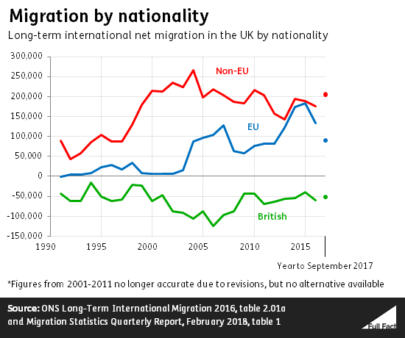
Employment trend four
Many people have come to the UK to work

Slide 22
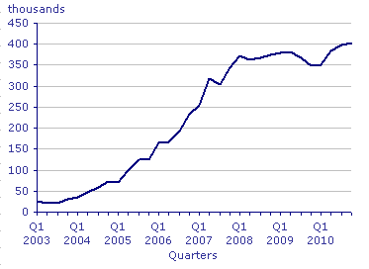
Example of the changing workforce – graph of Polish workers in the UK .
The number of Polish people in total is over 800,000 meaning Poland has overtaken India as the most common non-UK country of birth for people living in the UK, Office for National Statistics

Slide 23
Employment trend four
Many people have come to the UK to work
How well are the recently arrived immigrants insurance needs catered for
Could insurers/brokers do better on foreign language offerings
Could bespoke schemes be set up to attract the new workforce, example Polish food shop scheme
Should brokers/insurers employ more polish/Latvian/Spanish etc speakers so they can help target the insurance needs of these workers, taking this action could mean overcoming language and cultural barriers, and make their offering more meaningful as they would be dealing with someone from their background.

