Slide 1

VULNERABLE CUSTOMERS
WOMEN IN CILA
19 February 2019

Slide 2
“Someone who, due to their personal circumstances, is especially susceptible to detriment, particularly when a firm is not acting with appropriate levels of care.”
*FCA, Approach to Consumers 2018

Slide 3
INTRODUCTION
Who is vulnerable? Exploring the ‘hidden vulnerable’
Situations that can cause a Customer to become ‘vulnerable’
How to identify a vulnerable Customer and tailor your approach.

Slide 4
Think a little more before you tick the box!

Slide 5

FCA APPROACH TO CONSUMERS
STATISTICS

Slide 6
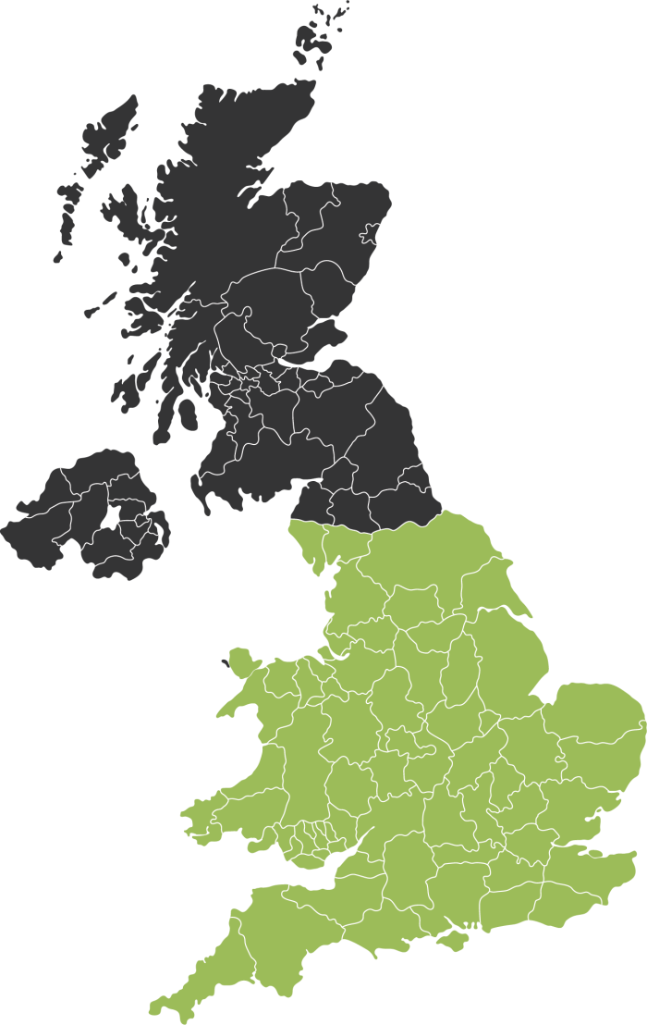
Cancer
By 2020 half of the UK population can be expected to be diagnosed with cancer as some point in their lives.
Source: FCA - Consumer Vulnerability

Slide 7
FCA APPROACH TO CONSUMERS
STATISTICS

Slide 8
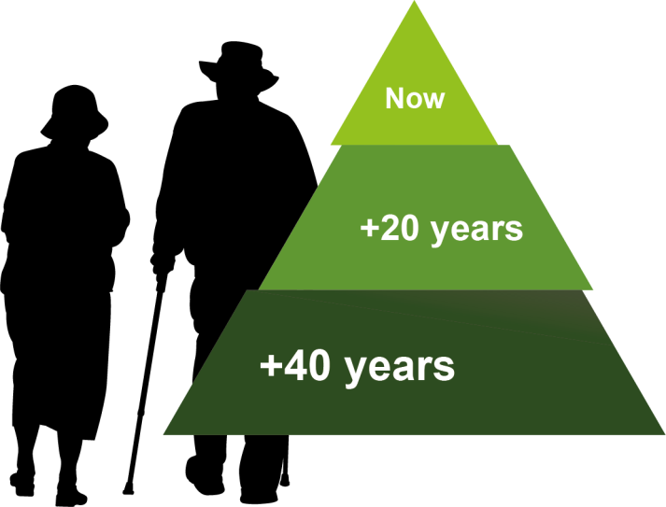
Old Age
Over 1.4m people in the UK are aged over 85. The number of people over 85 is predicted to double in the next 20 years, and nearly treble in the next 30 years.
Source: FCA - Consumer Vulnerability

Slide 9
FCA APPROACH TO CONSUMERS
STATISTICS

Slide 10

Mental Health
In any given year, one in four adults experiences at least
one mental disorder.
Source: FCA - Consumer Vulnerability

Slide 11
Who is a Vulnerable Customer ?
Exploring the ‘Hidden Vulnerable’

Slide 12


There are probably a few images of a ‘vulnerable Customer’ that instantly come to mind…
*FCA, Approach to Consumers 2018

Slide 13

Elderly Customer

Slide 14
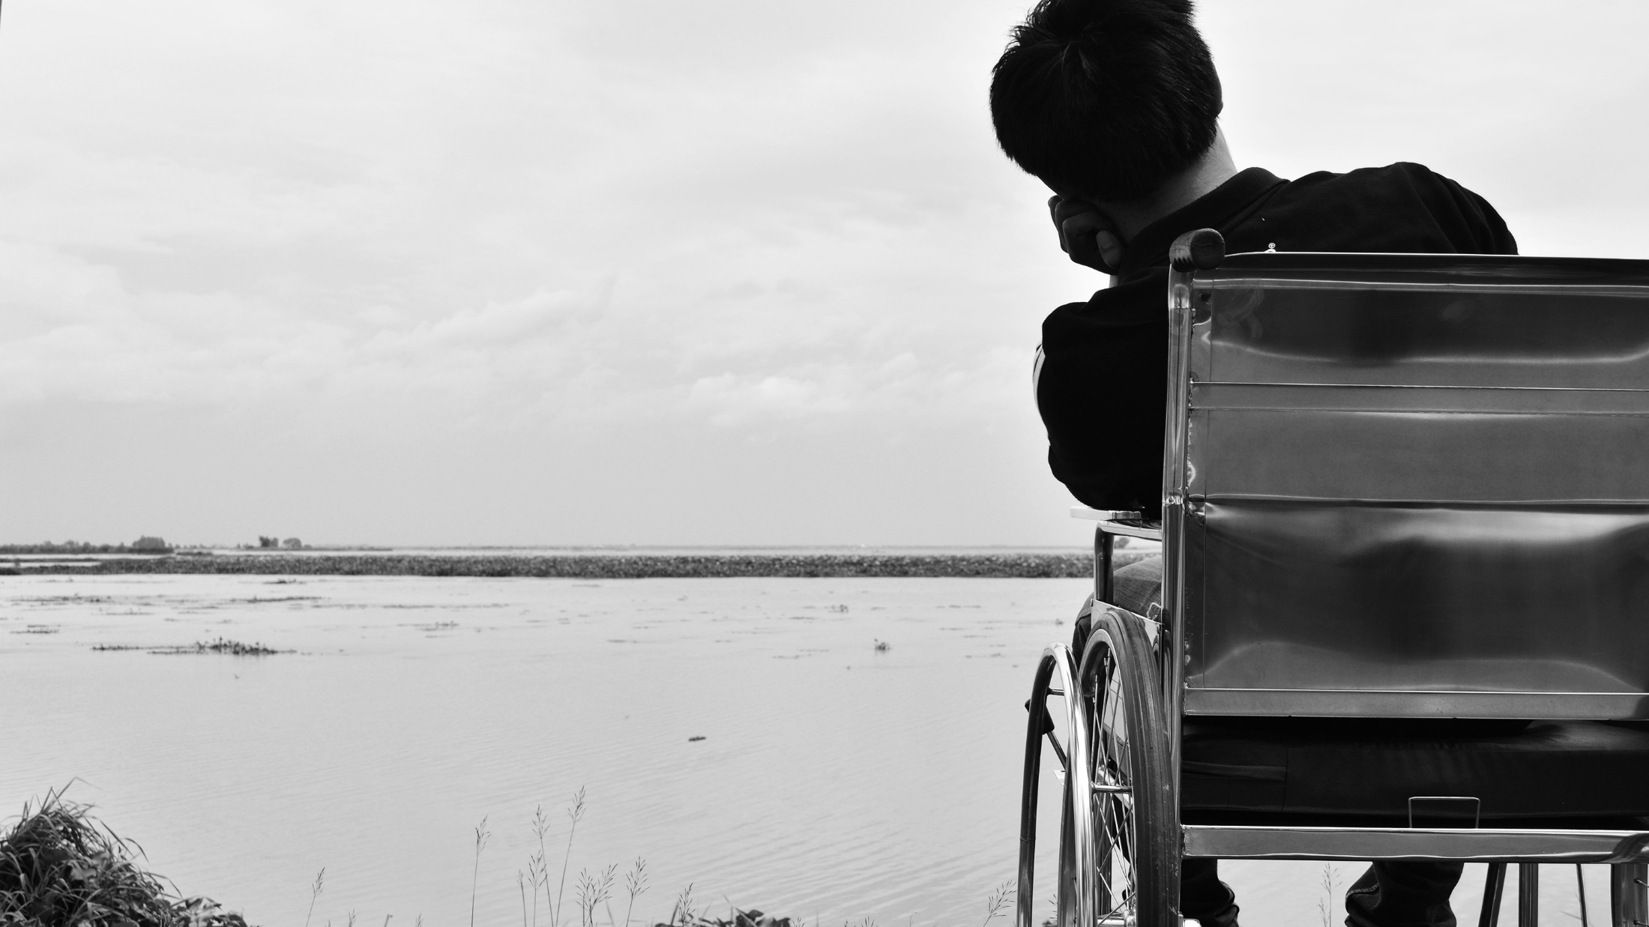
Physically Disabled
Customer

Slide 15
Who is a Vulnerable Customer?
‘Hidden’ Vulnerable Customers
We have described these as ‘hidden’ vulnerable as they are not necessarily going to immediately be identified as ‘vulnerable’ from an telephone call or meeting.
The customer may not be aware or have the capacity to be aware that they are ‘vulnerable’ to notify anyone in the claims process.
The customer may not feel comfortable identifying themselves as a vulnerable customer.

Slide 16

So who could be a ‘hidden’ Vulnerable Customer?

Slide 17
Who is a Vulnerable Customer?
Summary
This section has explored the ‘hidden’ vulnerable customers. The lists discussed are in no way exhaustive just the tip of the iceberg.
The FCA’s definition of who a vulnerable customer is, is far reaching and we must all extend our thoughts around who we consider to be a vulnerable customer.

Slide 18
SITUATIONS

Slide 19
Situation
(noun) A set of circumstances in which one finds oneself; a state of affairs.
Oxford English Dictionary

Slide 20
FIRE

Slide 21
FLOOD

Slide 22
ESCAPE OF WATER

Slide 23
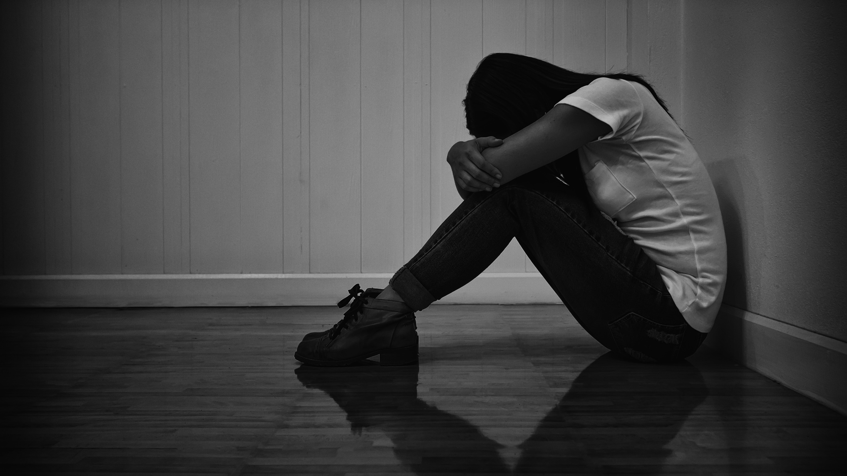
Bad News

Slide 24
HOW TO DEAL WITH VULNERABLE CUSTOMERS

Slide 25

How are you?

Slide 26
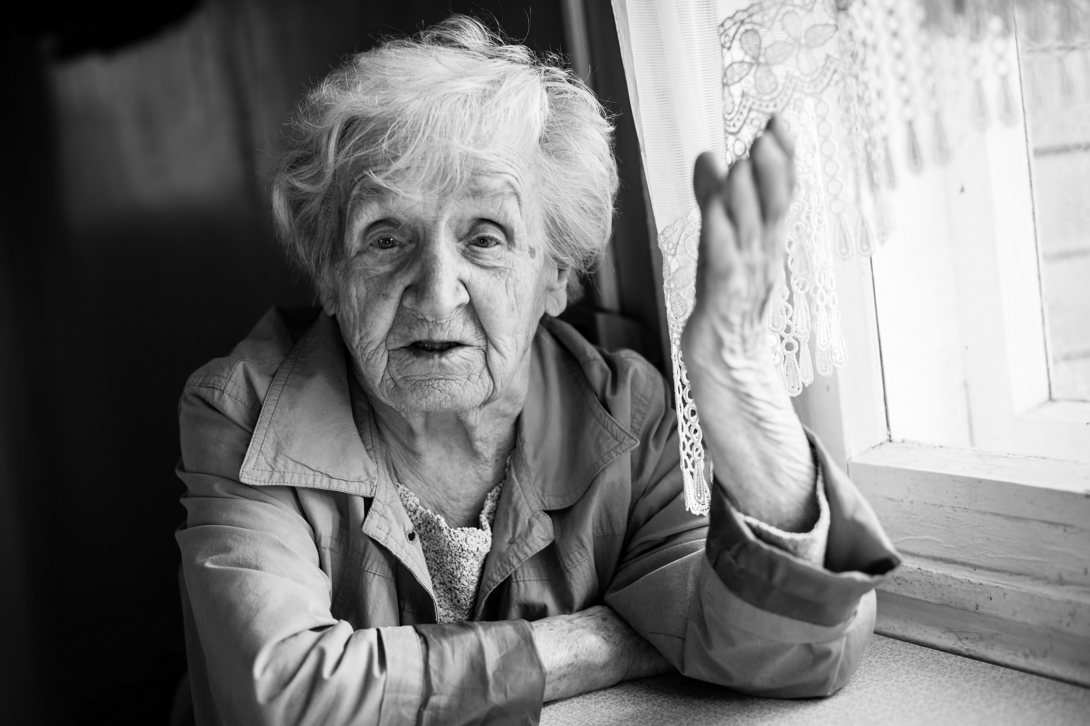
Listen
Let them talk and take the time to listen

Slide 27

What is important to them?

Slide 28

Establish the most important thing to them
What would be the best outcome from the customer’s perspective?
What is preventing this best outcome?
Can something be done to stop preventing this?

Slide 29

Control the number of parties involved

Slide 30

Establish best form of communication

Slide 31
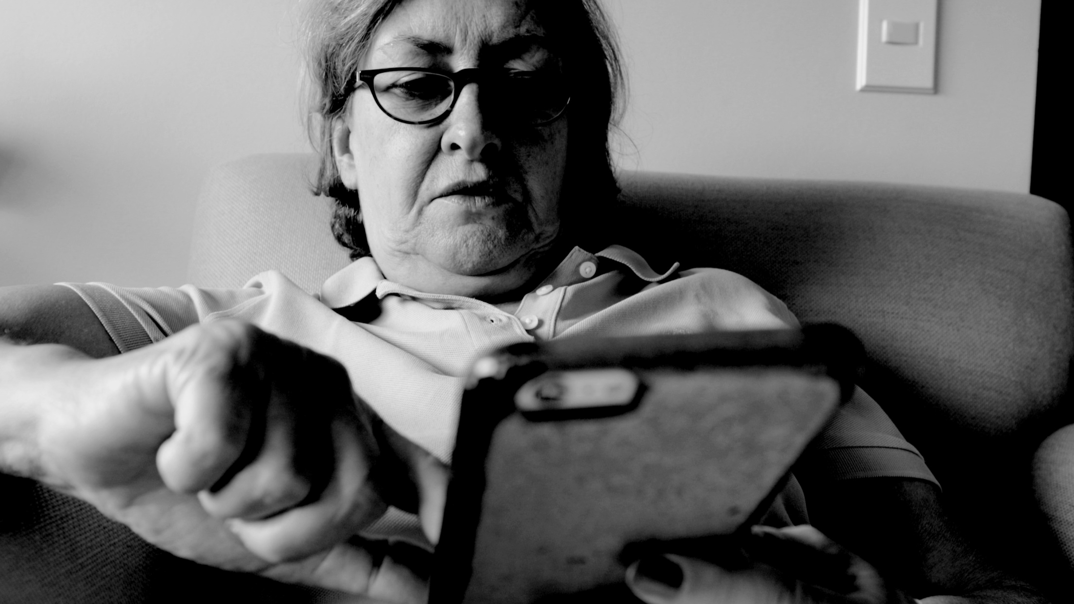
It is important to establish with the Insured how they wish to communicate with you, as not all methods of communication are suitable for everyone.

Slide 32


