Slide 1


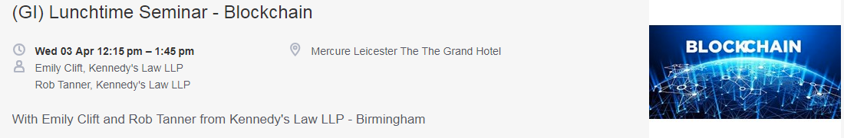

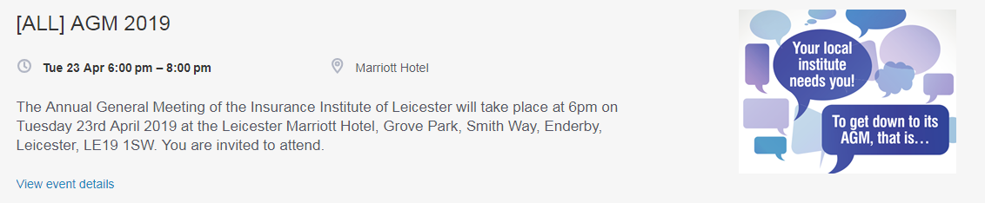

Lunchtime Seminar 06.03.2019
How to calculate BI from an account executive and claim perspective - a moderate level.
Angus Osborne-White
Major and Complex Loss | Global Technical Services
Crawfords
Special thanks to today’s sponsors:

Slide 2


Business Interruption
How to calculate BI from an account executive and claim perspective

Slide 3
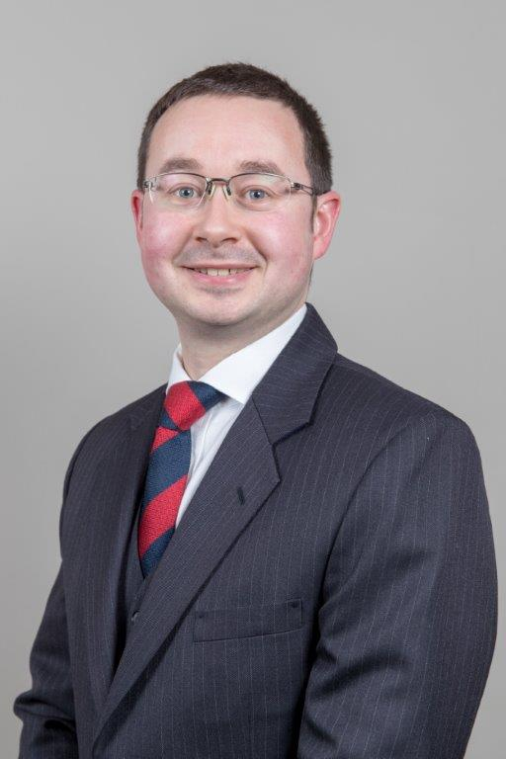
Angus Osborne-White
BEng (Hons) ACMA CGMA MIET MCMI Adv Dip CILA
Insurance and commercial risk management since 2004
Qualified Accountant and Loss Adjuster
Business Interruption specialist:
- Agriculture Engineering and renewables Large / Complex Cyber

Slide 4
Our Mission
Restoring and enhancing lives, businesses and communities.
Crawford & Company
Loss resolution for carriers, brokers and corporates
Our Vision
To be the leading provider and most trusted source for expert assistance, serving those who insure and self-insure the risks of businesses and communities anywhere in the world.

Slide 5

We bring together thoughtful experts from around the world to offer comprehensive, intelligent solutions to our customers.
Loss Adjusting | Third Party Administration | Managed Repair
Medical Management | On-Demand Services | Catastrophe Response

Slide 6




Crawford & Company
The world’s largest publicly listed independent provider of global claims
management solutions
Billion
$14
Organized across global service lines:
  P&C adjusting solutions (Crawford Claims Solutions)
  Large and complex claims (Global Technical Services)
  Global TPA solutions (Broadspire)
  Managed repair services (Contractor Connection)
Claims payments annually
Million
1.7
Claims handled worldwide
9,000
Total employees
CRD A&B
Low debt ratio / Traded on NYSE

Slide 7
Please….
….ask questions throughout
….turn off or put mobile phones on silent
….respect client confidentiality, don’t refer to specific claims
"there is no such thing as a stupid question, only stupid answers"
Colin Powell

Slide 8
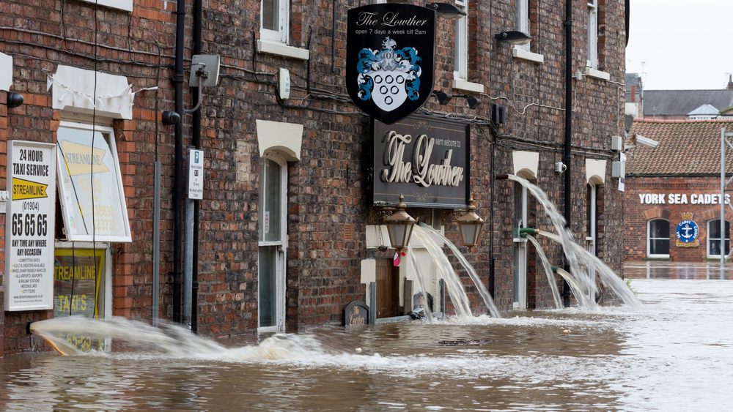
Table of Contents
01 | Attitudes to business interruption
02 | Establishing cover
03 | Maximum indemnity period
04 | Extensions
05 | Cyber
06 | Lessons learnt and case examples

Slide 9
What is Business Interruption?
Discussion…
Notes:
Establish if anyone in the room is entirely new to the profession and would benefit from a definition.

Slide 10
What is Business Interruption?
Provides protection for the consequential loss of revenue resulting from interruption to a business, caused by damage incurred by unforeseen events.
Provides for loss of gross profit (or revenue) and increased expenses during the effected period less any savings achieved as a result of the reduction in trade.
It does not provide cover (normally) for commercial fines and penalties, nor for regulatory fines and penalties (which are normally non-indemnifiable).
Notes:
Establish if anyone in the room is entirely new to the profession and would benefit from a definition.

Slide 11
The material damage proviso
The business interruption section is inextricably linked with the material damage section by virtue of the material damage proviso which requires that…
    “there shall be in force an insurance covering the interest of the Insured in the property at the premises against such loss and that the material damage insurers shall have agreed that there is liability under their policy.”
Regardless of deductible value
Notes:
Establish if anyone in the room is entirely new to the profession and would benefit from a definition.
Deductible value – particularly with regard to claims where Damage may be covered by warranty.

Slide 12
The common BI calculation
    Standard turnover (adjusted for trend et cetera) in the indemnity period
    less
    Actual turnover in the indemnity period
    gives
    Reduction in Turnover
    multiplied by
    Rate of Gross Profit
    gives
    Loss of Gross Profit
    plus
    Increased Costs of Working
    less
    Savings
    equals
    Loss before any adjustment for under-insurance

Slide 13
Policyholder attitudes to Business Interruption
Dark Art?
Inception
Renewal
Claim?
Discussion:
    How are policies discussed by account execs?
    How much consideration is given to the BI section at time of renewal?
    Declarations!
Notes:
Policyholders will generally only be thinking about their Business Interruption cover at inception, renewal, or any time that might prompt them for a review of their wider coverage.
Sometimes seen as a dark art – it contrasts heavily with property cover that can be (generally) more easily understood by way of producing invoices for costs incurred for remediation or replacement
Discussion for the room with regard to final three bullet points.
- How is information with regard to policy information obtained from policyholders? Push? Pull? Standardised forms/templates for brokerage?
- What is the review process with regard to the Business Interruption section – is the same information requested, or is the policyholder asked if anything has changed?
- At time of claim, we rarely find that a declaration has been made with respect to declaration linked policies – what is the broker view of this aspect?

Slide 14
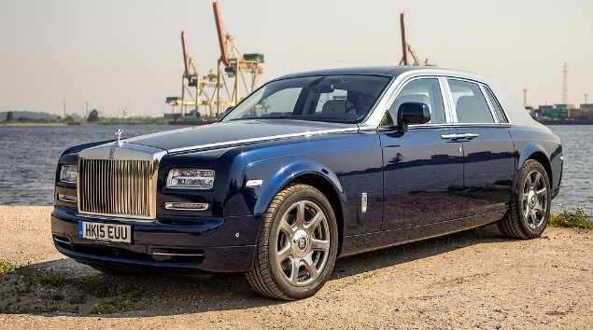

Expectations
What the broker wants to provide
What the policyholder wants to pay
originally posted to Flickr by Janitors at https://flickr.com/photos/65265630@N03/22719825307
By Nathan Wong - originally posted to Flickr as Mr Bean at Goodwood, CC BY 2.0, https://commons.wikimedia.org/w/index.php?curid=9681387

Slide 15
Establishing cover
What do we need?
How much does the business expect to make? (what could the business lose in terms of financial losses in the event of a business interruption?)
What’s the maximum period the Insured want to cover? (what’s the minimum period that it would take to restart the business from scratch?)
Notes:
This is the most basic information required.

Slide 16
Establishing cover
How much?
Always net of VAT (unless exempt)
Revenue – generally considers revenue lost, less any savings made
Gross Profit – generally considers revenue lost, less savings made but assumes that key uninsured working expenses will be saved
    Consider – material wastage in recommissioning, egg processing factory
Estimated Revenue/Gross Profit or declaration linked
Notes:
Revenue cover will generally be more comprehensive – I would assume that underwriters have an awareness of relevant business rates of Gross Profit for different industry sectors in order that their policies are competitive
Exempt businesses may include insurance businesses, landlords and small businesses and charities. Registration threshold is circa £85,000.
Gross Profit assumes that purchases (as a minimum) are uninsured, and therefore any additional expenditure or reduction in efficiency is not covered.
- consider example where a business has to make additional items in order to test recommissioning of machine – material used for the test items would not normally be covered under Gross Profit because this additional material would fall under the purchases category and therefore uninsured.
- consider a factory that processes eggs. Egg whites are made into meringues, egg yolks are packaged and sold to food processors. If the line making meringues is lost, then the business is obliged to continue to operate the egg yolk packaging line in order to mitigate losses, egg purchases are unlikely to reduce, despite the assumption in the Gross Profit calculation that they do.

Slide 17
Establishing cover
Gross Profit – typical wording
      The amount by which
      (i) the sum of the amount of the turnover and the amounts of the closing stock and work in progress shall exceed
      (ii) the sum of the amounts of the opening stock and work in progress and the amount of uninsured working expenses
Notes:
Turnover being the amount of money that the insured business receives as sales or funds for services provided
closing stock and opening stock take into consideration any movement in stock during the year in order that the rate of gross profit is not over or under represented due to excess of purchases (reducing RGP) or erosion of stock holdings (inflating RGP)
Uninsured working expenses - discussed next, but as a minimum, purchases/cost of goods sold

Slide 18
Establishing cover
Uninsured Working Expenses?
What costs might be directly proportional to sales revenue?
    Purchases
    Labour
    Energy
    Carriage/Freight
    Packaging
Care needs to be taken that costs are strictly proportional – be aware of unintended consequences
Notes:
Care needs to be taken that costs are strictly proportional. Consider energy, where there will almost certainly be a level of fixed costs in relation to heat and light for administrative areas of the business, as well as any variable element for production. Uninsuring energy could have significant drawbacks if for example additional energy was required to heat the offices as a result of a loss.

Slide 19
Establishing cover
Increased costs of working
Assists with Insured’s obligation to mitigate loss
Spent in the expectation that Insurer’s liability will be reduced
Need to consider residual values of ICW where temporary replacements are purchased
Requirement that ICW expenditure is “Economic”
Gross Profit cover – does not include increased costs in relation to purchases or other uninsured working expenses
Additional Increased Costs of Working
    “further additional expenditure…as the insured shall reasonably incur during the indemnity period in consequence of the damage for the purpose of avoiding or diminishing the reduction in turnover”
Notes:
Key element here is the requirement for ICW to be economic – spending a pound to save Insurers a pound
Usually included as standard
Additional Increased Cost of Working takes the economic requirement out of the picture. Must still be to prevent a reduction in turnover – goes beyond ICW cover

Slide 20
Establishing cover
Increased costs of working – in practice
Increased Costs of Working
    Temporary kitchens in the run up to Christmas are likely to save loss equal to or greater than their cost
Additional Increased Costs of Working
    For a loss in the first week of January, this might not be the case
    Consider scenario where purchases and wages are specified uninsured working expenses
In this scenario, ICW is “topped up” by the AICOW cover
Notes:
Key element here is the requirement for ICW to be economic – spending a pound to save Insurers a pound
Usually included as standard
Additional Increased Cost of Working takes the economic requirement out of the picture. Must still be to prevent a reduction in turnover – goes beyond ICW cover

Slide 21
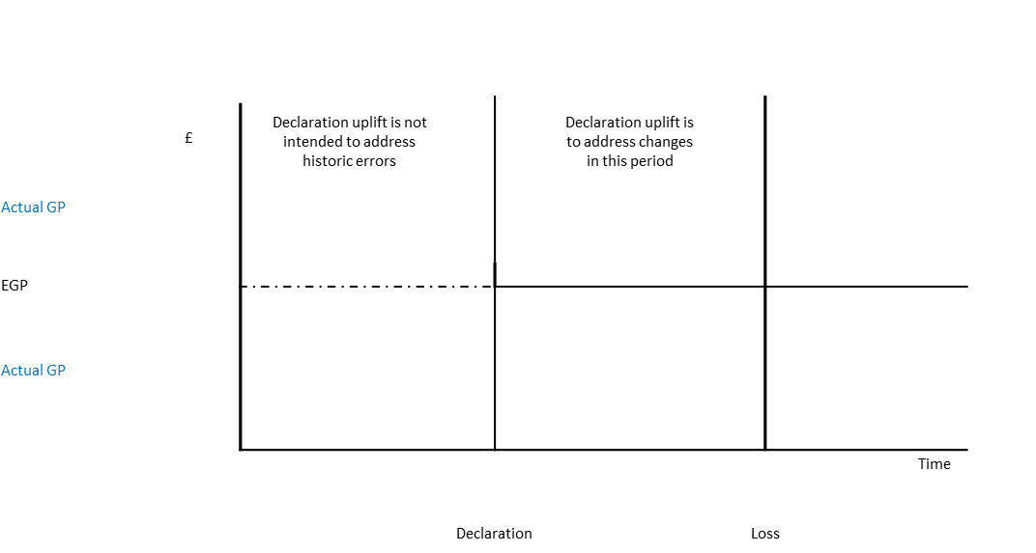



Establishing cover
Declaration Linked Coverage
Notes:
Declaration linked policies tend not to include proportionate reduction section. The 33% uplift (in some instances other percentages – have seen 25% or 50%) should not be set to cover expected value at risk – this increases risk and implications of under insurance in the event that the 133% is exceeded.
Declaration normally provides for the Insurer to receive additional funds if the original declaration was under, but also that a rebate is applied in the event that cover was too much – confusing as to why there is so seldom a declaration on file!

Slide 22
Establishing cover
The risk of trends

Slide 23
Trend – the Risk
Annual Turnover – “The turnover during the twelve months immediately before the date of the damage”
2016
2017
2018
2019
2020
Inception

Slide 24
Trend – the Risk
Annual Turnover – “The turnover during the twelve months immediately before the date of the damage”
2016
2017
2018
2019
2020
Inception
August 17
Accounts
30 Nov 16

Slide 25
Trend – the Risk
Annual Turnover – “The turnover during the twelve months immediately before the date of the damage”
2016
2017
2018
2019
2020
Inception
August 17
Accounts
30 Nov 16
Fire
July 18

Slide 26
Trend – the Risk
Annual Turnover – “The turnover during the twelve months immediately before the date of the damage”
2016
2017
2018
2019
2020
Inception
August 17
Accounts
30 Nov 16
Fire
July 18

Slide 27
Trend – the Risk
Annual Turnover – “The turnover during the twelve months immediately before the date of the damage”
Underinsured
2016
2017
2018
2019
2020
Inception
August 17
Accounts
30 Nov 16
Fire
July 18
July 19

Slide 28
Trend – the Risk
Annual Turnover – “The turnover during the twelve months immediately before the date of the damage”
?
2016
2017
2018
2019
2020
Inception
August 17
Accounts
30 Nov 16
Fire
July 18
July 19

Slide 29
Establishing cover
Upside Risk
If Insured benefits from positive risks materialising and financial performance exceeds expectations…
….make sure that they let their broker know!
Notes:
Policyholders will usually call their broker if a negative risk (a loss) occurs – should consider the event that any risk occurs that has a significant impact on the business whether up or down.
Consider – new businesses, acquisitions – anywhere where sudden growth might have been achieved.
Larger businesses – worth account execs being aware of news stories relating to their clients – consider Google News alerts for example

Slide 30
Maximum Indemnity Period
How long could the business be impacted for?
Risk planning scenarios – what would delay reinstatement?
    Could the business operate in alternative premises?
    What would be required?
    Could anything required be purchased today?
    If not, how long might it take?
    What redundancy is built into the Policyholder’s key processes?
    How easy is machinery to repair?
    If a repair is required, how long would it take, including commissioning and testing?
Notes:
Key industries that might suffer in respect of a loss of machinery include printers, specialist manufacturers with bespoke machinery with 6-12 mth lead times
Consider in event of loss – potential month of testing to ascertain whether written off, insurer’s acceptance of liability et cetera,
Then 6 month lead time to delivery
Then commissioning process of say a month
8 months until process up and running - How long will it take to recoup customer base?

Slide 31
Policy extensions
…optional extras?
Suppliers
Customers
Public Utilities
Denial of Access
Loss of Attraction
Transit
Wide Area Damage (Orient-Express Hotels v Generali)
Notes:
Suppliers – can be specified or otherwise – focus on businesses with small, potentially unique supplier base
Customers – as per suppliers – can be specified or otherwise (more typically specified), focus on businesses where limited number of large customers
Both require damage to have occurred at a customer’s premises and for loss of Revenue (or Gross Profit) to have arisen as a result of this damage
Public Utilities – two main “flavours” – terminal ends – much more comprehensive than supply undertaking which requires damage to have occurred to a substation or premises of the supplying utility.
Denial of Access – usual requirement is that it arises from damage from an insurable peril and that a competent authority issues the denial of access. Requirement is usually that damage occurs within the vicinity (or a specified range) and that access is prevented or hindered.
Loss of Attraction – if business is dependant upon a key store or place of interest (large department store, museum et cetera), then loss of attraction might provide cover where there is a reduction in footfall as a result of damage impacting that business
Transit – should be considered where businesses need to process high value work in progress at different locations or suppliers (consider Airbus example – wings made in Chester, flown to Toulouse to be assembled) what would be the implication if one of these wings was damaged in transit?
Standard BI wording looks at what the financial result would be if the premises weren’t damaged. In the case of wide area damage claims, even if the premises were not damaged, then there would be a reduction in turnover because (for example) less people were visiting the area as a result of the wider damage to the area. Wide area damage BI extensions would look to address this issue and provide cover for where a business might be impacted as a result of damage wider than its own premises and also wider than denial of access or loss of attraction.

Slide 32
Increased Cost of Working / Additional Increased Cost of Working only cover
“Throwing money at the problem”
Some businesses may look to have cover that enables them to buy their way out of loss:
    Subcontracting
    Alternative premises
    Expedited stock procurement
Typically businesses might be under contract to deliver a service that can easily be provided from elsewhere
Notes:
Businesses that this may work with include recycling or other services where there may be a strict contract to deliver and the service can be easily outsourced.
If there’s a long standing contract in place, then this reduces the risk of the customer going to the outsourced competitor, being able to outsource quickly reduces the risk of any contractual penalties
Risky, as if the Insured is unable to find anybody to undertake the work will result in loss of customers (and profit) and will suffer anyway.
Mark Harris providing webinar on recycling business interruption – registration via the CILA website – next Thursday (14 March)

Slide 33
Cyber
Changing the future of Business Interruption?
Material Damage Proviso
Business Interruption
    Shorter Maximum Indemnity Periods?
Reputational Damage
    Longer Maximum Indemnity Periods
    Initial waiting periods?
Notes:
Policies have to be constructed in such a way that the Material Damage proviso takes a different form to what we might expect under a traditional wording. “Damage” As a result of hacking or virus would not fit with traditional view of damage
Business Interruption policies are being linked to cyber cover for much shorter periods than we’ve discussed here – perhaps 3 months, partly, I would assume because of the impact that a cyber event can have across a geographically spread business where traditional damage might be constrained by physical location
Longer indemnity is being provided by reputational damage cover – as far as I can tell, measurement is in the same manner to BI, but a long time deductible to separate from the Business Interruption aspect of cover
Case examples – international consumer goods manufacturer involved in ransomware – loss of sales as a result of failure of logistical systems, bank – crypto jacking incident, national logistics organisation – ransomware took down database and warehousing systems – loss of stock control

Slide 34
Problems
What goes wrong at claim time?
Underinsurance
    Incorrect Gross Profit calculated – typically after deduction of labour
    No in year adjustment, despite significant growth
  Separation of revenue
  Maximum Indemnity Period – too short
  Equipment expectations vs reality
  Feedstock – cost or revenue?
  Terrorism claims
Notes:
Underinsurance is a common issue, can be prevented to some degree by use of declaration based policy wordings where policy is silent on proportionate reduction.
Insured might own separate businesses with cover separated but interdependence on revenue. Common example experiencing at the moment is where farmer has set up renewable scheme under separate Ltd company with own insurance, but in event of breakdown of the renewable system, increased costs are incurred by the farm – these aren’t normally covered by the engineering/BI policy applicable to the generation scheme
MIP being too short - effectively a form of underinsurance – need to make sure that both the reinstatement period and the recovery of the Insured’s customer base are considered
Equipment expectations – machinery might be “guaranteed” to do x, but falls short during normal use – Insured loss is based upon the performance prior to the loss, not what the manufacturer has said that it will do
Terrorism claims – isolated incidents but things to consider include the certification process reliant on pool:re and HM Treasury. Pool:re currently not interested in contingent losses and therefore unlikely to request certification – where does this put the Insured if there is a terrorist incident and no Damage was caused?

Slide 35
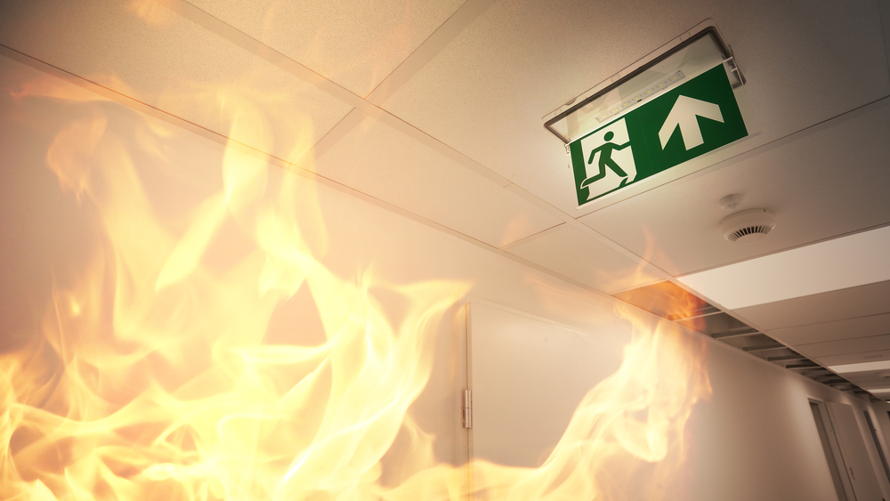
Questions?

Slide 36
Lunchtime Seminar 06.03.2019
How to calculate BI from an account executive and claim perspective - a moderate level.
Angus Osborne-White
Major and Complex Loss | Global Technical Services
Crawfords
Special thanks to today’s sponsors:

