Slide 1
The Future of Broking
John Warburton and Laura Smith

Slide 2
A BIT ABOUT ME … JOHN WARBURTON
1993
1999
2001
2004
2011
2015
Insurance guy
Consultant
Worked/ lived in several markets
... enough about digital/ startups to be dangerous

Slide 3
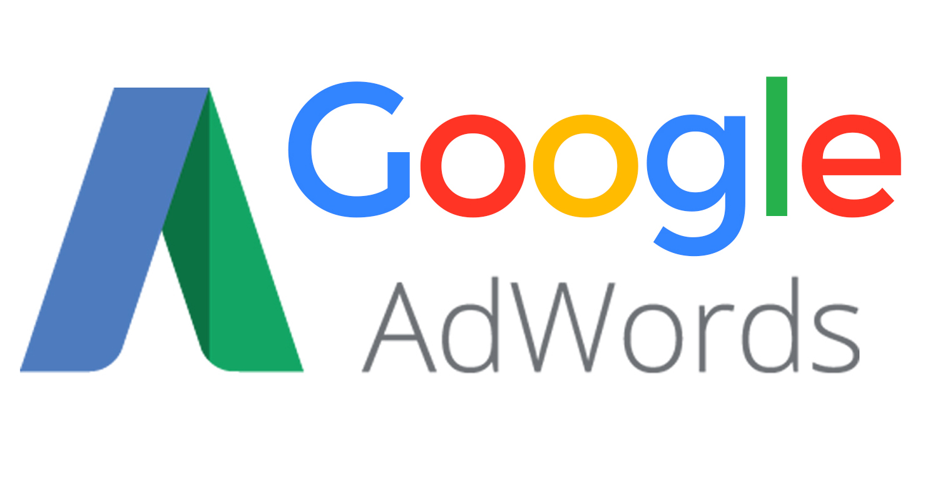
A BIT ABOUT ME … LAURA SMITH
2011
2012
2013
2014
2015
2016
2017
B2B Sales
B2B Marketing
Using variety of Social Media/ Digital Tools
... Now loving support sales & relationships in insurance broking

Slide 4
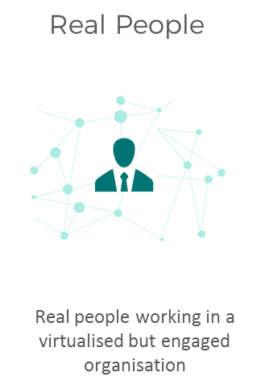
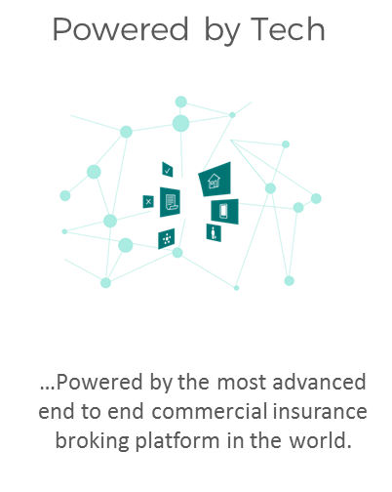
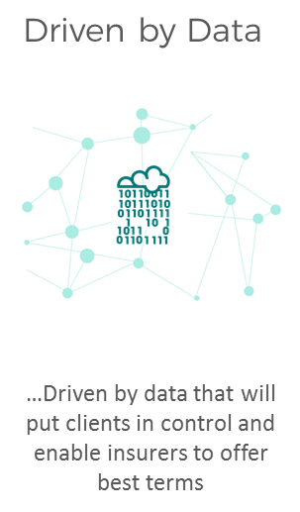
KONSILEO – A NEW BROKER MODEL

Slide 5
LEARNING OBJECTIVES FOR TODAY
What is the current state of play in the commercial broking market and what is driving change.
What clients want from technology and their broker contacts moving forwards. How current client service models work.
How will technology change things for brokers?
Lead Generation moving forwards.
The Internet of Things: What opportunities does this represent.
How will Insurance Career Development change in the future.

Slide 6
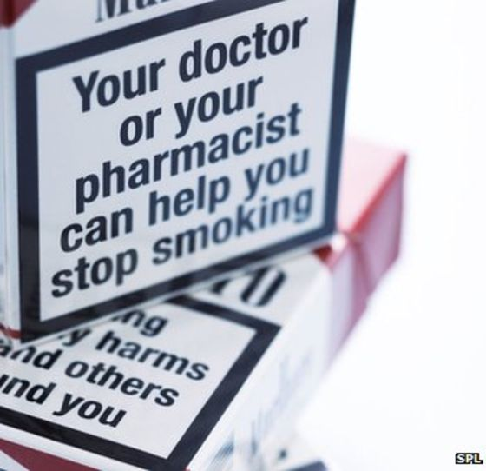
FUTURE OF BROKING - DISCUSSION
What will the 2028 client expect from insurance brokers?
What technology will brokers be using in 2028?
What will the 2028 profile of employees in broking be?
What do these developments mean for the 2028 insurance broking firm?

Slide 7
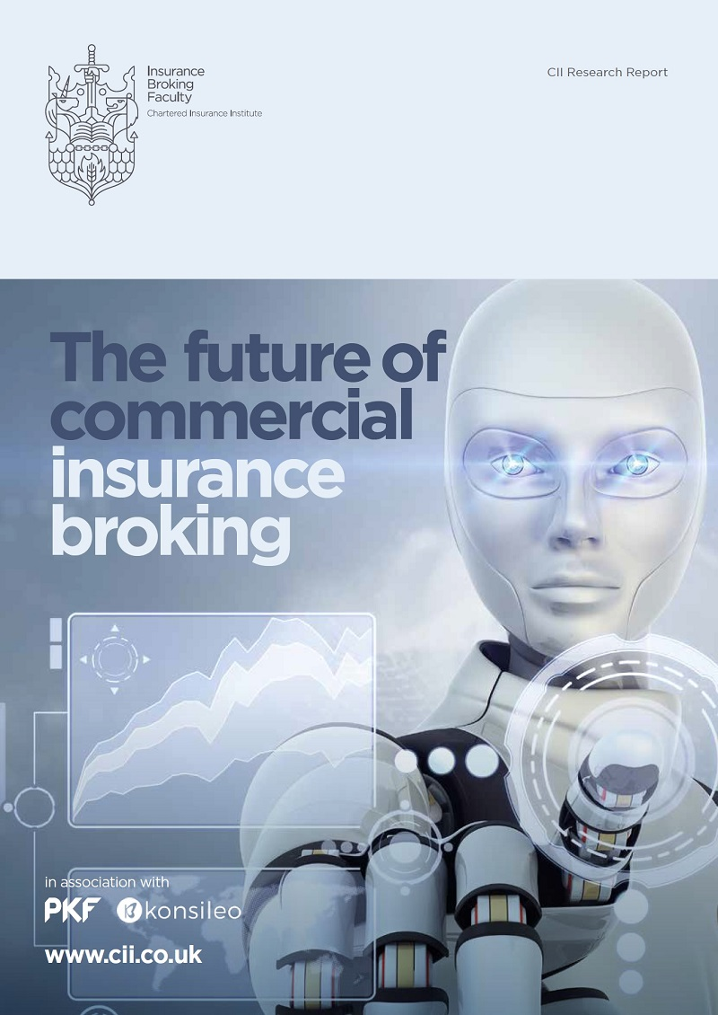
FUTURE OF COMMERCIAL INSURANCE BROKING IN A NUTSHELL
Broking market attractive but commoditisation at bottom end
Broking Firms: Choose business model
Broking People: Embrace learning
Insurers: Reward good practice and support brokers necessary change
Clients value advice & expertise
Technology not fully exploited
Broking as a career increasingly about becoming a professional risk advisor

Slide 8
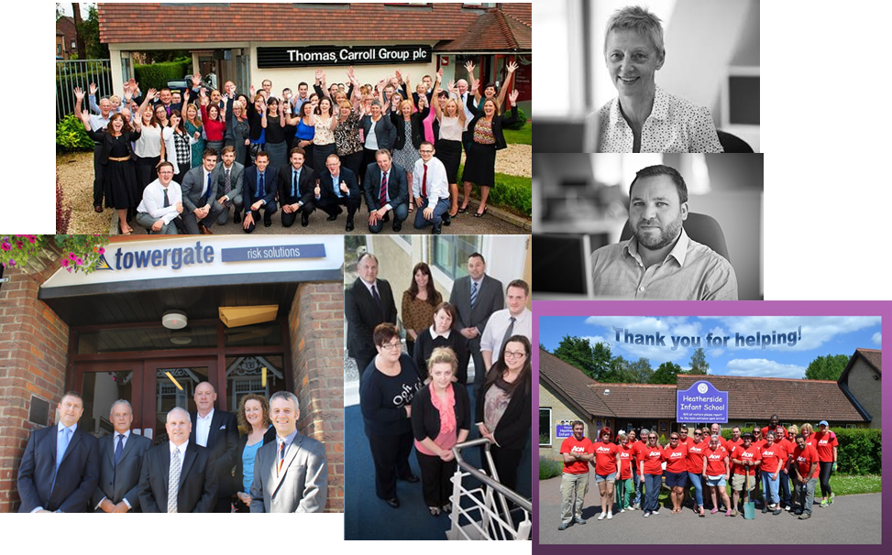
BROKERS & CLIENTS: BROKERS ARE AWESOME

Slide 9
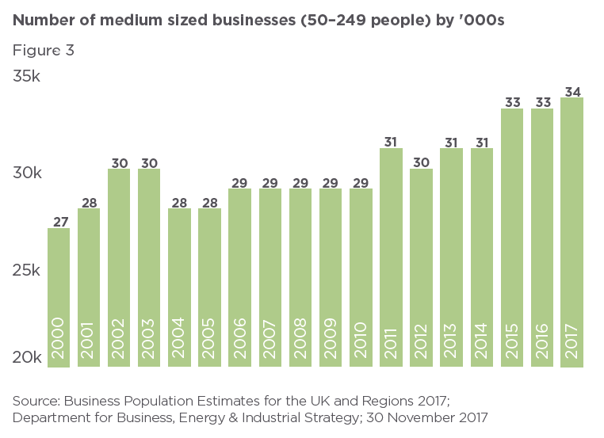
THE GLOBAL ECONOMY PRESENTS SME OPPORTUNITIES
Global economy changing with a move towards to local markets
Number of SMEs increasing
Global economy impacting on insurance market that is driving change in the shape of the market
Figure 2 – page 11

Slide 10
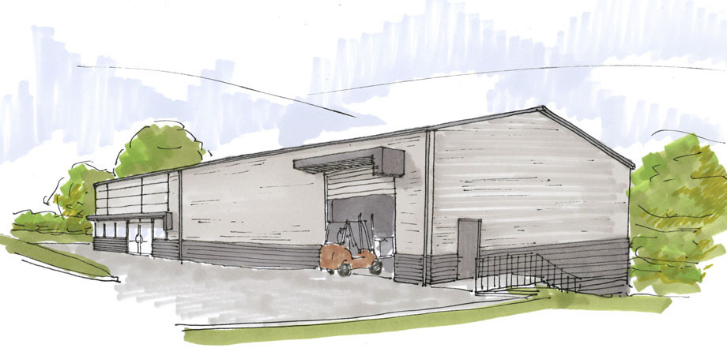
BROKERS & CLIENTS: CLIENTS’ NEEDS ARE COMPLEX & CHANGING
Interest rate risk
Regulation and government oversight
Information management
Speed of innovation
The variability of complexity
Supply chain risks
Raw material prices risk
Management and employees risk
E-business and technological risks
Growth risks
Source: Falkner & Hiebl
Source: KPMG

Slide 11
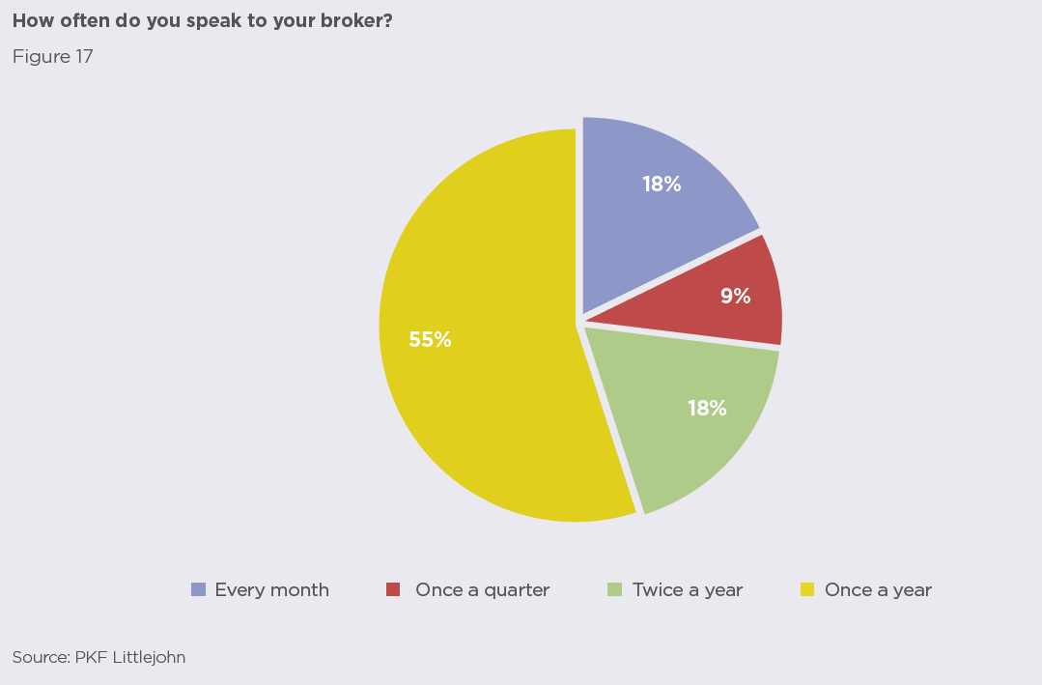
WHAT SME CLIENTS WANT
Less jargon
Less complexity & small print
Advisor who knows their business
Claims handling
Comfort around price
Risk management advice
Figure 17 – page 29

Slide 12
INCREASING GAP BETWEEN BROKER TOOLS & WHAT CLIENTS NEED
2008
“Broker helps me access the insurance market”
2018
“I’ll probably stay with my broker .. unless something better comes along ”
2028
“My broker’s advice is critical to my business”
OR
“Insurance? I’ll sort it out myself”
“However, many SMEs do not – or not adequately – apply risk management practices, …. cannot afford to rededicate resources” (Marcelino-Sádaba et al., 2014).
“SMEs focus on business strategies that have lower risks rather than on growth-oriented business strategies”(Gilmore et al 2004)
Ref: Page 31

Slide 13
SURVEY QUESTION 1: CLIENT NEEDS
“To what extent will (non-micro) SME clients in 2028 view brokers as valued advisors versus seek to do it themselves?” (1-10)
1 – Market will be entirely self-serve & commoditised, no market for advice – I’m getting a new job!
2 …
3 …
4 …
5 - About where it is today
6 …
7 …
8 …
9 …
10 – Brokers will find many ways to become more trusted advisors, more revenue in broking sector

Slide 14
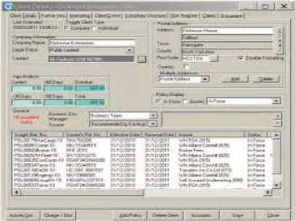
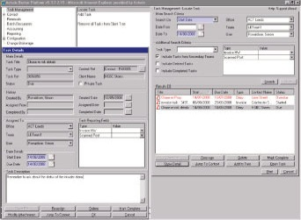
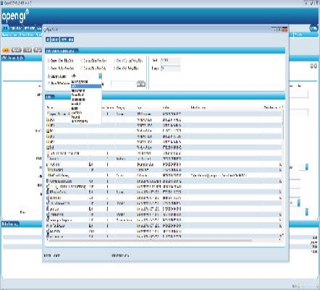
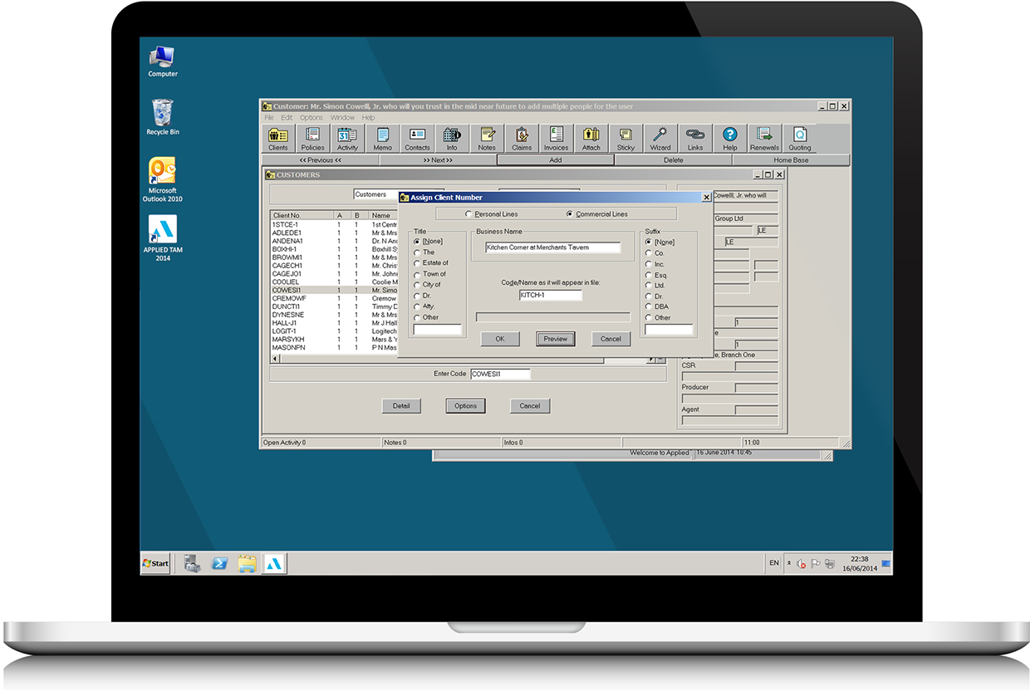
BROKING TECHNOLOGY NOT STATE OF THE ART

Slide 15
…. BUT NOT ONLY THE FAULT OF THE VENDORS
Small size of the market
Slow adoption of new features
Multiple customisations
Few project roles in Broking Firms
I-market not really delivered open architecture in market
Insurers’ focus on micro-SME etrade

Slide 16
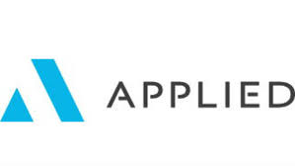
BROKER TECHNOLOGY EVOLUTION – LEGACY BUT OPPORTUNITY
Broker/insurer focus
High customisation
10+ years old
Broker innovation/experimentation
Client/broker interaction
+ In-house

Slide 17
AUTOMATED UNDERWRITING CAN ONLY GO SO FAR
Substantially commoditised
e.g. motor vehicle
Commodity potential
e.g. small PI
Unlikely to commoditise
e.g. complex commercial combined
Self-serve
Client risk
Heterogenous data
Accelerating factors
Retarding factors

Slide 18
TECH IN INSURANCE BROKING NEEDS A RE-THINK
Client
prospecting
Client
fact find
Mid-term
adjustments
Placing
Invoicing
Claims
Open API’s !!!
User journey design
Have [more & better] data

Slide 19
MODERN TECH NOT THAT HARD
Modern Methods
Emerging Technologies
Start with best process – “Use Cases”
Internet of Things
Open API’s
Machine Learning
+
Agile Development
Robotic Process Automation
Make use of pre-existing components/ applications
Big Data
Modern UX
Blockchain
Broking Technology: from TRANSACTION to the CLIENT and BROKER NEEDS

Slide 20
SURVEY QUESTION 2: BROKER TECHNOLOGY
“To what extent will technology for brokers and client risk management change for the better by 2028?” (1-10)
1 – In 2028 Technology for broking and client risk management will be relatively further behind other sectors than today
2 …
3 …
4 …
5 - About where it is today
6 …
7 …
8 …
9 …
10 – Technology for broking and client risk management will be state of the art by 2028

Slide 21
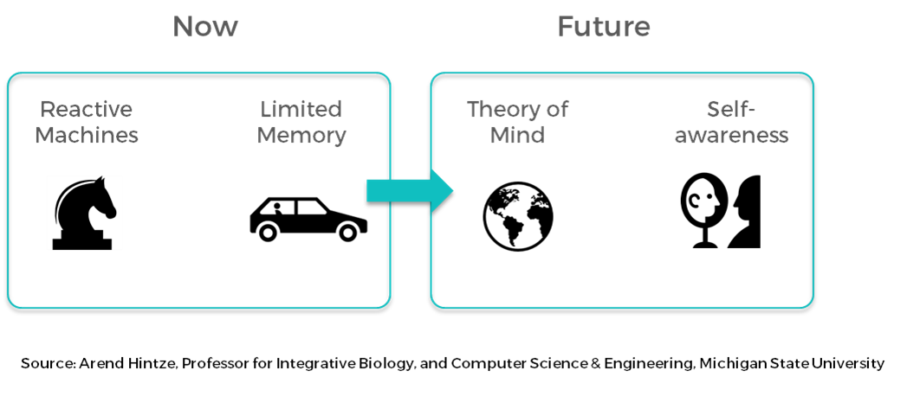
FUTURE OF EMPLOYMENT - THE ROBOTS ARE COMING
Repetitive, data manipulation tasks early
Empathetic tasks that rely on tacit knowledge
Tasks NOT roles will go
Expertise and Relationships will STILL be the key to great broking

Slide 22
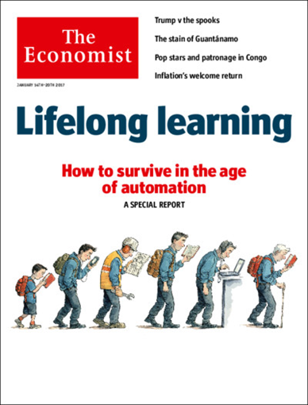
BROKERS WILL NEED TO INVEST IN SKILLS, MIX OF TECHNICAL AND SOFT
Broking is about - Clients, Clients, Clients

Slide 23
HOW TO FUTURE-PROOF YOUR INSURANCE BROKING CAREER
Develop Thought Leader Status
Client Industry Knowledge
+ Mentoring
Technical Insurance Knowledge

Slide 24
BROKING PEOPLE IN 2018: MORE TO DO ON PROFESSIONALISM
n=26,401
Source: CII, Konsileo & PKF Analysis

Slide 25
BROKERS CAN USE CLIENT INSIGHT TO BECOME AN INDUSTRY EXPERT
Interest rate risk
Supply chain risks
Raw material prices risk
Industry Knowledge – Sources
Clients themselves!
Trade publications/ sites
Industry events
Trade Associations
???
Management and employees risk
E-business and technological risks
Growth risks
What matters to the strategy of your clients’ business?
Source: Falkner & Hiebl

Slide 26
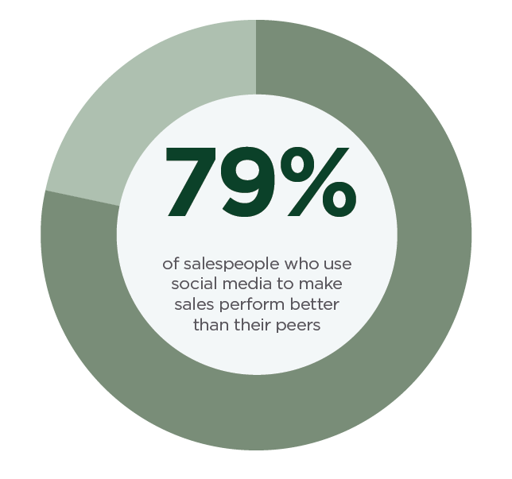
‘CONSUMER’ TECHNOLOGY CAN HELP BROKERS A LOT
Individuals can develop and grow relationships digitally…
EXPERTISE ADVISOR RELATIONSHIP
… and employers need to not get in their way
Professional
brand
Communicate
knowledge
Build
relationships
Share
knowledge
Understand
data

Slide 27
SOCIAL SELLING – A DIGITAL SALES OPPORTUNITY
Increased opportunity for touch points
Cyber attack in their industry, Insurance Press articles
Client liked content around new anti-theft system
Remind client of value-adding services or expertise
Beginning of the year
Renewal
New client premises opening - notification on LinkedIn
Job change within senior management team of client
Client connects to a new broker
Figure 22 – page 44

Slide 28
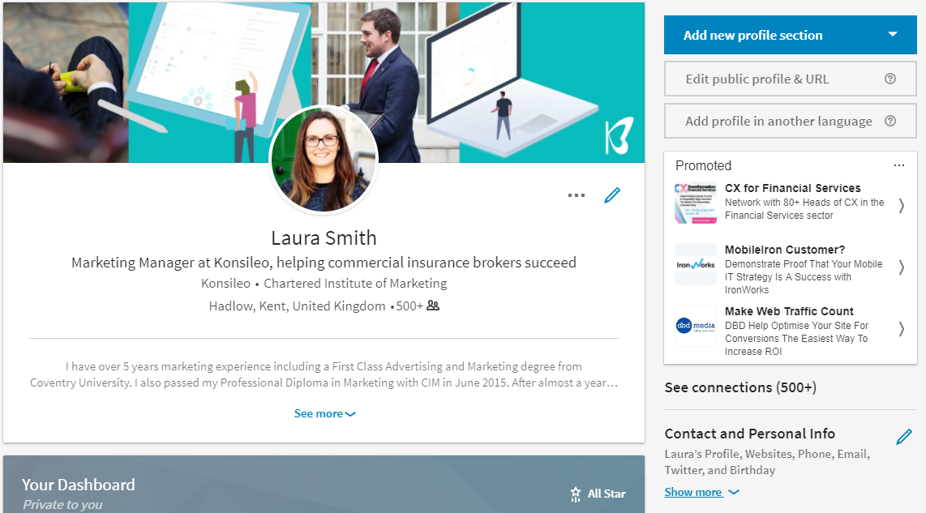
PROFESSIONAL BRAND – LINKEDIN PROFILE
Professional photo & header image
Personalised URL
Compelling headline
Up-to-date contact info
Up-to-date work information

Slide 29
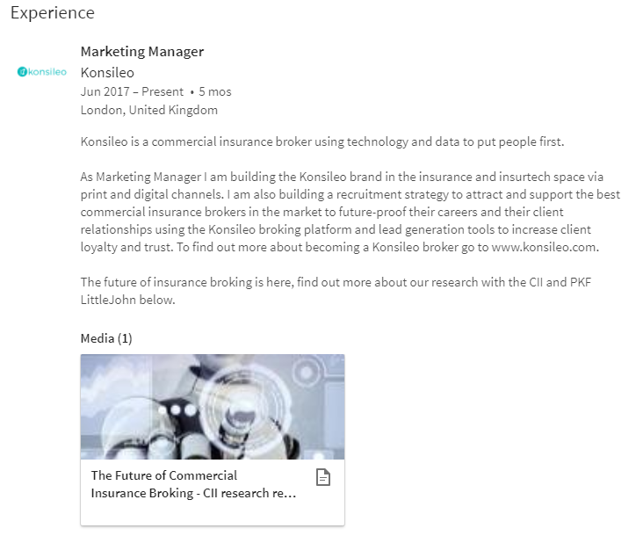
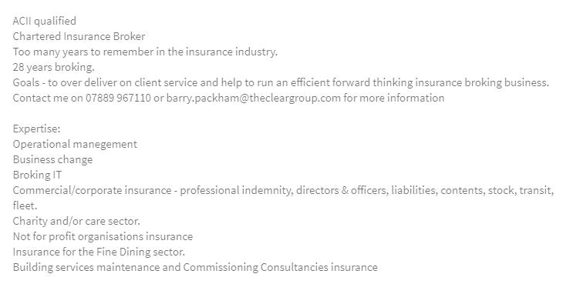
PROFESSIONAL BRAND – LINKEDIN PROFILE CONT…
Qualification status
Years of experience
Personal goals
Contact Information
Expertise
Tell your story
Show your development
Talk about what you gained from each role
Highlight your achievements
You can also include company information and links

Slide 30
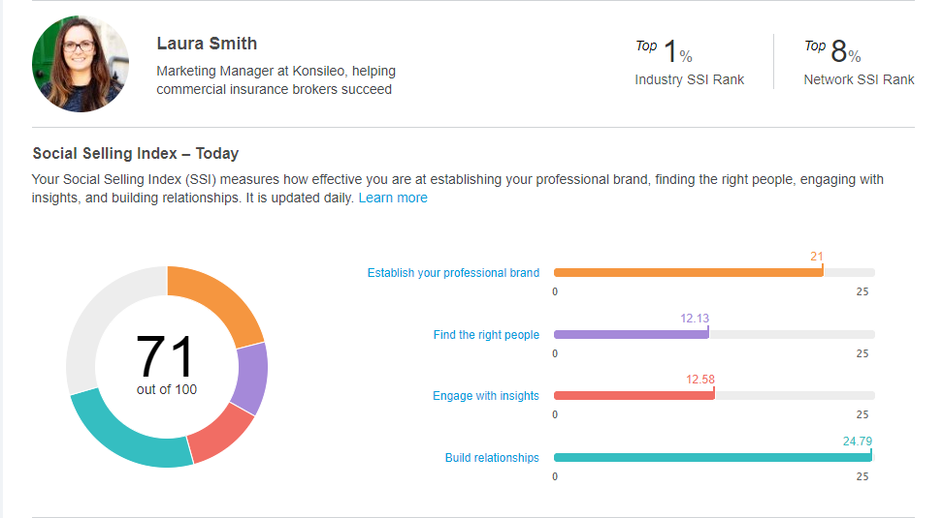
SOCIAL SELLING INDEX
A means of identifying how successful your social selling techniques are on LinkedIn
Social selling leaders have 45% more sales opportunities

Slide 31
WHAT MAKES A THOUGHT LEADER?
Engage in industry news and trends
Share high quality content
Provide insight
Have a POV
Connected to industry leaders
Active on social media
Has a large network
Creates content

Slide 32
TYPES OF CONTENT FOR THOUGHT LEADERSHIP
Original:
Article or blog you have written yourself
Curation:
Information you have brought together
Sharing:
Another person’s post or an external article
Commenting:
Adding a comment to someone else’s post
Discussion:
Starting a discussion in a LinkedIn Group

Slide 33
SURVEY QUESTION 3: BROKING EMPLOYMENT AND SKILLS
“To what extent will employment in insurance broking change by 2028?” (1-10)
1 – A great deal, more than 80% of current roles will go
2 …
3 …
4 …
5 - About where it is today
6 …
7 …
8 …
9 …
10 – Employment will increase a great deal 2028

Slide 34
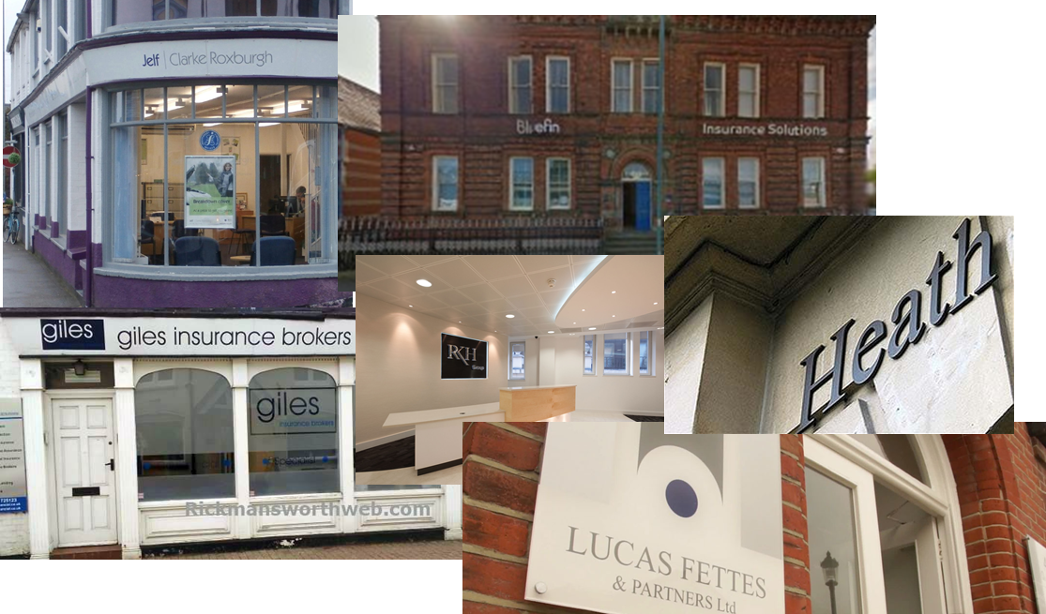
BROKING ORGANISATIONS A LOT OF CHANGE

Slide 35
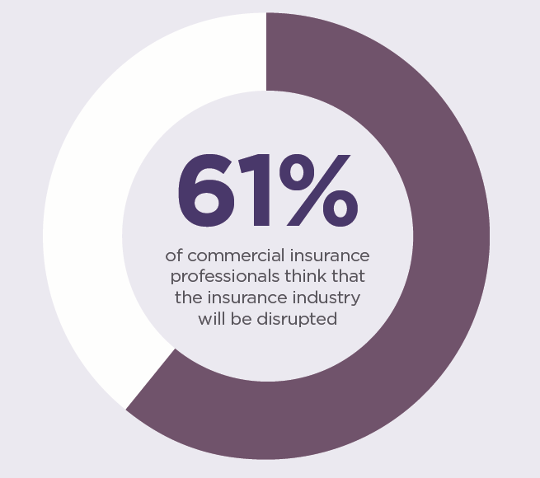
TECHNOLOGY DRIVING CHANGE FOR COMMERCIAL BROKERS
Insurance market seen as ripe for disruption
Technology driven change largely confined to SME business
Significant investment into commercial insurance market disruptors
Ref: page 20

Slide 36
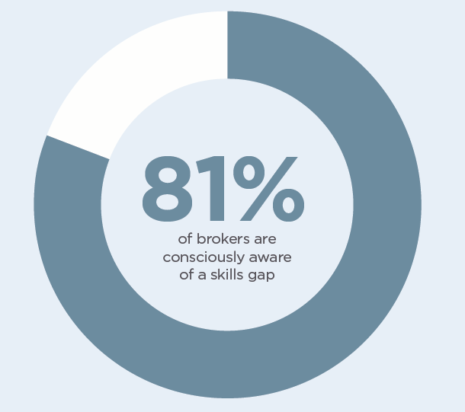
BROKING IS BECOMING A PROFESSION
Insurer training is reducing
Risk advice becoming more complex
Demographic bulge
Attract talent and then…
Formal training + mentoring + client contact
Ref: page 58

Slide 37
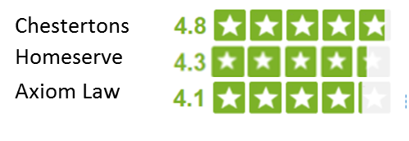
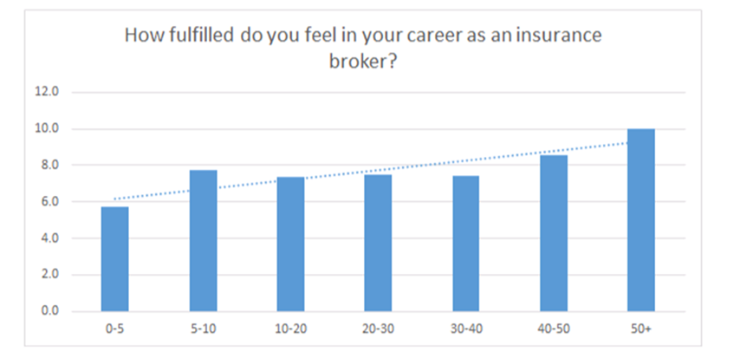
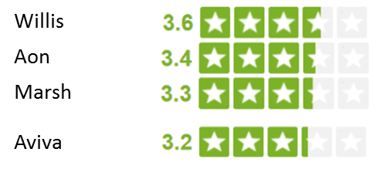
STAFF SATISFACTION BEHIND OTHER EXPERT SECTORS
Source: Glassdoor.co.uk 18/2/17
Source: CII, PKF & Konsileo Broker Survey 11/16
Ref: page 61

Slide 38
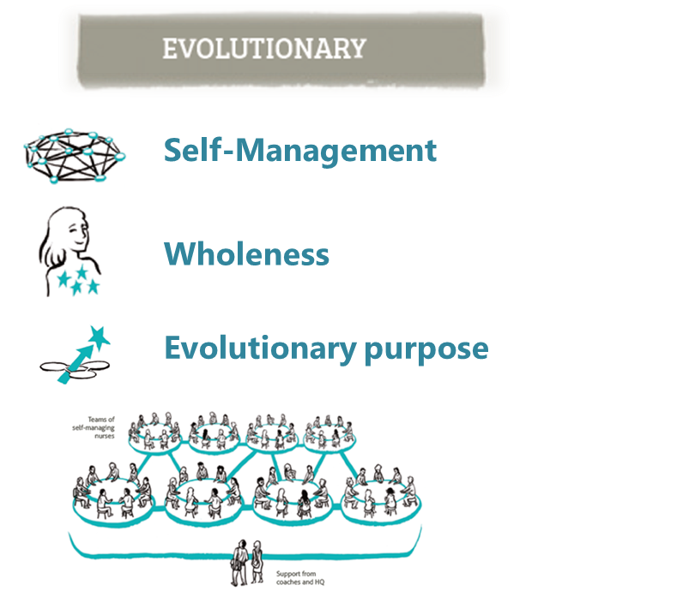
EMERGING ORGANISATIONAL THEORY INTERESTING FOR BROKING
©Frederic Laloux, Reinventing Organizations
Figure 33: page 68

Slide 39
‘BROKING WITH SOUL’ IS POSSIBLE
Example pitch from CEO of a firm that attracts top talent
Understanding the ‘why’
“We want to be the most technically expert broker in the UK”
Team input
“Our firm allows brokers to do the broking job they love and to earn better because of it.”
Social purpose
“We bring insurance products to vulnerable and less financially capable customers.”
Source: Frederic Laloux, Reinventing Organizations
Figure 33: page 68

Slide 40
SURVEY QUESTION 4: BROKING ORGANISATIONS AND LEADERSHIP
“In which direction will insurance broking organisations change by 2028?” (1-10)
1 – They will be small in number and very efficient, managing resources more tightly
2 …
3 …
4 …
5 - About where they are today
6 …
7 …
8 …
9 …
10 – Broking people will work somewhat independently and in self-organising teams

Slide 41
BROKING IN 2028: KEY QUESTIONS
1. Client/ Broker Relationship - Self-Serve or Advice Led?
2. Broker Technology - Lagging or Leading Other Sectors?
3. Broking People - Skilled Expert Advisors or Robot Maintenance?
4. Broking Organisations - Squeezing the Pips or Constantly Evolving?

Slide 42
