Slide 1
INSURANCE FRAUD Task Force – progress and developments
Croydon 2019

Slide 2
Insurance Fraud in UK
Insurance fraud as old as insurance.
Mutualisation acted as a check.
Disaggregation, complexity and IT facilitate.
Legal response varies:-
First Party – breach of contract and good faith.
Third Party – no contract or good faith. General law applies.
Often compulsory insurance (RTA/EL).
Debate around fraud becomes entwined with social policy (“compensation culture”/”access to justice” etc.) and question of who pays and appropriate amounts.

Slide 3
Why worry?
ABI estimate over £3.4bn per annum.
Educated guess – nobody knows.
Over £200m spent on prevention (and rising).
Fraud covers all classes but recent emphasis on personal injury in UK.
Other business costs – e.g. retailers/utilities also affected.
National cost – benefits, health service, emergency services, courts.
Ultimately all paid for by honest policyholders and taxpayers – not by insurers!

Slide 4
Prior Government and Industry response
Focus on third party fraud.
LASPO 2012 – if claim “fundamentally dishonest” claimant loses cost protection and must pay defendants costs.
CJCA 2015 s 57 – (personal injury only) if claimant is entitled to some compensation – typically exaggerates genuine claim – but has been “fundamentally dishonest” court must dismiss whole claim unless claimant suffers “substantial injustice”.
Dishonesty is “fundamental” if goes to whole or substantial part of claim.
Industry - IFB and IFED – initial focus on motor fraud.
Insurance Fraud Taskforce – general fraud focus.

Slide 5
IFT - Sponsorship
Government (Treasury and Ministry of Justice) had three key concerns:-
Cost. Fraud adds to costs of all policyholders. Premiums increased to pay for claims and fraud prevention. N.B. – not a direct correlation.
Fraud is socially corrosive. Undermines social cohesion. If society moves from “trust” to “verify” all lose.
Insurance fraud funds other crime.

Slide 6
Membership and programme
Core members were:- ABI, IFB, BIBA, FOS, CAB, FSCP + independent chair.
Taskforce was assisted by a wide advisory group. Flexible membership from law, academia, insurance industry, regulators, police, loss adjusters and others.
Taskforce established personal injury working group. Members were:- MASS, NAHL, APIL, Covea, Aviva, BLM law.
Taskforce worked during 2015. Interim report March 2015, Final Report January 2016, recommendations accepted May 2016.

Slide 7
Initial Findings
No simple profile of fraudster but broadly opportunistic vs organised. Different deterrents apply.
Culture of mistrust - business generally.
Specific concerns about insurance and financial services “small print”.
Widespread failure to understand insurance or policy – victim culture. Covea research. FOS confirm.
IT and lack of human contact – “victimless crime”.
Exaggeration is acceptable – fine line negotiation/dishonesty. Applies both ways.
Easy money and unlikely to be caught.
No or low penalty.
Encouragement of fraud by nuisance calls and “professional enablers”.

Slide 8
Initial Findings
Several available data bases. Generally data good, take up by insurers and others sub optimal.
Ignorance about and fear of data sharing.
Regulatory involvement variable – performance likewise.
Insurer management priority confusion. However clear link senior management involvement and fraud performance.
Fraud link with late claims.
Use of pre-med offers.
KYC checks for injury claimants and representation – is client genuine + is law firm instructed?

Slide 9
Personal Injury and fraud
UK personal injury market is inconsistent with comparable jurisdictions for low value/higher frequency claims.
NB – different UK claims experience is not fraud per se but system may provide environment where fraud occurs.
Accident from “misfortune to business opportunity” (IFT quote) – but importance of access to justice for honest policyholders.
Privatised system.
Supplier market evolved – CMC’s and “nuisance call” providers.
Challenges over regulation of lawyers and CMC’s.

Slide 10
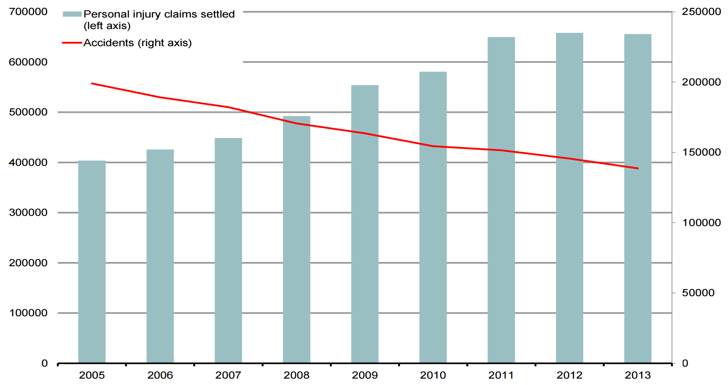
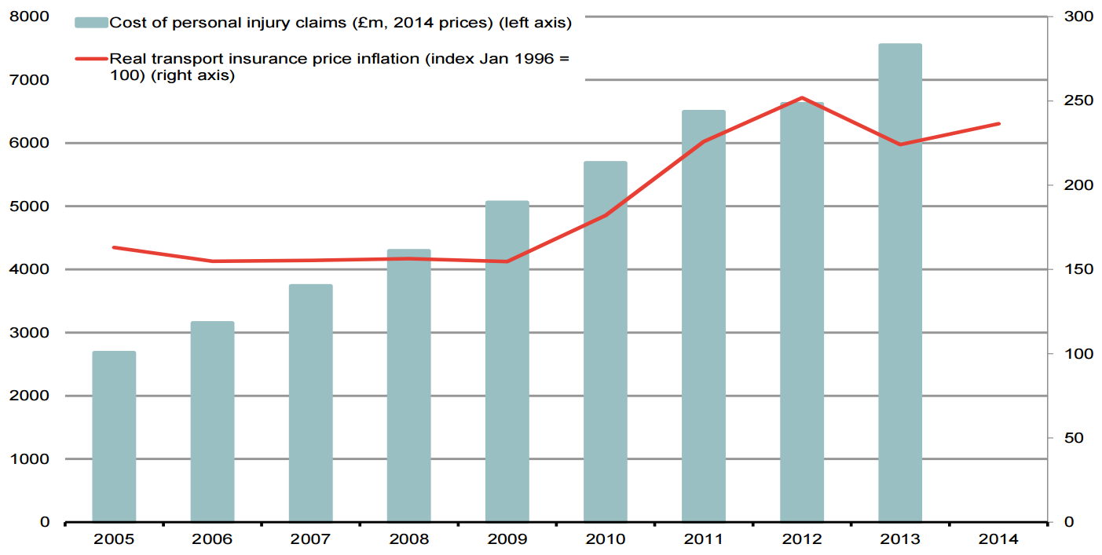
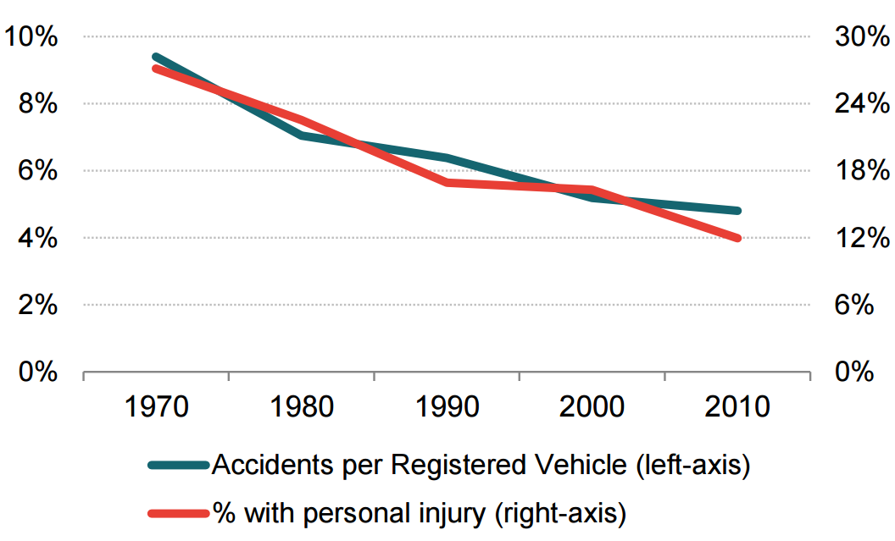
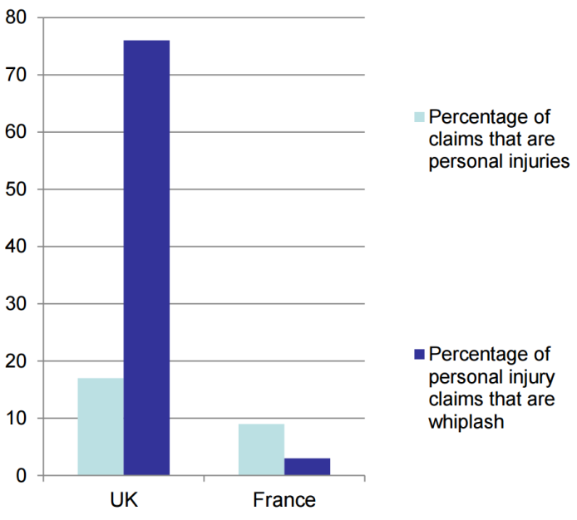
Comparisons
Source: Accident data from Transport Statistics Great Britain 2014, table TSGB 0801: https://www.gov.uk/government/statistics/transport-statistics-great-britain-2014); Claims data from Datamonitor Source: German Insurance Association (GDV), Statistical Yearbook of 2014 Percentage of all claims that are personal injury and of those, the percentage that are whiplash (2004) Source: Frontier analysis of Datamonitor data for the claims (deflated to 2014 prices) and Eurostat for transport insurance price inflation data

Slide 11
Recommendations and progress
Group 1. Series of recommendations to improve consumer understanding of insurance. Include better promotion of good practice by ABI.
ABI liaising with FCA on “smarter communications”.
ABI and BIBA Code of good practice for vulnerable consumers.
ABI, IFB and CII developing social media tools.
IFB licensing wider use Cheatline.
ABI agreed ToR’s and initial funding on long term communications strategy to include research on behavioural economics.
ABI produced Checklist on Effective Counter Fraud Practices.
N.B. individual companies have role on consumer education.
Improving trust and confidence is very long term project!

Slide 12
Recommendations and progress
Group 2 Data issues.
Positive developments re funding and access for IFR, CIFAS, CFDA. (insurance, credit, public sector).
ABI improved fraud statistics template.
ABI is commissioning research into application fraud.
MIB improving CUE data and availability at quote point.
CUE Travel – 2017 followed by Pets/Mobiles.
MIB investigating public access to CUE.
ICO published Starter Guide on data sharing. No sector guidance.
Claims Portal and IFB concluding study on data sharing.
IFB funding approved, new supervisory arrangements, affiliate scheme and role extending beyond RTA.
However…..
Take up? MyLicence 2017 only 55% use. Better but still some way to go.
GDPR – consequences?

Slide 13
Recommendations and progress
Group 3 Regulators.
HMG will review SRA powers – no timetable - Brexit.
SRA more active. Personal Injury thematic review. Warning notices re validity of client instructions and travel claims. Interventions. Liaison with IFB continues.
ICO leading Operation Linden to counter nuisance calls. Multi-agency group + international.
ICO Direct Marketing Guidance will be statutory code.
Regulation of CMC’s will be transferred to FCA. New regulatory regime devised. Enabling legislation through Financial Guidance and Claims Act 2018 - April 2019 implementation.

Slide 14
Recommendations and progress
Group 4. Personal Injury
Pre-med offers and tariff damages - Civil Liability Act 2018.
Claims Portal Board to note referral source on CNF and agree data sharing arrangement with IFB.
Claims Portal, ABI and IFB prepared text of letter to represented claimants confirming instructions.
N.B. IFT considered deterring fraudulent claims within existing system. Did not recommend changes to system itself.

Slide 15
Civil Liability Act 2018
Applies to injury to upper neck and torso with duration < 2yrs.
Enables damages tariff – figures to be decided.
Amounts likely to be considerably lower than current awards or Judicial College Guidelines (especially at lower end).
Courts have discretion to increase “in exceptional circumstances”, subject to prescribed maximum (20%).
“Pre-med” offers banned.
Small claims limit for personal injury to be raised (to £5,000 RTA and £2,000 for other personal injury?)
Discount rate review (by August 2019).
Insurers report savings.

Slide 16
Recommendation 26
Government has adopted all Taskforce recommendations including 26.
Government to establish and support a legacy vehicle to oversee progress on recommendations through annual reports.
Probably the most important recommendation of all! Only HMG has overview of all parties and long term effort required.
Expects active “self help”. Lack of resources and Brexit.
Government published first annual report (2016) in August 2017. Second (2017) in December 2018.
Taskforce implementation group continues to meet.

Slide 17
The Waterbed – package holiday claims
Thin pickings in NIHL and industry/government focus on RTA – problem moves elsewhere.
5% of consumers have received unsolicited call re holiday sickness.
8% if holiday last 3 years, 11% if unemployed, 17% if 3 or more children. Targeting?
As yet only 40% of consumers aware can claim against all– inclusive/package operators.
However consumer attitudes are ambivalent.
Individual claim values £500 - £2000.
Hospitality Business Association of Benidorm, Costa Blanca and Valencia estimate current claims costs @ e60m.
Reluctance to have UK tourists and costs rise.
Active response by travel industry, good media campaigns, liaison with insurers etc. – problem contained.
(figures produced by YouGov November 2016)

Slide 18
Danger signs
Systemic fraud requires organisation and incentives.
To succeed needs:-
ambivalent public attitude – (“not really a crime”)
individual claims relatively small and simple - do not justify intensive investigation but
sufficient financial return in bulk
inadequate or unavailable corroborating evidence
poor data held by those defrauded
lax management attitude - (“cost of business”)
under resourced or distracted regulators/inadequate regulation.

Slide 19
Glossary
ABI – Association of British Insurers
APIL – Association of Personal Injury Lawyers (claimant lawyers)
BIBA – British Insurance Brokers Association
CAB – Citizens Advice Bureau
CFDA – Counter Fraud Data Alliance
CIFAS – Credit Industry Fraud Avoidance System
CJC – Civil Justice Council
CJCA 2015 – Criminal Justice and Courts Act
CMC – Claims Management Company
CNF – Claim Notification Form
CUE – Claims Underwriting Exchange (claims database)
FOS – Financial Ombudsman Service
FSCP – Financial Services Consumer Panel
GMC – General Medical Council
ICO – Information Commissioner’s Office
IFB – Insurance Fraud Bureau
IFED – Insurance Fraud Enforcement Department (police department)
IFR – Insurance Fraud Bureau
LASPO 2012 – Legal Aid, Sentencing and Punishment of Offenders Act
MASS – Motor Accident Solicitors Society (claimant lawyers)
MID – Motor Insurance Database
NAHL – National Accident Helpline (claimant lawyers)
NIHL – Noise induced hearing loss
Ofcom – Office of Communications (telecoms regulator)
SAFO – Specified Anti Fraud Organisations (data sharing with public sector)
SRA – Solicitors Regulation Authority

