Slide 1
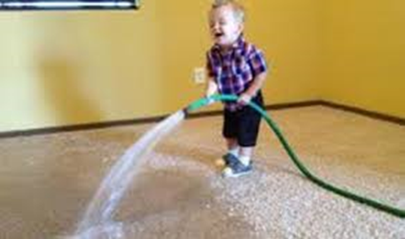
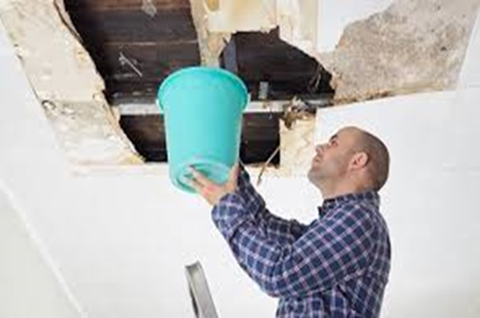
Escape of
Water Claims
Martin Ashfield - Claims Technical Director

Slide 2

Inflation - Only ever goes in one direction………….

Slide 3
The ABI figures do not lie………….
26.7m Households in UK
Insurers paid £7.5 - £8m per day on Domestic claims
Expressed as a % of incurred payments the last 3 years EOW split is :-
2015 – 21%
2016 – 26%
2017 – 28%
This is a Frequency issue, but Predominantly a Severity issue

Slide 4
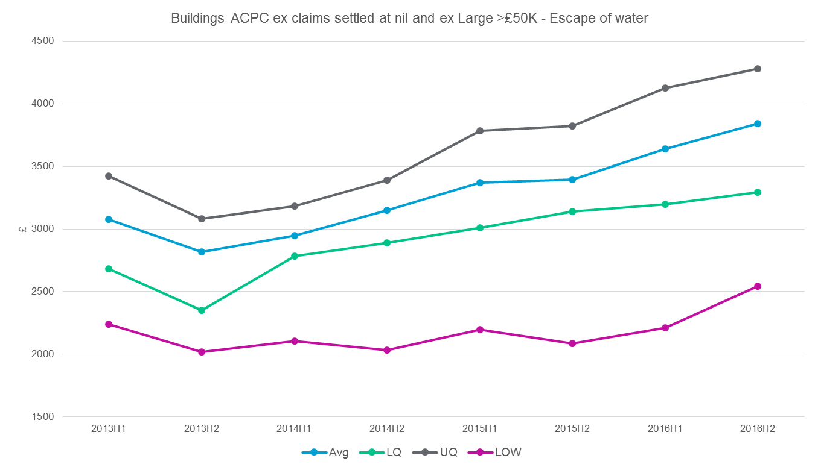
Water damage – a scourge for the industry
Excluding nil claims and claims >£50k

Slide 5
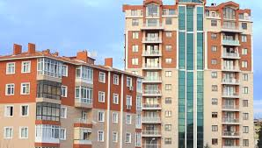
The physical environment is changing

Slide 6

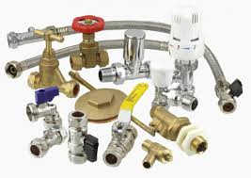
And things are not what they used to be

Slide 7
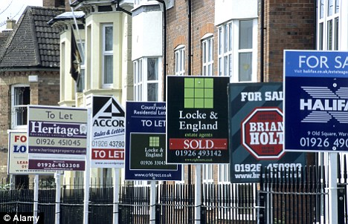
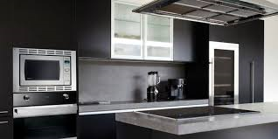
Lifestyle and Societal Changes

Slide 8
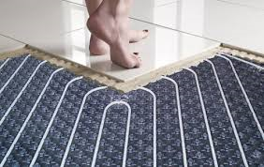
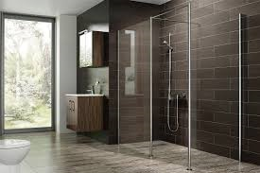
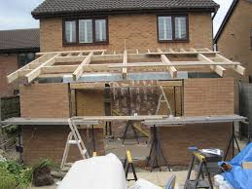
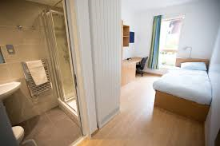
Home Improvements

Slide 9
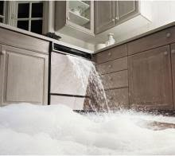

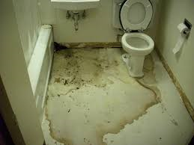
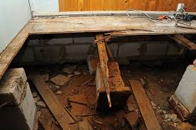
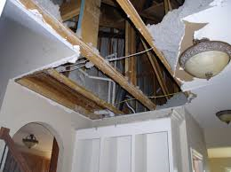
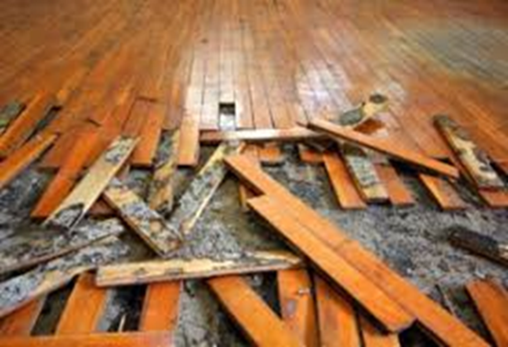
Examples of Damage

Slide 10

Suppliers – So, so important, but do they think like Insurers?

Slide 11

Suppliers – The power of alignment

Slide 12
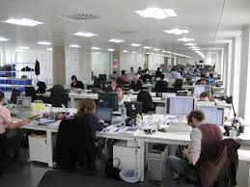

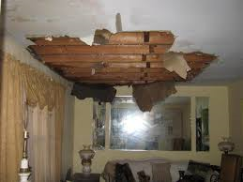

The first 30 minutes are crucial

Slide 13
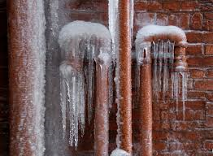

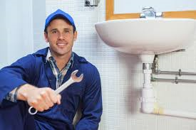

Considerations, Features and Actions

Slide 14
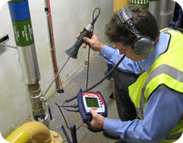

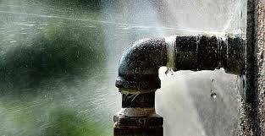

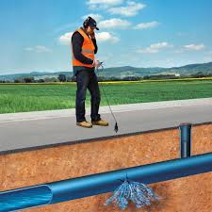
How well are we using Technology – Early Detection Strategy

Slide 15





Is there clarity on rights of recovery and activity?

Slide 16
And in summary…..
Visibility of Performance
Awareness and Attention
Understand causes and inputs
Appropriate Operating Model
Escape of Water
Suppliers and Outsource Partners are key

