Slide 1

Ethics & Values in Management
30 January 2019 – Donna Shoesmith

Slide 2
Today’s objective
To help those who have leadership responsibilities and wish to understand how ethics and values impact on leadership and how they can be used to good effect

Slide 3
Specific objectives
By the end of the workshop you will be able to
Understand what ethics are and are not
Consider how ethics & values affect all organisations
Assess how ethics can be used to improve an organisation
Understand the wider context of ethics in the modern world

Slide 4
Questions we’ll address
What does ‘business ethics’ mean?
What are the pros, cons and business impacts?
What are ethical dilemmas?
What should an ethics code contain?
What’s the place of values & codes of conduct?
How can leadership help or hinder?
How do we make values ‘stick’ in the real world?
What are the opportunities for you?

Slide 5
What does ‘business ethics’ mean?
“Business ethics is the application of ethical values to business behaviour. It applies to any and all aspects of business conduct, from boardroom strategies and how companies treat their employees and suppliers to sales techniques and accounting practices.
Ethics goes beyond the legal requirements for a company and is, therefore, about discretionary decisions and behaviour guided by values and moral principles.
Business ethics is relevant both to the conduct of individuals and to the conduct of the organisation as a whole.”
Institute of Business Ethics, London

Slide 6
What does ‘business ethics’ mean?
“I want employees to ask themselves, when they are in doubt about whether or not a particular act is likely to be ethical or not, whether or not they would be happy for any contemplated act to appear the next day on the front page of their local paper to be read by their spouse, children and friends, with the reporting done by an informed and critical commentator.”
Warren Buffet, Berkshire Hathaway

Slide 7

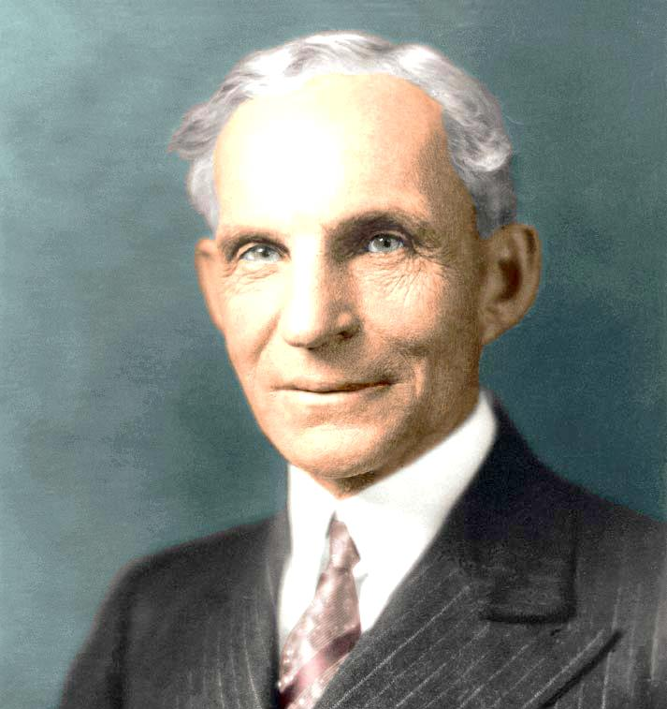
“Being good is good business”
Anita Roddick
“A business that makes nothing but money is a poor kind of business”
Henry Ford

Slide 8
Approaches to business ethics
Amoral business
Legalistic business
Responsive business
Ethical business
Seeks to win at all costs
Anything is acceptable
Will obey the law but no more than that
Recognises that being ethical can pay off
Ethical practice is at the heart of everything
What examples have you seen in the wider world?
Where are we now & where do we want to be?
How would stakeholders describe us?

Slide 9
Typical ‘ethical’ principles
Being trustworthy
Honesty/transparency
Meeting obligations
Having clear documentations/communications
Being involved in the community
Maintaining accounting control
Being respectful

Slide 10
‘Shareholder’ v ‘stakeholder’
Shareholder perspective
Stakeholder perspective
Decisions in the owners’ interests
Maximising profitability & value
Longer term financial sustainability
Wider range of individuals/groups with an interest in the organisation
Decisions aimed to balance & work for the good of all affected people

Slide 11
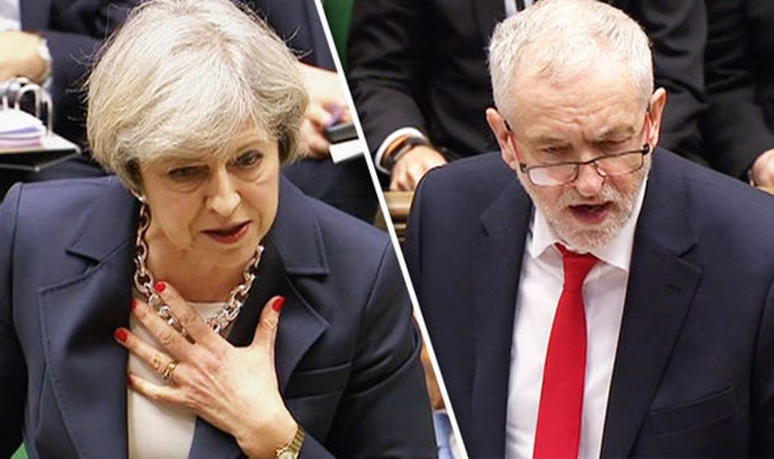

What compass guides our decisions?

Slide 12
Making ethical decisions
Is my decision a truthful one?
Is the decision fair to everyone affected?
Does it build goodwill for the organisation?
Is it beneficial to all parties who have a vested interest?

Slide 13
Why do business ‘ethically’?
Increased public expectation
Attract customers/investors
Prevent harm to society/environment
Protect business from unethical employees
Protect/safeguard individuals
Attract chosen talent
Stay legally compliant
Building teamwork/identity/engagement
Provide decision making parameters at time of change
Promote behaviours that help staff & customers

Slide 14
What are the barriers?
Cost?
Expectations raised unrealistically?
Set ourselves up to be criticised?
Overcoming cynicism?
Too hard/too much effort?
Short term pressures dominate?
Conflicting priorities & demands?

Slide 15
Ethical dilemmas
Should businesses profit from problem gambling?
Should supermarkets sell lager cheaper than bottled water?
Is ethical shopping a luxury we can't afford?
Should fashion retailers use suppliers who don't pay a living wage?
Should supermarkets dispose of out-of-date groceries or give them to food banks?
Should businesses avoid (not evade) tax?

Slide 16
Ethical dilemmas
Do we tell customers about all of the warts on our products?
Do we reveal everything to a prospective buyer during due diligence?
Is it acceptable to hide certain things on a CV?
What’s a legitimate expense on a business trip?
How much of billable time is really devoted to a client?
How honest am I when giving feedback to my boss or direct?

Slide 17
Issues in judging ethical dilemmas
We rationalise our behaviour
  “I’m just protecting them”
  “It’s not really theft”
  “Everyone does it”
Individuals set the bar in different places
…so do industry sectors
…so do professions
…so do national cultures

Slide 18
Developing your ethics code
1. Develop key areas of policy
2. Define/refresh corporate values
3. Translate into day to day behaviours
4. Drive/embody through your leadership
5. Reinforce through other culture ‘carriers’
6. Review, measure, assess, publicise

Slide 19
Key policy areas for ethics codes
Policies that govern;-
Accuracy/transparency of records/information
Conflicts of interests
Fraud/misrepresentation
Insider trading
Use of company assets
Financial processes & responsibility
Risk management

Slide 20
Key policy areas for ethics codes
How you do business;-
How you sell products
Service delivery, standards, expectations
How you respond to customers
Pricing
Keeping customers informed
Treating customers fairly
Choosing suppliers and business partners

Slide 21
Key policy areas for ethics codes
How you work with your people;-
Who & how you recruit
How you engage with employees
Basis for reward
Manging performance, development, succession
Employee well-being
Employee relations
Equalities, diversity, inclusion
Workplace respect/behaviour

Slide 22
The FCA’s 11 principles
1 Integrity | Conduct business with integrity
2 Skill, care and diligence | Conduct business with due skill, care and diligence
3 Management & control | Organise & control , with adequate risk management
4 Financial prudence | Maintain adequate financial resources
5 Market conduct | Observe proper standards of market conduct
6 Customers' interests | Pay regard to the interests of customers & treat fairly
7 Client communications | Address needs, communicate clearly/fairly
8 Conflicts of interest | Manage conflicts of interest fairly
9 Customers trust | Ensure suitability of advice and discretionary decisions
10 Clients' assets | Arrange adequate protection for clients’ assets
11 Regulator relations | Open, cooperative way, and disclose

Slide 23
Insurance Distribution Directive (IDD)

Slide 24
IDD and CII
The EU authorities passed the IDD law because they wanted to ‘to strengthen the confidence of customers’ in insurance
While the IDD means that firms have to put new procedures in place, the fundamental objectives of the Directive are the same as the objectives behind the CII Code of Ethics; to increase confidence in insurance.

Slide 25
CII Code of Ethics
All our members are required to adhere to the our Code of Ethics.
Ethics are a cornerstone of professionalism, and ethical behaviour is crucial to secure public trust and confidence
The CII Code of Ethics has been designed to provide members with practical, realistic guidance to follow.

Slide 26
CII Code of Ethics
Members are required to:
Comply with the Code and all relevant laws and regulations
Act with the highest ethical standards and integrity
Act in the best interests of each client
Provide a high standard of service
Treat people fairly regardless of age, disability, gender reassignment, marriage/civil partnership, pregnancy/maternity, race, religion or belief, sex and sexual orientation

Slide 27
Where are you now?
Applying the CII Code of ethics
How could this guide serve as an audit/gap analysis in orgs?
How does this link into the general principles of ethical behaviour/codes
How can a manager use the guide in terms of creating the right culture and ethics?

Slide 28
CII Code of Ethics
Online ethics course
Designed to help members update their knowledge on the CII's Code of Ethics. The course includes:
What do we mean by ethics?
Ethics and the business environment
Ethics in insurance and financial services
Ethics and your working environment
How to handle ethical issues
Free to members, and once completed members can claim CPD. The course has been added to all the essentials suites of ASSESS.

Slide 29
Developing your ethics code
1. Develop key areas of policy
2. Define/refresh corporate values
3. Translate into day to day behaviours
4. Drive/embody through your leadership
5. Reinforce through other culture ‘carriers’
6. Review, measure, assess, publicise

Slide 30
What are corporate ‘values’?
The things we hold dear – shared beliefs
Things were won’t compromise on
How we want to be know/described by;-
  Customers
  Business partners
  Competitors
  Current, previous and prospective staff
Things that flavour how we make decisions, select projects, resolve dilemmas, behave

Slide 31
Example values
“Everything we do is based on positive assumptions about all people and what they can achieve. We believe that…
Everyone has the potential and desire to grow, learn, make choices and be accountable
We enable people to improve their lives through authentic, confident communications that are both supportive and challenging
We can only support individuals if we work together to build and commit to a strong, financially viable organisation
We must apply these principles in exactly the same way, to staff, service users and others, however challenging it is”

Slide 32
Example values
“Care More: We’re in business to help customers when bad things happen. In these moments of truth, getting the best outcome for customers is our number one priority. We mobilise every resource and do everything we can to help.
Never Rest: We're always looking to improve. We challenge ourselves to learn about the cutting edge and harness it. We challenge the status quo.
Kill Complexity: Outstanding, cost-effective customer service. Simple.
Create Legacy: We invest with courage to build a bright and sustainable future for all.”

Slide 33
Working with values
Describe day to day scenarios & desired responses
Behaviours – what might staff be doing?
Behaviours – what might managers be doing?
What would customers & others see?
What examples of ‘mis-matching’ could happen when we’re under pressure/stress?

Slide 34
Developing your ethics code
1. Develop key areas of policy
2. Define/refresh corporate values
3. Translate into day to day behaviours
4. Drive/embody through your leadership
5. Reinforce through other culture ‘carriers’
6. Review, measure, assess, publicise

Slide 35
Case studies
What ‘ethical’ issues are raised?
What are the dilemmas?
Integrity/conflict between ‘stated’/‘real’ values?
How does leadership come across?
What compromises have been made?
What would you do as a leader?

Slide 36
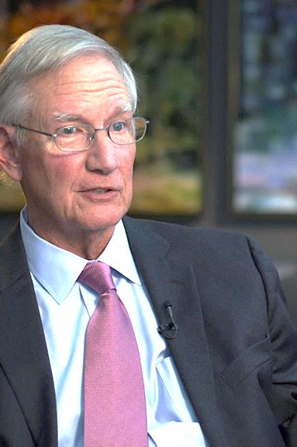
The role of leadership
“Your minute-to-minute actions provide a living model of your vision. Each day is marked by thousands of symbolic acts. You’re spewing forth messages constantly.
Never doubt that you’ll send them, or that others will make a pattern from them. You are a rich, daily pattern to others. You must manage it, because people are ‘boss-watchers’.
What you spend your time on (not what you talk about) will become people’s pre-occupation. Understand the power of your smallest actions. Amidst uncertainty, when people are struggling to understand the world, their significance is monumental.”
Tom Peters

Slide 37
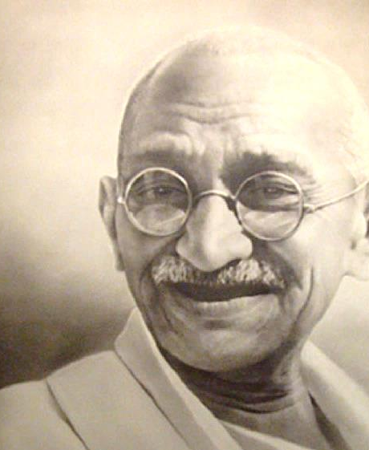
The role of leadership
“We must be the change we wish to see in the world.”
Mahatma Ghandi

Slide 38
Your role in embedding values?
Profile yourself/get feedback
Identify achievable change opportunities
Hunt out excuses to relate them to day to day issues
Tell stories – develop story telling skills
Give feedback to management colleagues
Deal with mis-matches personally & overtly
Show how you use them to make decisions
Don’t exempt ANYONE
Celebrate positive examples
Don’t ever stop

Slide 39

Leadership styles & culture (HBR)
1. What positive cultural features do we want to promote?
Flexibility
Capacity to innovate
Responsibility
‘Ownership’ mentality
Standards
Clear expected standards
Rewards
Accurate feedback linked to rewards
Clarity
About mission/vision/values/strategy
Commitment
Own contribution to a common purpose

Slide 40
Leadership styles & culture (HBR)
2. What impacts do leadership styles have on culture?
Commanding
“Do what I ask”
Pace-setting
“Do what I do, now”
Coaching
“What do you think?”
Affiliative
“People come first”
Visionary
“Come with me”

Slide 41
Emotional intelligence
Self
Social
Recognition
“If I’m aware of my thoughts, feelings, actions & their impact…”
“…which will help me to be more attuned to what’s going on around me…”
“…I’m more likely to be able to make choices about what I do & say ‘in the moment’…”
“…and increase my ability to influence & manage relationships with others”
Regulation

Slide 42
Employee engagement
“A positive attitude held by the employee towards the organisation and its values. An engaged employee is aware of the business context, and works with colleagues to improve performance within the job for the benefit of the organisation. The organisation must work to develop and nurture engagement, which requires a two-way relationship between employee and employer.”
(Institute of Employment Studies)

Slide 43
Employee engagement (McCleod)
The four ‘Pillars of Employee Engagement’
Strategic narrative
Engaging managers
Employee voice
Organisation integrity
Clarity about where we are going & how individuals contribute
Managers who engage with & involve people confidently
Opportunities for people to speak up, be heard & influence things
Living our values – actions consistent with stated values

Slide 44
Developing your ethics code
1. Develop key areas of policy
2. Define/refresh corporate values
3. Translate into day to day behaviours
4. Drive/embody through your leadership
5. Reinforce through other culture ‘carriers’
6. Review, measure, assess, publicise

Slide 45
‘Carriers’ of culture
Job adverts
Job descriptions
Training programmes
Project plans & lessons learned reviews
Staff surveys
Customer surveys
Staff recognition/reward/performance management
Stories we communicate internally/externally

Slide 46
Developing your ethics code
1. Develop key areas of policy
2. Define/refresh corporate values
3. Translate into day to day behaviours
4. Drive/embody through your leadership
5. Reinforce through other culture ‘carriers’
6. Review, measure, assess, publicise

Slide 47
Review, measure, assess…..
Refocus KPIs?
Change reporting?
Audit progress through formal/informal surveys?
Change customer feedback?
Re-align employee performance management?
Test staff understanding & commitment?
Publicise achievements?
Address regression to old ways?

Slide 48
What should we measure?
Mission/Vision/Values
People perspective
Process perspective
External perspective
Financial perspective
The right people, well led & with the right skills…
Doing the right things in the most effective way…
To deliver the right services expected by customers…
So we meet financial & stakeholder expectations

Slide 49
What should we measure?
Mission/Vision/Values
People perspective
Process perspective
External perspective
Financial perspective
Competence
Engagement
Ideas
Bus Dev’t
Performance
Behaviour
Leader styles
Efficiency
Cross selling leads/referrals
Accuracy
Rework
Quality
IT down time
SLA’s
Reputation
Satisfaction
Supplier performance
Complaints
Costs
Turnover
GWP
Profit
Share value

Slide 50
Developing your ethics code
1. Develop key areas of policy
2. Define/refresh corporate values
3. Translate into day to day behaviours
4. Drive/embody through your leadership
5. Reinforce through other culture ‘carriers’
6. Review, measure, assess, publicise

Slide 51

What next?
What landed today?
Where are you particularly strong?
What do you most need to address?
How might you take that forward?

