Slide 1


Insurance & Risk Management in 2019 & Beyond: Global Trends in a Local Context by
Jeff Heasman PGCert CELTA, LL.B (Hons), LL.M linkedin.com/in/jeffheasman
@JHTCTweet

Slide 2
Learning outcomes
By the end of the session, participants will be able to:
understand the nature and importance of risk management.
recognise current and predicted trends in the global insurance industry.
apply the current and predicted trends to a local context.
create local solutions that will maximise opportunities and minimise risk.

Slide 3
Today´s approach
There will be an overview of the current trends in the global insurance market.
We will discuss the risk factors.
There will be discussion about how these trends may impact into the local context.

Slide 4
A reminder of what risk is
Potential of gaining or losing something of value.
Negatives and positives.
Threats and opportunities.
A balancing act.
It´s in this context that we will critically analyse the current global trends and how they will impact locally.

Slide 5
The changing regulatory landscape
We are experiencing regulatory change like never before and 2019 is an important year.
According to PwC, 67% of CEOs are “extremely concerned” about the impact of further regulation.
There are a lot of potential threats but can you think of any opportunities from recent regulation?

Slide 6
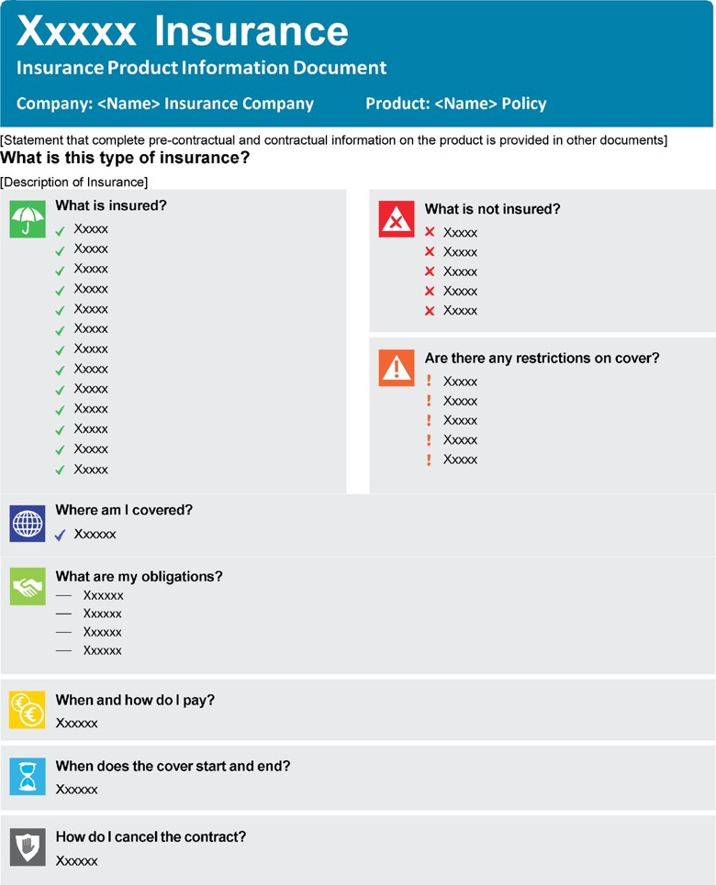
How could this new document (the IPID) present an opportunity?

Slide 7
InsurTech
How do we reach the next generation of App happy customer?
Simplicity, fairness and speed.
Lemonade
  Insured via a smartphone in 90 seconds.
  Claims paid in 3 minutes (record is 3 seconds).
  Open source policies.
Pay as you go insurance
  Trov (electrical items).
  Zego (EL insurance that integrates to HR systems – monthly or annual).
  Just Miles (flat monthly fee and then based on monthly mileage).
  Cuvva (hourly rates from £1.20 and above!).
  Will it offer real savings? Are budget airlines a good comparison?

Slide 8
Artificial intelligence & data analytics
First mover or fast follower?
Automation of business processes – this used to mean standardised letter templates. Now, it could include:
  Drones
  Telematics
  Chatbots
Customer insights through social media to leverage competitive advantages.
Lenddo – creditworthinesschecks via social media.

Slide 9
Driverless cars – where ethics and artificial intelligence collide.
Advanced data analytics:
  Risk prevention and management (Boiler IQ).
  Ecosystems.

Slide 10
Ecosystems
Increases opportunity to engage with the customer in a traditionally low-touch industry.
Nurtures loyalty and attracts new customers.
Data increases and price sensitivity reduces (but does better data price out higher risk clients?)
Discovery South Africa – Vitality.

Slide 11
UK market trends & underwriting pricing
ABI State of the Market Report.
Reinsurance saves the day for the liability insurance market.
The UK cyber insurance market is estimated as being worth in excess of £20 million.

Slide 12
Smart homes and offices, connected cars, smart watches and fit bands. They´re all here already and make underwriting more accurate. It will expand.
An increasing datasphere leads to dynamic pricing opportunities for underwriting.
Payments will also become increasingly frictionless.
Most of the technology is here. Remember – we need to view risk as a threat or an opportunity!

Slide 13
Over to you …
What are the positives and negatives of these trends?
What are the opportunities and threats?
How might this all impact locally?
What can we do to stay one step ahead of the game?

Slide 14
In summary
The current trends present both threats and opportunities.
The local market will not be immune.
Companies that are dynamic, transparent and fair will reap the rewards.
There has never been a more exciting time to be part of the industry!

Slide 15

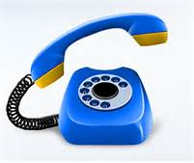


Thank you and please stay in touch
3rd Floor, Capital Tower +44 (0) 2921 660 283
Greyfriars Road
Cardiff
CF10 3AG info@jeffheasman.com
www.jeffheasman.com @JHTCTweet
linkedin.com/in/jeffheasman

