Slide 1
Construction Insurance
Tutor: Peter Fice MBA, Chartered Insurer, ACII

Slide 2
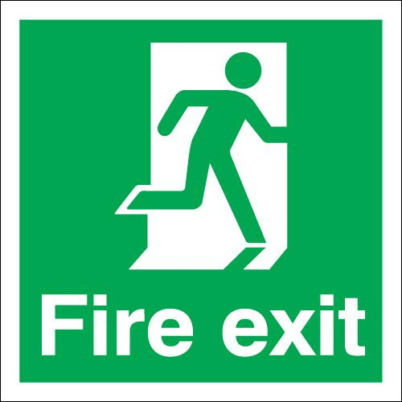




Housekeeping

Slide 3
Agenda
Refresh knowledge on;
  Contractors All Risks Insurance?
  Key hazards and risks in the construction industry
  Definitions and common terms
  Cover extensions and exclusions
Contract works, Plant and Machinery, Tools, and Temporary Buildings

Slide 4
Agenda
Superior and Adverse Features determining Risk Quality
Key risks affecting Housebuilders
JCT Standard Form of Contract
Liability covers
Case studies and Exercises

Slide 5
Learning Outcomes
Understand why cover is required
Be familiar with cover, exclusions and restrictions in Contract Works Insurance Policies
Have an understanding of the insurance clauses within a JCT contract and the implications for Contractors, Insurers and Property Owners.
Be aware of the Risk factors

Slide 6
The Construction Industry
A very substantial sector in the UK economy.
Closely follows the fortune of the UK economy.
Includes hundreds of different trades.
Thousands of micro businesses, SME’s and large scale construction and civil engineering.

Slide 7
What is Contractors All Risks Insurance?
Cover for all permanent and temporary works along with materials, tools, plant, machinery and temporary buildings used in connection with a construction contract.
It provides cover before, during and after construction.

Slide 8
Exercise - Assessing Risk Factors in the construction industry
Location
Financials
Management Quality
Employers

Slide 9
Hazards and Risks in the construction industry
What are the main causes of loss at the various stages of construction?

Slide 10
Hazards and Risks in the construction industry
Site set up
Site clearance
Foundations and Installations of Services
Frame
Walls and Roofs
Fitting out
Roads and car parks
Landscaping
Occupation
Maintenance

Slide 11
Hazards and Risks in the construction industry
Fire
Hot work
Water damage
Theft and Malicious Damage
Weather conditions
Toxic Mold

Slide 12
Modern Construction Methods
Panel construction
Modular/Volumetric Construction
Hybrid concrete solutions

Slide 13
Definitions and common terms
Contract Site
Contract Works
Estimated Contract Price
Maintenance period
Property insured
Hired in Machinery and Plant

Slide 14
Superior and Adverse Features determining Risk Quality
Experience
Location
Insurance history
Financial health
Business activities
Employees and Safety
Property worked on

Slide 15
Extensions to cover
Additional Costs (following a loss)
Continuing hire charges (to damaged plant)
Contract price increase (inflation protection)
Debris removal
Employees tools and personal effects
Employer’s interest
European Union and Public Authorities

Slide 16
Extensions to cover
Expediting expenses
Negligent Breakdown
Plans and documents
Professional fees
Storage of materials

Slide 17
Common exclusions
Damage to;
Tower cranes (can be included in EAR)
Vessels designed to float or travel on water
Mechanically propelled vehicles licensed for road use
Existing structures
Any Property after a Certificate of Completion has been issued

Slide 18
Common exclusions
Damage arising from defective design, plans, materials or workmanship
Wear and tear, or deterioration
Liquidated damages
Damage following cessation of works for a period of 3 consecutive months
The excess shown in the schedule

Slide 19
Case Study - discussion
ABC are a building construction firm with 10 years experience. They often buy derelict houses and build replacement properties. They erect their own scaffolding and do most work themselves.
What are the key factors to look out for?

Slide 20
Main Risks to employers in the construction industry (House builders)
Cost and availability of materials
Sub-contractor availability risks
Health & Safety risks
Housing demand and mortgage availability
Government and regulatory risk
Cyber

Slide 21
JCT Standard Forms of Contract
Joint Contracts Tribunal (latest ed 2011)
Existing structure and new building work to be insured in joint names of the Principal and the Contractor.
Clause 6.5.1 – “Non negligence”

Slide 22
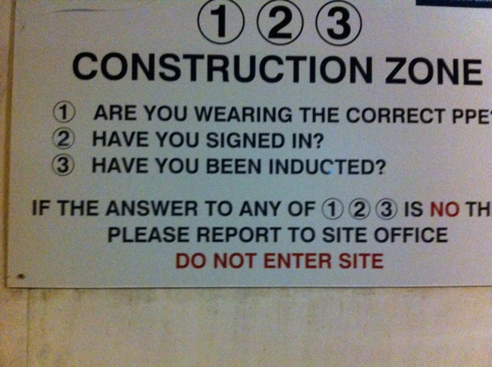
Employee Liability Risks

Slide 23
Employer Liability Considerations
Construction is a dangerous activity.
EL insurance is a statutory requirement.
Less skilled workforce and the transitory culture influence numbers of EL claims.
Regulatory effect of;
> Jackson reforms
> Ogden rate

Slide 24
Employer Liability Considerations
Working at height
Work at depth
Manually lifting materials
Injury from operating machinery
Falling masonry and other objects
Inadequate training
Hot work

Slide 25
Public Liability Risks
Provides cover for Contractors in case someone is injured or their property is damaged as a result of the Contractor’s business.
Risk to public entering construction sites.
Negligent working practices.

Slide 26
Public Liability Risks
Provides protection for the Principal against injury and/or damage caused by negligence.
Slips and trips.
Hot work.

Slide 27
Case Study - discussion
XYZ are a large building contractor firm specialising in commercial buildings and some civil engineering work. They mostly employ sub-contractors and they are often seen in city centres.
What are the key factors to look out for?

Slide 28
Learning Outcomes
Understand why cover is required
Be familiar with cover, exclusions and restrictions in Contract Works Insurance Policies
Have an understanding of the insurance clauses within a JCT contract and the implications for Contractors, Insurers and Property Owners.
Be aware of the Risk factors

Slide 29
Introduction to Construction Insurance
Thank you for your attendance.
Any questions
Don’t forget your CPD hours!

