Slide 1



Slide 2

sert image here

Slide 3
Complaints
'Any expression of dissatisfaction, whether oral or written, and whether justified or not, from or on behalf of an eligible complainant about the firm's provision of, or failure to provide, a financial service'.

Slide 5

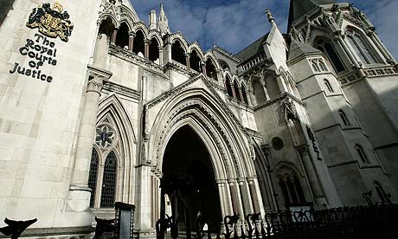

Slide 7

Time Limits

Slide 8
Time Limits
6 months from receiving a firm's final response.
6 years from the date of the advice.
3 years from the date of knowledge.
15 year long stop does not apply.

Slide 9
15 Year Long Stop
“We [ the FCA] do not consider it is in the interests of consumers to rule out the possibility of complaints being dealt with outside the 15-year period that would apply to court cases”.
In 2014/15 there were 489 such complaints which exceeded the 15 year long stop, of which 35% were upheld.
In 2017/18 there have been only 235, of which 29% were upheld - only 68 complaints.

Slide 10

The FCA has said it will review the case for a long stop in 2019 as part of its wider review of how the Financial Advice Market Review has panned out.

Slide 11
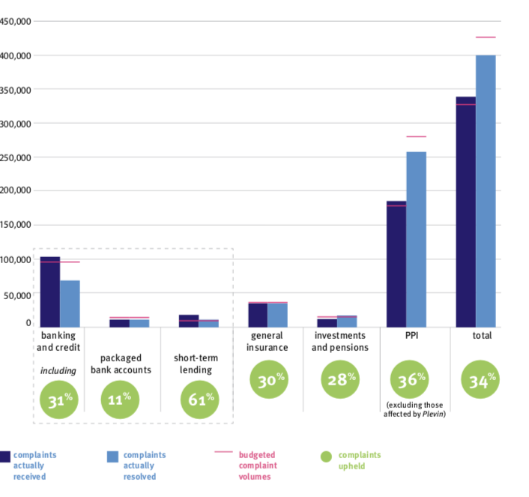
FOS – 2017/2018

Slide 12
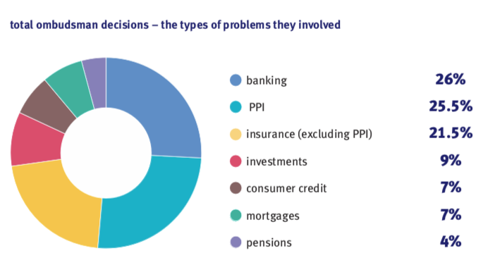
FOS 2015/2016

Slide 13
FOS – 2017/2018
1.4 million new enquires.
339,967 new complaints.
400,658 complaints resolved.
51% complaints upheld.

Slide 15

The Courts

Slide 16
Causes of Action
Breach of statutory duty
Negligence.
Breach of contract.
Breach of fiduciary duty.

Slide 17

Time Limits

Slide 18
Time Limits
Limitation Act 1980
6 years from the date of the advice.
3 years from the date of knowledge.
15 year long stop.

Slide 19

Contract

Slide 20
Contract
Crestsign v National Westminster Bank plc and Royal Bank of Scotland plc [2014] EWHC 3043
“[The bank] did provide negligent advice but they successfully excluded any duty not to do so. They did not show themselves worthy of the trust Mr Parker placed in them, but unfortunately for Crestsign, the common law provides it with no remedy because the banks successfully disclaimed responsibility for the advice they gave on the suitability of the swap, which was negligent but not actionable”)

Slide 21
Contract

Slide 22
Summary
Always refer a complaint to your insurer.
Know your time limits.
Contract is King! Have it check by a solicitor/lawyer.

Slide 23

Clare O’Sullivan
Associate
T: 0845 209 1346
E: clare.osullivan@clarkewillmott.com

