Slide 1
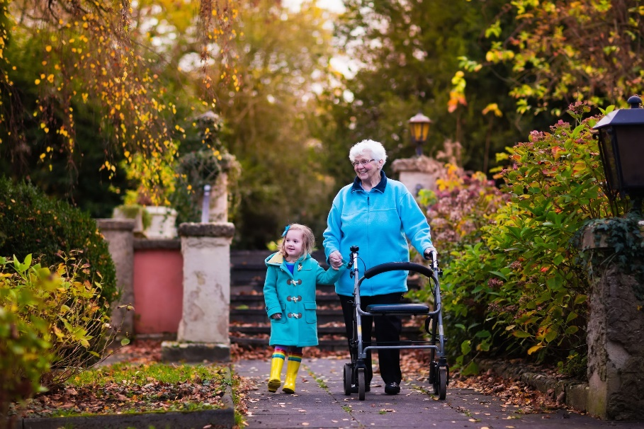
The Insurance Charities
1902 ‘Insurance Clerks Orphanage’ established in response to the high mortality rate in London
2004 merger ‘The Insurance Charities’ created
Your industry charity
We help finance requests from hospital parking through to funding life changing surgery
Notes:
We are your industry charity - supporting you through the hard times in recognition of your work within the insurance sector
We help finance requests from hospital parking through to funding life changing surgery

Slide 2
What do we do?
Provide help to past & present insurance employees & their dependants across the UK & Ireland
Give over £1.2 million annually to people in need
Dedicated welfare advisor to provide practical help
Holistic approach to applicants, we look at the whole family situation
Help people get back on their feet and become self-sufficient
Notes:
Ongoing support where income is insufficient
One-off help with special expenditure
Practical help with money management

Slide 3
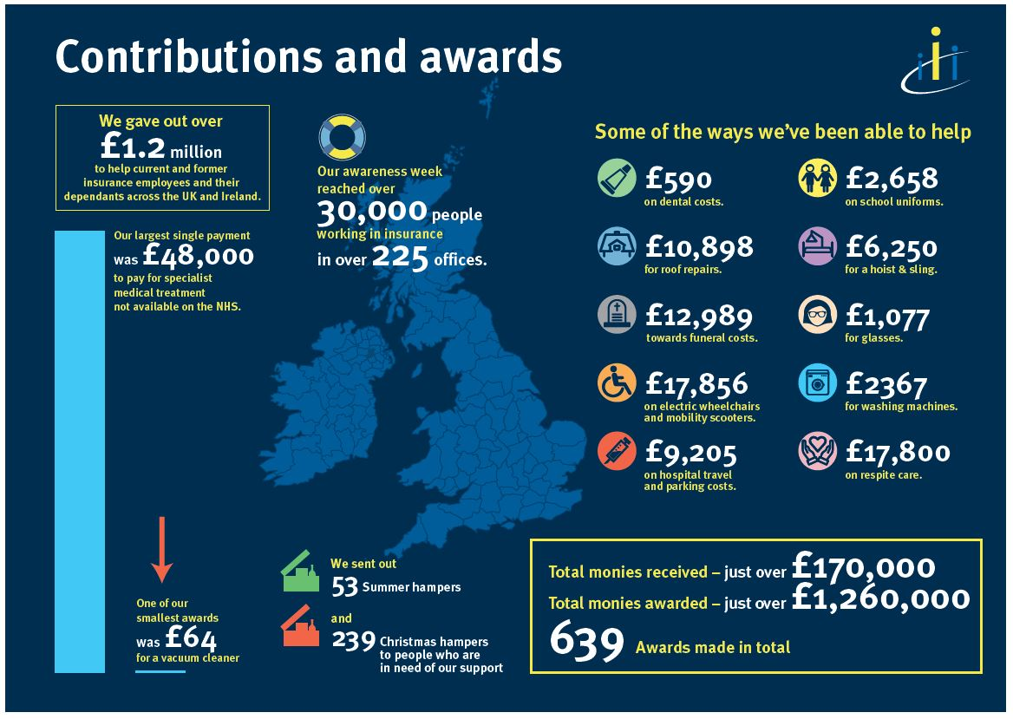

Slide 4
Leicester
Over the last five years the Leicester Insurance Institute has donated £4,840 to The Insurance Charities.
We have awarded £36,854 to help insurance people in Leicester in need of our help & support since 2013.
TIC | 2017/18 | 2016/17 | 2015/16 | 2014/15 | 2013/14
Leicester | £12,808 | £9,151 | £1,981 | £5,167 | £7,746
No of families | 4 | 4 | 1 | 3 | 7
Notes:
Money donated from Leicester Insurance Institute (raffles at quiz’s and a loose change box).

Slide 5
Leicester
In 2017/18 we awarded £12,808 to help insurance people in Leicester in need of our help & support. Some of things we helped with are:
Respite breaks
Travel to school
Glasses
Property adaptations
Christmas hampers
On-going financial support

Slide 6
Case study
Young family
Unexpected illness
On-going health issues & related costs
Small costs quickly add up
Debt escalates
Financial strain
Emotional strain
Family at breaking point

Slide 7
How can you help?
Tell your employer about us
Tell your insurance colleagues who may need our help to get in touch
Support us; participate in events such as Insurance Charities Awareness Week in June
And finally, visit our website to find out more and apply for help: www.theinsurancecharities.org.uk/

