Slide 1

Regulatory Hot Topics

Slide 2
Agenda
Platforms Market Study
MiFID II catch up (discussion)
Cash-flow planning
Defined benefit (DB) transfers

Slide 3
Learning objectives
By the end of the session, you should be able to
Understand the FCA’s platform study findings and implications for the advice sector
Confirm understanding of MiFID II requirements
Consider some key aspects of cash-flow planning
Understand the FCA’s policy development on DB transfers
Understand FCA expectations for advice on DB transfers
Review your firm’s approach
Notes:
Forward-looking
Big picture

Slide 4


Slide 5

Platforms Market Study: Positives
Market appears to be working well in many respects
Customer satisfaction is currently high
Consumers who pay more for their platform tend to get greater functionality on average
Notes:
Interim report

Slide 6
Platforms Market Study: Concerns
    Competition not working well for certain consumer groups
    Switching between platforms can be difficult
    Orphan clients face higher charges and lower service
    Possible inducements: training courses, white labelling, bulk rebalancing, model portfolio management tools

Slide 7
Proposed remedies
Easier switching: market solution (Transfers and Re-registration Industry Group)
Considering adviser charging guidance on switching
Help for orphan clients – considering platforms to:
    Have process to encourage client to switch
    Sneak on adviser receiving adviser charge if no activity for 1 year
D2C:
Easier to shop around: MiFID II + market innovation
Improve fund competition: market innovation

Slide 8
Advice Market Study (2019?)
Possible findings
    Weak price competition
    Little correlation between price and quality
    Little correlation between price and demand
    Price clustering
    High consumer satisfaction
    Poor perception of fees by consumers

Slide 9
Advice Market Study
Possible remedies
    Improved price comparison?
      Websites?
      Comparison tool?
      Prescribed examples?
    Clarify expectations on value for money – PROD
    Repeat charges disclosures – in place (MiFID II)
    Market innovations/solutions

Slide 10
MiFID II update
Inducements
Suitability
Recording
Disclosure
Knowledge and competence
PROD
Adviser charging
Independence
Best execution
Product governance
Client categorisation
Appropriateness

Slide 11
Cash-flow planning
Why?
Who?
Which?
How?

Slide 12


Slide 13



Slide 14
PS 18/6: New Rules and Guidance
No change to default position
Guidance on assessing suitability:
    Role of DB benefits play in providing retirement income
    The relevant wider circumstances of the individual
    The way funds will be accessed
    Receiving scheme investments
    Alternative ways of achieving the client’s objectives
Appropriate pension transfer analysis (APTA)
    Cash-flow planning
    Transfer value comparator (TVC)

Slide 15
It could cost you £140,000 to obtain a comparable level of guaranteed income on the open market.
This means the same retirement income could cost you £20,000 more by transferring.

Slide 16
PS18/20: Further New Rules and Guidance
PTS to have investment advice qualification
Destination of funds (including self-investors)
Two advisers working together
Triage
Attitude to transfer risk
Suitability Reports for stay recommendations
Possible contingent charging ban: considering further (no proposals)
Tweaks:
    Update to PTS qualification standard
    Re-defining what constitutes a DB transfer
    Changes to pension increase assumptions

Slide 17
Triage
Generic information only
Explanations ‘that make them more or less suitable for general groups of people’
Can decide not to deal with some clients
Suggest at-a-distance approach (guide/videos)

Slide 18
Attitude to transfer risk
Client’s view/attitude on:
Risks and benefits of staying in the DB scheme
Risks and benefits of transferring to a flexible benefits scheme
Certainty of income in retirement
Likelihood of accessing funds in flexible benefits in an unplanned way (and the impact of this on )
Restrictions on their ability to access funds in a DB scheme
(and experience of) managing investments themselves or paying for them to be managed in a flexible benefit scheme

Slide 19
Also …
Younger clients
Schemes in trouble
High transfer values

Slide 20
DB Recommendations
Ensure FCA guidance is explicitly built into the advice process
Have a formal written firm view on client scenarios (younger clients, ill-health, death benefits, flexibility etc)
Systems and controls

Slide 21


Slide 22
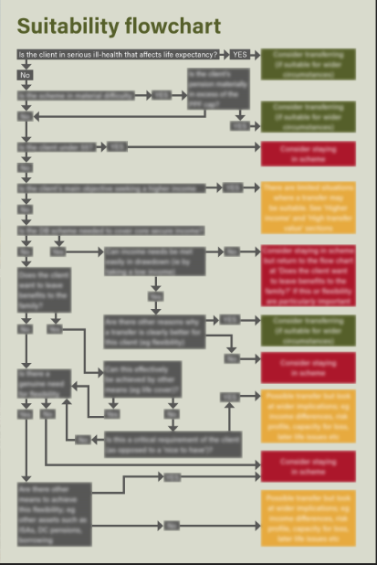

Slide 23
Questions

Slide 24
Learning objectives
By the end of the session, you should be able to
Understand the FCA’s platform study findings and implications for the advice sector
Confirm understanding of MiFID II requirements
Consider some key aspects of cash-flow planning
Understand the FCA’s policy development on DB transfers
Understand FCA expectations for advice on DB transfers
Review your firm’s approach
Notes:
Forward-looking
Big picture

Slide 25


