Slide 1
It’s like a jungle out there…
For investment professionals only
Sheffield L&P – Graeme Abell – Director of Strategic Accounts
September 2018
Notes:
Notes Presentation Title Page
Date
Type name of Presenters

Slide 2
Learning Outcomes
Understand
Discuss
Describe
current valuations for the key mainstream asset classes, equities and bonds using fundamental analysis
what could be considered as alternative areas of investment opportunities within the equity and bond sectors
more traditional areas of alternative investments exploring some of the key characteristics and measures

Slide 3
Our path through the jungle…
The manestream
Equities – the ups and the downs
Infrastructure – taking a different path
Fixed income – the highs and the lows
Property – solid assets
Alternatives, different species, different behaviours

Slide 4
The Manestream

Slide 5
Global – but still American! – Bear with us!
Source: Thomson Reuters Datastream, November 2017. Rebased to 100 at November 2012. Image source: By Yathin S Krishnappa - Own work, CC BY-SA 3.0, https://commons.wikimedia.org/w/index.php?curid=23241619

Slide 6
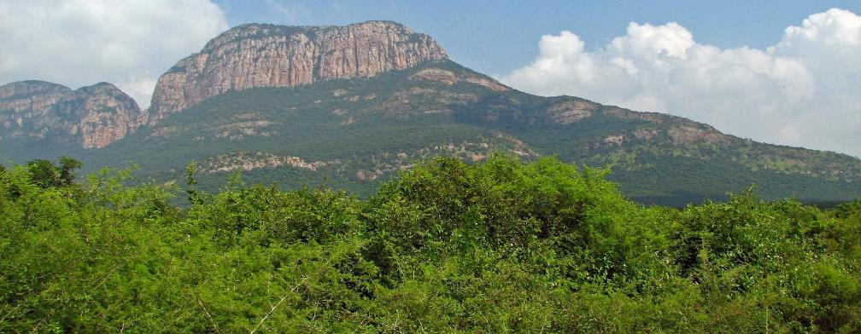
Steep rise, steep fall
Historic bond yields
16%
14%
12%
Bond yields rise
10%
Bond yields fall
8%
6%
4%
2%
0%
1926
1936
1946
1956
1966
1976
1986
1996
2006
2016
Long US Treasuries yield
Source: Barclays Capital Equity Gilt Study 2005, Bloomberg data for long-dated gilt yield from 31 December 1996 to 30 June 2016. Image source: By McKay Savage from London, UK - India - TN-AP Circuit - 005 - cliffs, CC BY 2.0, https://commons.wikimedia.org/w/index.php?curid=23468154

Slide 7
What does your ATR say?
Risk rating v financial planning (cash flow modelling)
Risk rating: 1
Risk rating: 2
Risk rating: 3
Risk rating: 4
Risk rating: 5
Risk rating: 6
Risk rating: 7
Risk rating: 8
Cash flow modelling needs: 1
Cash flow modelling needs: 2
Cash flow modelling needs: 3
Cash flow modelling needs: 4
Cash flow modelling needs: 5
Cash flow modelling needs: 6
Cash flow modelling needs: 7
Cash flow modelling needs: 8
A decade of debate!
Image source: By Mysid (SVG), Ilkant (original) - Vectorized by Mysid after Image:Cg pp maze.png., CC BY-SA 3.0, https://commons.wikimedia.org/w/index.php?curid=4351492

Slide 8
A trip along the same vines…
A decade of pointless debate…….
MSCI AC World and Citigroup World Govt. Bond Index (10Y+), US Dollar terms
70% bond/ 30% equity
(5.0% p.a.)
50/50
(5.0% p.a.)
70% equity/ 30% bond
(4.8% p.a.)
Total return, rebased (USD) *
Have low risk investors borrowed returns from high risk investors?
Source: Datastream, 2nd January 2017. *Rebased as at end December 2006

Slide 9
Still the same a year on?
Or have we reached a pivotal moment?
Mixtures of equity (MSCI AC World) and bonds (Citigroup World Govt Bond Index (10Y+), USD terms
70 equity / 30 bond
(16.9%)
50/50
(9.1%)
Total return, rebased (USD) *
30 equity / 70 bond
(1.8%.)
Low risk investors now giving back returns to higher risk investors…..
Source: Thomson Reuters Datastream, 20 June 2018. *Rebased as at 10 August 2016

Slide 10
Avoiding volatility is costing you!
Real returns on US S&P 500 and US 10 Year Treasuries, rebased*
S&P 500
(13.4% p.a.)
Total Returns, rebased*
10- Year Treasury
(-0.1% p.a.)
Yield1.5%
Yield2.3%
Changing risk properties……
Source: M&G, DataStream, 29 May 2018. *Rebased as at 29 May 2013. Image source: By Greg Hewgill - originally posted to Flickr as Lions, CC BY 2.0, https://commons.wikimedia.org/w/index.php?curid=7312646

Slide 11
Equities – ups and downs

Slide 12
US equities - a long but steady path
If you only look at one chart . . . this is it
US long-term real equity returns (log level index – returns per annum)
6.2% pa real!
Source: M&G, Credit Suisse, Datastream, 31 October 2017. Image source: By James Antrobus - Bang Krachao. Bangkok, Thailand. 1, CC BY 2.0, https://commons.wikimedia.org/w/index.php?curid=49398198

Slide 13
But when do you start the journey?
Probability that the stock market will rise in a given calendar year
Dow Industrials Index calendar year performance since 1897
Past performance is not a guide to future performance
Source: www.HulbertRatings.com. Image source: By Château de Breteuil - Own work, CC BY-SA 3.0,https://commons.wikimedia.org/w/index.php?curid=26883938.

Slide 14
Is the market priced for caution?
Little or no reward for ‘low risk’
World real yields
World equity
World government bonds
GBP cash
Equity Risk Premium remains elevated……
Source: Thomson Reuters Datastream, Bloomberg, 30 April 2018. World equity proxy is MSCI World Index; cash proxy is LIBOR 3 months. World government bond proxy is The BofA Merrill Lynch Global Government Index. All data is inflation-adjusted
Notes:
Multi asset common

Slide 15
Fruits of the jungle
Historical level of equity risk premium (ERP)
Korea
Germany
UK
Japan
USA
Market cheaper
Market more expensive
On an ERP basis most equities are cheap!
Source: Thomson Reuters Datastream, 2 July 2018.(The chart is considering data starting from 31 December 1999)

Slide 16
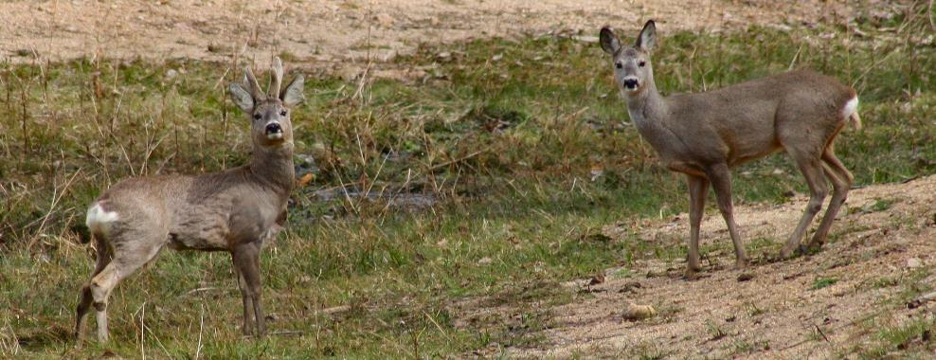
Are UK Equities …… Deer? Buying the FTSE…alternative thinking?
11,620
7,232
Source: Datastream, 28 February 2018. Image source: By No machine-readable author provided. Jojo assumed (based on copyright claims). - No machine-readable source provided. Own work assumed (based on copyright claims)., CC BY-SA 3.0, https://commons.wikimedia.org/w/index.php?curid=674425
Notes:
Nationwide house index for dec 99 avg house price £79,000
Q1 2017 = £220,000
Iuf I said to the audience you can buy houses for today only for 99 prices, it w7ould be the last thing I’d say as you would all be rushing for the doors. But you can but the FTSE at roughly 99 prices

Slide 17
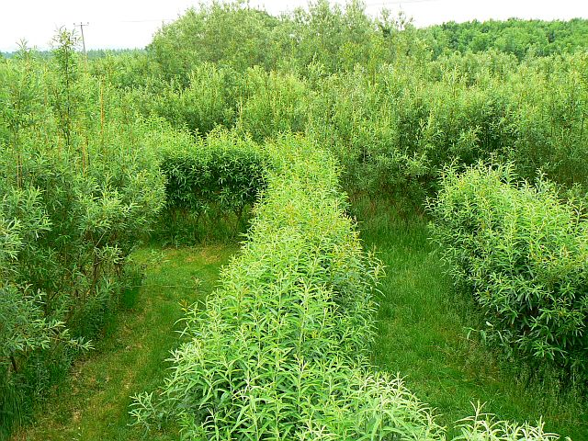
The path not so clear?
Investors have favoured perceived safety and non-cyclical growth
Rolling 10-year relative performance of Value vs. Growth
Value’s underperformance remains greater than that seen in 2000
Source: MSCI, Datastream., March 2018. Image source: By Brian Robert Marshall, CC BY-SA 2.0, https://commons.wikimedia.org/w/index.php?curid=13511092

Slide 18
Fixed Income – the highs and the lows

Slide 19
Fixed interest – always important to choose the right animal
Selectivity in fixed interest is key
10 year bond yields (local currency)
Developed markets
Emerging markets
Emerging markets a path less travelled?
Source: Bloomberg, 5 December 2017. Image source: By AmazemNet - Own work, CC0, https://commons.wikimedia.org/w/index.php?curid=45119286
Notes:
Approved by KH: 18/05/2015

Slide 20
Emerging markets – the dragons!
Bonds since 2000 – YTD - Total return
It’s been a profitable path!
Source: Morningstar, UK database, net income reinvested, price to price. 31 March 2018. Rebased to 100 at 31 December 2000. Image source: By Achmad Ariefiandy - http://www.plosone.org/article/info%3Adoi%2F10.1371%2Fjournal.pone.0011097, CC BY 3.0, https://commons.wikimedia.org/w/index.php?curid=12836494

Slide 21
More pickings from the fruits of the jungle
Low risk assets looking decidedly risky
Global investment grade
US investment grade
Euro investment grade
UK investment grade
Global high yield
Market cheaper
Market more expensive
Spread levels look tight
Source: Bloomberg 31 August 2018 (the chart is considering data starting from 1 January 2009). Image source: By Lombana - Own work, CC BY-SA 3.0, https://commons.wikimedia.org/w/index.php?curid=18313309
Notes:
WIP FI Data Updates Slides speciali credit spreads analysis post crisis. Tight = min
Wide = max
Pie charts
1st quarter = <
2nd quarter = >

Slide 22
Snaking…a little wriggle room?
Low return world advocates for more active approach
Barclays Global Aggregate Corporate Index yield-to-worst and interest rate duration
In today’s environment, we believe a highly flexible approach to fixed income investing is required
Source: M&G, Bloomberg, 31 May 2018. Image source: By User:Vmenkov - Self-photographed, CC BY-SA 3.0, https://commons.wikimedia.org/w/index.php?curid=4990563
Notes:
Update from sheet behind chart, all codes included
Approved by KHR and Compliance Marketing 01/12/2016

Slide 23
Pondering a different route
Floating rate notes spread
6.3%
5.9%
4.8%
And like a lily they float!
Source: M&G, Bloomberg, BofA Merrill Lynch Indices, 31 May 2018. Image source: By Rod Allday, CC BY-SA 2.0, https://commons.wikimedia.org/w/index.php?curid=14150208

Slide 24
Property and infrastructure – solid assets

Slide 25
Commercial property a solid foundation
Correlations - commercial property vs other asset classes
Dec 1986 – March 2015 | Cash | Bonds | Equities | Direct property
Cash | 1.00
Bonds | 0.13 | 1.00
Equities | 0.04 | 0.09 | 1.00
Direct property | -0.02 | -0.16 | 0.09 | 1.00
Low or negative correlation with other asset classes
Source: Morningstar and M&G statistics. IPD, data based on monthly returns, December 1986 to 31 December 2016.. IPD Monthly Index, FTSE All-Share Index, FTSE All-Stocks Gilt Index. Cash return is the 3-month LIBOR (Bank of England)

Slide 26
UK Commercial Property
Strong transaction volumes from a mixed investor base
£65.5bn
15 year average: £47bn
£24.2bn
Demand still very strong & diversified…….
Source: Property Data, 14 August 2018. Image source: By Iramuthusamy - Own work, CC BY-SA 3.0, https://commons.wikimedia.org/w/index.php?curid=18528833
Notes:
…transaction volumes got to £12.7bn in Q1 (£13.1 Q1 17).
Overseas a much smaller proportion of this (speaks to previous slide and relative sterling strength) – notably means that the UK investors have been picking up the slack
The main factor that could be said to be stifling demand, is the lack of sought after assets available – long lease, high quality assets
Considering the yield still on offer and the uptick in property allocation required, the investment market looks stable and in line with recent years

Slide 27
Still a work in progress?
Construction activity downgraded - will be supportive of rental growth
Forecast
Whilst supply is constrained
Source: PMA, Summer 2018. Image sources: By K. Stefanova - http://africaphotos.usaid.gov/search_details.cfm?Keyword_ID=313&Country_ID=22&Sector_ID=10&Photo_ID=5022&StartRow=46, Public Domain, https://commons.wikimedia.org/w/index.php?curid=1275394. By Felagund - Photo taken by Adi Perez, CC BY-SA 3.0, https://commons.wikimedia.org/w/index.php?curid=823030

Slide 28
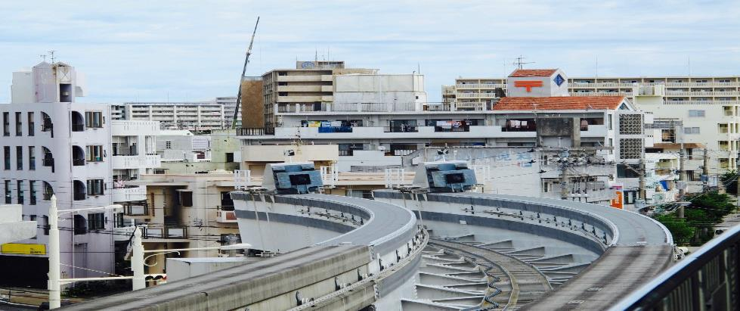
The concrete jungle…
M&G Real Estate forecasts
Capital values muted for a long term asset…….
Source: M&G Real Estate forecasts as at July 2018, IPF February 2018. Image source: By Simon Rodriguez - Imported from 500px (archived version) by the Archive Team. (detail page), CC BY 3.0, https://commons.wikimedia.org/w/index.php?curid=71469279

Slide 29
Infrastructure – bridging a gap?
Listed infrastructure provides clear diversification benefits
M&G’s infrastructure universe vs MSCI AC World (10 years)
Increased allocation to listed infrastructure
Past performance is not a guide to future performance
… and the longer the holding period, the more pronounced the effect
Source: M&G, PCR team, 25 August 2017. Image source: Shutterstock

Slide 30
Infrastructure a hut above the rest
Listed infrastructure offers higher yield and lower drawdown vs global equities
Yield: M&G’s infrastructure universe vs MSCI AC World
Drawdown (in USD)**
Past performance is not a guide to future performance
Source: Factset, 30 June 2017 *As at 31 January 2017. **As at 27 October 2017. Image source: By Rod Waddington - https://www.flickr.com/photos/rod_waddington/30696847550/, CC BY-SA 2.0, https://commons.wikimedia.org/w/index.php?curid=54035574

Slide 31
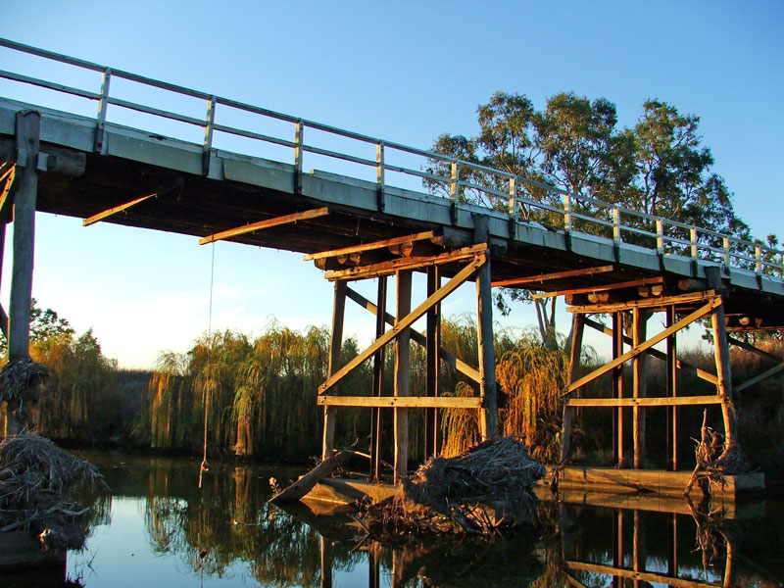
Infrastructure – taking a different path
Our definition of listed infrastructure: capturing long-term growth
Infrastructure class
Economic (65-75%)
Social (10-20%)
Evolving (15-25%)
Utility
Health
Communication
Industry &
sub-industry
Energy
Education
Transactional
Transport
Security
Royalty
Dividend profile*
Past performance is not a guide to future performance
A stable, dependable foundation…..augmented by growth
Source: M&G, December 2017 *Expected annual dividend increase, for illustrative purposes only. Image source: By Alan Heardman, CC BY-SA 2.0, https://commons.wikimedia.org/w/index.php?curid=13128563

Slide 32
Rates popping up again…
Rising interest rates
Effect of +100 basis point shift on investible universe, propagated (%)
‘Evolving’ bucket is an effective diversifier
Source: M&G PCR team, Bloomberg Global Factor Model, 31 October 2016. Image source: By Smart Destinations - Muskrats at the San Diego Zoo auf flickr, CC BY-SA 2.0, https://commons.wikimedia.org/w/index.php?curid=19600102

Slide 33
Some structures are very ropey…
Active looks attractive as infrastructure indices are flawed
Infrastructure index | Constituents | Utilities | Energy | Telecom services | Transport
FTSE Core Infrastructure | 149 | 56% | 11% | 1% | 25%
FTSE Core Infrastructure 50/50 | 227 | 48% | 11% | 1% | 32%
S&P Global Infrastructure | 75 | 39% | 18% | 0% | 43%
MSCI ACWI Infrastructure | 262 | 41% | 9% | 42% | 4%
Macquarie Global Infrastructure* | 241 | 80% | 12% | 0% | 7%
Highly concentrated with bond-proxy performance
Source: Provider factsheets, 31 August 2017 *Macquarie Global Infrastructure Index discontinued from 21 November 2016. ¹ Quote from FTSE Russell, June 2016. Image source: By Enzo Arcamone - Own work, CC BY-SA 4.0, https://commons.wikimedia.org/w/index.php?curid=70919301

Slide 34
Alternatives, different species, different behaviours…

Slide 35
Is volatility a dangerous animal?
Which asset is more risky? All depends on your time horizon……
Asset A
Price
Asset B
Volatility is not risk!
Source: M&G, May 2018. For illustrative purposes only
Notes:
For most investors, the destination is more important than the journey
Short-term volatility is often a distraction, and possibly an opportunity
The argument for these beliefs is built on two pillars:
Value: Tells you about you about expected returns, the destination
Episodes: Are opportunities volatility can create
“Volatility can indeed cause overconfidence if we fail to appreciate that past volatility isn't a guide to the future”

Slide 36
Is caging a volatile animal a good thing?
Not everyone is doing the same thing……
Source: FE Analystics 30 May 2018. Pricing spread bid to bid, daily in sterling. Image source: By Auckland Museum, CC BY 4.0, https://commons.wikimedia.org/w/index.php?curid=65549635
Notes:
Destination not the journey

Slide 37
…and out of the jungle
Same path same results?
Widen your horizons for equities
Path unclear for fixed income
Property and infrastructure for a diverse path

Slide 38
Learning Outcomes
Understand
Discuss
Describe
current valuations for the key mainstream asset classes, equities and bonds using fundamental analysis
what could be considered as alternative areas of investment opportunities within the equity and bond sectors
more traditional areas of alternative investments exploring some of the key characteristics and measures

Slide 39
M&G Global Listed Infrastructure Fund
Risks associated with this fund
The value of investments and the income from them will rise and fall. This will cause the fund price, as well as any income paid by the fund, to fall as well as rise. There is no guarantee the fund will achieve its objective, and you may not get back the amount you originally invested.
Changes in currency exchange rates will affect the value of your investment.
The fund holds a relatively small number of investments and, as a result, may experience larger price rises and falls than a fund which holds a larger number of investments.
The fund will invest in emerging markets which are generally more sensitive to economic and political factors, and where investments are less easily bought and sold. In exceptional circumstances, the fund may encounter difficulties when selling or collecting income from these investments, which could cause the fund to incur a loss. In extreme circumstances, it could lead to the temporary suspension of dealing in shares in the fund.
Convertibles are subject to the risks associated with both bonds and company shares, and to risks specific to the asset class. Their value may change significantly depending on economic and interest rate conditions, the creditworthiness of the issuer, the performance of the underlying company shares and general financial market conditions. In addition, issuers of convertibles may fail to meet payment obligations and their credit ratings may be downgraded. Convertibles may also be less liquid than the underlying company shares.
Where market conditions make it hard to sell the fund’s investments at a fair price to meet customers’ sale requests, we may temporarily suspend dealing in the fund’s shares.
Some transactions the fund makes, such as placing cash on deposit, require the use of other financial institutions (for example, banks). If one of these institutions defaults on their obligations or becomes insolvent, the fund may incur a loss.
For any performance shown, please note that past performance is not a guide to future performance.
It is also important to note that:
The fund invests mainly in company shares and is therefore likely to experience larger price fluctuations than funds that invest in bonds and/or cash.
Notes:
GLIN_KIID

Slide 40
M&G Global Listed Infrastructure Fund
Fund overview
Fund name | M&G Global Listed Infrastructure Fund
Fund manager: | Alex Araujo
Launch date (manager tenure): | October 2017 (October 2017)
Fund size: | £17 million
Investment objective: | To deliver a higher total return than that of the MSCI AC World Index over any five-year period; To deliver an income stream that increases every year in sterling terms.
Investment style: | Global equity, dividend growth, bottom-up stock selection, ESG integrated
Typical number of holdings: | 40-50
Comparative index: | MSCI AC World Index
Valuation currency: | Sterling
Fund structure | UK OEIC - UCITS
Pricing/dealing frequency: | Daily dealing
Distribution frequency: | Quarterly
Source: M&G, 31 August 2018
Notes:
Fund size to be updated monthly using figures from multi-asset data template available on RFDM intranet page:
http://thesource.mandg.local/Retail/RFDM/MFR%20Data/Forms/AllItems.aspx
Source to be updated accordingly

Slide 41
M&G Episode Income Fund
Risks associated with this fund
The value of investments and the income from them will rise and fall. This will cause the fund price, as well as any income paid by the fund, to fall as well as rise. There is no guarantee the fund will achieve its objective, and you may not get back the amount you originally invested.
The fund may use derivatives with the aim of profiting from a rise or a fall in the value of an asset (for example, a company’s bonds). However, if the asset’s value varies in a different manner, the fund may incur a loss.
Changes in currency exchange rates will affect the value of your investment.
The fund will invest in emerging markets which are generally smaller, more sensitive to economic and political factors, and where investments are less easily bought and sold. In exceptional circumstances, the fund may encounter difficulties when selling or collecting income from these investments, which could cause the fund to incur a loss. In extreme circumstances, it could lead to the temporary suspension of dealing in shares in the fund.
Where market conditions make it hard to sell the fund’s investments at a fair price to meet customers’ sale requests, we may temporarily suspend dealing in the fund’s shares.
Some transactions the fund makes, such as placing cash on deposit, require the use of other financial institutions (for example, banks). If one of these institutions defaults on their obligations or becomes insolvent, the fund may incur a loss.
For any performance shown, please note that past performance is not a guide to future performance.
It is also important to note that: The Fund allows for the extensive use of derivatives
Notes:
INMA_KIID

Slide 42
M&G Episode Allocation Fund
Risks associated with this fund
The value of investments and the income from them will rise and fall. This will cause the fund price, as well as any income paid by the fund, to fall as well as rise. There is no guarantee the fund will achieve its objective, and you may not get back the amount you originally invested.
The fund may use derivatives with the aim of profiting from a rise or a fall in the value of an asset (for example, a company’s bonds). However, if the asset’s value varies in a different manner, the fund may incur a loss.
The fund invests in other funds, and there is a risk that the value of the assets held by those funds is not always reflected in the funds’ reported values. The fund manager will not have control over the management of those funds or the pricing of the assets they hold.
Changes in currency exchange rates will affect the value of your investment.
The fund will invest in emerging markets which are generally smaller, more sensitive to economic and political factors, and where investments are less easily bought and sold. In exceptional circumstances, the fund may encounter difficulties when selling or collecting income from these investments, which could cause the fund to incur a loss. In extreme circumstances, it could lead to the temporary suspension of dealing in shares in the fund.
Where market conditions make it hard to sell the fund’s investments at a fair price to meet customers’ sale requests, we may temporarily suspend dealing in the fund’s shares.
Some transactions the fund makes, such as placing cash on deposit, require the use of other financial institutions (for example, banks). If one of these institutions defaults on their obligations or becomes insolvent, the fund may incur a loss.
It is also important to note that: The Fund allows for the extensive use of derivatives
Notes:
CMAF_KIID

Slide 43
INMA_GBP_A_Acc_BASIC_RATE_NO_COMPARATOR
Performance in sterling
M&G Episode Income Fund and M&G Episode Allocation Fund
 | YTD % | 2017 % | 2016 % | 2015 % | 2014 % | 2013 %
M&G Episode Income Fund (GBP I share class) | 0.6 | 10.3 | 14.9 | -2.6 | 13.7 | 7.3
 | YTD % | 2017 % | 2016 % | 2015 % | 2014 % | 2013 %
M&G Episode Allocation Fund (GBP I share class) | -0.8 | 11.1 | 12.9 | 0.8 | 7.8 | 10.0
Ratings as at 30.06.18. The Morningstar Overall Rating is based on the funds’ Sterling Class I Accumulation share class. Copyright © 2018. Morningstar UK Limited. All Rights Reserved. Neither Morningstar nor its content providers are responsible for any damages or losses arising from any use of this information. FE Crown Fund Ratings based on the fund’s Sterling I Acc shares. FE Crown Fund Ratings do no constitute investment advice offered by FE and should not be used as the sole basis for making any investment decision. All rights reserved. Defaqto is an independent financial researcher. The Elite RatingTM system is proprietary to FundCalibre Ltd.
Ratings should not be taken as recommendation.
Past performance is not a guide to future performance
Source: Morningstar, Inc., 31 July 2018, Sterling A share class, net income reinvested, price to price

Slide 44
Performance
Medium risk
Index / Sector / Fund | 1 yr % | 3 yrs % | 5 yrs %
Index : ARC Sterling Balanced Asset PCI in GB | 1.6 | 11.8 | 24.1
Sector : IA Mixed Investment 20% - 60% Shares in GB | 2.3 | 15.2 | 29.8
M&G Episode Allocation I Acc GBP in GB | 4.0 | 19.1 | 41.3
Quartile ranking* | 1 | 2 | 1
M&G Episode Income I Acc GBP in GB | 4.1 | 20.5 | 42.2
Quartile ranking* | 1 | 1 | 1
Past performance is not a guide to future performance
Valuation focused rather than volatility led…
Source: Financial Express. Data in GBP as at 8 June 2018. *Quartile ranking as at 31 May 2018

Slide 45
For financial advisers only. Not for onward distribution. No other persons should rely on any information contained within. This financial promotion is issued by M&G Securities Limited which is authorised and regulated by the Financial Conduct Authority in the UK and provides ISAs and other investment products. The company’s registered office is Laurence Pountney Hill, London EC4R 0HH. Registered in England No. 90776.

