Slide 1
Retirement planning - The Retirement Risk Conundrum

Slide 2
Learning objectives
By attending this session, delegates will be able to:
Examine the main approaches to risk-based retirement income planning
Consider the developments in underwriting and how this can improve client outcomes
Be aware of the regulatory changes under PS17/12 that firms must adopt
Consider the benefits of a combined approach to guarantees and investment

Slide 3


conundrum
R
E
T
i
r
e
m
e
n
t
How long should it last?
Notes:
Here is a conundrum that we will try to answer as we go through the session today, along with a bit of a clue. Can you work it out? We’ll come back to it by the end of the session today, but it is certainly something that a lot of people need to work out!

Slide 4

The number of older people is growing!
In UK in 2016, there were:
11.6 million
people aged
over 65
1.5 million
people aged
over 85
14,450
people aged
over 100
The projections
In next 17 years,
In next 23 years,
16 million
people aged
over 65
4.3 million
people aged
over 85
1 in 5
will live to see their
100th birthday
Fastest growth is the post 85 age cohort
Source: Age UK Later Life in the United Kingdom December 2016 Report
Notes:
Care issues are linked to demographics and longevity – the number of older people is growing in the UK. Let’s look at the figures in 2016:
11.6 million over 65. 1.5 million over 85 - typically this is the average age of somebody going into a residential care setting and it’s also the average of those clients that are applying for one of our immediate care plans. There are now almost 14,500 aged over 100.
And we can see the projections, in the next 17 years 16 million over 65. At the point that many people start to need care - 85 – the numbers increase rapidly to 4.3 million in the next 23 years.
One in five are predicted to live to see their 100th birthday, so becoming a centenarian.
The fastest growth is in that post 85 age group, we’ve already seen it’s an untapped market in terms of those taking advice. It’s set to get much bigger, so financial services and financial advisers, really need to be at the forefront for those who enter care as self funders. The longer we live the more chance there is of needing care.
SRCID-11-5360

Slide 5
The longevity challenge – the longer we live…..
85
90
95
Age:
Male:
+6.6 years = 91.6
+7.6 years = 92.6
+4.4 yrs = 94.4
+5.0 yrs = 95.0
+2.9 yrs = 97.9
+3.3 yrs = 98.3
Female:
Source: Office for National Statistics. Projected expectations of life from the 2014-based national population projections, principal projection
for the UK; cohort life expectancy, for males and females, at the ages shown in 2017; published 11 December 2015.
Notes:
So the situation with longevity is that: the longer you live the longer you can be expected to live. Actuaries calculate the revision of life expectancy depending on key ages reached, as illustrated here. It goes up all the time. At 85, which is the average age for people going into a residential care setting, males are expected to live for 6.6 years to 91.6, and females, 7.6 years to 92.6. But then at 90, and you’ll see that it has changed again – males with life expectancy of 4.4 years – to 94.4 and females with 5 years to 95. Having reached 95, males and females are now expected to live to about age 98 – the gap between them having narrowed considerably.
It’s very difficult to predict life expectancy at older ages. How will clients estimate their longevity?
Source website:
https://www.ons.gov.uk/peoplepopulationandcommunity/birthsdeathsandmarriages/lifeexpectancies/bulletins/pastandprojecteddatafromtheperiodandcohortlifetables/2014baseduk1981to2064
https://www.ons.gov.uk/peoplepopulationandcommunity/birthsdeathsandmarriages/lifeexpectancies/datasets/expectationoflifeprincipalprojectionunitedkingdom
SRCID-11-5358

Slide 6
Change in life expectancy over the years!
Female age 86 in 2017 – born in 1931
Life expectancy of a female in 1931 was 62.9 years
Life expectancy at age 86 = just under 7 years
Takes her to 93
30 years more than when she was born!
Source: www.ons.gov.uk/how-has-life-expectancy-changed-over-time
www.ons.gov.uk/peoplepopulationandcommunity/births
deathsandmarriages/lifeexpectancies/datasets/expectationoflifeprincipalprojectionunitedkingdom
Notes:
http://workspaces/dms/sources/jrsjrl/_layouts/15/DocIdRedir.aspx?ID=SRCID-11-6594
http://workspaces/dms/sources/jrsjrl/_layouts/15/DocIdRedir.aspx?ID=SRCID-11-6595

Slide 7
How much can we spend?
3.86%
96.14%
Source: figures derived from the ONS 2014-based projection for the UK population.. Probability of death by year for a typical female aged 65 in UK population in 2017.
For financial intermediary use only. Not approved for use with customers.
Notes:
Source ONS 2014-based projections
http://workspaces/dms/sources/jrsjrl/_layouts/15/DocIdRedir.aspx?ID=SRCID-11-5571
The 3.86% is at the average age of death, but as only 3.86% of people die at that age, there is have over a 96% change of getting it wrong.

Slide 8

Accumulation vs Decumulation
Climbing the mountain
Investing for growth
Use Income to build capital
Pound cost averaging
Time on your side
Notes:
Let’s consider the change in environment when a client decides to move from accumulation to decumulation; from growing the retirement pot to switching on income.
In the growth phase, the focus is very much on increasing capital, usually from income whilst working.
There are some factors that work in the client’s favour, such as pound cost averaging if contributing on a regular basis, as well as the luxury of time. If they hit a particularly volatile patch in the run up to retirement, they have the choice of postponing their decisions for a while until they are ready or the timing is right in the markets.

Slide 9
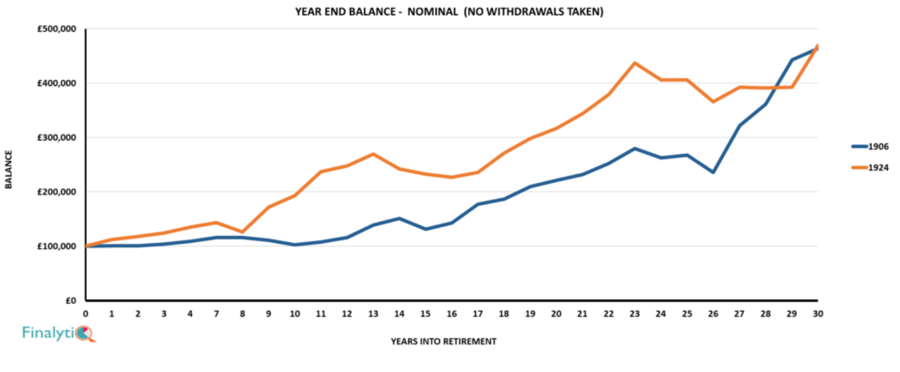
£100,000 – No withdrawals
Notes:
Https://finalytiq.co.uk/it-aint-volatility-stupid/
http://workspaces/dms/sources/jrsjrl/_layouts/15/DocIdRedir.aspx?ID=SRCID-11-6459

Slide 10
Accumulation vs decumulation
Descending the mountain
Income and/or growth?
Capital depletion risk
Longevity risk
Pound cost ravaging
Sequencing risk
Capacity for loss
Notes:
4. So having gone through that David, can a typical CIP provide the same client and adviser benefits when they start to spend down their assets as it does while they’re accumulating them, making a CRP unnecessary? (ML/TC)
(DE) Good question, in my view an advisers existing CIP approach can work just as well in decumulation as it does in accumulation as long as it recognises 3 key differences.
The first key difference: Go through the mountain analogy (one well-trodden route up the wealth mountain, with an evidence base of Modern Portfolio Theory and the Efficient Frontier, compared to differing ways down the wealth mountain driven by the interaction of more and varied risks) and possibly the ski-ing add on (would you recommend someone new to ski-ing, goes down the black run – is that exposing them to too much risk of injury?)
When we’re descending the mountain so to speak, and starting to use the funds for income provision, the challenges are different, and this is where a CRP can help.
The capital is now being called upon to provide income as well as maintain growth, which could lead to capital depletion. This can also have an impact for advisers who manage an assets under management business model.
We also now encounter longevity risk. This is a two pronged issue, in that not only do we not know how long the client is going to live for, and therefore need money for, but with the shift from annuities to drawdown, more and more clients are adopting the longevity risks now instead of the insurance company.
In additiona, they will now face the double whammy of negative pound cost averaging, assuming they take a monetary amount of withdrawal from a falling market, and also face the timing risk of potentially getting off to a bad start when taking income if the market is volatile.
Lastly, the area that takes on increased importance is capacity for loss, especially if the client is no longer working or reducing their working capacity and therefore other sources of income.

Slide 11
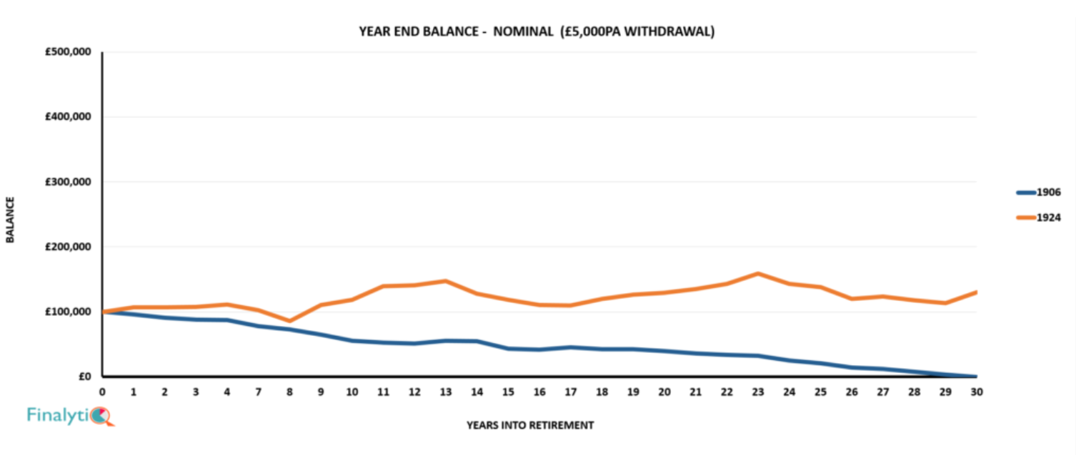
£100,000 - £5,000 pa withdrawal
Notes:
https://finalytiq.co.uk/it-aint-volatility-stupid/
http://workspaces/dms/sources/jrsjrl/_layouts/15/DocIdRedir.aspx?ID=SRCID-11-6459

Slide 12
Centralised retirement Proposition
1.
Consistently applied and documented Advice Principles
6.
Consistent review process
2.
Robust approach to Capacity for Loss and a spending hierarchy
CIP
5.
Adoption of Withdrawal Policy Statements
3.
Evidence based view on sustainable withdrawal rates
4.
Use of appropriate planning tools
Notes:
So there is a lot to consider, but for the purposes of today, we’re going to focus mainly on steps 2 and 3.
Why is capacity for loss so crucial in decumulation and needs to evidenced and monitored, and how should a sustainable withdrawal rate be tackled and documented.

Slide 13
Client view of Capacity for loss – what changes in decumulation?
Risk capacity rebalanced
Capital and need for income
Income volatility
Changing views on what is acceptable
Changing circumstances
Giving up or reducing work?
Notes:
The second key difference: Go through how capacity for loss changes from a function of risk appetite in accumulation to a measurable matter of fact in decumulation, citing the FSA FG11/12 statement
Let’s start with capacity for loss:
When a client decides to switch on income, there are various factors at play that need thinking about. The client’s need for income means that the advice needs to consider income volatility as well as capital preservation. The client’s views on how much risk they are prepared to accept are likely to change as they not only get older, but as their circumstances change. If they are giving up work, they are likely to have a finite amount of savings, investments and assets to call upion which puts a different light on risk.

Slide 14



Probability-based
Notes:
lv= source
http://workspaces/dms/sources/jrsjrl/sources/lv%20navigating%20the%20retirement%20income%20challenges.pdf
Investec report – is 4% the magic number
http://workspaces/dms/sources/jrsjrl/_layouts/15/DocIdRedir.aspx?ID=SRCID-11-6453
Aegon – sustainable income rate in retirement
http://workspaces/dms/sources/jrsjrl/_layouts/15/DocIdRedir.aspx?ID=SRCID-11-6454
In the past, some would say that the rule of thumb of 4% was a safe withdrawal rate. However, this has been brought into question over recent years, with a number of commentators highlighting the dangers of this approach.

Slide 15
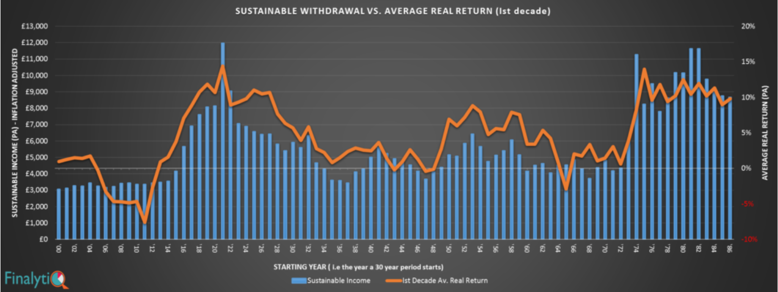
Worst case scenario - uk
Notes:
https://finalytiq.wpengine.com/technically-buggered-historical-evidence-sequence-risk-retirement-portfolios/
http://workspaces/dms/sources/jrsjrl/_layouts/15/DocIdRedir.aspx?ID=SRCID-11-6460

Slide 16
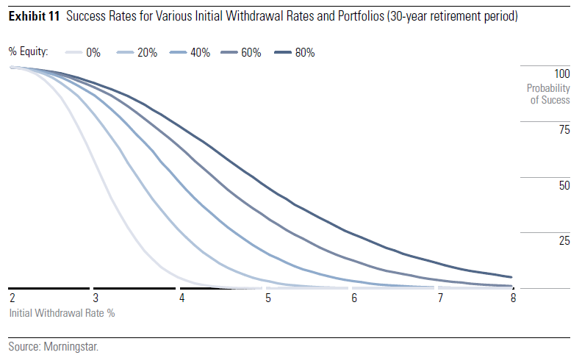
“Safe” withdrawal rates - various portfolios
Source : Morningstar “Safe withdrawal rates for Retirees in the United Kingdom – Blanchett, Buffenoir, Kemp and Watt, published 1.5.16
Notes:
http://workspaces/dms/sources/jrsjrl/_layouts/15/DocIdRedir.aspx?ID=SRCID-11-4742
NB – see slide on year end balances.. As we can see here (click) portfolios with higher weightings to equities offer higher initial withdrawal rates but also more risk. Morningstar comment that “its important to note that most retirees aren’t comfortable taking excessive risk in their portfolios.”
Source – Morningstar “Safe Withdrawal Rates for retirees in the United Kingdom” page 11
SRCID-11-4646
SRCID-11-4647

Slide 17
What are the needs?
Dreams
Gifts
Helping the family e.g. costs of
education or first-time-buyer deposits
Risk/Return?
Freedom Income
This includes meals out, cinema trips and weekends away
Just In Case Fund
Rainy day funds (6 x monthly outgoings)
Essential Income
The fundamental costs e.g. utility bills, household shopping and clothing
Immediate Concerns and Debt
Priority debts repaid e.g. mortgage arrears, credit cards and loans
Personal
Minimum
Income
Requirement (PMIR)
Model based on http://www.nextavenue.org/article/2014-04/determine-your-hierarchy-needs-retirement copyright 2003 Mitch Antony
Notes:
For anyone who is looking to build their retirement portfolio or is thinking about providing an income in retirement, the only product that can eliminate the issue of volatility is a Guaranteed Income for Life plan.
This doesn’t mean it necessarily has to be the only product the retiree uses, but it can be clearly demonstrated that a GIfL needs to be used to offer a firm foundation which provides the personal Minimum Income Requirement that most people will have.
This allows the retiree to build in their flexibility and potential for growth using drawdown, once they know that their living costs will be paid.
SRCID-11-3189 SRCID-11-3183
Model based on http://www.nextavenue.org/article/2014-04/determine-your-hierarchy-needs-retirement copyright 2003 Mitch Antony

Slide 18
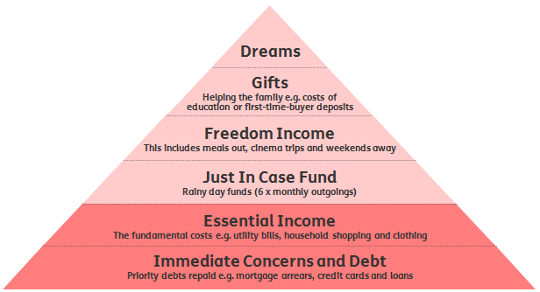
What are the needs?
Notes:
SRCID-11-3189 SRCID-11-3183
Model based on http://www.nextavenue.org/article/2014-04/determine-your-hierarchy-needs-retirement copyright 2003 Mitch Antony
we need to ensure people have immediate concerns covered as a base and build from there. Not the other way around.

Slide 19
Personalise a guaranteed income comparison
Correct Cost of Personal Minimum Income Requirement
Correct ‘investment risk-free’ rate
Correct critical yield for drawdown comparison

Slide 20
Is a single rate appropriate?
£20k
Capital sum required @ 70%
probability = £174k
(SWR = 6.9%)
Income
£8k
Capital sum required @ 95% probability = £335k
(SWR = 2.4%)
65
85
100
Time
Source: FinalytiQ ‘Timeline’ SWR tool (based on historic UK data, a 50/50 equity/bonds portfolio and 1.5%pa overall fees) https://www.timeline.co/

Slide 21
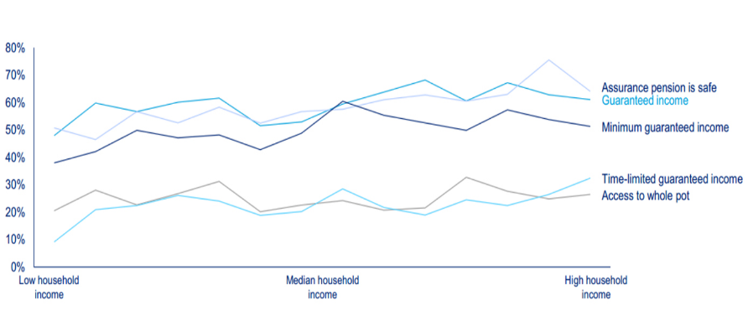
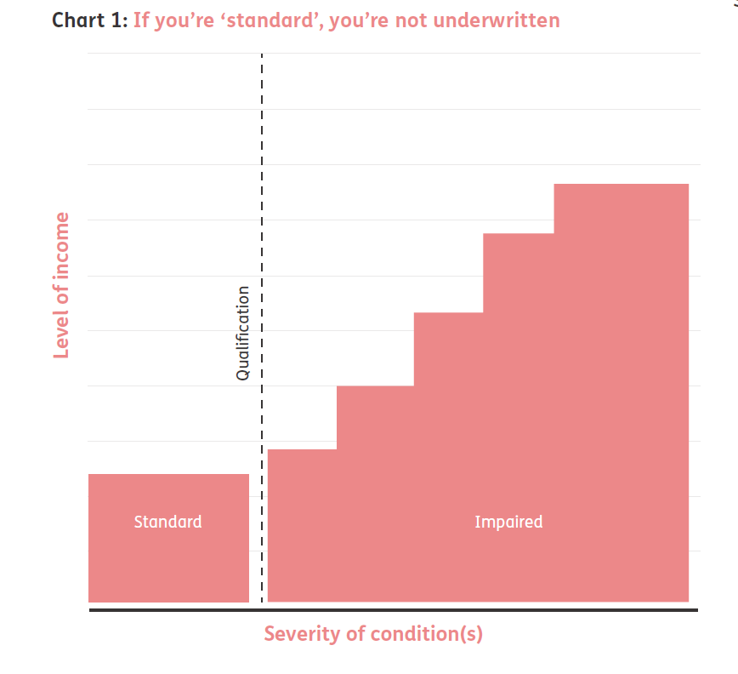
Underwriting – new and old thinking
Old thinking
Notes:
Whilst the templates talk about enhanced annuities, things have moved on. Does someone’s health of lifestyle mean they ‘qualify’ for a better rate?
You may not be able to make that judgment call now, because we have evolved our underwriting processes now. So let me show you what I mean by that. This is how it used to look. Does this look familiar? So you would have “standard” people, and they all got the same annuity rate. So if you had ten people the same age in a room and four of them were standard, those four people would get identical annuity income. And then if you could get them across that qualification line then the good news was they might get a bit more, by collecting the information that would enable underwriters to map them onto the income line depending on the nature and the severity of their conditions or what their lifestyle looked like.

Slide 22
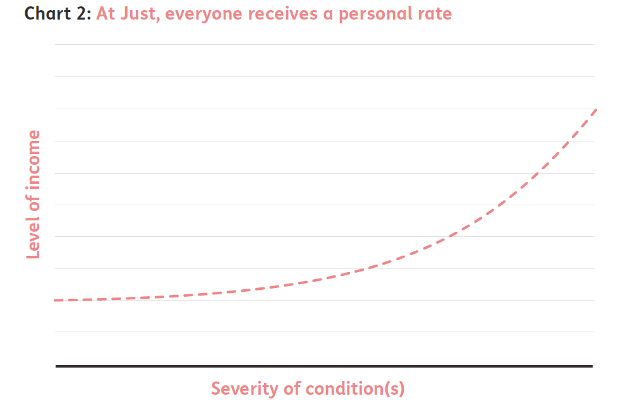
Underwriting – new and old thinking
New thinking
Notes:
What we’ve done now is we’ve just moved that qualification line right back to the start. It doesn’t exist any more. Our underwriting process has evolved is now sensitive to things like height and weight etc. that everybody gets their own income rate.

Slide 23





who gets the most income?
Bob
Mary
Helen
Dave
John
Marital Status
Marital Status
Marital Status
Marital Status
Marital Status
Married
Single
Widowed
Separated
Divorced
Height/Weight
Imperial
Height/Weight
Imperial
Height/Weight
Imperial
Height/Weight
Imperial
Height/Weight
Imperial
5ft 10in / 13st 10lb
5ft 4in / 11st 11lb
5ft 5in / 8st 11lb
5ft 10in / 17st 11lb
5ft 8in / 8st 7lb
Weekly Alcohol Consumption
Weekly Alcohol Consumption
Weekly Alcohol Consumption
Weekly Alcohol Consumption
Weekly Alcohol Consumption
7
18
23
27
21
Source: Just 08.06.2018 Individual 65, £100,000 purchase price, ‘lifestyle’ details as shown. Postcode RH2 7RT Payable monthly in advance, 5 year guaranteed period, no escalation and no spouses benefit. Allows for 2% adviser charge.
Notes:
So let’s put that to the test and let’s get you thinking about which of these people gets the most income. Do you think Bob/Mary/John/Dave/Helen gets the best rate.
Or do you think there’s nothing in it and they all look fairly “standard”?
How would you know? Only by underwriting them. Let’s do that and see the results
SRCID-11-7591 - Small Factors spreadsheet 08 06 2018
SRCID-11-7592 -Small Factors 08 06 2018

Slide 24





Little things mean a lot
Bob
Mary
Helen
Dave
John
Source: Just 08.06.2018 Individual 65, £100,000 purchase price, ‘lifestyle’ details as shown. Postcode RH2 7RT Payable monthly in advance, 5 year guaranteed period, no escalation and no spouses benefit. Allows for 2% adviser charge..
Notes:
SRCID-11-7591 - Small Factors spreadsheet 08 06 2018
SRCID-11-7592 -Small Factors 08 06 2018
Much has been said about the need to underwrite retirees to see IF they qualify for a personalised rate. The need to ensure that someone isn’t missing out on an enhanced annuity is clearly important if the person is looking for a guaranteed income for life. But shouldn’t everyone get a personalised rate? No two people are the same, even though on the face of it they may seem similar in many ways. Whilst someone may appear ‘average’ in terms of health and lifestyle, the graph below shows that just a few key factors can make a big difference.
So, what are the differences between our five people? On the face of it, they may seem in average health. But is average the same as perfect?
Helen may argue that she is no different in terms of health than Bob. So why is her income so much higher?
Well, it comes down to some of the seemingly small factors which may not seem that unusual. In this case the differences are about height and weight, alcohol consumption and marital status.
As you can see, no longer is underwriting an option for some clients; here at Just, we believe everyone should have the right to their own personalised rate.

Slide 25
Freedom choice and certainty
Excellent –No health issues. Good - who is slightly underweight and doesn’t have any health issues.
Reasonable - slightly underweight, an ex-smoker, and has high blood pressure and cholesterol for which they take 1 medication for each condition daily.
Coping - high blood pressure and cholesterol, as well as being diagnosed with diabetes 9 years ago. They take 1 medication for each condition daily.
Challenging - a smoker who has high blood pressure and cholesterol, as well as being diagnosed with Parkinson's 9 years ago. They take 1 medication daily for each condition. They spent time in hospital a year ago, and their activities of daily living are also impacted.
Critical – underweight, and stage 3 bowel cancer that was diagnosed 6 months ago, and has undergone surgery, chemotherapy and radiotherapy.
Rates offered from Just on 05.06.2018. Illustrations based on an individual aged 65, with a £100,000 pension fund. A facilitated adviser charge of 2% has been assumed.
Notes:
http://workspaces/dms/sources/jrsjrl/_layouts/15/DocIdRedir.aspx?ID=SRCID-11-7608

Slide 26

Value Protection – a lump sum benefit
Full Fund Value
Less Pension Commencement Lump Sum
Less Taxable Lump Sum
X % of Value Protection selected
Less Gross Payments to date
= Value Protection Lump Sum
Notes:
For GIfL solutions with Value Protection, the value protection lump sum would be calculated as follows.
Full Fund Value
less Pension Commencement Lump Sum
less Taxable Lump Sum
x % of Value Protection selected
less Gross Payments to date
= Value Protection Lump Sum

Slide 27


Annuity Death Benefits
No Death Benefit
£2,888
20 Year Guarantee
£2,605
50% Spouse + G5
£2,537
100% Value Protection
£2,461
£50,000
Comparisons are based on an individual aged 65 with a £50,000 pension fund. They are slightly underweight, an ex-smoker, and suffer from high blood pressure and cholesterol, for which they take 1 medication for each condition daily. They have a healthy spouse aged 62.
The above figures are based on an annuity being payable monthly in arrears, no overlap where applicable, based on RH2 7RT postcode, where a facilitated adviser charge of 2% has been assumed. Just annuity rates, 5 June 2018.
Notes:
http://workspaces/dms/sources/jrsjrl/_layouts/15/DocIdRedir.aspx?ID=SRCID-11-7584
Let’s consider the cost of some of the death benefit options available.
Based on £50,000 (after TFC) for example. His income without benefits would be £read from slide. We can then see how the cost of benefits becomes more expensive depending on the option selected.
With 50% spouse’s pension and a 5 year guarantee period, the income falls to £read from slide and with a 20 year guarantee only, to £read from slide. We’ve chosen a 20 year term as that is roughly the point average Life expectancy is reached.
100% value protection produces an income of £read from slide. For annuities, there are two factors to highlight here:
Firstly, the removal of the 55% tax charge means that Value Protection becomes a viable option once more, ensuring that the balance of the annuity is returned to beneficiaries on death, less any income already paid, less tax if the annuitant dies after age 75.
Secondly, guarantee periods can now be extended, with Just this could be up to 30 years.
So this now means there is more choice on how an annuity can be tailored to suit an individual’s wishes and how they provide for loved ones in the event of death.

Slide 28
GIfL death benefits 100% Value protection
Death after 6 months
£1,230
£48,770
Death after 5 years
£12,305
£37,695
Death after 10 years
£24,610
£25,390 (subject to tax)
Death after 24 years
£59,064
£50,000
Comparisons are based on an individual aged 65 with a £50,000 pension fund. They are slightly underweight, an ex-smoker, and suffer from high blood pressure and cholesterol, for which they take 1 medication for each condition daily. They have a healthy spouse aged 62.
The above figures are based on an annuity being payable monthly in arrears, no overlap where applicable, based on RH2 7RT postcode, where a facilitated adviser charge of 2% has been assumed. Just annuity rates, 5 June 2018.
Notes:
Derived from VP figure (applying VP calculation) from ‘cost of options sales aid’ http://workspaces/dms/sources/jrsjrl/_layouts/15/DocIdRedir.aspx?ID=SRCID-11-7584
What does that means for clients who choose VP as a death benefit?
They can have an income of £read from slide. If they die after 6 months they would have had income of £read from slide
If they die after 5 years they would have had income of £read from slide and a tax free death benefit payment to the named beneficiary of £read from slide
If they live to 75 they would have had income of £read from slide and a lump sum payment subject to tax of £read from slide
And finally they break even just after 23 years with any more income above their initial fund level
SRCID-11-5445

Slide 29



Unscrambling the information
Notes:
And, of course, there are a lot of initiatives taking place. In 2017 a number of consultations and discussion papers were produced around what people are doing with their pension freedoms and the lack of shopping around was highlighted as a key issue and a risk to good outcomes. Perhaps this is nothing new. A number of measures have been put in place over the years to encourage people to shop around, including highlighting the open market option in retirement packs along with statements about how lifestyle and medical details might make a difference. But the fact is that not enough people are shopping around. Let’s look at the stats.
Advising on Pension Transfers http://workspaces/dms/sources/jrsjrl/_layouts/15/DocIdRedir.aspx?ID=SRCID-11-6427
Famr report
https://www.fca.org.uk/publication/market-studies/retirement-outcomes-review-interim-report.pdf
Pdf of FAMR report in DMS
http://workspaces/dms/sources/jrsjrl/_layouts/15/DocIdRedir.aspx?ID=SRCID-11-6372
PS 17/12 – information prompts in the annuity market
Link to the report
https://www.fca.org.uk/publication/policy/ps17-12.pdf
Pdf copy of the report
http://workspaces/dms/sources/jrsjrl/_layouts/15/DocIdRedir.aspx?ID=SRCID-11-6383
FCA business plan 2017/18
Link to the report
https://www.fca.org.uk/publication/business-plans/business-plan-2017-18.pdf
Source on dms
http://workspaces/dms/sources/jrsjrl/_layouts/15/DocIdRedir.aspx?ID=SRCID-11-6003
Link to retirement outcome review – interim report
https://www.fca.org.uk/publication/market-studies/retirement-outcomes-review-interim-report.pdf
Source on dms
http://workspaces/dms/sources/jrsjrl/_layouts/15/DocIdRedir.aspx?ID=SRCID-11-6372

Slide 30

Nudge, nudge
Every guaranteed pension annuity quote will include an information prompt.
Encourages the client to shop around.
If applicable and the client has given their consent:
  Additional figure showing the best rate available in the market.
  Difference in monetary terms.
If the firm does not have access to the best rates in the market:
  Client made aware.
  Nudged to shop around more widely.
Protected benefits shown where applicable.
  If better than ‘market’, the difference that applies.
1 March 2018
Notes:
Every quote includes a prompt to shop around – that may or may not take the form of a comparison.
It the client has given consent, then an additional figure will be issued with each quote, showing how much better off they could be if they used a different provider! However, the prompt won’t show who that other provider is..
The rules say that if the firm does not have access to the better rate shown, they have to make the client aware of the ‘shopping around’ option. Clearly, where the prompt is issued by a provider, and another rate is better, that will be stated on the prompt. But it may be the case that a prompt is issued by a restricted adviser who doesn’t have access to the higher rate. In that case, the higher rate would still have to be shown to the client, but with details on how they can obtain it, even if the restricted firm cannot obtain it for them! Obviously, it is up to the client what route they actually take.

Slide 31

Additional warnings
Guaranteed, Enhanced or Protected benefits
Guaranteed Annuity Rate (GAR)
Guaranteed Minimum Pension (GMP)
Sect 9(2b) rights
Pension Commencement Lump Sum (PCLS) > 25%
Potential eligibility for an Enhanced Annuity
Clear and prominent
Same underwriting information for comparison used to produce own quotes
Source: FCA PS17/12, May 2017
Notes:
The other ‘warning’ is a statement around enhanced annuities, and that the client could obtain a higher income. However, we don’t think this goes far enough in as much as any data a provider holds to make the comparison is what will be used for the WOM quotes. This means that if there are a few questions for their underwriting, or limited information, that’s all that will be used for every other quote! Again, the adviser has to assess whether the prompts are appropriate. Will they be accurate enough? Remember this is not designed to replace the full process that advisers go through.
http://workspaces/dms/sources/jrsjrl/_layouts/15/DocIdRedir.aspx?ID=SRCID-11-6345
2.20 We also set out two scenarios where we believed it would be appropriate for firms providing the information prompt to give additional warnings alongside the prompt. These were where consumers are entitled to a pension commencement lump sum (PCLS) of higher than 25% of their fund value or entitled to a guaranteed annuity rate (GAR), whether at the time of the quote or in future (PS17/12. P11)
Our final rules, therefore, require that where a GAR is payable in the future an estimated annual income figure must be provided. (PS17/12. P12)
Finally, we do not propose to mandate that a consumer must take advice if the value of the fund used to purchase the annuity is over £30,000 (PS17/12. P13)
2.27 In CP16/37 we proposed that firms should use the same underwriting information to produce the comparison of quotes that they use to produce their own quotes.(PS17/12. P13)
As set out previously, we have mandated a warning in respect of potential eligibility for enhanced annuities. We consider that this warning will be more effective at prompting consumers to consider their eligibility for an enhanced annuity. (PS17/12. P14)
Section 9(2b) Rights: Contracted-out benefits accrued in a COSR after 5/4/97 which have been transferred to another arrangement.

Slide 32

Client consent to obtain comparisons
Adviser validation taken for illustration comparisons.
The Retirement Health Form has been updated to enable the customer to provide consent for their information to be shared with the market.
Template 3 issued where:
  Form does not give client consent and no prior consent via adviser.
  Prior consent from adviser, but form contradicts this.
  Full application received with no client consent.
Notes:
When it comes to client consent, at the time of requesting illustrations, the adviser is the ‘data controller’. This means that we can take verbal confirmation that you hold the client’s authority for us to obtain comparisons.
When it comes to the Retirement Health Form and capturing further details, you will find an updated question around consent for the client to sign, enabling providers to use the information to get the comparisons.
But remember, template 3 (i.e. a prompt with NO comparison, will be issued where….. Read bullets)

Slide 33
Centralised retirement Proposition
1.
Consistently applied and documented Advice Principles
6.
Consistent review process
2.
Robust approach to Capacity for Loss and a spending hierarchy
CIP
5.
Adoption of Withdrawal Policy Statements
3.
Evidence based view on sustainable withdrawal rates
4.
Use of appropriate planning tools
Notes:
So there is a lot to consider, but for the purposes of today, we’re going to focus mainly on steps 2 and 3.
Why is capacity for loss so crucial in decumulation and needs to evidenced and monitored, and how should a sustainable withdrawal rate be tackled and documented.

Slide 34
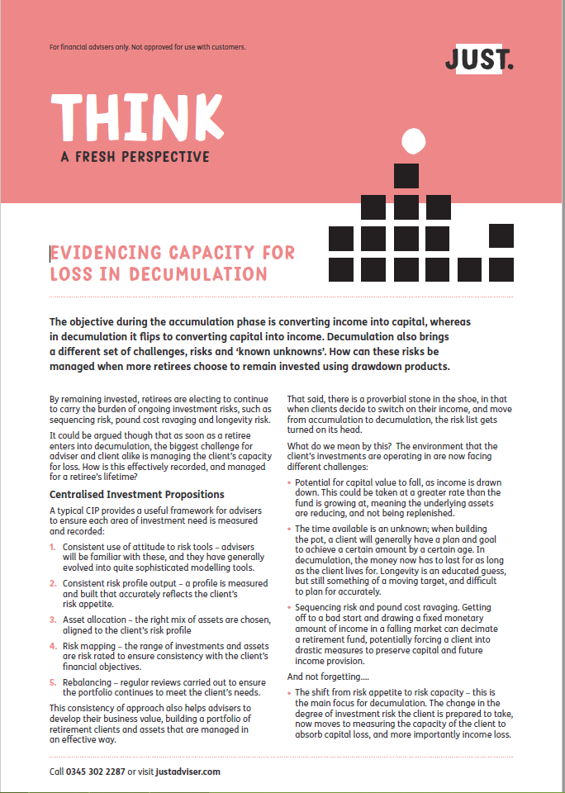

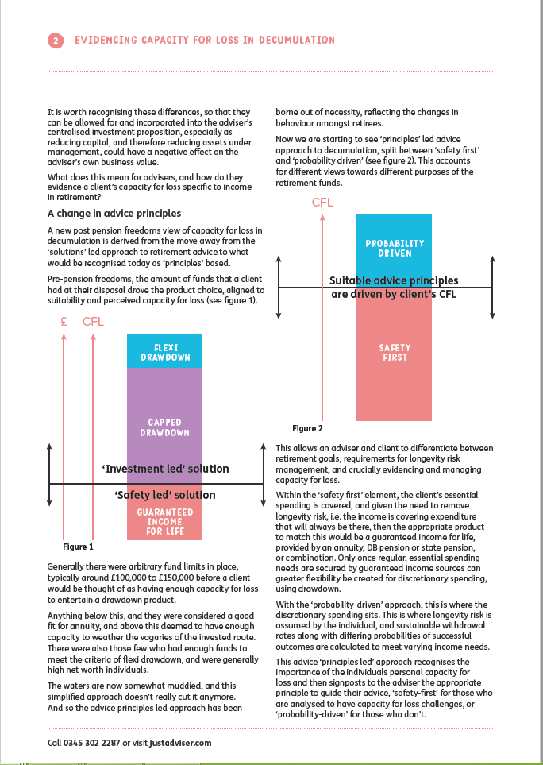
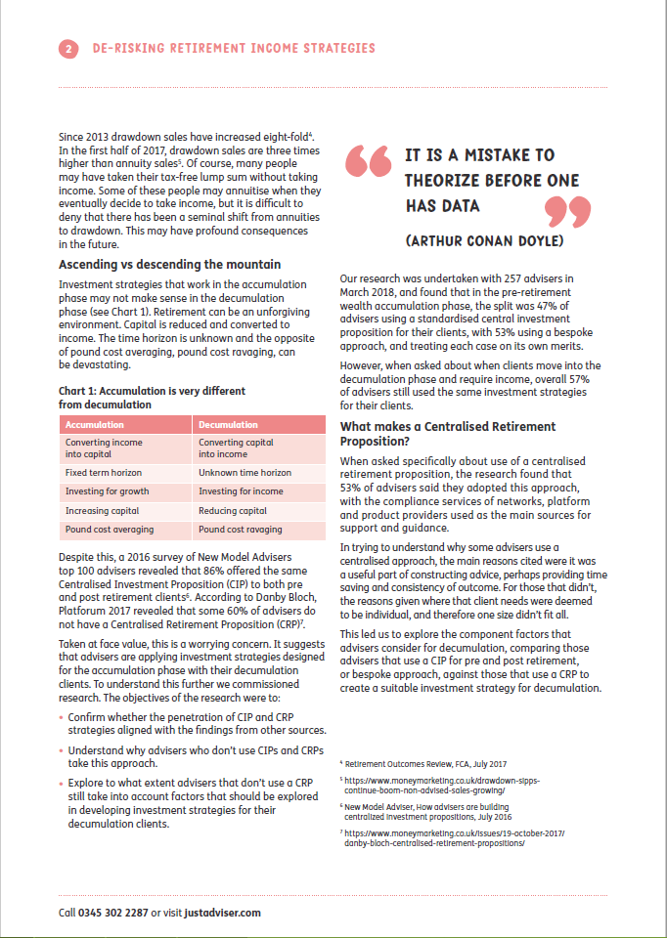

support

Slide 35
conundrum
R
E
T
i
r
e
m
e
n
t
How long should it last?
E
n
T
i
r
e
t
E
R
m
Notes:
Here is the conundrum from earlier on and the answer!

Slide 36
Learning outcomes
By attending this session, delegates will be able to:
Examine the main approaches to risk-based retirement income planning
Consider the developments in underwriting and how this can improve client outcomes
Be aware of the regulatory changes under PS17/12 that firms must adopt
Consider the benefits of a combined approach to guarantees and investment

Slide 37
The Retirement Risk Conundrum

Slide 38

Important information
It is our intention that the information contained within this presentation is accurate. We have taken all reasonable steps to ensure that it is up-to-date and, where relevant, reflects the current views of our experts. However, we do not accept any liability for errors or omissions in the information supplied and if you require clarification on anything, our recommendation is that you contact us at the address below for verification, or call 0345 302 2287.
Our registered address:
Just Group plc
Vale House, Roebuck Close,
Bancroft Road,
Reigate,
Surrey RH2 7RU
Regulatory information:
Just is a trading name of Just Retirement Limited (“JRL”), Just Retirement Money Limited (“JRML”), Partnership Life Assurance Company Limited (“PLACL”) and Partnership Home Loans Limited (“PHLL”) which are subsidiary companies of Just Group plc. JRL is registered in England and Wales, with company number 05017193.
JRML is registered in England and Wales, with company number 09415215. The registered office for both JRL and JRML is Vale House, Roebuck Close, Bancroft Road, Reigate, Surrey, RH2 7RU.
PLACL is registered in England and Wales, with company number 05465261. PHLL is registered in England and Wales, with company number 05108846. The registered office for both PLACL and PHLL
is 5th floor, 110 Bishopsgate, London EC2N 4AY. JRL and PLACL are authorised by the Prudential Regulation Authority and regulated by the Financial Conduct Authority and the Prudential Regulation Authority.
JRML and PHLL are authorised and regulated by the Financial Conduct Authority. Calls may be monitored and recorded, and call charges may apply.
@Just_Adviser
Follow the updates on us on twitter
www.justadviser.com
Our dedicated intermediary site packed with useful calculators, guides, product information, topical articles and more.
Approved to 21/09/2018

