Slide 1
STRATEGIC
EXPIRED
DRAFT
Retirement & Investment Conference
Harry Richards
  Assistant Fund Manager, Fixed Income
September 2018

Slide 2
When does the party end?
DYNAMIC
ENG
UT
SICAV
On Request
This is updated by Katharine Dryer, Fabrizio Palmucci or Ariel Bezalel, Joe Moxham
EUROPE
“Only when the tide goes out do you discover who's been swimming naked”
Warren Buffett
“Last rate hike in a cycle is much like the last kiss in a relationship: you rarely think it is going to be the last one, while it is actually happening.”
Alex Gurevich
ASIA
Cryptocurrency carnage
Volatility ETFs
Emerging market pain
LATAM
UK
Italian politics
MIDEAST
Trade wars
Financials under pressure

Slide 3
EM FX
DYNAMIC
ENG
UT
SICAV
On Request
This is updated by Katharine Dryer, Fabrizio Palmucci or Ariel Bezalel, Joe Moxham
DRAFT
EUROPE
Trade talk, rising libor, QT and USD revival really taking its toll on EM
EXPIRED
ASIA
LATAM
UK
MIDEAST
Source: Bloomberg, September 2018.

Slide 4
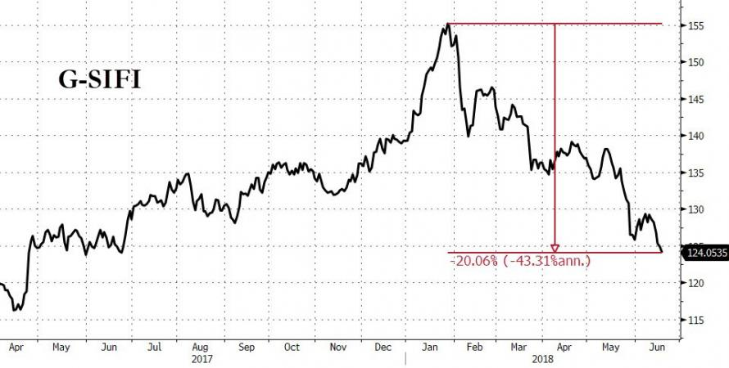
G-SIFIs – the clue is in the name
DYNAMIC
ENG
UT
SICAV
On Request
This is updated by Katharine Dryer, Fabrizio Palmucci or Ariel Bezalel, Joe Moxham
EUROPE
Global systemically important financial institutions are in a bear market
ASIA
LATAM
UK
MIDEAST
Source: Zerohedge, 19.06.18.

Slide 5
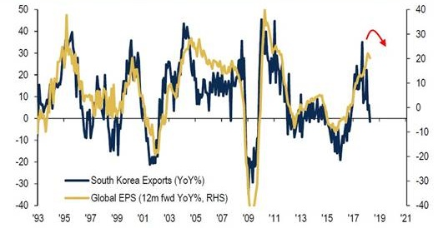
Leading indicators for activity turning down
DYNAMIC
ENG
UT
SICAV
On Request
This is updated by Katharine Dryer, Fabrizio Palmucci or Ariel Bezalel, Joe Moxham
EUROPE
South Korean export growth, a great lead indicator of global EPS, just turned negative
ASIA
LATAM
UK
MIDEAST
Source: BofA Merrill Lynch Global Investment Strategy, Bloomberg, as at 30.06.18.

Slide 6
US Treasury 5s30s
DYNAMIC
ENG
UT
SICAV
On Request
This is updated by Katharine Dryer, Fabrizio Palmucci or Ariel Bezalel, Joe Moxham
DRAFT
EUROPE
Robert Kaplan “the flattening yield curve and the muted rise in 10-year Treasury yields suggest that the outlook for GDP growth is sluggish and that warrants attention as the history of inverted curves is not positive.”
EXPIRED
ASIA
LATAM
UK
MIDEAST
Source: Bloomberg, June 2018.

Slide 7
OECD Total Broad Money M3 % change y-o-y SA
DYNAMIC
ENG
UT
SICAV
On Request
This is updated by Katharine Dryer, Fabrizio Palmucci or Ariel Bezalel, Joe Moxham
DRAFT
EUROPE
Growth in broad money lowest since 2011 in leading economies
EXPIRED
ASIA
LATAM
UK
MIDEAST
Source: Bloomberg, April 2018.

Slide 8
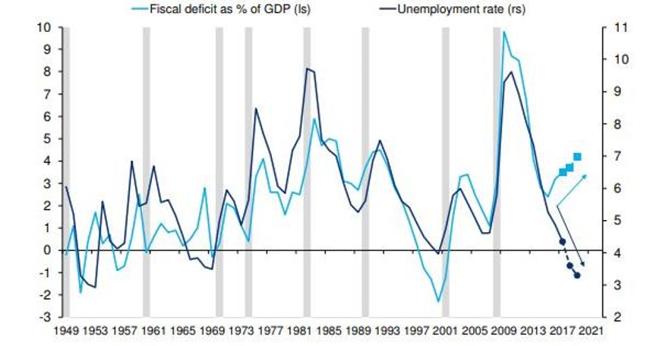
A shot in the arm at the wrong time?
DYNAMIC
ENG
UT
SICAV
On Request
This is updated by Katharine Dryer, Fabrizio Palmucci or Ariel Bezalel, Joe Moxham
EUROPE
Fiscal firepower already utilised. Next US recession to start with record deficit?
Fiscal deficit and unemployment rate
ASIA
LATAM
UK
MIDEAST
Source: OMB, BLS, Federal Reserve Board, Havier Analytics, Deutsche Bank Research.

Slide 9
A ‘REAL’ alternative
DYNAMIC
ENG
UT
SICAV
On Request
This is updated by Katharine Dryer, Fabrizio Palmucci or Ariel Bezalel, Joe Moxham
EUROPE
The real yield on two-year treasuries stands out. Cash is back as an asset class
ASIA
LATAM
UK
MIDEAST
Source: Bloomberg, as at 20.06.18.

Slide 10
The power of liquidity
DYNAMIC
ENG
UT
SICAV
On Request
This is updated by Katharine Dryer, Fabrizio Palmucci or Ariel Bezalel, Joe Moxham
DRAFT
EUROPE
G3 Central Bank Balance Sheets versus MSCI World
ASIA
EXPIRED
LATAM
UK
MIDEAST
Source: Bloomberg, as at 10.09.18

Slide 11
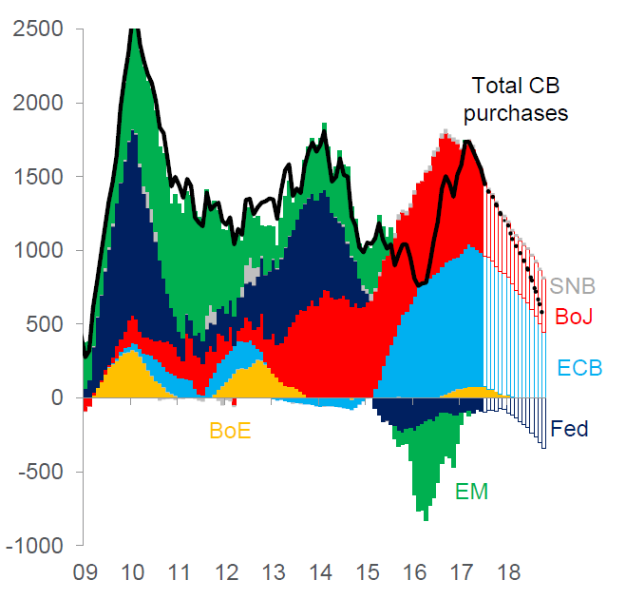
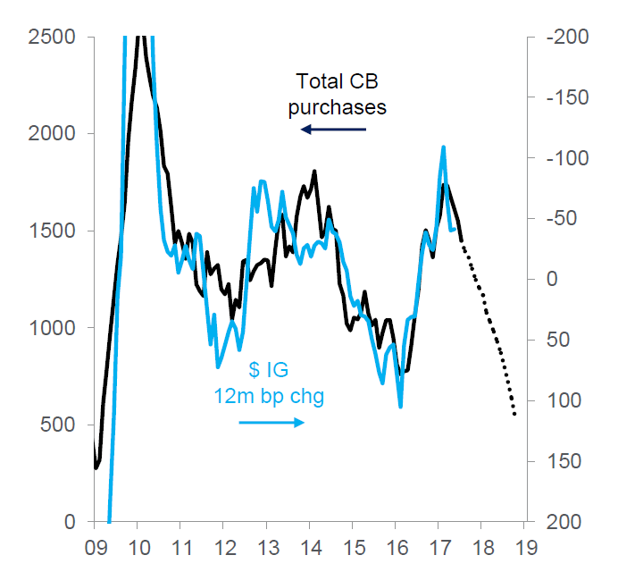
Who needs fundamentals when the fit is this good
DYNAMIC
ENG
UT
SICAV
On Request
This is updated by Katharine Dryer, Fabrizio Palmucci or Ariel Bezalel, Joe Moxham
DRAFT
EUROPE
Our favourite market indicator
Can you see why?
ASIA
EXPIRED
Securities purchased by global central banks, rolling 12m, $bn
CB securities purchases ($bn) vs US IG credit spread 12m chg (bp)
LATAM
UK
MIDEAST
Source: National central banks, Citi Research, Yield Book. EMFX reserve changes are FX-adjusted.
Fed Balance Sheet Unwind: $420bn in 2018, $600bn in 2019. Tax cuts to add $140bn to economy wide earnings in 2018 and just
$80bn in extra nominal GDP gains.

Slide 12
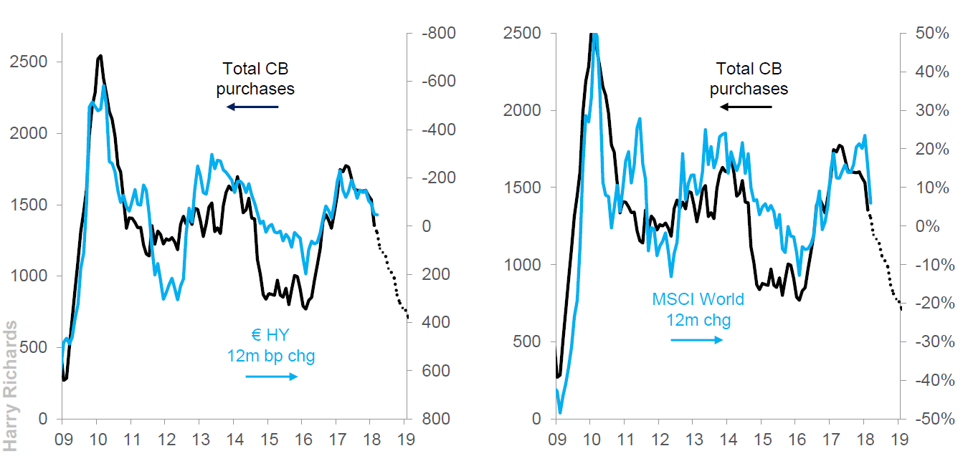
Why fight the flow?
DYNAMIC
ENG
UT
SICAV
On Request
This is updated by Katharine Dryer, Fabrizio Palmucci or Ariel Bezalel, Joe Moxham
DRAFT
EUROPE
We know what central banks are doing
Why are we so slow to price that in?
ASIA
EXPIRED
LATAM
UK
MIDEAST
Source: Citi Research, national central banks, March 2018.

Slide 13
Duration history
STRAT BOND
ENG
UT
Monthly
Data provided by Client Reporting
DRAFT
Jupiter Strategic Bond Fund
Current effective duration
EXPIRED
UK
2588_71710
This fund changed its investment objective on 19.12.13 to allow the manager to use derivatives for investment purposes.
Source: FactSet, 31.07.18. Fund launched on 02.06.08.
2588_72440

Slide 14
US 10-year yield: 1980-2018
DYNAMIC
ENG
UT
SICAV
On Request
This is updated by Katharine Dryer, Fabrizio Palmucci or Ariel Bezalel, Joe Moxham
DRAFT
EUROPE
EXPIRED
ASIA
Black
Monday
S&L
Crisis
Japan
Bubble
Bursts
Tequila
Crisis
Dotcom
Bubble
Bursts
LATAM
GFC
UK
???
MIDEAST
Source: Bloomberg, March 2018.

Slide 15
The US treasury asymmetry
DYNAMIC
ENG
UT
SICAV
On Request
This is updated by Katharine Dryer, Fabrizio Palmucci or Ariel Bezalel, Joe Moxham
EUROPE
ASIA
LATAM
UK
MIDEAST
Source: Bloomberg, as at 04.09.18.

Slide 16
A ‘REAL’ alternative
DYNAMIC
ENG
UT
SICAV
On Request
This is updated by Katharine Dryer, Fabrizio Palmucci or Ariel Bezalel, Joe Moxham
EUROPE
The real yield on two-year treasuries stands out. Cash is back as an asset class
ASIA
LATAM
UK
MIDEAST
Source: Bloomberg, as at 20.06.18.

Slide 17
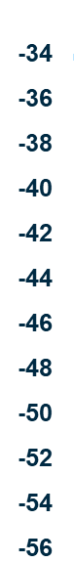
Financial conditions are key
DYNAMIC
ENG
UT
SICAV
On Request
This is updated by Katharine Dryer, Fabrizio Palmucci or Ariel Bezalel, Joe Moxham
EUROPE
ASIA
LATAM
UK
MIDEAST
Source: Bloomberg, as at 20.06.18.

Slide 18
Bear market in China
DYNAMIC
ENG
UT
SICAV
On Request
This is updated by Katharine Dryer, Fabrizio Palmucci or Ariel Bezalel, Joe Moxham
EUROPE
Shanghai composite is down over 20% from the peak earlier this year
ASIA
LATAM
UK
MIDEAST
Source: Bloomberg, as at 10.09.18

Slide 19
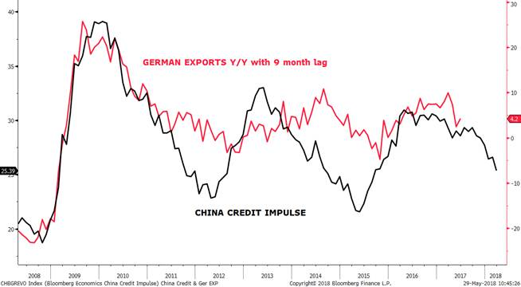
German exports vs. China credit impulse
DYNAMIC
ENG
UT
SICAV
On Request
This is updated by Katharine Dryer, Fabrizio Palmucci or Ariel Bezalel, Joe Moxham
EUROPE
German factory orders have contracted four months in a row
ASIA
LATAM
UK
MIDEAST
Source: Bloomberg, Deutsche Bundesbank

Slide 20
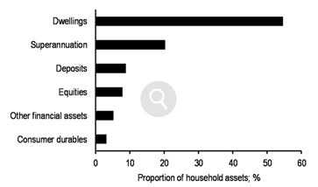
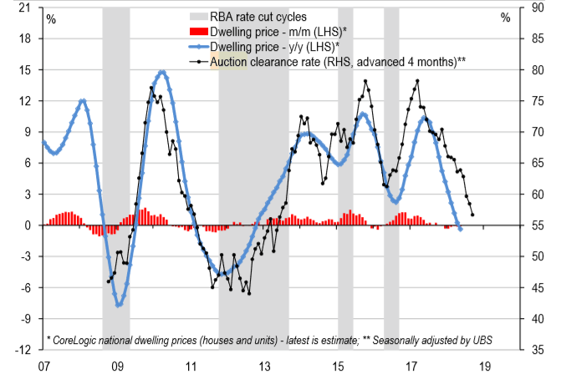
Household wealth to take a hit?
DYNAMIC
ENG
UT
SICAV
On Request
This is updated by Katharine Dryer, Fabrizio Palmucci or Ariel Bezalel, Joe Moxham
EUROPE
Auction clearance rates fell to a ~ 5-year low of the under 60%, implying weak house prices in the near-term*
ASIA
LATAM
UK
MIDEAST
*Source: CoreLogic, RBA, UBS.
Source: JP Morgan.

Slide 21
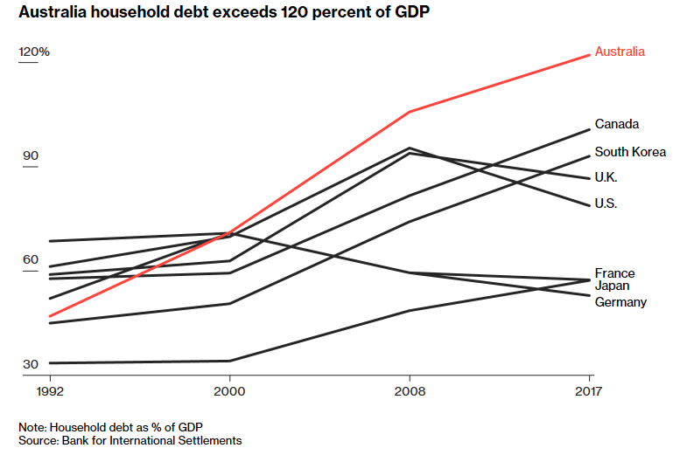
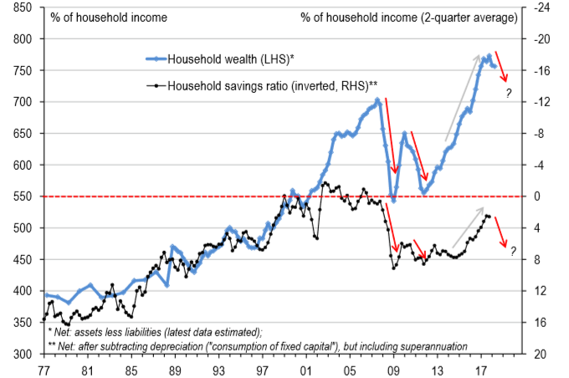
Australia – borrowing more, saving less
DYNAMIC
ENG
UT
SICAV
On Request
This is updated by Katharine Dryer, Fabrizio Palmucci or Ariel Bezalel, Joe Moxham
EUROPE
Household debt to income stands at 190%
Surge in household wealth drove a drop in savings which boosted spending, but set a fade ahead*
ASIA
LATAM
UK
MIDEAST
Source: Bloomberg 28.06.2018. Bank for International Settlements
*Source: CoreLogic, RBA, UBS.

Slide 22
Australia – M3 growth vs. CPI
DYNAMIC
ENG
UT
SICAV
On Request
This is updated by Katharine Dryer, Fabrizio Palmucci or Ariel Bezalel, Joe Moxham
EUROPE
ASIA
LATAM
UK
MIDEAST
Source: Bloomberg, as at 30.04.18.

Slide 23
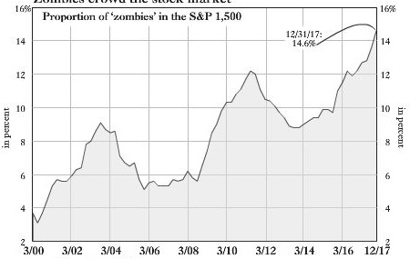
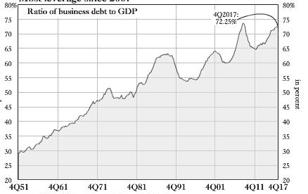
US credit: Late cycle
DYNAMIC
ENG
UT
SICAV
On Request
This is updated by Katharine Dryer, Fabrizio Palmucci or Ariel Bezalel, Joe Moxham
DRAFT
EUROPE
Kept alive by low rates
Zombies crowd the stock market
Most leverage since 2007*
ASIA
EXPIRED
LATAM
UK
MIDEAST
Zombies: Proportion of firms whose EBIT fails to cover interest expense.
Source: Bianco Research LLC. December 2017.
*Source: Federal Reserve Bureau of Economic Analysis. December 2017.

Slide 24
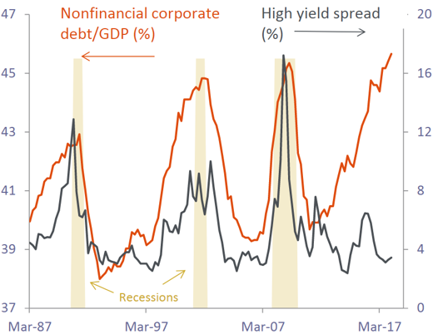
Spreads are dislocated from corporate debt levels
DYNAMIC
ENG
UT
SICAV
On Request
This is updated by Katharine Dryer, Fabrizio Palmucci or Ariel Bezalel, Joe Moxham
EUROPE
The divergence between corporate debt levels and HY spreads is alarming
ASIA
LATAM
UK
MIDEAST
Source: Bloomberg, PiperJaffray.

Slide 25
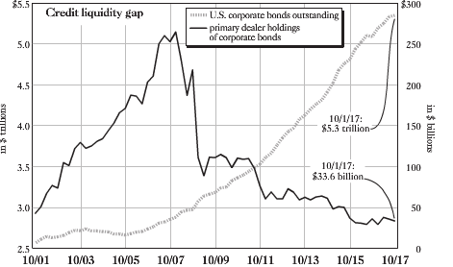
The credit liquidity gap
DYNAMIC
ENG
UT
SICAV
On Request
This is updated by Katharine Dryer, Fabrizio Palmucci or Ariel Bezalel, Joe Moxham
EUROPE
Okay for a bull market
ASIA
LATAM
UK
MIDEAST
Source: Federal Reserve Bank of St Louis, Federal Reserve Bank of New York, Saha Capital, L.P.

Slide 26
Investment themes
DYNAMIC
ENG
UT
SICAV
On Request
This is updated by Katharine Dryer, Fabrizio Palmucci or Ariel Bezalel, Joe Moxham
DRAFT
EUROPE
Rationale
Implementation
US rates
    Downside risks to economic growth
    Unsustainable consumer growth
    Decelerating money supply
    Long 10 years US Treasuries
ASIA
EXPIRED
Australian rates
    Downside risks to economic growth
    Risks to property prices
    Proximity to China
    Long 10 years Australian Treasuries
Emerging markets
    Attractive local real rates in India
    High Sharpe ratio in Russia hard-currency corporates
    Indian local bonds (FX tactically hedged)
    Russian corporates in hard-currency
LATAM
High Yield: Old-style/ Legacy tier one
    Attractive carry and relative low volatility during sell-offs
    High probability of call from issuers due to phasing out of capital benefit
    UK and European Banks legacy Tier 1 and Upper Tier 2 bonds
UK
Cash proxies
    Stretched valuations in credit markets
    Keep the portfolio liquid to redeploy
    Short-dated yield to call corporates
MIDEAST
Tail-risk management
    Mitigation in case of unforeseeable events
    Gold mining convertibles
    HY CDS protection
Special situations
    Benefit from idiosyncratic credit or macro stories
    Varied
The views expressed are those of the presenter at the time of preparation and may change in the future.
Holdings examples are for illustrative purposes only and are not a recommendation to buy or sell.

Slide 28
Indices disclosure
This document contains information based on the MSCI World Index. Neither MSCI nor any other party involved in or related to compiling, computing or creating the MSCI data makes any express or implied warranties or representations with respect to such data (or the results to be obtained by the use thereof), and all such parties hereby expressly disclaim all warranties of originality, accuracy, completeness, merchantability or fitness for a particular purpose with respect to any of such data. Without limiting any of the foregoing, in no event shall MSCI, any of its affiliates or any third party involved in or related to compiling, computing or creating the data have any liability for any direct, indirect, special, punitive, consequential or any other damages (including lost profits) even if notified of the possibility of such damages. No further distribution or dissemination of the MSCI data is permitted without MSCI’s express written consent.

