Slide 1
Birmingham CII 12 September 2018
The Salisbury Novichok Poisoning Case
Damian Glynn - Director, Head of Financial Lines

Slide 2
Agenda
Overview
Policy cover – non damage denial of access?
Recent events

Slide 3
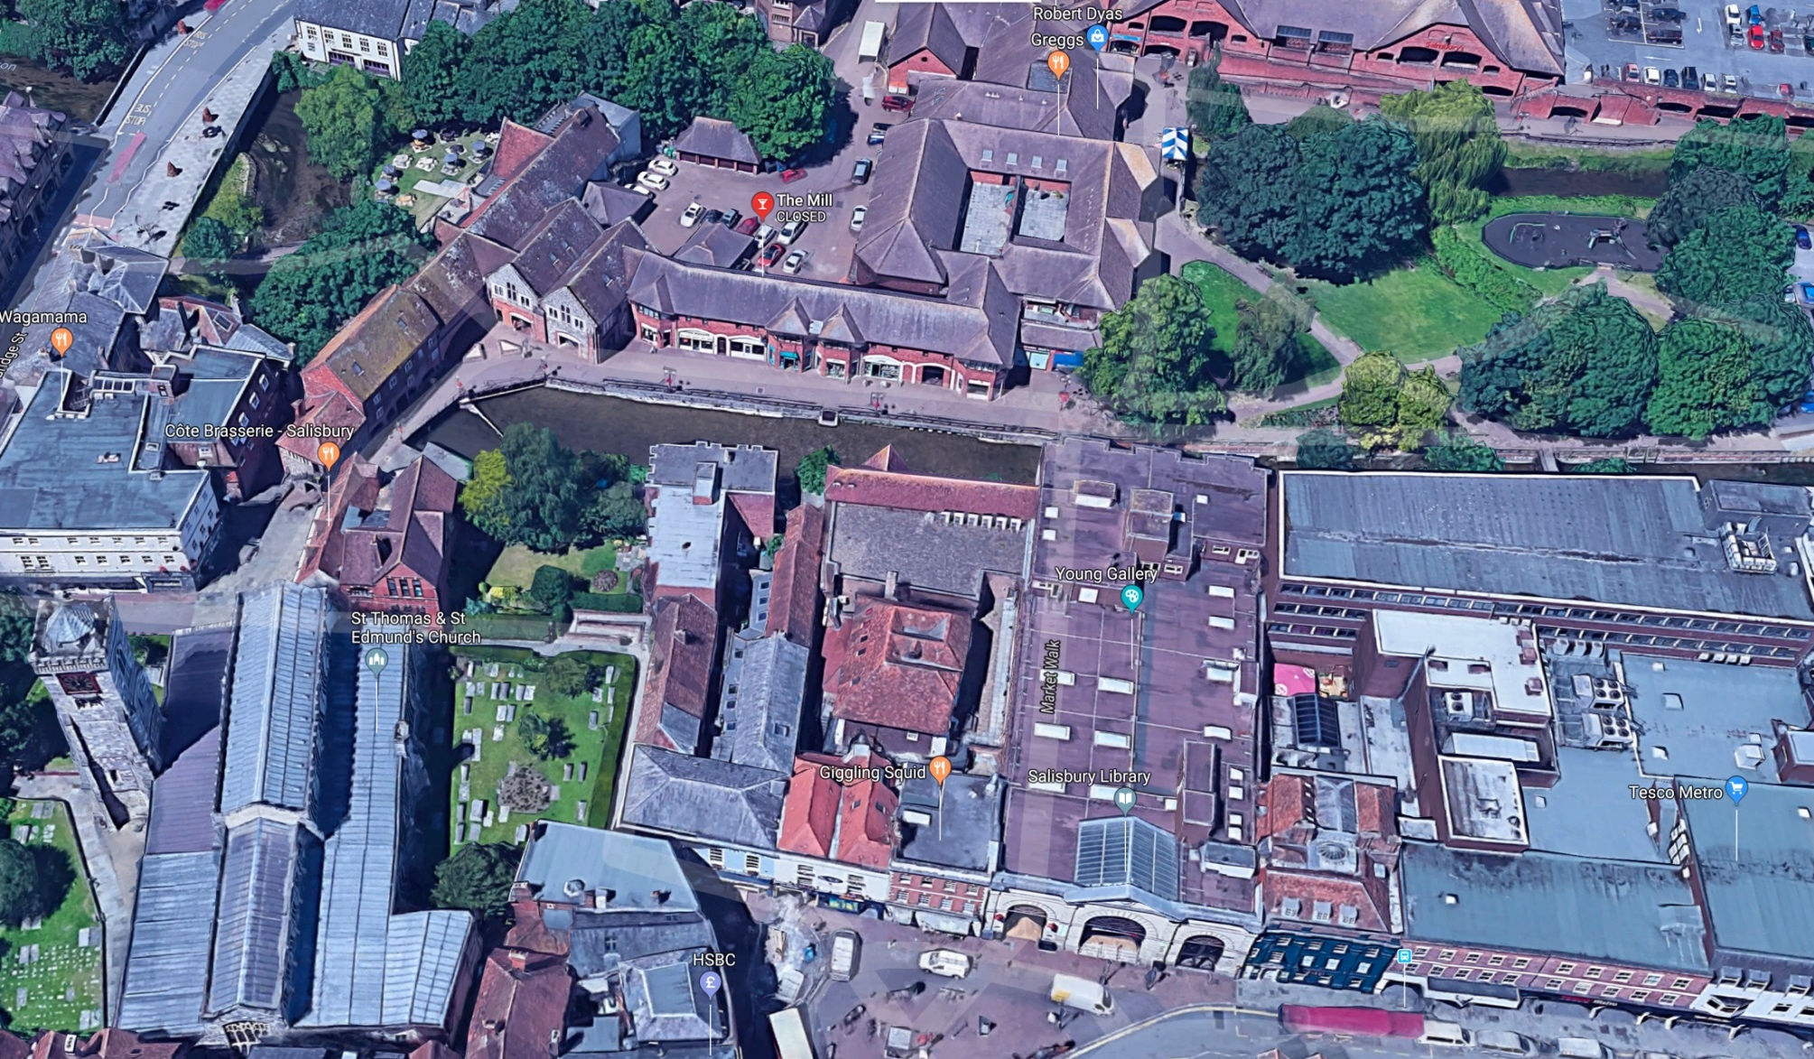
Movements of Sergei and Yulia Skripal : Cause?
2. The Mill Pub
1. Sainsbury’s car park
5. Pair found
on bench
4. Market Walk
3. Zizzi

Slide 4

Time table of events in Salisbury
4th March Initial uncertainty re cause/location
6th March Counter – terrorism officers take over
from Wiltshire police investigation
12th March Presence of Novichok identified
14th March Investigation focusing on Skripal’s home
28th March Conclusion that front door handle has been initially contaminated

Slide 5
Scope of investigation
2,500 pedestrians searched
900 witness statements
14,000 vehicles checked
2,300 exhibits recovered
4,000 hours of CCTV footage reviewed

Slide 6
Terrorism Act 2000
Threat of action (inside or outside UK)
Designed to influence Government or public
Political/religious/racial/ideological cause
Threat of action (in or outs

Slide 7
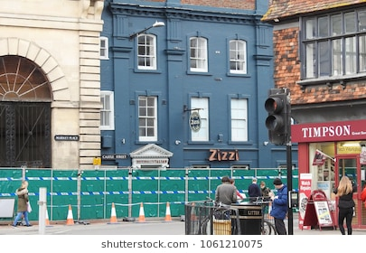
Non damage denial of access?
action (in or outside UK)
Designed to influence Government or public
Re a political/ religious/racial/ ideological cause

Slide 8
Premises directly affected – non damage denial of access?
Riley: loss resulting from access being prevented/hindered due to property
  Occupied by terrorists/unlawfully by TP
  Closed down/sealed off by police, statutory authority
  Hoax bomb

Slide 9
Non damage denial of access: actual policy wordings
Police/statutory restriction of access due to
      Incident in the vicinity
      Disturbance/commotion in the vicinity
Vicinity
Causation

Slide 10
Premises directly affected – damage?
Damage
        State of property has changed
        Subsequent repair/remediation
9 sites: Novichok contamination

Slide 11
Damage: policy considerations
Chemical exclusion (CBRN)?
Pollution/contamination exclusion
Exception to the exclusion: defined perils
Malicious persons: ejusdem generis, and relevance of location

Slide 12

Damage denial of access
Due to damage in the vicinity
Physical restriction (but wordings not always explicit)
Disinclination to travel is not a restriction

Slide 13
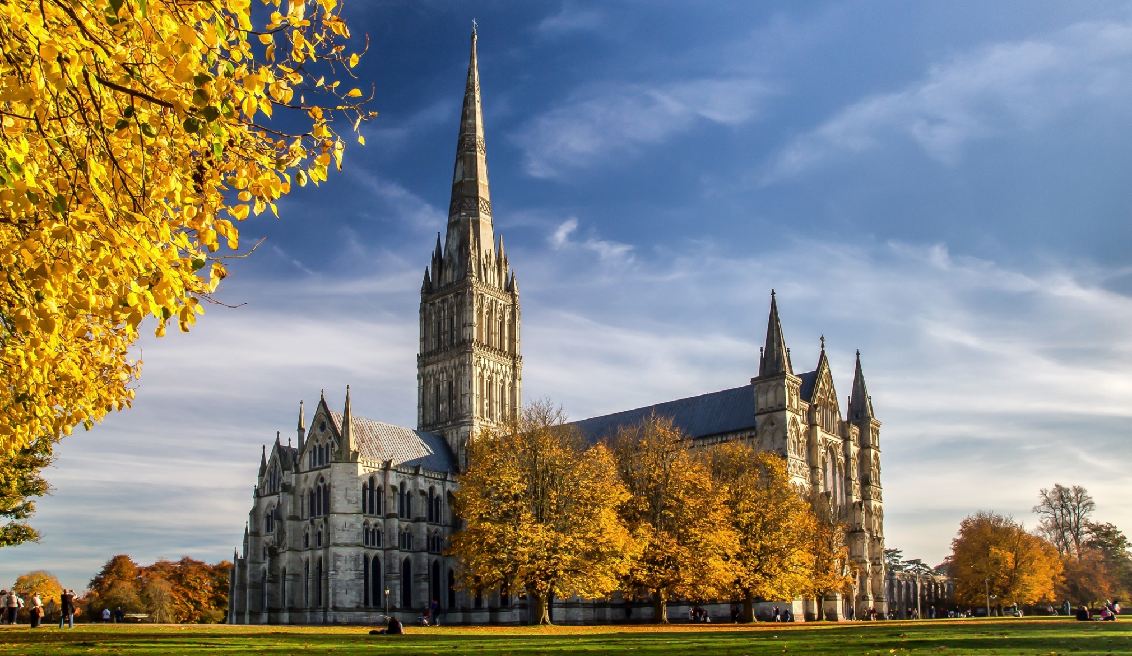
Loss of attraction?
Damage to property in the vicinity causing a fall in the number of customers to the insured premises
‘Salisbury’ is not an attraction: need specific property damage

Slide 14
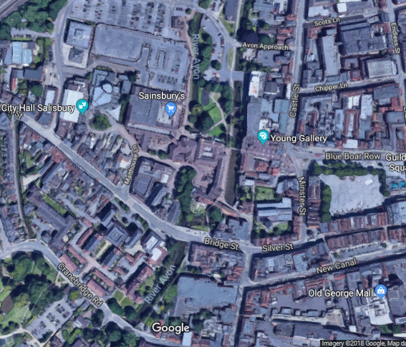
Recent developments: D Sturgess/C Rowley
Skripals found
on bench
Skiprals found
on bench
Queen Elizabeth Gardens
Queen Elizabeth Gardens

Slide 15



Any questions?
Any Questions ?

