Slide 1
Ipswich, Suffolk & North Essex CII
Legal Update
12 July 2018
Stephen King – Partner – Mills & Reeve LLP

Slide 2

Who we are

Slide 3
Mills & Reeve Insurance Sector
In 5 offices – Birmingham, Leeds, London, Manchester and Norwich
Sector
  13 partners
  43 fee earners
Eastern Region
  2 partners
  1 principal associate
  2 senior associates
  1 associate
  3 members of Claims Handling Unit

Slide 4
The Insurance Sector – Our business
Tax/Pensions/ Property/Family/ Construction
Surety
Trade Credit
Political Risk
Product Liability
Commercial
Disputes
Healthcare
Regulatory
Technology
CLAIMS
&
DISPUTES
Cyber
Expert
Services
COMMERCIAL
Commercial
Agreements
ADVISORY
Nameco
(Lloyds name / syndicate work)
Policy wordings
M&A
Professional
Indemnity / Financial lines eg D&O
Employment
Warranty &
Indemnity
Property
Casualty
Title indemnity

Slide 5
Outline of today
Brokers Duties
Notifications
GDPR/Cyber
Non-party costs orders
Civil Liability Bill
Second Insurance Directive

Slide 6

Broker Duties 1

Slide 7
Broker Duties 1
Pakeezah Meat Supplies v Total Insurance 22 May 2018
Background
Fire at insured premises 18.7.2013:
Cover declined for non disclosure:
Existence of deep fat fryers
Insolvency circumstances
County Court judgments

Slide 8
Broker Duties 1
Pakeezah Meat Supplies v Total Insurance
Cause of action against broker where failure:
  to advise on disclosure obligations
  to elicit matters that ought to be disclosed
NB. Personnel changes at the insured - Need to ensure people dealing with have “appropriate understanding of questions of materiality”
NB also Jones v Environcom – where on information disclosed insurance would not have been available.

Slide 9

Broker duties 2

Slide 10
Broker Duties 2
Jones v Environcom (2010)
Background
Electrical goods waste facility
Use of plasma cutters
16.9.07 fire

Slide 11
Broker Duties 2
Jones v Environcom
Claim rejected
Non disclosure of plasma cutters
Non disclosure of previous fires
Insurers settle for £950k
Brokers sued for balance of £6m

Slide 12
Broker Duties 2
Jones v Environcom
The court held a broker must:
Advise clients of their duty to disclose all material circumstances;
Explain the consequences of failure to disclose;
Indicate the sort of matters that ought to be disclosed as being material (or arguably material); and
Take reasonable care to elicit matters which clients ought to disclose but might consider unnecessary to mention.
Higher standard of care may apply if the broker has not adequately advised their client of its disclosure obligations.
The broker has no duty to enquire about the use of plasma cutters (technical knowledge of client’s business), but was negligent in not enquiring about fires or advising the insured to disclose fires (an insured peril).
Additionally broker could not rely on written standard form explanations that the disclosure obligations have been properly explained.

Slide 13

Broker Duties 3

Slide 14
Broker Duties 3
Avondale Exhibitions Limited v Arthur J Gallagher Insurance (4 June 2018)
Combined insurance cover arranged since 2007
Fire at premises 26 August 2012
Claim made on QBE policy for 2012/13
QBE decline cover and avoid cover for 2010/11, 2011/12, 2012/13
Reasons: failure to disclose 2 criminal convictions of Mr Watkins

Slide 15
Broker Duties 3
Avondale v AJ Gallagher
Avondale sue broker:
They assert had informed Giles of convictions
Giles had not passed on information
Secondary case that Giles had not advised Avondale of importance of making necessary disclosure to elicit information
Giles disputes was told of convictions but if had been, agreed in breach of duty
Had made clear what was required by way of disclosure

Slide 16
Broker Duties 3
Avondale v A J Gallagher
Factual dispute
No general rule about whether
  specific oral advice as to material disclosure must be given
  specific enquiry regarding a material piece of information must be made
“the adequacy of communication ought to be assessed on a case-by-case basis” HHJ Keyser QC
Also: No expert evidence had been presented by claimant

Slide 17

Broker Duties 4?

Slide 18
Broker Duties 4?
Duty to warn that opinions might be interpreted differently?
Barker v Baxendale Walker December 2017
Court of Appeal

Slide 19
Broker Duties 4?
Barker v Baxendale
Tax avoidance scheme involving creation of Employment Benefit Trust and transfer of assets with creation of a sub Trust
Advice premised on specific construction of section 28(4) Inheritance Tax Act 1984
HMRC challenged the scheme
Claimants settled with HMRC for £11.29 million tax…
…and sued the lawyers

Slide 20
Broker Duties 4?
Barker v Baxendale
Whether a professional is subject to a duty to warn that their advice might be interpreted differently is fact sensitive
If the statutory position is clear and well tested, risk less likely to arise however it is possible to be correct about construction and still under a duty to warn
In essence, when advising consider the potential alternative arguments and the warning clients need – Montgomery v Lanarkshire Heath Board [2015] applied outside a clinical context.

Slide 21

Notifications

Slide 22
Notifications
Euro Pools Plc v Royal & Sun Alliance Insurance Plc (1 May 2018)
Three notifications in 2006/7/8 policy years - Did later notifications attach to earlier ones?
General design issues around pools with moveable floor and walls
February 2007 notification – Boom system and moveable floors (2007 policy)
  (i) awareness of boom system problem (air tank leak) – notified
  solution – air bags – within excess
  (ii) major design fault with floors rope and winch mechanism
  Solution – change to hydraulics and ropes = claim on policy
May 2008 notification – Boom system (2008 policy)
  Airbag system problem (solution to (i) in 2007)
  Solution now is change to hydraulic system
  Costs exceed excess
November 2007 notification – Moveable floors (2008 policy)
  Leeds pool problem with diving pool – floor jammed. Circumstance notified

Slide 23
Notifications
Euro Pools v RSA
Euro Pools say was 2008 notification re boom claim was effective notification
Airbag fix not causally connected to air tank fault
Reliance on Kajima case in 2008 (actual awareness in order to notify)
RSA argue – Kajima interpretation too narrow – airbag failure was symptom of wider design flaw – it was the design flaw that was notified
Held: Euro Pools succeed – not aware in February 2007 of problems with air drive system

Slide 24
Notifications
Euro Pools v RSA
Re Leeds pool:
November 2007 notification separate to February notification (hydraulics rather than original rope system)
RSA say problem was broad failure of design for moving floors
Held: Euro Pools win due to state of their knowledge about cause of actual problem at time of notification.

Slide 25
Notifications - Learning Points
Restrictive interpretation of Kajima
Narrow view of scope of notifications
Beware emerging problem before facts understood

Slide 26
Non-party costs orders
Section 51 Supreme Courts Act 1980:
“51 (3) – The court shall have full power to determine by whom and to
what extent the costs are to be paid”
Travelers Insurance Co v XYZ (May 2018)
Background – PIP breast implant cases
Transform Medical Group (CS) Ltd one of suppliers – insured by Travelers
623 claims made, of which 197 claims covered, remaining 426 uninsured
Transform insolvency
Claims made directly against Travelers for costs of action
Travelers had made decisions about conduct of the case, and had declined to reveal extent of under insurance

Slide 27
Non-party costs orders
Jurisdiction established in earlier cases - TGA Chapman v Christopher (1998), as clarified by Citibank SA v Excess Insurance Co Ltd (1998) and Cormack v Excess Insurance Co Ltd (CA 2000).
Five factors which must be present before appropriate to order the defendant’s insurers to pay the claimant's costs:
The insurers funded the defence.
The defence failed in its entirety.
The insurers, rather than the defendant, determined to defend the claim.
The insurers had the conduct and control of the litigation.
The insurers fought the claim exclusively (or predominantly) to defend their own interests.

Slide 28
Non-party costs orders
Only likely to be present in a relatively rare class of cases in the context of liability insurance.
NB:
If insured insolvent - order is more likely
Exclusivity of self-interest is not necessary.
Proof of conduct causing additional costs required
No duty on a defendant's insurer to disclose a cover limit to the claimant.
In cases of professional indemnity, it is generally less likely to be appropriate to make an order for costs against the insurers.
A split trial in professional indemnity cases may make an order more likely (Citibank);
Joint retainer needs to be clear

Slide 29

GDPR – When things go wrong

Slide 30
GDPR – When things go wrong
Mills & Reeve GDPR Hub
A key principle in the GDPR is that data controllers need to process personal data lawfully, fairly and transparently.
https://www.mills-reeve.com/gdpr/
“We prefer the carrot to the stick.” –
Information Commissioner’ Office 2017

Slide 31
GDPR – When things go wrong
Insurability of administrative fines?
Probably not – Article 83(1) GDPR
Imposition of fines shall be “effective, proportionate and dissuasive” – so a civil sanction of a penal character
Scope of cyber cover ?
Article 82 (1) – data subject can claim compensation for breach of the GDPR, including a personal data breach, even if arises from accidental loss
Does the cyber policy cover anything other than “attacks” resulting in loss ?
Potential pitfalls for cyber cover:
Exclusion clauses – eg terrorism exclusion clause “an act committed for political, religious, ideological or similar purposes including the intention to influence any government and/or to put the public, or any section of the public, in fear
Would that apply to a data breach perpetrated in order unlawfully to obtain information to assist a political campaign ?

Slide 32
GDPR – When things go wrong
Brokers and insurers beware!
Review policies to check they provide necessary cover both for the costs of an ICO or other regulatory investigation and the full range of civil claims

Slide 33

Civil Liability Bill

Slide 34
Civil Liability Bill
Reform of Road Traffic Accident Injury claims
Tariff for soft tissue injury, £5000 small claims limit (96% of RTA claims)
Example: maximum fixed tariff for whiplash and symptoms
up to 24 months = £3,725
less than 3 months = £225
up to 6 months = £450
up to 9 months = £765
Whiplash = sprain, strain, tear or rupture of one or more muscles, tendons, ligaments in the back or neck. Effects may include…pain in the neck, back, shoulders or arms, reduced mobility in the neck, back or shoulders, headaches, muscle spasms, or a swelling in the neck.
And
The discount rate

Slide 35
Civil Liability Bill
Discount rate - previous assumption was:
Investment in very low risk investments
Now is:
“More risk than a very low level of risk but less risk than a prudent and properly advised investor”
First review of discount rate must take place within 90 days of coming into force and be reviewed every three years involving an expert panel

Slide 36
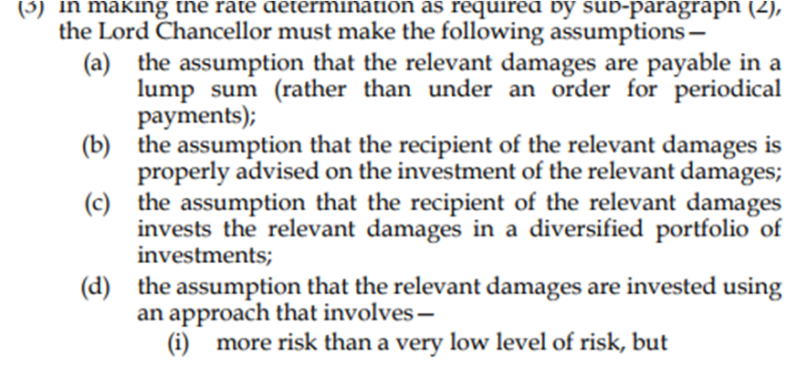
Civil Liability Bill

Slide 37
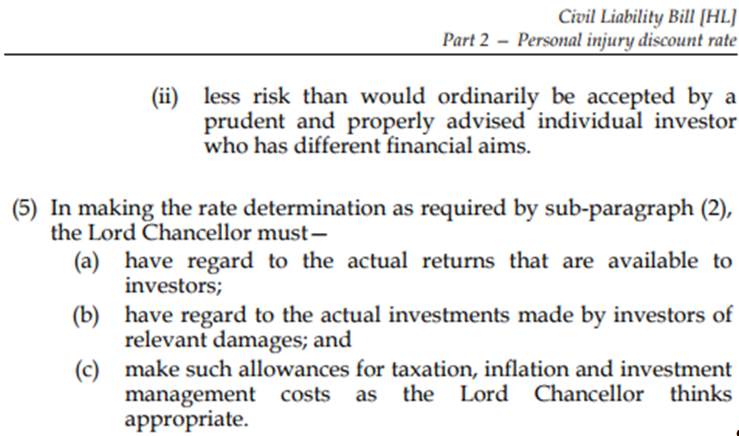
Civil Liability Bill

Slide 38
Second Insurance Directive
Insurance Distribution Directive (IDD)
Briefing summarising the FCA implementation of the Insurance Distribution Directive including professionalism requirements.
http://www.cii.co.uk/knowledge/claims/articles/cii-briefing-insurance-distribution-directive/45831
The Insurance Distribution Directive (IDD) is revision of the Insurance Mediation Directive (IMD), which was introduced by the FSA in 2005. It will come into force in October 2018.
The IDD introduces a new requirement for those staff that sell, advise on and transact insurance contracts for all types of insurance customers.
Of particular importance is the requirement for all people within this scope to complete at least 15 hours of continuing professional development per year.
The FCA and HM Treasury have begun consulting on implementing the IDD in time for the in force date.

Slide 39

Any Questions?

