Slide 1
The Insurance Institute of Ipswich, Suffolk and North Essex
London Market Update
The London Market – What is it?
Current Environment
25th April 2018
January 2018
The London Market Target Operating Model (TOM) – Why and what will it achieve?
‘BREXIT’
1

Slide 2
The London Market
What is it?
January 2018
2

Slide 3


Slide 4
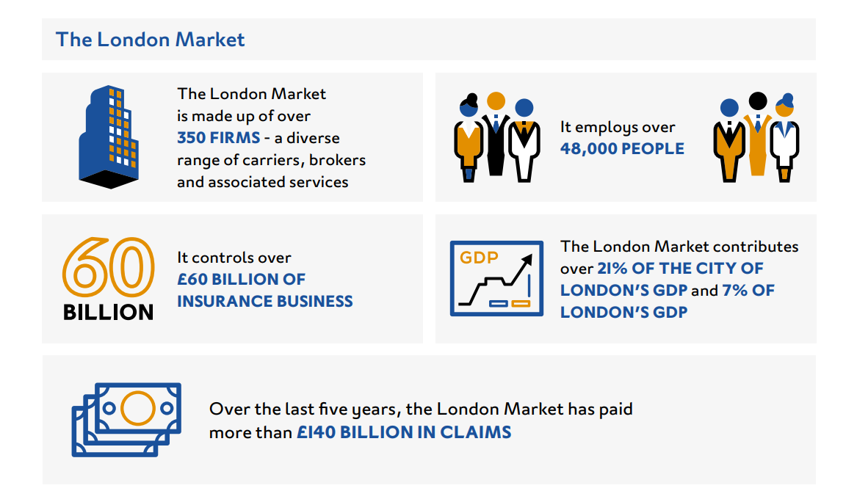
Overview of the London Market
3

Slide 5
London Market
Current Environment?
January 2018
5

Slide 6
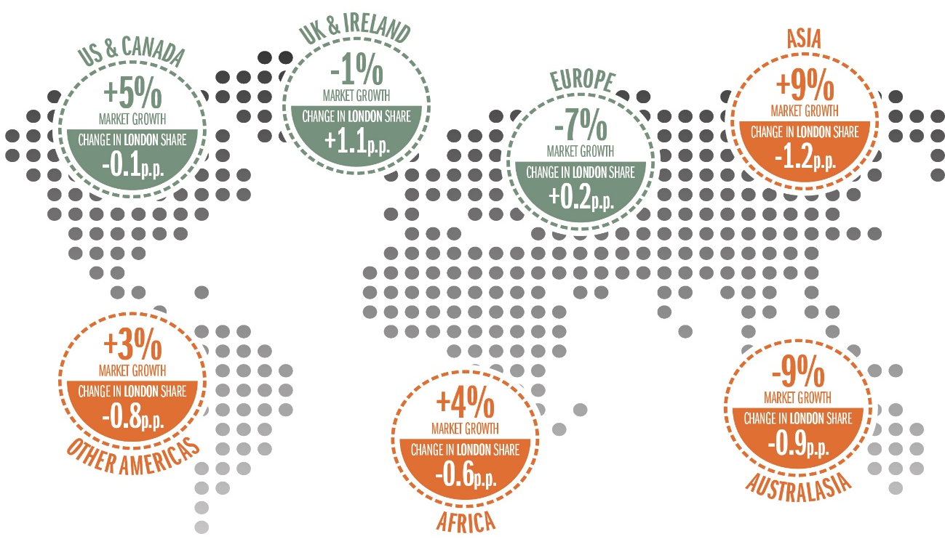
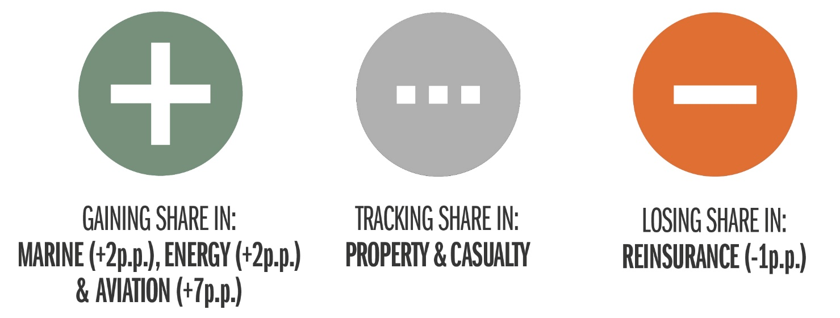
Strong forces are shaping the future of the London Market
Maintaining London’s position as the centre of excellence for re/insurance
LONDON IS NOT KEEPING PACE WITH EMERGING MARKET GROWTH, WITH A DECLINING SHARE FROM 2013-2015
LONDON IS LOSING SHARE IN REINSURANCE
© Lloyd’s
Notes:
London Matters 2017 was released in May last year – it revisited the data on London’s position in the global market place, it is worth just reminding ourselves briefly of the challenges we face and what we have done so far.
Why is this important to you?
London Market needs to be an easier place to transact business and to continues to remain economically viable to do so
London Market is still an attractive place for Global Brokers and Insurers to do business
Provides the opportunity for significant cost reduction in your organisation by adopting LM TOM initiatives
Claims remains an essential part of the London Market offering and the more business written, usually means the more claims there will be.
The LM TOM Programme is making a significant investment to ensure the London Market continues to be a centre of excellence in the specialty commercial re/insurance market in order to stay competitive and relevant

Slide 7

London Market
Target Operating Model ‘TOM’
January 2018
9

Slide 8
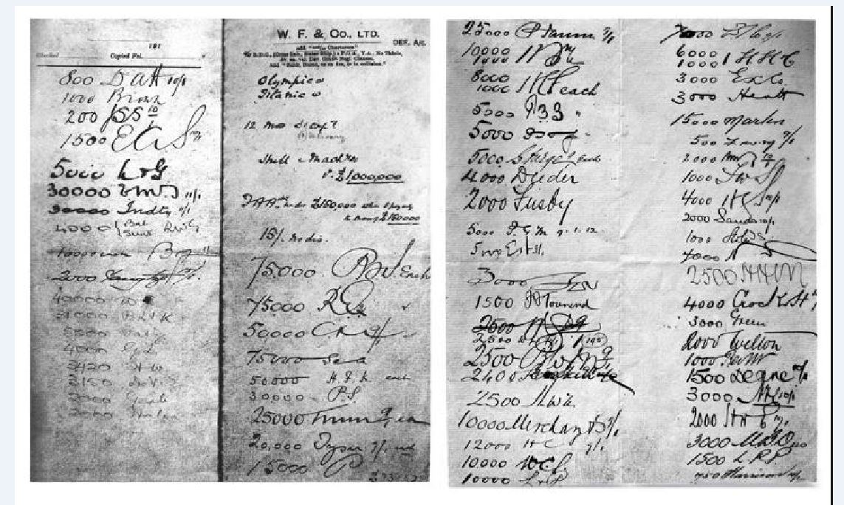
Contract agreements by Lloyd’s Syndicates

Slide 9
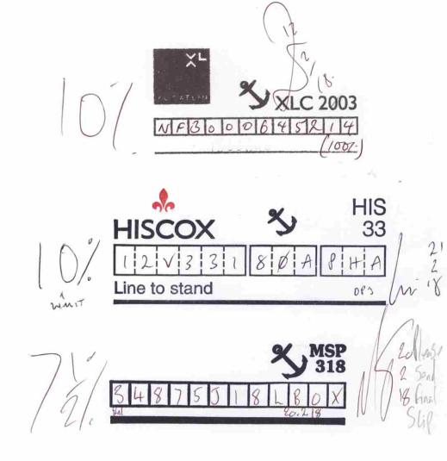
Contract agreements by Lloyd’s Syndicates

Slide 10
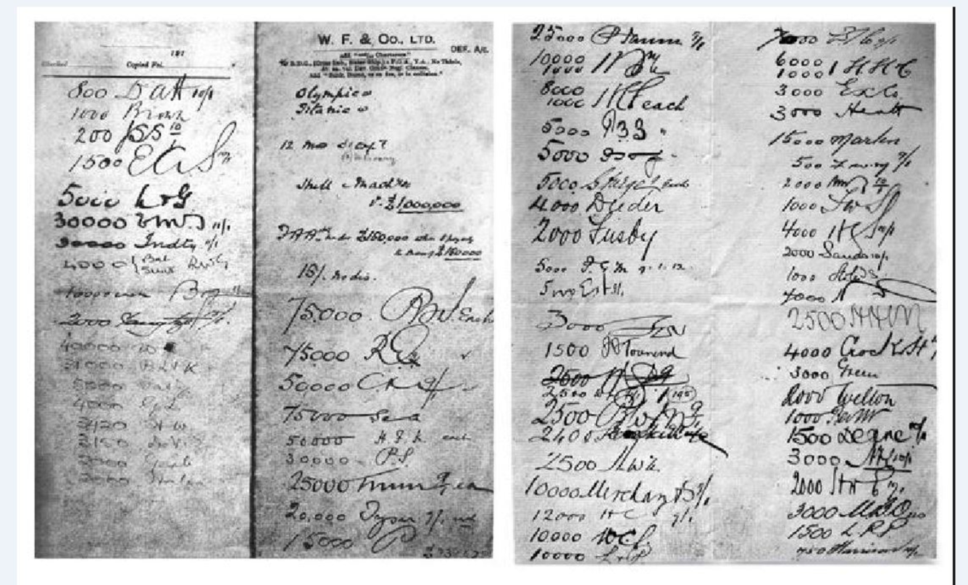
So, what is the difference?
1912
2018

Slide 11
The LMG (London Market Group) (https://www.londonmarketgroup.co.uk/lmg-overview) is a market-wide body, bringing together the specialist commercial (re)insurance broking and underwriting communities in London. It is supported by the International Underwriting Association of London (IUA), Lloyd’s of London, the Lloyd’s Market Association (LMA) and the London & International Insurance Brokers’ Association (LIIBA)
The LMG speaks collectively for market practitioners on growth and modernisation issues, and its aim is to build on London’s position and reputation as the global centre of insurance excellence
The Board is made up of the following:
Nicolas Aubert (Chair) Chief Executive Officer Willis Tower Watson GB
Anthony Baldwin Chief Executive Officer AIG Europe
Inga Beale Chief Executive Officer Lloyd’s
Christopher Croft Chief Executive Officer LIIBA (London & Int’l Insurance Brokers’Association)
David Gittings Chief Executive Officer LMA (Lloyd’s Market Association)
Andrew Agnew Managing Director Specialty Arthur J. Gallagher International
Andrew Brooks Chief Executive Officer Ascot
Andrew Horton Chief Executive Officer Beazley
Andrew Kendrick Senior Vice President, Chubb Group
Shirine Khoury-Haq Director of Operations Lloyd’s
Brian Kirwan Chief Executive Officer Allianz Global Speciality
David Ledger Chief Executive Officer Aon Benfield
Dave Matcham Chief Executive Officer IUA (International Underwriting Association)
Malcolm Newman Managing Director EMEA Hub SCOR
Christopher Beazley Chief Executive Officer LMG (London Market Group)
Roy White Chief Executive Officer-Specialities Marsh UK
Matthew Wilson Group Chief Executive Officer Brit Insurance
Paul Jardine Executive Vice President XL Catlin
In 2014 the LMG instigated The “London Matters” report which was published in November 2014 and refreshed again in 2017 (https://www.londonmarketgroup.co.uk/lm-2017) This gave factual evidence regarding the perceived challenges to the future success of the London Market over the next decade. From these reports, four interdependent workstreams have been established to make our market more attractive, responsive and competitive to clients
13
© Lloyd’s

Slide 12
Strategic context of the TOM
LMG Vision, TOM Mission & Core Goals
London Market Group
Vision
To build and maintain London’s position as the global centre of commercial insurance and re-insurance excellence.
Building a diverse, dynamic workforce
Making London an easier place to do business
Creating a better business environment
Telling the London Market story
London Market Target Operating Model (TOM)
Mission
To make it easier to do business with the London Market
Core goals
One Touch Data Capture
Broker and carriers will enter data only once – reducing the risk of error and costly re-work caused by entering data multiple times in multiple formats.
Enhanced Global Shared Central Services
Centralising the market’s collaborative tasks
and increasing efficiencies and consistency
while avoiding duplication.
14
© Lloyd’s
Notes:
Strategic context of the TOM
1) LMG vision
TOM is one of four streams of work established by the London Market Group to address some fundamental concerns threatening the future of the London commercial insurance Market:
London is losing market share, and its position as the first choice for commercial and speciality (re)insurance is at risk
Market share is stagnant or shrinking depending on the line of business
The cost and speed of doing business in London is driving business away
The London Market is not focussed enough on its customers and their needs
The London Market is slower to react to threats and opportunities than the competition
A lack of standardisation makes us less attractive than other markets and has made the London Market inefficient
Access to Market data which is a powerful asset could be better used for the advantage of individual participants
Competition is the life blood of the market and will lead to better service, better products and more business being done in London.
2) How the TOM supports that:
We’re building a new target operating model to make it easier to do business with the London Market
Our overriding mission is to make the market accessible, efficient and relevant to the needs of our customers.
We want to deliver simplicity and reduce the cost of doing business here.
But most of all we want to help your businesses grow and thrive, allowing you to concentrate on using your expertise to deliver the value proposition that makes London so compelling.
3) Introduce the next section: an end to end view of the TOM:
So that’s why we’re doing this. Now I am now going to walk you through how all the different components of the programme integrate to support achievement of the TOM’s two core goals - One Touch Data Capture (straight through processing) and Enhanced Central Services.

Slide 13





















Outside
Audit
Delegated
Authority
Data
Compliance
Claims
Collaboration
Electronic
Placement
Central
Subscription Services
Contract
Creation
Central Data &
Orchestration
Contract
Quality
Tool (CQT)
Tax Calculator
Central Services
Refresh Programme
(Broker EBOT / ECOT)
Clause
Library
Elective Services
Insurance
Transaction
Accounting
Central Services
Refresh Programme
(Carrier EBOT / ECOT)
Electronic Data
Contract /
Structured Data
Capture
ACORD Data Exchange: standardised integration throughout the lifecycle
Broker / Carrier interaction: throughout the lifecycle
Customer
© Lloyd’s
15
Notes:
Cover the usual overview but reference back how each component relates to claims

Slide 14
Phases
Audit
Phase 1
Delegated
Authority
Data
Compliance
2017 LM TOM key milestones
Electronic
Placement
Central Data &
Orchestration
Contract
Quality
Tool (CQT)
Central Services
Refresh Programme
(Broker EBOT / ECOT)
Insurance
Transaction
Accounting
Electronic Data
Contract /
Structured Data
Capture
ACORD Data Exchange: standardised integration throughout the lifecycle
Broker / Carrier interaction: throughout the lifecycle
Customer
© Lloyd’s
16
Notes:
Bring out how the market prioritised what went into phase one and how these elements are necessary forerunner for developing the claims solution

Slide 15
Phases
Phase 2
Claims
Collaboration
Central Data &
Orchestration
Tax Calculator
ACORD Data Exchange: standardised integration throughout the lifecycle
Broker / Carrier interaction: throughout the lifecycle
Customer
© Lloyd’s
17

Slide 16
Phases
Phase 3
Central
Subscription Services
Central Data &
Orchestration
Clause
Library
Elective Services
Insurance
Transaction
Accounting
Central Services
Refresh Programme
(Carrier EBOT / ECOT)
ACORD Data Exchange: standardised integration throughout the lifecycle
Broker / Carrier interaction: throughout the lifecycle
Customer
© Lloyd’s
18

Slide 17
What Can be Insured by Lloyd’s Post Brexit?
GWP (EUR MN) based on 2016 reported figures, excluding Life
Do nothing – World Trade Organisation Rules
Lloyd’s Brussels Subsidiary
Accessible
Reverse solicitation
Prohibited
Accessible via Brussels
Subsidiary

Slide 18

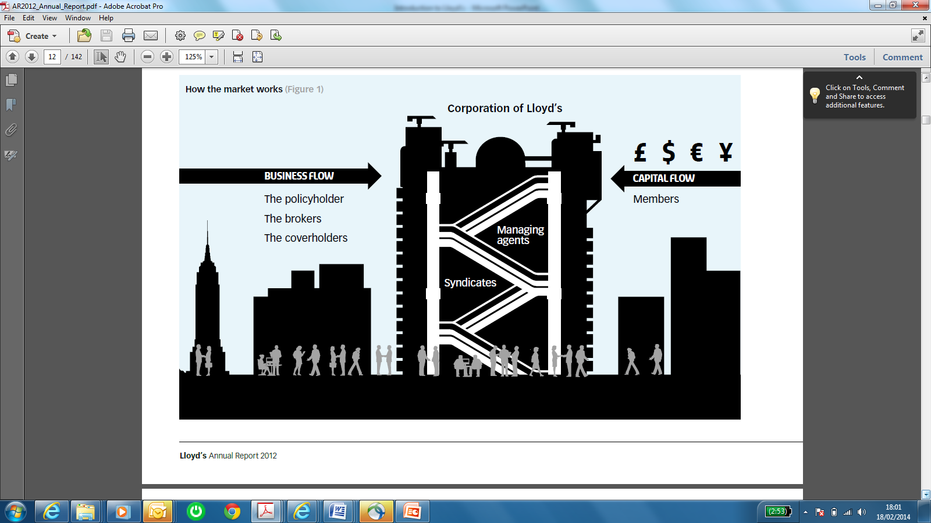
Lloyd’s Brussels subsidiary
How will it work?
Incorporation and structure
Business reinsured to syndicates
Syndicate
Lloyd’s Brussels subsidiary will enter into an Outsourcing Agreement with Managing Agents allowing them to underwrite on behalf of the Brussels subsidiary. In this capacity Managing Agents will be outsourced underwriting service providers to the Brussels subsidiary. For the sake of consistency this document will continue to refer to outsourced underwriting service providers as managing agents
Lloyd’s Brussels subsidiary will authorise managing agents to appoint coverholders and service companies on its behalf, within agreed European business plans
Brokers will undertake negotiation of Coverholder Appointment Agreements (CAAs) between managing agent underwriters and coverholders, thus allowing the current relationships between these entities to continue. The only visible change between the original binder/new CAA will be the underwriting entity, which will be Lloyd’s Brussels Subsidiary instead of the managing agent
Under the terms of the Outsourcing Agreement business will be reinsured back to the syndicates
100% owned by The Corporation
Lloyd’s Brussels Subsidiary
(Credit rating to be maintained)
+ Branches
Society of Lloyd’s
Capital
injection (equity)
+ UK Branch
Managing Agent (UK)
Coverholder
(EU Country)
Broker
Policy holder
Key:
Business flow

Slide 19
Questions?
© Lloyd’s
Notes:
As the LM TOM Benefits are in your firms, you and your teams have to do work to achieve them but..... the LM TOM team need to do as much as we can to support you. This is where most of our work is.
We now have a change management team in place. We’ve been running workshops brokers and carriers to support those leading the change within your organisation to help them plan and prepare for change.
We also continue have engagement with market Associations to build strong ties with their members and keep them informed on progress.
We also work with vendors and coverholders, as the form part of the wider market.
The team has developed a change management toolkit with a wide range of material, created centrally for use by as many parties as possible. Build once, re-use many times.
The team also supports market firms at the adoption stage with training and communications material to support change management plans.
We have also checked in on our progress with the market, completing a survey earlier this year. The key take always were that there is a good level of awareness regarding the LM TOM but there needs to be more accountability by market firms and how firms create linkages between the LM TOM objectives and how they link to supporting their own firm’s objectives.

Slide 20
22

