Slide 1
The Insurance Institute of Leicester 7 February 2018
Lynne Grover-Thomson ACII
Sophie Horsfall ACII

Slide 2
The Insurance Institute of Leicester
MIB – ‘a brief history’
How MIB assists other areas of the insurance industry
Current costs and challenges of uninsured driving
Public awareness and working with the police
New agreements with the government
Current areas of focus and challenge
Vnuk, the impact of a Slovenian tractor on motor insurance in the UK
Other cases having an impact
Research into ‘hit and run’ accidents

Slide 3
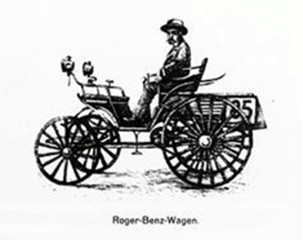
The Insurance Institute of Leicester

Slide 4
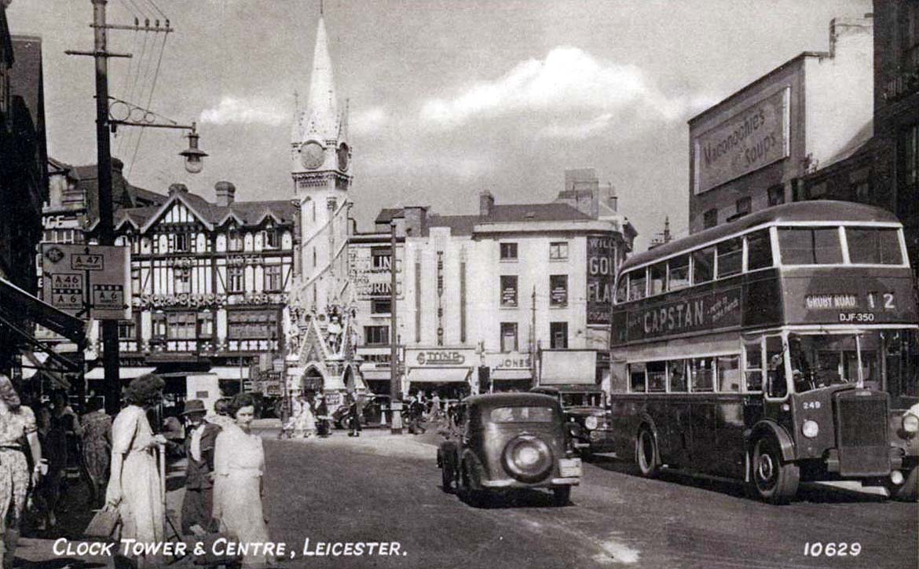
The Insurance Institute of Leicester

Slide 5
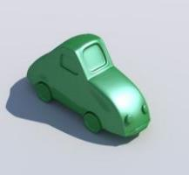
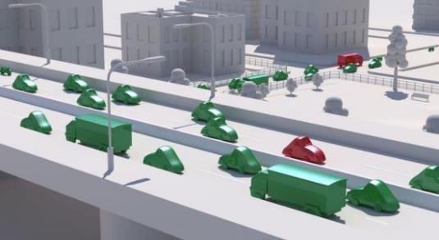
The Insurance Institute of Leicester
Our Mission
To significantly reduce the levels and impact of uninsured and untraced driving in the UK
Provide first class outsourced services for cross-industry data asset management
To compensate victims of uninsured and untraced drivers fairly and promptly

Slide 6
MIB Services
Uninsured Driving
MIB Claim Services
MIB Non-Claim Services
Non MIB Managed
Services
National Guarantee Fund
Uninsured Drivers Agreement
Police Services
Untraced Drivers Agreement
UK Green Card Bureau
askCUE.co.uk
Police Helpline
UK Information Centre
Continuous Insurance Enforcement (CIE)
UK Compensation Body

Slide 7
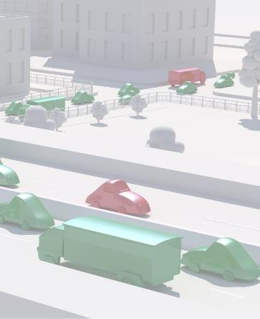
The Insurance Institute of Leicester
Uninsured driving in numbers
Total cost of uninsured motoring: £400 million
Total UK vehicles: 39.2 million
Number of uninsured vehicles: 1 million
Injured victims: 29,000
Deaths: 120

Slide 8
The Insurance Institute of Leicester
Continuous Insurance Enforcement (CIE)
Launched in June 2011
3 million letters issued
More than 135,000 successful prosecutions in court
More than 900,000 Fixed Penalty Notices

Slide 9
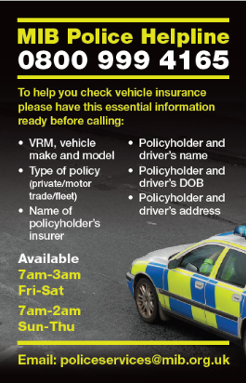
The Insurance Institute of Leicester
What are the results?
Police Helpline total enquiries:
2013: 195,000
2014: 127,000*
2015: 132,000
2016: 132,000
Sun-Thurs: 7am-2am; Fri-Sat: 7am-3am
“The MIB are a key partner, for the Police service, in tackling uninsured driving. The Police Helpline and MIB assisted officers in seizing over 146,000 vehicles in 2016, an increase of over 20% on 2015, which was invaluable in improving road safety and tackling criminality”
Anthony Bangham - National Police Chiefs Council (NPCC) lead for Roads Policing

Slide 10
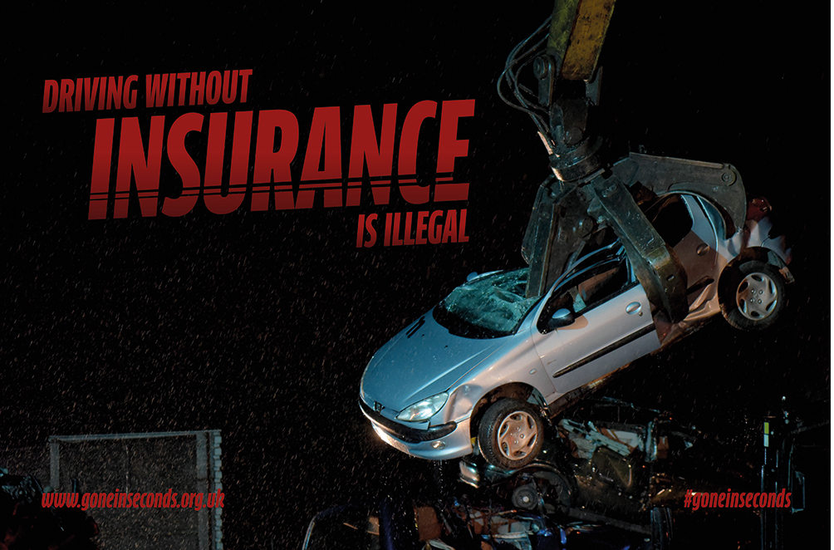
The Insurance Institute of Leicester
What are the results?
Changing uninsured driving together
Uninsured vehicles seized:
2005: 45,000
2006: 78,000
2007: 150,000
2008: 185,000
2009: 180,000
2010: 150,000
2011: 140,000
2012: 137,000
2013: 135,000
2014: 116,000
2015: 121,000
2016 146,000

Slide 11
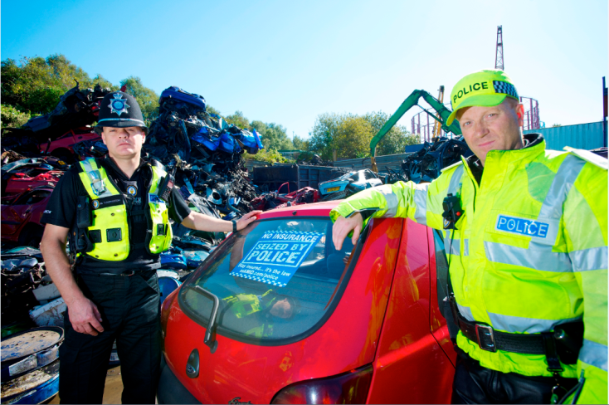
The Insurance Institute of Leicester
More than 1.8 million vehicles seized

Slide 12
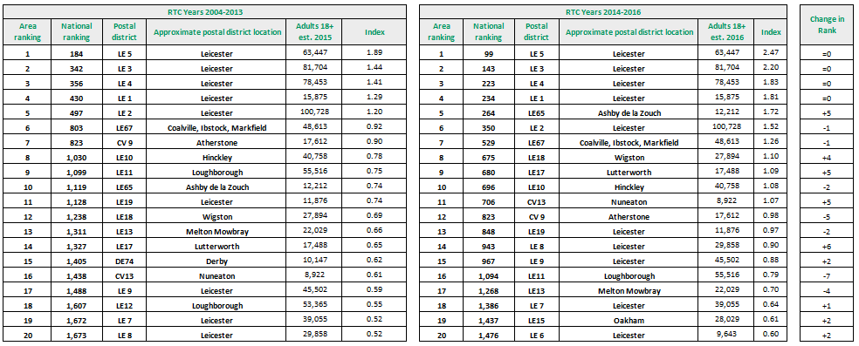
The Insurance Institute of Leicester

Slide 13
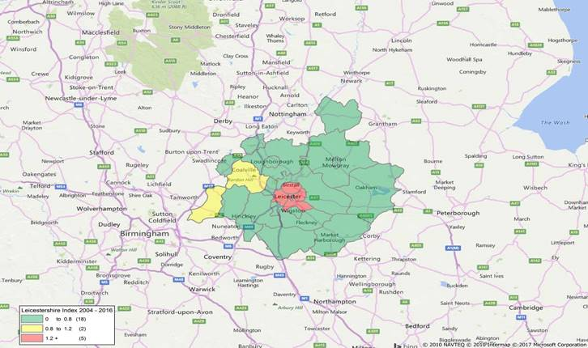
The Insurance Institute of Leicester

Slide 14
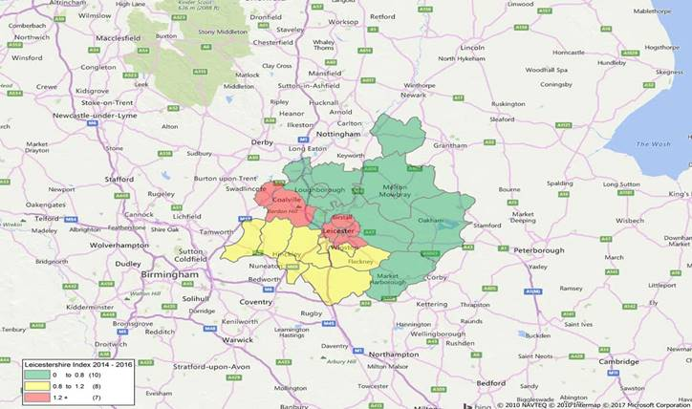
The Insurance Institute of Leicester

Slide 15
The Insurance Institute of Leicester

Slide 16
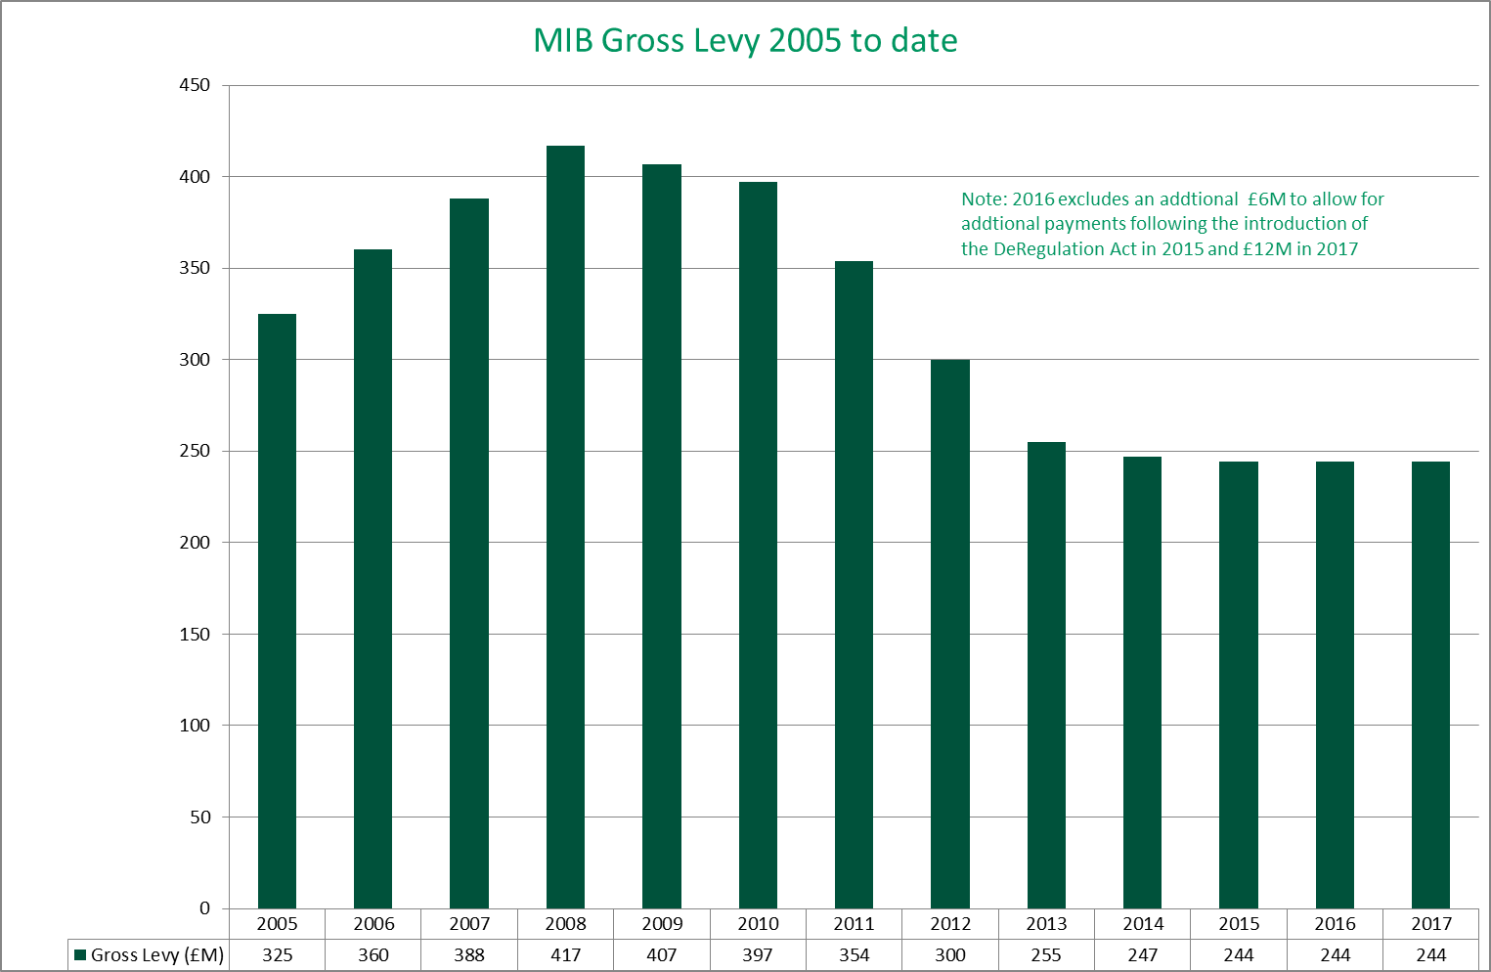
The Insurance Institute of Leicester

Slide 17
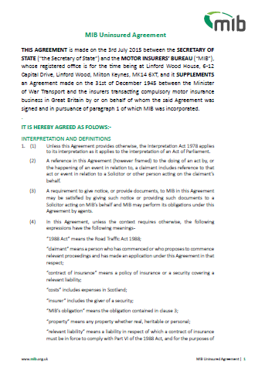
The Insurance Institute of Leicester
Uninsured Agreement 2015

Slide 18
The Insurance Institute of Leicester
Claims Handling at MIB
The Uninsured Drivers’ Agreement
MIB obligations – link to legal obligations
Exclusions:
Repaying insurers (subrogation)
‘Subsidiarity’
Damage to uninsured vehicles
Passengers who know …
Litigation
Recovery from uninsured driver

Slide 19
The Insurance Institute of Leicester
Claims Handling at MIB
The Untraced Drivers’ Agreement 2017
Inquisitorial system
MIB investigates
Police report
Medical records – A&E often revealing
Interviews / statements
Property damage – yes but …
Reporting to Police
Claimant obliged to assist
Disputes – arbitration system
Contribution to legal costs
Cameron –v- Hussain

Slide 20
The Insurance Institute of Leicester
Recovery of PD XS claims from claimant’s insurer
Article 75 was changed in 2017 to enable MIB to recover claims for policy xs from the claimants own motor insurer:
Claims received at MIB
1st May untraced agreement
1st August uninsured agreement
We will also recover any associated legal costs

Slide 21
The Insurance Institute of Leicester
The Question?
The scope of …
“Each member state shall … ensure that civil liability in respect of the use of vehicles … is covered by insurance”
[now Art 3 MID 2009]

Slide 22
The Insurance Institute of Leicester
Legislative background
“a person must not use a vehicle on a road or other public place …” (s143 RTA 1988)
Member states required to have compulsory insurance in respect of the use of vehicles normally based in its territory (Article 3)
“Motor vehicle means … a mechanically propelled vehicle intended or adapted for use on roads” (s185 RTA 1988)
“Vehicle means any motor vehicle intended for travel on land and propelled by mechanical power but not running on rails, and any trailer whether or not coupled” (Article 1.1)

Slide 23
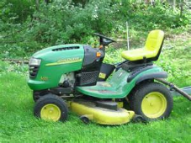
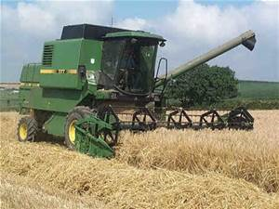
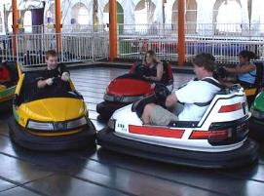
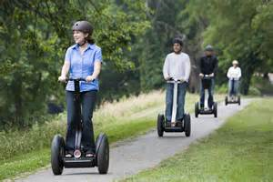
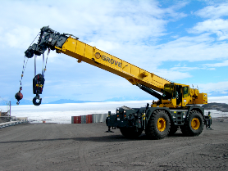
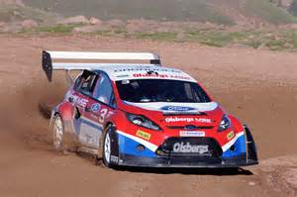
The Insurance Institute of Leicester

Slide 24
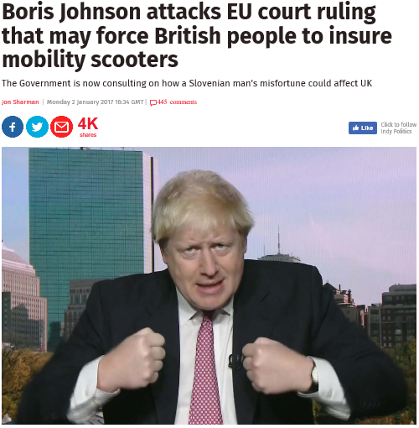
The Insurance Institute of Leicester

Slide 25
The Insurance Institute of Leicester
Concerns/fixes
Enforcement - public message
Fraud
Motor sport and other risks
The Directive
The “Inception impact assessment”
The ‘in traffic’ solution
“areas where the public has access”
REFIT – the last chance?
BREXIT

Slide 26
The Insurance Institute of Leicester
Rodrigues de Andrade v Dalvador & Ors

Slide 27
The Insurance Institute of Leicester
And finally …
R & S Pilling v UKI [2017]
“I consider that it follows that the repair of a car, … is “use” of the car within … the RTA, being an activity consistent with its normal function” MR

Slide 28
The Insurance Institute of Leicester
“Let’s hope we get paid enough to cover the Fixed Penalty Notice!”

Slide 29
The Insurance Institute of Leicester
Other challenges
University of Leicester research
RoadPeace JR
And for uninsured driving …

Slide 30
The Insurance Institute of Leicester
Questions?

Slide 31
The Insurance Institute of Leicester
Lynne Grover-Thomson ACII
Sophie Horsfall ACII
Motor Insurers’ Bureau
Linford Wood House
6-12 Capital Drive
Milton Keynes
MK14 6XT
Tel: 01908 830001
www.mib.org.uk
facebook.com/driveinsured
twitter.com/driveInsured
youtube.com/driveinsured

