Slide 1

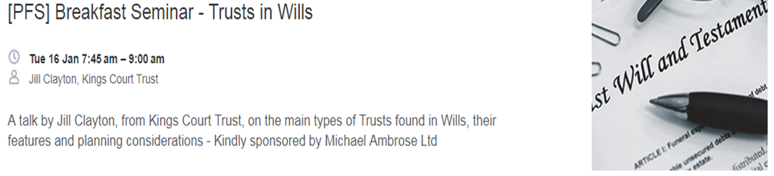

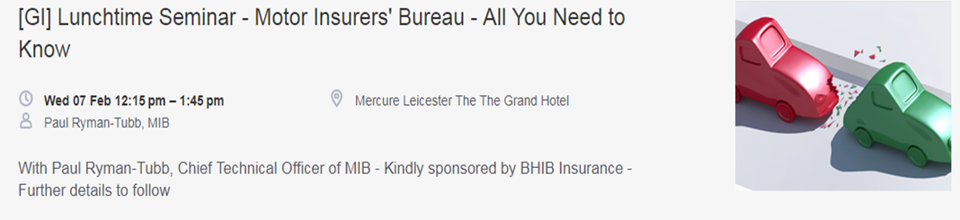
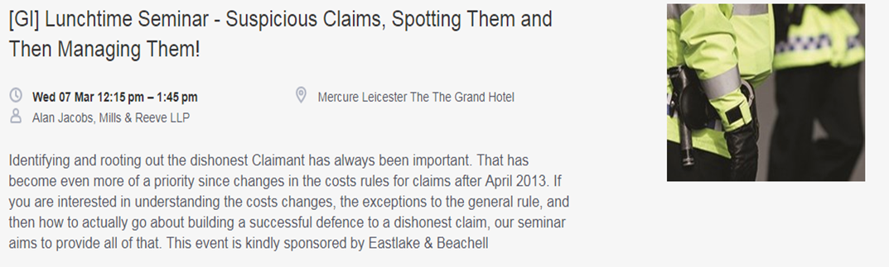

Lunchtime Seminar 10/01/2018
Claims against Insurers for Late Payment: Enterprise Act 2016/Insurance Act s.13A – is your business exposed?
by Sarah Trendell-Smyth and
Kelly Barnett, Mills & Reeve LLP
Special thanks to today’s sponsors:

Slide 2
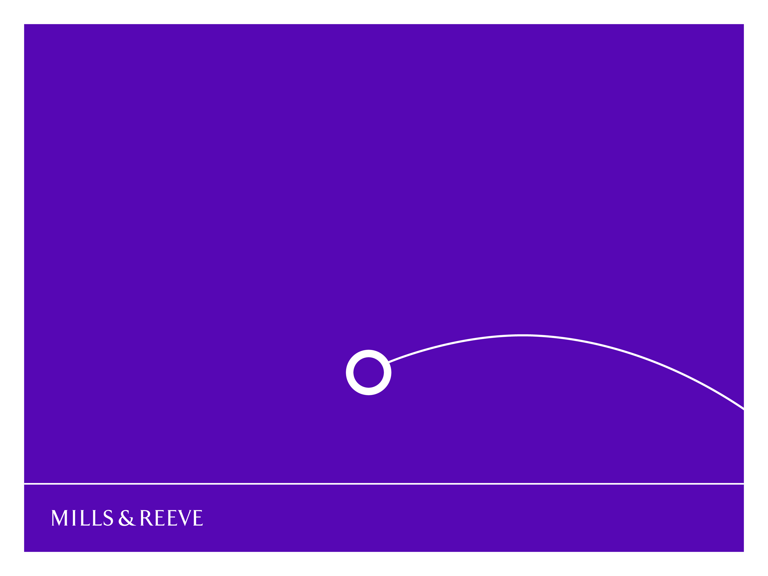
Title goes here
Damages for late payment of insurance claims
Subtitle goes here
27 April 2010
Name Surname One
Sarah Trendell-Smyth
Kelly Barnett
Name Surname Two

Slide 3
Introduction
Key dates
Overview of the reforms
Reminder of the key aspects of the Insurance Act 2015
The Enterprise Act 2016/S13A of Insurance Act 2015
Practical steps and potential issues
A claim for breach
Contracting out
Other practical considerations

Slide 4
Key dates
Insurance Act 2015
Effective 12 August 2016
Enterprise Act 2016
Effective 4 May 2017
Marine Insurance Act 1906
Third Parties (Rights Against Insurers) Act 2010
Effective 1 August 2016

Slide 5

A change of tack
Fundamental reform
Redressing the perceived imbalance between insurer and insured
Alignment with other jurisdictions – “damages on damages”

Slide 6
A change of Tack
Secretary of State for Business Sajid Javid in his oral statement to Parliament
“As we’ve seen all too graphically with the recent flooding, its absolutely vital that insurance companies pay out quickly….unnecessary delays by insurers can spell the end for small businesses, hitting employees, suppliers and the wider community and economy.

Slide 7
Overview: Enterprise Act 2016
Introduces two key concepts (now s13A of Insurance Act):
  That an insurer must pay claims within a reasonable period of time; and
  A failure to pay claims within a reasonable period of time will entitle the insured to claim damages for losses suffered as a result of that failure
Implied into all insurance contracts unless contracted out (non-consumer contracts only) from 4 May 2017
Between insurer and its policy holder only – not third parties

Slide 8
Overview: Enterprise Act 2016
Insurers (and appointed claims handlers/loss adjusters) will have a reasonable time to investigate and assess a claim
What is “reasonable” will depend on all the relevant circumstances
Factors to take into account may include:
  The type of insurance
  The size and complexity of the claim
  Compliance with any relevant statutory or regulatory rules or guidance
  Factors outside of the insurer’s control

Slide 9
Overview: Enterprise Act 2016
Coverage - reasonable grounds for dispute
No breach for failing to pay the claim (or the affected part of it) while the coverage dispute is continuing;
But:
The conduct of the insurer (and therefore its handlers/adjusters) in handling the claim may be a relevant factor in deciding whether that term was breached
Need to manage policyholder expectations
Fraud trigger needs to be justifiable – insurers’ responsibility

Slide 10

Unchartered waters?

Slide 11
Unchartered Waters?
From a legislative perspective - yes.
But from an operational perspective? TCF, Lloyd’s conduct rules, Insurers’ own service standards, recourse to FOS.
Even the Law Commission acknowledged there was no evidence of systemic late payment by the insurance industry
Pressure point

Slide 12
First and third party claims
Distress and inconvenience
Temporary Business Interruption
Permanent loss of business
Reputational loss

Slide 13
Navigation tips
Understand which claims present the most significant exposure
Consider in each case what time is likely to be required for investigation and assessment
Insurers - can you commit to a particular time frame?
Insureds/Brokers – make sure you provide all information/documentation promptly

Slide 14
Navigation tips
Insurers/handlers are likely to include wording such as this:
“It is your obligation to present your claim promptly, clearly and supported with evidence. Failure to do so may result in delayed processing of your claim. Insurers will not be responsible for any such delay caused by any failure on your part to present the claim in this manner”

Slide 15
Navigation tips
Consider asking for/making interim payments for undisputed parts of the claim
Where possible, be transparent about what is stopping you reaching a decision
Effective communication and record keeping

Slide 16
Settlement
Can a potential claim for late payment be compromised when the claim is paid?
Consider whether wide settlement release wording is appropriate
Limitation – 1 year from the date the original claim under the policy was paid
Consider whether to raise potential delay, at the settlement point

Slide 17

Impact: when a claim is made

Slide 18
Defence considerations
Before payment of the original claim:
  Identify situations where a claim under the Act may be obvious from the start - “We are going to go out of business if we don’t have a payment by XX….”
After payment; usual hurdles to overcome:
  Burden of proof
  Reasonable time
  Reasonable grounds for disputing the claim

Slide 19
Damages
Causation – Insured must be able to show that the unreasonable delay caused the loss. There is no loss if they would have gone out of business anyway.
Ordinary principles of loss
  Remoteness – loss of business but not of eg the holiday planned next year
  Foreseeability – within the reasonable contemplation of parties when insurance contract was made
  Mitigation – Insured have a duty to mitigate
Distress and Inconvenience

Slide 20
Contracting out
Contracting out in non-consumer insurance
Must comply with transparency requirements of s.17 of the Insurance Act 2015
  Sufficient steps to draw the disadvantageous term to the insured’s attention
  Disadvantageous term must be clear and unambiguous as to its effect
Contracting out in respect of deliberate or reckless breaches of the implied term is of no effect

Slide 21
Other practical considerations
Potential for claims for damages for late payment to significantly exceed applicable policy limits
Reserving approach
Reinsurance – insurer will have no right of recourse against reinsurer if it has to pay out under the Act (unless caused by a breach of contract between the reinsurer and insurer)

Slide 22
Other practical considerations
Conflict between lead insurer and following market or primary and excess layers
Liability of third parties:
  Contractual relationships / terms of retainer
  Pay claims and then pursue third parties?

Slide 23

All at sea or plain sailing?

Slide 24
All at sea or plain sailing?
To get ‘shipshape’ the industry as a whole should be:
  Updating SLAs with external handlers, loss adjusters and MGAs – making clear the division of responsibilities/timescales for investigations
  Reviewing agreements with following markets and reinsurers
  Deciding where possible what is a reasonable time to investigate certain types of claims, and training handlers
  Identifying the types of claims in your area most likely to give rise to issues
  Insureds – clear presentation of risk – ‘foreseeability’

Slide 25
All at sea or plain sailing?
Thinking through what you can do in terms of practice, procedure and systems to mitigate the potentially unreasonable delays
Considering your delegated authority arrangements, including whether to have an account in escrow from which external handlers can draw down funds, in order to avoid delays
Working out how to reserve for such claims
Policy wordings – caps?

Slide 26


Slide 27
