Slide 1
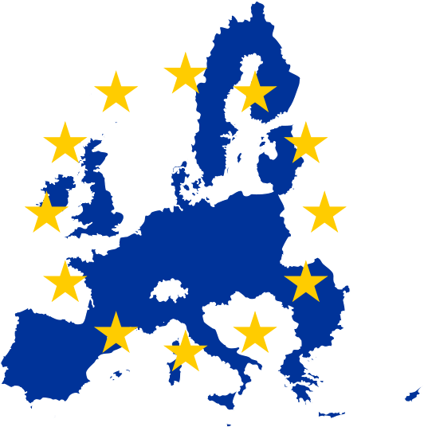
General Data Protection Regulation
(GDPR)
Richard Galley
7 December 2017

Slide 2
Today’s session
The purpose of this session is to help you understand the key elements of the EU General Data Protection Regulation (GDPR) and how you will need to prepare for implementation of the UK’s new Data Protection Act.

Slide 3
Agenda
Setting the scene
DPA versus GDPR
GDPR’s scope
The 6 Principles
Consent and other lawful bases
Individuals’ rights
Accountability & governance
Breaches
The UK Data Protection Bill
‘Top Tips’ & Action Planning

Slide 4
GDPR
GDPR in force from 25 May 2018
Makes existing DP Directive (& UK Data Protection Act) redundant
Brexit??!
UK’s decision to leave the EU will not affect GDPR’s implementation

Slide 5
GDPR
“ … one way or another, GDPR is going to be an important part of the global data protection landscape over the years ahead, with great relevance to UK organisations, the public and their data.”
Rob Luke
Deputy Commissioner, ICO
May 2017

Slide 6
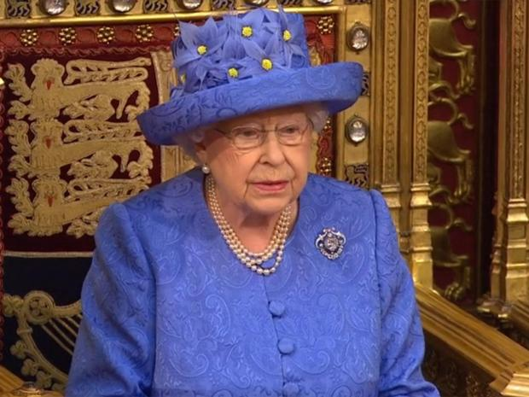
GDPR = Data Protection Bill 2017
“A new law will ensure that the United Kingdom retains its world-class regime protecting personal data”
The Queen’s Speech
21 June 2017

Slide 7
“Any legislation introduced into Parliament is open to change so once we have a clearer idea of its final form we will be able to make firmer plans and develop the structure and the content of the guidance. Our aim is to provide a suite of data protection guidance that is as comprehensive as possible by May 2018.”
UK Information Commissioner

Slide 8
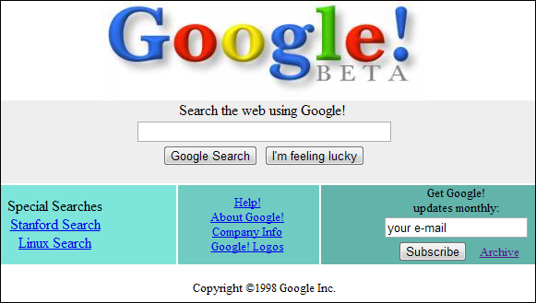
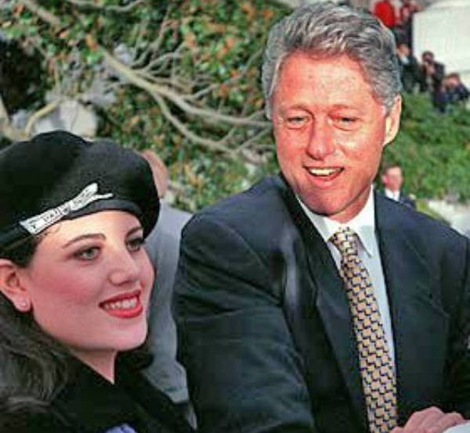
1998

Slide 9
GDPR – Why?!
?
Unifies data regulations within the EU - creates a single regulatory framework across EU for DP
Gives you and me greater control over our personal information
Protects the rights and interests of the individual – quantity and use of data

Slide 10
GDPR highlights
Principles based!
Applies to ‘controllers’ and ‘processors’
‘controller’ says how and why personal data is processed
‘processor’ acts on the controller’s behalf
Applies to processing carried out by organisations operating in EU and to organisations outside EU that offer goods or services to EU citizens

Slide 11
GDPR highlights
Places specific legal obligations on processors (e.g. keep records of personal data and processing activities)
Significantly more legal liability if responsible for a breach

Slide 12
GDPR
v.
DPA

Slide 13
DPA v. GDPR
DPA | GDPR
Only UK | Whole of EU
Enforced by Information Commissioners Office (ICO) | Enforced by national Supervisory Authorities (SA)
Non-compliance can result in fines up to £500,000 or 1% of annual turnover | Non-compliance can result in fines up to £17 million or 4% of the business’s annual global turnover
No need for any business to have a dedicated Data Protection Officer (DPO) | DPO mandatory for some –e.g. public authorities / large scale processing

Slide 14
DPA v. GDPR
DPA | GDPR
No obligation to report data breaches (but encouraged to do so) | Certain data breaches must be reported to the SA within 72 hours of the incident
No requirement for an organisation to remove all data they hold on an individual | Individual has ‘Right to erasure’ – data being permanently deleted
Data collection does not necessarily require an opt-in | Individuals must actively opt-in and there must be clear privacy notices

Slide 15
DPA v. GDPR
DPA | GDPR
Data portability encouraged but not a right | Right to data portability allowing individuals to obtain and reuse their personal data for their own purposes across different services - moving, copying or transferring personal data easily from one IT environment to another in a safe and secure way, without hindrance to usability

Slide 16
GDPR Scope

Slide 17
GDPR scope
personal data
GDPR definition more detailed – makes clear that information such as an online identifier – e.g. IP addresses – can be personal data

Slide 18
GDPR scope
Personal data
any information relating to an identified or identifiable natural person ("data subject"); an identifiable person is one who can be identified, directly or indirectly, in particular by reference to an identifier such as a name, an identification number, location data, online identifier or to one or more factors specific to the physical, physiological, genetic, mental, economic, cultural or social identity of that person.

Slide 19
GDPR scope
personal data
GDPR definition more detailed – makes clear that information such as an online identifier – e.g. IP addresses – can be personal data
sensitive personal data
GDPR definition broadly same as DPA but includes ‘genetic and biometric’ data

Slide 20
GDPR scope
Sensitive Personal Data
are personal data, revealing racial or ethnic origin, political opinions, religious or philosophical beliefs, trade-union membership; data concerning health or sex life and sexual orientation; genetic data or biometric data. Data relating to criminal offences and convictions are addressed separately (as criminal law lies outside the EU's legislative competence)

Slide 21
GDPR scope
personal data
GDPR definition more detailed – makes clear that information such as an online identifier – e.g. IP addresses – can be personal data
sensitive personal data
GDPR definition broadly same as DPA but includes ‘genetic and biometric’ data
automated personal data and manual filing systems

Slide 22
GDPR’s
6 Principles

Slide 23
GDPR – The 6 Principles
1
Personal data shall be processed lawfully, fairly and in a transparent manner in relation to individuals
Lawful: Processing must meet the tests described in GDPR
Fair: What is processed must match up with how it has been described
Transparent: Tell the subject what data processing will be done

Slide 24
GDPR – The 6 Principles
1
Personal data shall be processed lawfully …
Must identify a lawful basis before processing personal data (often referred to as the “conditions for processing” under DPA)
Document this

Slide 25
GDPR – The 6 Principles
Personal data shall be collected for specified, explicit and legitimate purposes and not further processed in a manner that is incompatible with those purposes; further processing for archiving purposes in the public interest, scientific or historical research purposes or statistical purposes shall not be considered to be incompatible with the initial purposes
2

Slide 26
GDPR – The 6 Principles
Personal data shall be adequate, relevant and limited to what is necessary in relation to the purposes for which they are processed
3
No more than the minimum amount of data should be kept for specific processing

Slide 27
GDPR – The 6 Principles
Personal data shall be accurate and, where necessary, kept up to date; every reasonable step must be taken to ensure that personal data that are inaccurate are erased or rectified without delay
4

Slide 28
GDPR – The 6 Principles
Personal data shall be kept in a form which permits identification of data subjects for no longer than is necessary for the purposes for which the personal data are processed; personal data may be stored for longer periods insofar as they will be processed solely for archiving purposes in the public interest, scientific or historical research purposes or statistical purposes subject to implementation of the appropriate technical and organisational measures required by the GDPR in order to safeguard the rights and freedoms of individuals
5

Slide 29
GDPR – The 6 Principles
Personal data shall be processed in a manner that ensures appropriate security of them, including protection against unauthorised or unlawful processing and against accidental loss, destruction or damage, using appropriate technical or organisational measures
6

Slide 30
GDPR
&
Consent

Slide 31
GDPR & consent
Consent - definition
DPA | GDPR
“any freely given specific and informed indication of his wishes by which the data subject signifies his agreement to personal data relating to him being processed” | “any freely given, specific, informed and unambiguous indication of the data subject's wishes by which he or she, by a statement or by a clear affirmative action, signifies agreement to the processing of personal data relating to him or her”

Slide 32
GDPR & consent
Consent
has to be “freely given, specific, informed and an unambiguous indication of the individual’s wishes”
requires some form of clear affirmative action – silence, or inactivity does not constitute consent & pre-ticked boxes banned
consent must be verifiable – some form of record must be kept of how and when consent was given
may be withdrawn, easily, by individuals at any time

Slide 33
GDPR & consent
If existing DPA consents don’t meet the GDPR standards or are poorly documented, need to seek fresh GDPR-compliant consent, identify a different lawful basis for your processing (and ensure continued processing is fair), or stop the processing

Slide 34
GDPR & consent
If consent is difficult - consider using an alternative basis
Consent appropriate if people offered real choice and control over use of their data - if not consent is inappropriate.
If processing personal data without consent will happen anyway, asking for consent is misleading and inherently unfair
If ‘consent’ a precondition of a service, consent is unlikely to be the most appropriate lawful basis

Slide 35
GDPR & consent
Look out for ICO’s definitive guidance
‘early in 2018’
(Draft version now available from ICO website)

Slide 36
Consent – the alternatives
IMPORTANT!
Organisations can rely on other lawful bases apart from consent!

Slide 37
Consent – the alternatives
Personal data can be processed on the following legal bases (i.e. without consent):
Necessary for the performance of a contract with the individual
Necessary for compliance with a legal obligation
Necessary to protect the vital interests of a data subject or another person
Necessary for performance of a task carried out in the public interest / exercise of official authority

Slide 38
Consent – the alternatives
Personal data can be processed on the following legal bases, without consent:
Necessary for the purposes of legitimate interests: if there’s a genuine and legitimate reason (including commercial benefit), unless this is outweighed by harm to the individual’s rights and interests

Slide 39
Consent – ‘legitimate interests’
“Private-sector organisations will often be able to consider the ‘legitimate interests’ basis if they find it hard to meet the standard for consent and no other specific basis applies. This recognises that you may have good reason to process someone’s personal data without their consent – but you must ensure there is no unwarranted impact on them, and that you are still fair, transparent and accountable.”
ICO
Draft GDPR Consent Guidance

Slide 40
Consent – ‘legitimate interests’
‘Legitimate interests’ include:
processing for direct marketing purposes or preventing fraud
transmission of personal data within a group of undertakings for internal admin purposes
processing for ensuring network and information security
reporting possible criminal acts or threats to public security to a competent authority

Slide 41
Marketing and GDPR
GDPR - Recital 47: direct marketing is a ‘legitimate use’ of personal information
However!
Other rules also apply e.g. Privacy and Electronic Communication Regulations 2003 (PECR).
PECR restricts marketing by phone, text, email or other electronic means.
When sending electronic marketing messages need to comply with data protection rules and PECR

Slide 42
Marketing and GDPR
“We recommend that your marketing campaigns are always permission-based and you explain clearly what a person's details will be used for. Provide a simple way for them to opt out of marketing messages and have a system in place for dealing with complaints.”
ICO – July 2017

Slide 43
GDPR & legal bases
Issues for you?

Slide 44
Children

Slide 45
GDPR & children
Privacy Notice
Where services offered directly to a child - privacy notice must be written in a clear, plain way that a child will understand
Includes most internet services provided at user’s request, normally for remuneration – GDPR emphasises protection is particularly significant child’s personal data is used for the purposes of marketing and creating online profiles

Slide 46
GDPR & children
Consent
Those offering online services to children may need to obtain consent from parent / guardian to process child’s data
If consent is basis for processing child’s personal data, a child under the age of 16 can’t give consent themselves – consent required from a person holding ‘parental responsibility’

Slide 47
Individual
Rights

Slide 48
GDPR & individual’s rights
GDPR provides the following rights for individuals
The right to be informed
The right of access
The right to rectification
The right to erasure
The right to restrict processing
The right to data portability
The right to object

Slide 49
GDPR & individual’s rights
The right to be informed

Slide 50
GDPR & individual’s rights
The right to be informed
Requires transparency over how personal data is used and obliges data controllers to provide “fair processing information”, typically through a privacy notice

Slide 51
GDPR & individual’s rights
Privacy Notice
Doesn’t have to be a single statement
ICO recommends a ‘blended approach’ – information can be provided in different, most appropriate places / media
People unwilling to read lengthy statements but …
That doesn’t mean they’re not interested in what happens to their data

Slide 52
GDPR & individual’s rights
The right to be informed
GDPR sets out information that should be supplied and when individuals should be informed
Determined by whether or not personal data obtained directly from individuals
Much of the information is consistent with current obligations under the DPA, but …
Some further information explicitly required

Slide 53
GDPR & individual’s rights
The right to be informed – new to GDPR
Individuals have the right to be informed about the:
period for which data will be stored (or the criteria used to determine that period)
existence of the rights to erasure, to rectification, to restriction of processing, to object to processing, to complaints to SA (ICO)
source of data where they were not collected from the data subject
existence of, and an explanation of the logic involved in, any automated processing

Slide 54
GDPR & individual’s rights
The right to be informed
Information supplied about processing of personal data must be:
concise, transparent, intelligible and easily accessible
written in clear and plain language; and
free of charge

Slide 55
GDPR & individual’s rights
ICO Code of Practice - Privacy Notices
“Following the advice in this code about the use of language, about adopting innovative technical means for delivering privacy information such as layered and just in time notices, and about user testing will help you to comply with the new provisions of the GDPR, as well as the current requirements of the DPA.”
ICO

Slide 56
GDPR & individual’s rights
ICO Code of Practice - Privacy Notices
Issues covered include:
Where you should deliver privacy information
When you should actively communicate privacy information
How you should write a privacy notice
Test, roll out and review

Slide 57
Privacy Notices
Issues for you?

Slide 58
GDPR & individual’s rights
The right of access

Slide 59
GDPR & individual’s rights
The right of access
Reason for being – allows individuals access to personal data so that they are aware of and can confirm the lawfulness and / or accuracy of data processing

Slide 60
GDPR & individual’s rights
The right of access
Individuals have the right to obtain:
confirmation that their data is being processed;
access to their personal data; and
other supplementary information (i.e. info in the privacy notice)
Similar to existing subject access rights under the DPA.

Slide 61
GDPR & individual’s rights
The right of access
Information must be provided free of charge
‘Reasonable fee’ may be charged when a request is unfounded / excessive, or when asked to replicate information
‘Reasonable fee’ – must be based on the administrative cost of providing the information
You may refuse if request ‘ manifestly unfounded or excessive’ – give explanation

Slide 62
GDPR & individual’s rights
The right of access
Information must be provided without delay and at the latest within one month of request
Two month extensions where requests are complex or numerous – individual must be told why extension is necessary within one month of the request being received

Slide 63
GDPR & individual’s rights
The right of access
If request made electronically – information should be provided in a commonly used electronic format
GDPR’s best practice recommendation – where possible provide remote access to a secure self-service system which provides the individual with direct access to their information

Slide 64
Right of access
Issues for you?

Slide 65
GDPR & individual’s rights
The right to rectification

Slide 66
GDPR & individual’s rights
The right to rectification
Individuals entitled to have their data rectified where it is inaccurate or incomplete
Must respond within one month – can be extended by two months where the request is complex

Slide 67
GDPR & individual’s rights
The right to erasure

Slide 68
GDPR & individual’s rights
…. a.k.a ‘the right to be forgotten’

Slide 69
GDPR & individual’s rights
The right to erasure
“Under the DPA, the right to erasure is limited to processing that causes unwarranted and substantial damage or distress. Under GDPR, this threshold is not present.”
ICO

Slide 70
GDPR & individual’s rights
The right to erasure
enables individual to ask for personal data to be deleted / removed where no compelling reason for continued processing
Not absolute - can be refused e.g. where data is processed for purposes in the public interest, or in legal claims, or in exercising the right of freedom of expression and information

Slide 71
GDPR & individual’s rights
The right to erasure - specific circumstances
Personal data no longer needed in relation to the purpose for which it was originally collected / processed
Individual withdraws consent
Individual objects to processing & no overriding legitimate interest for it continuing
Personal data unlawfully processed
Erasure needed to comply with legal obligation

Slide 72
Right to erasure
Issues for you?

Slide 73
GDPR & individual’s rights
The right to restrict processing

Slide 74
GDPR & individual’s rights
The right to restrict processing
Individuals can block / restrict processing e.g. where they contest the accuracy of the data
Similar to DPA

Slide 75
GDPR & individual’s rights
The right to restrict processing
Individual contests accuracy of data - restrict processing until accuracy has been verified
Individual objects to processing and consideration is being given to whether legitimate grounds override those of the individual
Processing is unlawful – the individual opposes erasure and requests restriction instead
Personal data no longer needed but individual requires it for a legal claim

Slide 76
GDPR & individual’s rights
The right to data portability

Slide 77
GDPR & individual’s rights
The right to data portability
An individual is entitled to obtain and reuse their personal data for their own purposes across different services
Allows movement, copying or transferring personal data easily from one IT environment to another in a safe and secure way, without hindrance to usability

Slide 78
GDPR & individual’s rights
The right to data portability
Only applies:
to personal data an individual has provided;
where the processing is based on the individual’s consent or for the performance of a contract; and
when processing is carried out by automated means

Slide 79
GDPR & individual’s rights
The right to data portability
Data must be in a structured, commonly used and machine readable form (e.g. CSV files)
‘Machine readable’ – data structured so that software can extract specific elements of it
Information must be provided free of charge
May be required to transmit the data directly to another organisation – if technically feasible & no need to adopt / maintain processing systems technically compatible with other organisations

Slide 80
GDPR & individual’s rights
The right to data portability
“What tools are recommended to answer data portability requests?
data controllers should offer a direct download opportunity for the data subject and,
they should allow data subjects to directly transmit the data to another data controller e.g. via an Application Programming Interface”
Article 29 Working Party
FAQs

Slide 81
GDPR & individual’s rights
The right to data portability
“Data subjects may also make use of a personal data store, a trusted third party, to hold and store the personal data and grant permission to data controllers to access and process the personal data as required, so data can be transferred easily from one controller to another.”
Article 29 Working Party
FAQs

Slide 82
GDPR & individual’s rights
The right to data portability
“To what extent are data controllers responsible for the data transferred or received through the right to data portability?
Data controllers that answer data portability requests are not responsible for the processing handled by the data subject or by another company receiving personal data…”
Article 29 Working Party
FAQs

Slide 83
GDPR & individual’s rights
The right to data portability
“… At the same time, the receiving data controller is responsible for ensuring that the portable data provided are relevant and not excessive with regard to the new data processing, that they have clearly informed the data subject of the purpose of this new processing and, more generally, that they have respected the data protection principles applying to their processing in accordance with the GDPR provisions” Article 29 Working Party
FAQs

Slide 84
Right to data portability
Issues for you?

Slide 85
GDPR & individual’s rights
The right to object

Slide 86
GDPR & individual’s rights
The right to object
Individuals can object to direct marketing (including profiling) and processing for statistical purposes.
Their right to object must be brought to their attention “at the first point of communication” e.g. via privacy notice
“explicitly brought to the attention of the data subject and shall be presented clearly and separately from any other information”

Slide 87
GDPR & individual’s rights
The right to object
Objection must be on “grounds relating to his or her particular situation”
Processing of data must stop unless compelling legitimate grounds for it, which override the interests, rights and freedoms of the individual

Slide 88
GDPR & individual’s rights
The right to object
Processing personal data for direct marketing purposes must stop as soon as objection received - no exemptions or grounds to refuse
Objections to processing for direct marketing must be dealt with at any time and free of charge
Similar to existing DPA

Slide 89
GDPR & individual’s rights
Automated decision making and profiling
Individuals have the right not to be subject to a decision when:
it is based on automated processing; and
it produces a legal effect or a similarly significant effect on the individual

Slide 90
GDPR & individual’s rights
Automated decision making and profiling
The right does not apply if the decision:
is necessary for entering into or performance of a contract between the organisation and the individual;
is authorised by law (e.g. for the purposes of fraud or tax evasion prevention); or
based on explicit consent

Slide 91
GDPR & individual’s rights
Automated decision making and profiling
Profiling – automated processing to evaluate certain personal aspects of an individual, in particular to analyse or predict their:
performance at work
economic situation
health
personal preferences
reliability
behaviour
location
movements

Slide 92
GDPR & individual’s rights
Automated decision making and profiling
Ensure processing is fair and transparent – provide meaningful information about logic involved & the significance and envisaged consequences
Use appropriate mathematical or statistical procedures for profiling
Appropriate technical and organisational measures to enable inaccuracies to be corrected and minimise risk of errors
Secure personal data – proportionate to the risk to the interests and rights of the individual

Slide 93
Automated decision making & profiling
Issues for you?

Slide 94
Accountability

Slide 95
GDPR accountability principle
Required to show how compliance with the principles is achieved – for example by documenting the decisions taken about a processing activity

Slide 96
Accountability & Culture
Board
Management
Staff
ICO
Data Subjects
DP Key Priority
Reporting

Slide 97
Accountability & Culture
Board
Management
Staff
ICO
Data Subjects
DP Key Priority
Reporting

Slide 98
GDPR accountability principle
Organisations must:
implement technical and organisational measures that ensure and demonstrate compliance (e.g. DP policies, staff training, internal audits of processing activities etc.)
maintain relevant documentation on processing activities
where appropriate, appoint a data protection officer
public authority
carrying out large scale systematic monitoring of individuals (for example, online behaviour tracking)
carrying out large scale processing of special categories of data or data relating to criminal convictions and offences

Slide 99
GDPR accountability principle
pseudonymisation - “the processing of personal data in such a way that the data can no longer be attributed to a specific data subject without the use of additional information … additional information must be kept separately and subject to technical and organisational measures to ensure non-attribution to an identified or identifiable person” …
in short it’s a privacy-enhancing technique!
You must:
implement measures that meet the principles of data protection including:
data minimisation
pseudonymisation
transparency
creating and improving security features on an ongoing basis
use data protection impact assessments where appropriate

Slide 100
Data retention
Create Data Retention Policy
assess what data currently stored & list all personal data types handled
identify and log where data is held (e.g. servers, databases, emails, company computers and backups etc.)
define the storage period for each type of data – take account of legal and regulatory requirements (e.g. Employer’s Liability insurance etc.)
Implement and enforce policy – include summary in Privacy Notice

Slide 101
Data retention periods
Legal and Regulatory stipulations take priority
SYSC 9.1.5:
“With respect to retention periods, the general principle is that records should be retained for as long as is relevant for the purposes for which they are made”
General ‘rule of thumb’ = 6 years (e.g. from claim)
Policies that cover any loss that happened during the policy term, no matter when the claim is made – retain indefinitely

Slide 102
Data retention - HR
HR records included
Terms of Employment (Information) Act, 1994 employee’s terms and conditions of employment - retain for duration of their employment
Safety, Health and Welfare at Work (General Applications) Regulations 1993 - 10 year retention from the date of an accident
The Companies Acts and Taxes Consolidation Act, 1997 - 8 year retention of tax records
Parental Leave Acts 1998-2006 - 8 year retention of records showing the dates and times an employee took parental leave

Slide 103
Data retention - HR
HR records included
National Minimum Wage Act, 2000 - 3 year retention to show compliance with the Act’s provisions
Organisation of Working Time Act, 1997 & Organisation of Working Time (Records) Prescribed Form and Exemptions) Regulations 2001 - 3 year retention for records of weekly working hours, the name and address of employee, the employee’s PPS numbers and a statement of their duties

Slide 104
Data retention - HR
HR records included
Protection of Young Persons (Employment) Act, 1996, -3 year retention of employment records relating to persons under 18 years of age
Protection of Employment Acts, 1977-2007 - where an employer has collective redundancies, must retain records to show that Act’s provisions complied with for a 3 year period
Employment Equality Acts - records relating to recruitment process should be retained for 1 year

Slide 105
Data retention - HR
Statute of Limitations 1957
Personal injury actions - recommended 3 years (mandatory 2 years) from date of cause of action
Breach of contract actions - contracts retained for at least 7 years from the date of termination of the employment

Slide 106
GDPR accountability principle
Data Protection Officer
Any organisation can appoint a DPO:
Inform / advise organisation about obligations to comply with the data protection law
Monitor compliance with data protection law – e.g. advise on data protection impact assessments and conduct internal audits
First point of contact for supervisory authorities and for individuals whose data is processed

Slide 107
GDPR accountability principle
Data Protection Officer
Reports to the highest management level of the organisation – i.e. board level
Operates independently and is not dismissed or penalised for performing their task
Adequate resources provided to enable DPO to meet their obligations

Slide 108
GDPR accountability principle
Data protection impact assessments
DPIA must be carried out when:
using new technologies; and
the processing is likely to result in a high risk to the rights and freedoms of individuals

Slide 109
GDPR accountability principle
Data protection impact assessments
‘High risk’ includes:
systematic & extensive processing, including profiling and where decisions have legal or significant effects on individuals
large scale processing data relating to criminal convictions or offences

Slide 110
GDPR accountability principle
Data protection impact assessments
Should include:
Description of processing operations and purposes, including legitimate interests
Assessment of the necessity and proportionality of processing in relation to the purpose
Assessment of the risks to individuals.
Measures in place to address risk & to demonstrate that you compliance

Slide 111
GDPR accountability principle
Data protection impact assessments
Suggestion –
Consider adopting DPIA on all IT, operational & business development projects as best practice …
… Privacy by design

Slide 112
Breach
notification

Slide 113
GDPR & notification of breach
Must notify the supervisory authority of a breach likely to result in a risk to the rights and freedoms of individuals, and in some cases to the individuals affected for example:
damage to reputation
financial loss
loss of confidentiality
any other significant economic or social disadvantage
report these breaches within 72 hours

Slide 114
GDPR & notification of breach
REMEMBER!
Failure to notify a breach when required to do so may result in a fine of up to £17 million or 4% of global turnover

Slide 115
Data
Protection
Bill
2017

Slide 116
UK Data Protection Bill 2017
“The Bill is a complete data protection system, so as well as
governing general data covered by GDPR, it covers all other general data, law enforcement data and national security data. Furthermore, the Bill exercises a number of agreed modifications to
the GDPR to make it work for the benefit of the UK in areas such as
academic research, financial services and child protection.”
Department for Digital, Culture, Media & Sport
2018
2018

Slide 117
UK Data Protection Bill 2017
Implements the GDPR standards across all general data processing
Provides clarity on the definitions used in the GDPR in the UK context
Ensures that sensitive health, social care and education data can continue to be processed to ensure continued confidentiality in health and safeguarding situations can be maintained
2018
2018

Slide 118
UK Data Protection Bill 2017
Provides appropriate restrictions to rights to access and delete data to allow certain processing currently undertaken to continue where there is a strong public policy justification, including for national security purposes
Sets the age from which parental consent is not needed to process data online at age 13
2018
2018

Slide 119
UK Data Protection Bill 2017
Key GDPR derogations in the Bill …
allows the processing of sensitive and criminal conviction data in the absence of consent where justification exists, including allowing employers to fulfil obligations of employment law and to support insurance processing.
2018
2018

Slide 120
Top 10
Tips

Slide 121
Top Ten Tips
Review data protection policies and procedures – ensure that these are compliant with the GDPR
Policies and procedures should include what actions need to happen in the event of a data breach
1

Slide 122
Top Ten Tips
Consider what breaches might do harm to customers/clients and pay particular attention to mitigating these risks
Most serious are either financial fraud or identity fraud – pay particular attention to personal information stored on servers
2

Slide 123
Top Ten Tips
Train all staff involved in collecting and processing data
Try to automate as many processes as possible in order to reduce the risk of human error
3

Slide 124
Top Ten Tips
Be clear about your legal bases for processing data – document and communicate
Set clear, fair and transparent rules for obtaining customer consent
4

Slide 125
Top Ten Tips
5
Don’t keep data forever unless it’s needed

Slide 126
Top Ten Tips
6
Have a policy for destroying out-of-date data
& enforce it!

Slide 127
Top Ten Tips
Recognise the importance of handling DP complaints as quickly, efficiently and accurately as you would do any others
7

Slide 128
Top Ten Tips
Integrate data protection fully into all business processes
Do not treat this as an add-on or side issue
8

Slide 129
Top Ten Tips
Ensure that Data Protection and Information Security are seen as being a priority issues for the Board / senior management
If you’re not required to appoint a DPO, ensure that someone in authority is assigned oversight of DP
9

Slide 130
Top Ten Tips
10
Treat customers fairly and respect their right to privacy

Slide 131
Fewer than 250 employees?
ICO Helpline for small organisations:
Dial 0303 123 1113 and select option 4
Covers:
GDPR
Current data protection rules and other legislation regulated by the ICO including electronic marketing and Freedom of Information

Slide 132
Data protection self assessment tools
https://ico.org.uk/for-organisations/resources-and-support/data-protection-self-assessment/

Slide 133
Next steps & action plan
What must happen?
When must it happen by?
Names in frames
How will others be engaged (e.g. staff / customers)?
How is success defined and measured?

Slide 134
Knowledge Test

Slide 135
1. | The initials ‘GDPR’ stand for:
A. General Data Protection Regime
B. General Data Protection Rules
C. General Data Protection Regulation
D. General Data Protection Requirements

Slide 136
2. | When does GDPR come into force?:
A. 23 February 2018
B. 1 April 2018
C. 25 May 2018
D. 25 December 2018

Slide 137
3. | What penalty can GDPR non-compliance result in?:
Fine up to £500,000 or 4% of annual turnover
Fine up to £10 million or 4% of annual turnover
Fine up to £17 million or 4% of annual turnover
Fine up to €500,000 or 4% of annual turnover

Slide 138
4. | How many GDPR Principles are there?:
6
8
11
12

Slide 139
5. | Which of the following is a legal basis for processing data?:
A. Consent
B. Compliance with a legal obligation
C. Performance of a contract with the individual
D. All of the above

Slide 140
6. | What is the official title of the ‘Right to be forgotten’?
Right to eradication
B. Right to erasure
C. Right to extermination
D. Right to extinction

Slide 141
7. | What right entitles an individual to obtain and reuse their personal data for their own purposes across different services?:
Right of data portability
Right of access
Right to rectification
Right to be informed

Slide 142
8. | Individuals have the right not to be subject to a decision when …?:
It is necessary for entering into or performance of a contract between the organisation and the individual
It is authorised by law
It is based on explicit consent
D. It is based on automated processing

Slide 143
9. | What does DPIA stand for?:
Data Protection Implementation Assessment
Data Protection Impact Assessment
Data Protection Implications Assessment
Data Protection Imperfection Assessment

Slide 144
10. | Under GDPR within how many hours does a notifiable breach have to be reported to ICO?:
24
48
72
96

Slide 145
Answers

Slide 146
1. | The initials ‘GDPR’ stand for:
A. General Data Protection Regime
B. General Data Protection Rules
C. General Data Protection Regulation
D. General Data Protection Requirements

Slide 147
2. | When does GDPR come into force?:
A. 23 February2018
B. 1 April 2018
C. 25 May 2018
D. 25 December 2018

Slide 148
3. | What penalty can GDPR non-compliance result in?:
Fine up to £500,000 or 4% of annual turnover
Fine up to £10 million or 4% of annual turnover
Fine up to £17 million or 4% of annual turnover
Fine up to €500,000 or 4% of annual turnover

Slide 149
4. | How many GDPR Principles are there?:
6
8
11
12

Slide 150
5. | Which of the following is a legal basis for processing data?:
A. Consent
B. Compliance with a legal obligation
C. Performance of a contract with the individual
D. All of the above

Slide 151
6. | What is the official title of the ‘Right to be forgotten’?
Right to eradication
Right to erasure
Right to extermination
Right to extinction

Slide 152
7. | What right entitles an individual to obtain and reuse their personal data for their own purposes across different services?:
Right of data portability
Right of access
Right to rectification
Right to be informed

Slide 153
8. | Individuals have the right not to be subject to a decision when …?:
A. It is necessary for entering into or performance of a contract between the organisation and the individual
B. It is authorised by law
C. It is based on explicit consent
D. It is based on automated processing

Slide 154
9. | What does DPIA stand for?:
Data Protection Implementation Assessment
Data Protection Impact Assessment
Data Protection Implications Assessment
Data Protection Imperfection Assessment

Slide 155
10. | Under GDPR within how many hours does a notifiable breach have to be reported to ICO?:
24
48
72
96

Slide 156
Thank you!

Slide 157
Richard Galley
Senior Associate
Searchlight Insurance Training
Riverbridge House
Guildford Road
Leatherhead
Surrey
KT22 9AD
Telephone 01372 361177
Mobile 07712 789187
Mail richard@richardgalley.co.uk
www.searchlightsolutions.co.uk

