Slide 1
Ogden – Past, Present & Future
28th November 2017
Sophia Reed, Partner, BLM
Alistair Kinley, Director of Policy and Government Affairs

Slide 2
introduction
The difference between special and general damages in liability claims
How the Ogden table rates affect liability claims
How the recent change in discount rate will affect premiums in the market place
The capital implications for insurers following the Ogden table change
The future

Slide 3
General Damages
What are General Damages?
Injuries
Judicial College Guidelines
    - Simmons v Castle
    - 10% uplift
    - mesothelioma
Kemp v Kemp

Slide 4
Special Damages
What are special damages?
Heads of loss
Calculations
Interest

Slide 5
The Actuarial Tables - Ogden
Basis and establishment of the Ogden approach
What the Tables cover
Why we use them and when
Smith v Manchester awards

Slide 6
Table 9
Table 9 | Multipliers for loss of earnings to pension age 65 (males)
Age at date of | Multiplier calculated with allowance for projected mortality from the 2008-based population projections and rate of return of |  |  |  |  |  |  |  |  |  |  | Age at date of
trial | -2.0% | -1.5% | -1.0% | -0.75% | -0.5% | 0.0% | 0.5% | 1.0% | 1.5% | 2.0% | 2.5% | 3.0% trial
16 | 81.11 | 70.46 | 61.56 | 57.67 | 54.09 | 47.80 | 42.47 | 37.95 | 34.08 | 30.77 | 27.92 | 25.46 | 16
17 | 78.49 | 68.41 | 59.95 | 56.23 | 52.82 | 46.80 | 41.68 | 37.32 | 33.59 | 30.38 | 27.61 | 25.21 | 17
18 | 75.93 | 66.39 | 58.35 | 54.82 | 51.56 | 45.80 | 40.89 | 36.69 | 33.09 | 29.98 | 27.29 | 24.96 | 18
19 | 73.42 | 64.40 | 56.78 | 53.41 | 50.31 | 44.80 | 40.10 | 36.06 | 32.58 | 29.58 | 26.97 | 24.70 | ¹⁹
20 | 70.97 | 62.45 | 55.22 | 52.02 | 49.07 | 43.81 | 39.30 | 35.42 | 32.07 | 29.16 | 26.64 | 24.43 | 20
21 | 68.57 | 60.53 | 53.68 | 50.64 | 47.83 | 42.82 | 38.50 | 34.78 | 31.55 | 28.74 | 26.30 | 24.15 | 21
22 | 66.21 | 58.63 | 52.16 | 49.27 | 46.60 | 41.82 | 37.70 | 34.13 | 31.02 | 28.31 | 25.95 | 23.87 | 22
23 | 63.90 | 56.77 | 50.65 | 47.92 | 45.38 | 40.83 | 36.89 | 33.47 | 30.49 | 27.88 | 25.59 | 23.57 | 23
24 | 61.64 | 54.93 | 49.15 | 46.57 | 44.16 | 39.84 | 36.08 | 32.81 | 29.94 | 27.43 | 25.22 | 23.27 | 24
25 | 59.43 | 53.12 | 47.68 | 45.23 | 42.95 | 38.85 | 35.27 | 32.14 | 29.39 | 26.98 | 24.85 | 22.96 | 25
26 | 57.26 | 51.35 | 46.22 | 43.91 | 41.75 | 37.86 | 34.45 | 31.46 | 28.84 | 26.52 | 24.47 | 22.65 | 26
27 | 55.14 | 49.60 | 44.77 | 42.59 | 40.56 | 36.87 | 33.63 | 30.78 | 28.27 | 26.05 | 24.07 | 22.32 | 27
28 | 53.06 | 47.87 | 43.34 | 41.29 | 39.37 | 35.88 | 32.81 | 30.10 | 27.70 | 25.57 | 23.67 | 21.98 | 28
29 | 51.02 | 46.17 | 41.92 | 39.99 | 38.18 | 34.89 | 31.98 | 29.40 | 27.11 | 25.08 | 23.26 | 21.63 | ²⁹
30 | 49.03 | 44.50 | 40.52 | 38.71 | 37.01 | 33.90 | 31.15 | 28.70 | 26.52 | 24.58 | 22.84 | 21.28 | 30
31 | 47.08 | 42.86 | 39.14 | 37.44 | 35.84 | 32.92 | 30.32 | 28.00 | 25.93 | 24.07 | 22.41 | 20.91 | 31
32 | 45.17 | 41.25 | 37.78 | 36.19 | 34.69 | 31.94 | 29.49 | 27.29 | 25.33 | 23.56 | 21.97 | 20.54 | 32
33 | 43.31 | 39.67 | 36.43 | 34.95 | 33.54 | 30.96 | 28.65 | 26.58 | 24.72 | 23.04 | 21.53 | 20.16 | 33
34 | 41.48 | 38.11 | 35.10 | 33.71 | 32.40 | 29.99 | 27.81 | 25.86 | 24.10 | 22.51 | 21.07 | 19.77 | ³⁴
35 | 39.69 | 36.57 | 33.78 | 32.49 | 31.27 | 29.01 | 26.97 | 25.14 | 23.48 | 21.97 | 20.60 | 19.36 | 35
36 | 37.94 | 35.06 | 32.47 | 31.28 | 30.14 | 28.03 | 26.13 | 24.41 | 22.84 | 21.42 | 20.13 | 18.95 | 36
37 | 36.22 | 33.57 | 31.18 | 30.07 | 29.02 | 27.06 | 25.28 | 23.67 | 22.20 | 20.86 | 19.64 | 18.52 | 37
38 | 34.54 | 32.11 | 29.90 | 28.88 | 27.90 | 26.08 | 24.43 | 22.92 | 21.55 | 20.29 | 19.13 | 18.08 | 38
39 | 32.89 | 30.66 | 28.64 | 27.69 | 26.79 | 25.11 | 23.57 | 22.17 | 20.88 | 19.70 | 18.62 | 17.62 | ³⁹
40 | 31.27 | 29.24 | 27.38 | 26.52 | 25.69 | 24.13 | 22.71 | 21.41 | 20.21 | 19.11 | 18.09 | 17.16 | ao
41 | 29.69 | 27.84 | 26.14 | 25.35 | 24.59 | 23.16 | 21.85 | 20.64 | 19.53 | 18.50 | 17.55 | 16.68 | 41
42 | 28.14 | 26.46 | 24.92 | 24.19 | 23.50 | 22.19 | 20.98 | 19.87 | 18.84 | 17.88 | 17.00 | 16.18 | 42
43 | 26.62 | 25.10 | 23.70 | 23.04 | 22.41 | 21.22 | 20.11 | 19.09 | 18.14 | 17.26 | 16.44 | 15.68 | 43
44 | 25.13 | 23.77 | 22.50 | 21.91 | 21.33 | 20.25 | 19.24 | 18.30 | 17.43 | 16.62 | 15.86 | 15.16 | 44
45 | 23.68 | 22.45 | 21.32 | 20.78 | 20.26 | 19.28 | 18.36 | 17.51 | 16.71 | 15.97 | 15.27 | 14.62 | 45
46 | 22.25 | 21.16 | 20.14 | 19.66 | 19.19 | 18.31 | 17.48 | 16.71 | 15.98 | 15.30 | 14.67 | 14.07 | 46
47 | 20.86 | 19.89 | 18.98 | 18.55 | 18.14 | 17.34 | 16.60 | 15.90 | 15.24 | 14.63 | 14.05 | 13.50 | 47
48 | 19.49 | 18.64 | 17.84 | 17.45 | 17.08 | 16.38 | 15.71 | 15.09 | 14.50 | 13.94 | 13.42 | 12.92 | 48
49 | 18.15 | 17.41 | 16.70 | 16.37 | 16.04 | 15.41 | 14.82 | 14.27 | 13.74 | 13.24 | 12.77 | 12.33 | ⁴⁹
50 | 16.85 | 16.20 | 15.58 | 15.29 | 15.00 | 14.46 | 13.94 | 13.44 | 12.98 | 12.53 | 12.11 | 11.71 | 50
51 | 15.57 | 15.01 | 14.48 | 14.22 | 13.98 | 13.50 | 13.04 | 12.61 | 12.20 | 11.81 | 11.44 | 11.09 | 51
52 | 14.32 | 13.84 | 13.39 | 13.17 | 12.95 | 12.54 | 12.15 | 11.77 | 11.42 | 11.08 | 10.75 | 10.44 | 52
53 | 13.09 | 12.69 | 12.30 | 12.12 | 11.94 | 11.59 | 11.25 | 10.93 | 10.62 | 10.33 | 10.05 | 9.78 | 53
54 | 11.89 | 11.56 | 11.24 | 11.08 | 10.93 | 10.63 | 10.35 | 10.08 | 9.82 | 9.57 | 9.33 | 9.10 | 54
55 | 10.71 | 10.44 | 10.18 | 10.05 | 9.92 | 9.68 | 9.45 | 9.22 | 9.00 | 8.79 | 8.59 | 8.40 | 55
56 | 9.56 | 9.34 | 9.13 | 9.03 | 8.93 | 8.73 | 8.54 | 8.35 | 8.17 | 8.00 | 7.84 | 7.67 | 56
57 | 8.43 | 8.26 | 8.09 | 8.01 | 7.93 | 7.77 | 7.62 | 7.47 | 7.33 | 7.19 | 7.06 | 6.93 | 57
58 | 7.32 | 7.19 | 7.06 | 7.00 | 6.94 | 6.82 | 6.70 | 6.59 | 6.48 | 6.37 | 6.26 | 6.16 | 58
59 | 6.22 | 6.13 | 6.03 | 5.99 | 5.94 | 5.85 | 5.77 | 5.68 | 5.60 | 5.52 | 5.45 | 5.37 | ⁵⁹
60 | 5.14 | 5.08 | 5.01 | 4.98 | 4.95 | 4.89 | 4.83 | 4.77 | 4.71 | 4.66 | 4.60 | 4.55 | 60
61 | 4.09 | 4.04 | 4.00 | 3.98 | 3.96 | 3.92 | 3.89 | 3.85 | 3.81 | 3.77 | 3.74 | 3.70 | 61
62 | 3.04 | 3.02 | 3.00 | 2.99 | 2.98 | 2.95 | 2.93 | 2.91 | 2.89 | 2.87 | 2.85 | 2.83 | 62
63 | 2.02 | 2.01 | 2.00 | 1.99 | 1.99 | 1.98 | 1.97 | 1.96 | 1.95 | 1.94 | 1.93 | 1.92 | 63
64 | 1.00 | 1.00 | 1.00 | 1.00 | 1.00 | 0.99 | 0.99 | 0.99 | 0.99 | 0.98 | 0.98 | 0.98 | 64

Slide 7
Example 1
A Male aged 25 earning £30,000 per annum is injured in an accident rendering him unable to work.
Allow for him to work until age 65 years
Appropriate multiplier from Table 9
Discount rate now -0.75%
Multiplier is 45.23
Contingencies for factors other than mortality – Tables A-D
Calculation is 45.23 x 0.89 = 40.25
40.25 x £30,000 = £1,207,500

Slide 8
Discount Rate difficulties
Current -0.75%
Multiplier for the 25 year old is 40.25 (£1,207,500)
Difference if change the rate:-
2.5% = 22.11(24.85 x 0.89) x £30k = £663,300
1% = 28.60 (32.14 x 0.89) x £30k = £858,000
0% = 34.57 (38.85 x 0.89) x £30k = £1,037,100
Notes:
Contingencies other than mortality Tables a – D non disabled and disabled basis.

Slide 9
Example 2
Female aged 53 years old earning £30,000 per annum
Allow for her to work until 65 years
Appropriate multiplier from Table 10
Multiplier is 12.27
Contingencies for factors other than mortality Table C
Calculation is 12.27 x 0.81 = 9.94
9.94 x £30,000 = £298,200

Slide 10
Differences in Discount Rates
Current -0.75%
Multiplier for the 53 year old is 9.94 (£298,200)
Difference if change the rate:-
2.5% = 8.23 (10.17 x 0.81) x £30k = £246,900
1% = 8.95 (11.06 x 0.81) x £30k = £268,500
0% = 9.50 (11.73 x 0.81) x £30k = £285,000

Slide 11

SO WHAT NEXT FOR THE DISCOUNT RATE?

Slide 12
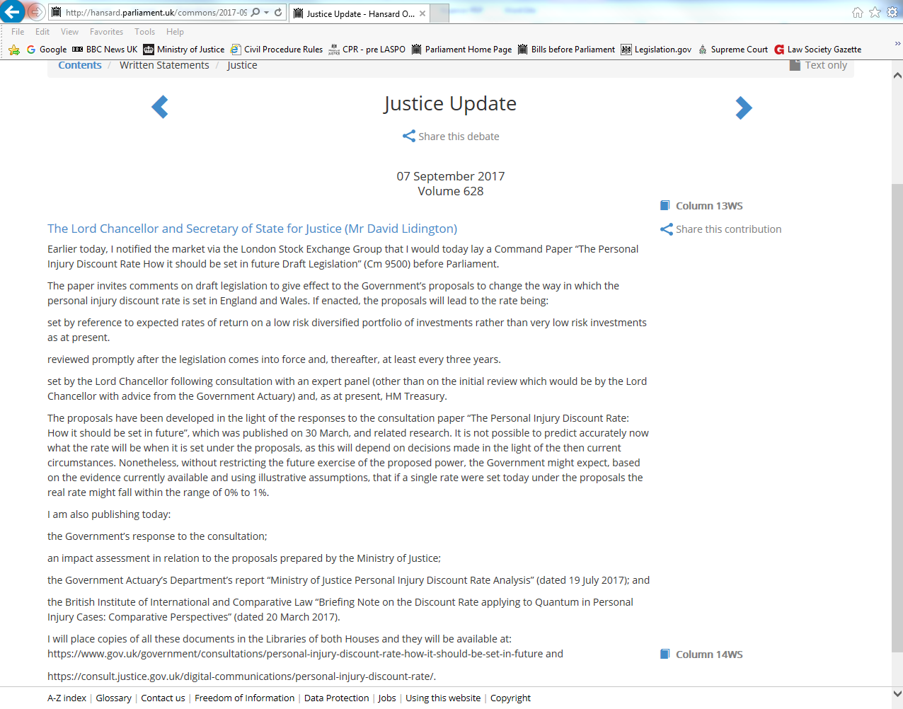

Slide 13

key legal aspects = Damages Act 1996 & Wells v Wells (HL, 1998)
former gives Lord Chancellor power to set the rate, latter links it to the yield on ILGS
last set in 2001 at 2.5% (BoE base rate was 5.25%)
ILGS yields have deteriorated since
February 2017 rate goes to -0.25%:
“this is the only legally acceptable rate I can set”
MoJ consultation, response & draft Bill on 7 September 2017

Slide 14
Motor current profitability and benchmarking
Ogden - UK implied real spot rates (20 year term)
27 February 2017, the Lord Chancellor announced a change to the Ogden discount rate to a new rate of -0.75%.
Source: Bank of England
Deloitte Motor Insurance Seminar September 2017

Slide 15
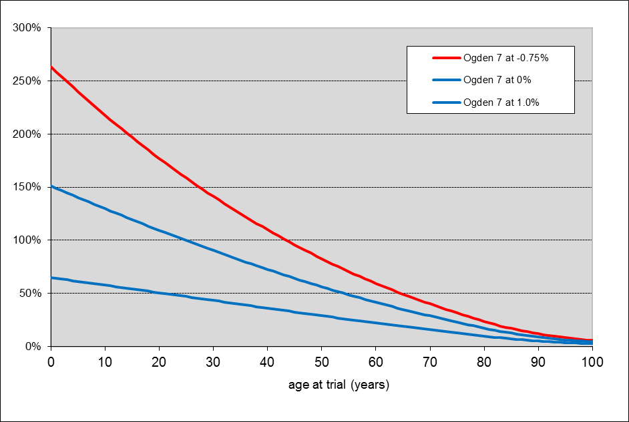
age at trial | normal life expectancy (male) | then: Ogden tables at 2.5% | now: Ogden tables at -0.75% | percentage increase |  | the future? at 0% | at 1%
10 | 78.31 | 34.08 | 108.32 | 218% |  | 78.31 (130) | 53.78 (58)
30 | 56.34 | 29.60 | 71.43 | 141% |  | 56.34 (90) | 42.45 (43)
50 | 35.45 | 22.69 | 41.44 | 83% |  | 35.45 (56) | 29.27 (29)

Slide 16

one theoretical case example…
 | 2.5% discount rate | -0.75% discount rate | % increases
claim value | £6m | £7.75m | 29%
primary layer (£5m) pays | £5m | £5m | 0%
XS / reinsurance (£5m XS 5m) pays | £1m | £2.75m | 175%
gearing:
new awards at
-0.75% will eat into higher layers & reinsurance to a greater extent
pricing:
cost of reinsurance protection likely to increase ?
capacity:
possible reduction in market???
premium:
increased costs for insurers, and consequently premium increases (personal and commercial lines alike)

Slide 17
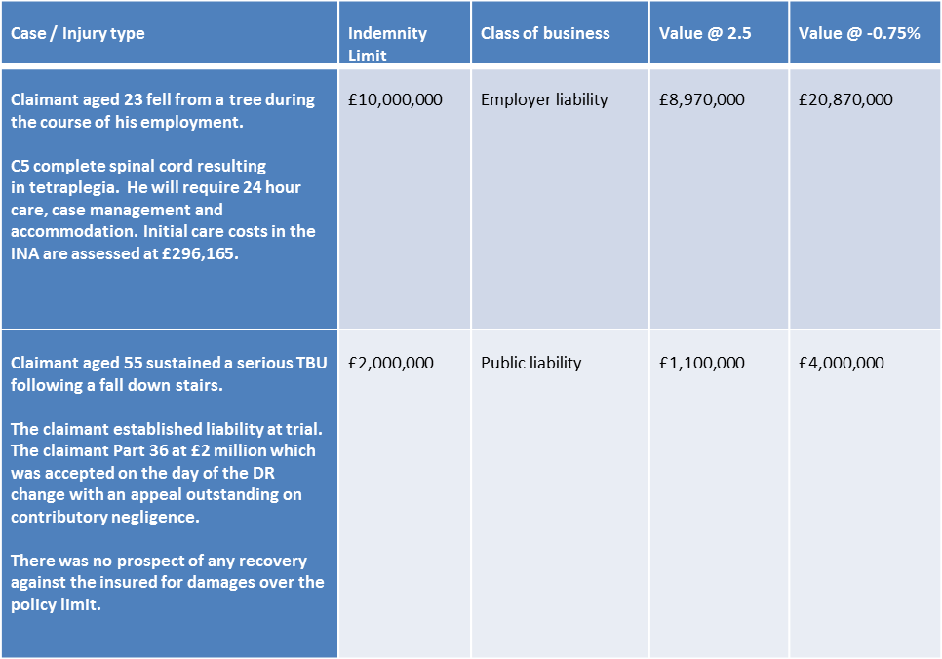
… and two real ones

Slide 18

consideration of policy limits in the market?
        claims once £1m to £2m now worth anything up to £5m
        the change in the discount rate has made £10m claims commonplace
        statutory minimum for EL cover in the UK remains £5m
        no statutory requirement or limit for PL & often low in SME market
        insureds at greater risk of becoming insolvent?
        can limits be increased?
        claimants going uncompensated?
        claimants pursuing greater numbers of defendants?

Slide 19

what does the timetable for reform look like?
legislation needed = uncertainty
minority Government = uncertainty
Brexit timing (March 2019) = uncertainty
by end 2018 or in h1 2019?
prospective or retrospective?
devolution aspects
key takeaway: positive rate change in medium term if bill passes

Slide 20

“The figure of 0% to 1% that was given in the paper was not an estimate, essentially, of what the Lord Chancellor would be fixing as the discount rate. It was an assessment of the direction of travel of the rate, in the event that we moved from a very low risk portfolio to a low risk portfolio…”
Lord Keen QC, Minister for Civil Justice
1st November 2017

Slide 21

Whiplash & small claims
from Autumn Statement 2015 to Prison & Courts Bill and now Civil Liability Bill (Queen’s Speech 2017)
  “The Bill will ban offers to settle claims without the support of medical evidence and introduce a new fixed tariff of compensation for whiplash injuries with a duration of up to 2 years.”
ban and tariff in the bill, but it also needs secondary legislation
small claims limit to increase to £5,000 (RTA) and £2,000 (casualty)

Slide 22
Injury Duration | 2015 average for PSLA (insurance industry data) | Judicial College Guidelines (13th edition, September 2015) | Judicial College Guidelines (14th edition, September 2017) | MoJ tariff (proposed)
0–3 months | £1,750 | a few ‘00 to £2,050 | a few ‘00 to £2,150 | £225
4–6 months | £2,150 | £2,050 to £3,630 | £2,050 to £3,630 | £450
7–9 months | £2,600 | £2,050 to £3,630 | £2,150 to £3,810 | £765
10–12 months | £3,100 | £2,050 to £3,630 | £2,150 to £3,810 | £1,190
13–15 months | £3,500 | £3,630 to £6,600 | £3,810 to £6,920 | £1,820
16–18 months | £3,950 | £3,630 to £6,600 | £3,810 to £6,920 | £2,660
19–24 months | £4,500 | £3,630 to £6,600 | £3,810 to £6,920 | £3,725
Source: Ministry of Justice
Notes:
Seems to be roughly a 5% increase from JCG 13 to JCG 14
Figures used are from the post Jackson column (ie including the Simmons v Castle 10% increase in GDs)

Slide 23
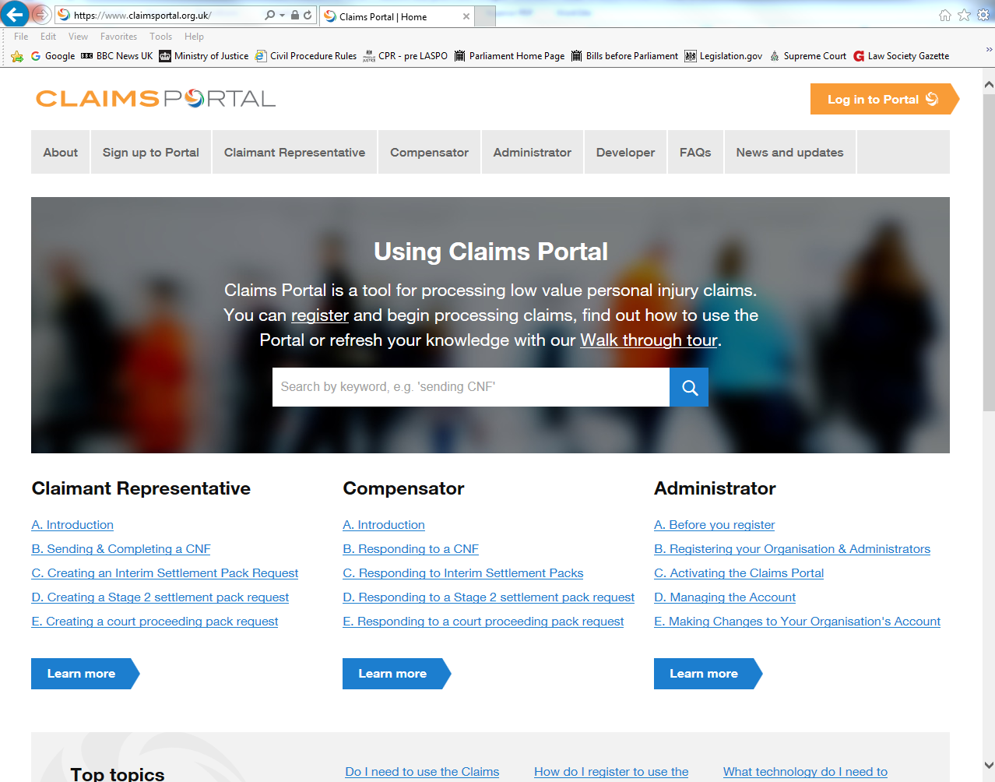

Slide 24
Whiplash & small claims
from Autumn Statement 2015 to Prison & Courts Bill and now Civil Liability Bill (Queen’s Speech 2017)
  “The Bill will ban offers to settle claims without the support of medical evidence and introduce a new fixed tariff of compensation for whiplash injuries with a duration of up to 2 years.”
ban and tariff in the bill, but it also needs secondary legislation
small claims limit to increase to £5,000 (RTA) and £2,000 (casualty)

Slide 25
Whiplash & small claims
from Autumn Statement 2015 to Prison & Courts Bill and now Civil Liability Bill (Queen’s Speech 2017)
  “The Bill will ban offers to settle claims without the support of medical evidence and introduce a new fixed tariff of compensation for whiplash injuries with a duration of up to 2 years.”
ban and tariff in the bill, but it also needs secondary legislation
small claims limit to increase to £2,000 (RTA) and £5,000 (casualty)
key takeaways: (1) tabloid-friendly reform aimed at saving £35 pa
(2) costs saved vs risks of dealing with more LIPs?

